Slide 1
A short history lesson about sports
Author:
Julian Bień (Gimnazjum nr. 2 im. Jana Kochanowskiego w Zgierzu z oddziałami dwujęzycznymi)
Executive PE teacher:
mr. Michał Basta

Slide 2
Table of contents
Hockey
Football
Athletics
Handball
Voleyball
Gymnastics
Weightlifting
A history of the olympic games
Polish sport succeses of pre-war period
Polish sport succeses of post-war period
Polish sport succeses of latter communist era
Ending slide

Slide 3
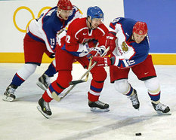
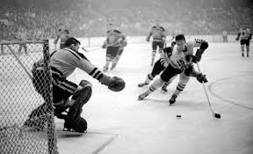
HOCKEY
People began playing hockey in the late thirteenth century, with France and England being cited as the countries of its origin. Originally it was just a simple game played by peasants and soldiers on frozen lakes.
After its arrival in XIX-century Canada, hockey was turned into official sport discipline. It is also being played on the olympics since 1924.

Slide 4
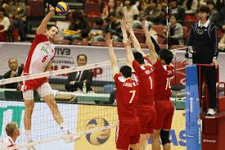
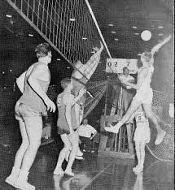
Voleyball
William Morgan of YMCA Massachusets is an inventor of volleyball. It was first played on February 9th, 1895.
Despite being a modern and entertaining discipline, voleyball was announced as an official, international sport in 1947.

Slide 5
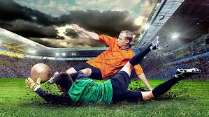
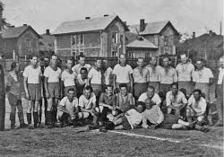
FOOTBALL
Football was first played in Asia around 2000 years ago. For many years, this was a simple sport discipline for peasants, often being played by a pack of dirty, screaming children kicking pig bladders around the streets.
In the nineteenth century, football became a well-known sport discipline played by both proffesionals, and amateurs.
A first football club, F.C. Sheffield, was created
in 1857, and continues to exist to this very day.

Slide 6
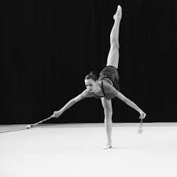
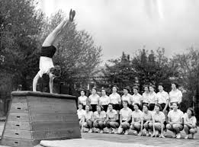
Gymnastics
This sport discipline was created by ancient Greeks, who played it „for body and spirit’s harmony”. That idea was soonly captured by Romans, Jews, and Chinese folks.
Modern gymnastic technics (swedish and german) were created between eighteenth and nineteenth century, with the first technicue serving as a modern form of rehabilitation, and the second one being responsible for physical endurance.

Slide 7
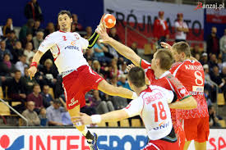
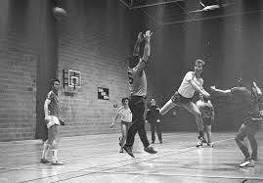
HANDBALL
That discipline was known throughout the world since ancient times, being most popular in Aztek and Mayan countries, where it served as a form of ritual.
A modern handball was created by Dutch people between nineteenth and twentieth century.XIX i XX wieku. It has been an international sport since 1920’s.

Slide 8
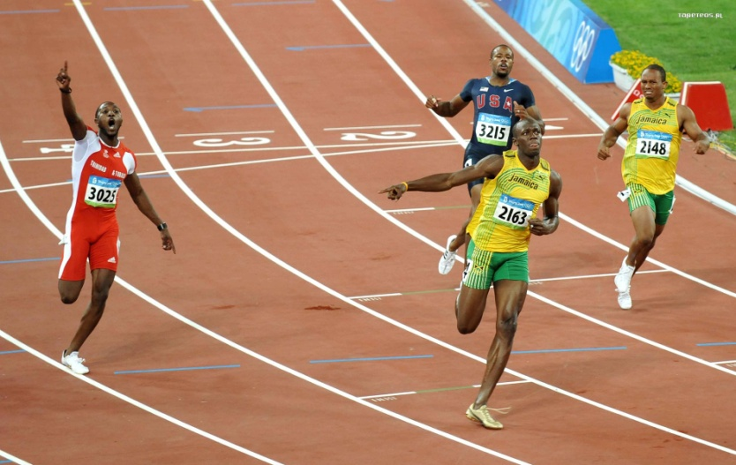
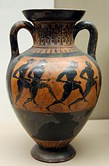
ATHLETICS
Since the beggining of time, athletics was practiced by prehistoric people in order to hunt fast. It was a most popular sport in ancient Greece.
Being practiced by nearly every Greek (resulting in a muscular form of body on most of these people), it was obviously a primary discipline of the first modern olympic games in Athenes, 1896.

Slide 9
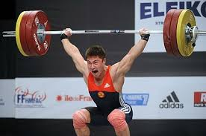
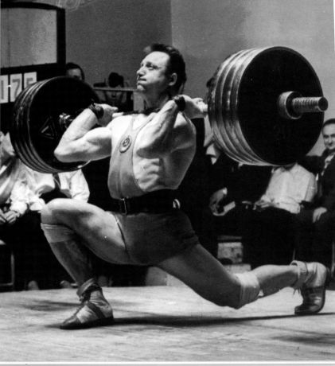
WEIGHTLIFTING
Weightlifting as an official discipline was tested on 1896 olympics, and is since then known throughout the world.
Weight categories were constanly changing, reaching maximally 82 kilos in 1913, and finally 110 kilos in 1968. Today, a maximal weight to lift is 105 kilos.

Slide 10
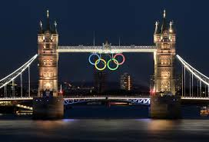
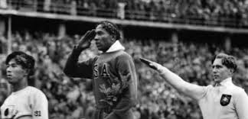
OLYMPIC GAMES
Originally, they were played in ancient Greece. It was an important national event, and every war had to be stopped during the olympics.
Since its renewal in 1896, the olympic games are an international sports and cultural event, bringing attention to the country chosen by the International Olympic Commitee.

Slide 11
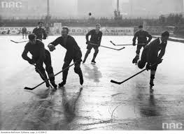
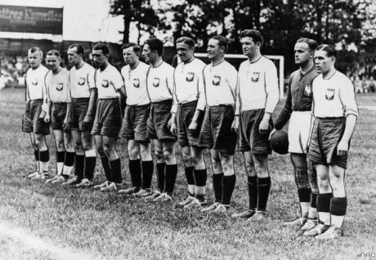
POLISH SPORT SUCCESSES: 1918-1939
After creating a Polish Atheltic Organisation in 1919, an independent Poland began creating her sport crews, and attending international sports events.
Polish football team had a legendary coach, Jozef Kaluza. Poles have won many hard matches with powerful opponents during his coaching. The biggest, and also the last victory was that on August 27, 1939, when Poland won the International Football Championship, beating Hungary,
Polish Ice Hockey Organisation was created in 1925. Their players have won many important matches, notably their first one in Davos, 1926, and the most profitable one in Lake Placid, 1932.

Slide 12
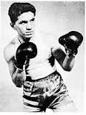
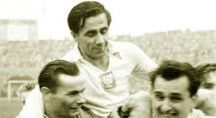
Polish sport succeses: 1946-1967
After the end of World War 2, voleyball and handball started to be played in Poland. Polish sportsmen started winning international competitions on an enormous scale. A prime examples might be fantastic Polish boxers trained by Feliks „Papa” Stamm: Antkiewicz, Chychla, Zimny, Pietrzykowski, and others. They had won gold olympic medals in Helsinki (1952), Rome (1960), and Tokyo (1964).
Also worth mentioning are Polish voleyball players, who had won a silver medal on Men’s World Cup in Szczecin (1965), handball players, especially Jan Suski „a best handball player in Europe” as told by International Olympic Comitee, and Polish basketball players, who had triumphed on an international handball cup in Poland (1965).
On September 4th, 1963, Polish football players have beaten Norway 9:0, which was their biggest victory for the next 45 yers.

Slide 13
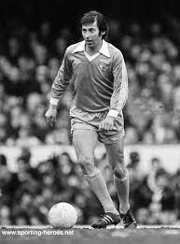
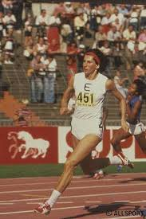
POLISH SPORT SUCCESSES: 1968-1989
A time period between 1968 and 1989 is called „a golden era of Polish sport” with 17 sportsmen or teams winning gold medals on olympic games in Munich (1972), Montreal (1976) and Moscow (1980)
Voleyball players from Montreal,
Wladyslaw Kozakiewicz (pole vault),
Irena Szewinska (athletics),
Janusz Pyciak-Peciak (pentathlonist)
or Wladyslaw Komar (shot put), all of them were succesful, well-known Polish sportsmen.
Polish football team triumphed with Kazimierz Deyna, Zbigniew Boniek or Kazimierz Gorski. They were reaching highest scores on nearly every championship throughout the 70’s and 80’s.

Slide 14
THE END
Yes, I do indeed realise, that I haven’t covered all the topics about such sport disciplines as swimming, basketball, cycling, and more.
Is’t that however a proof, that sports is a very deep-reaching, fascinating thing that deserves to be studied, or developed? Let’s all think about it.

