Slide 1
The history of Soccer
Patryk Zarębski
Mateusz Żywica
Michał Dzięgielewski

Slide 2
Introduction
Discovering the history of soccer isn't as straight forward as you might think. This is partly due to the fact that there were many similar games played long ago which might resemble soccer but are totally not alike.
Much research has been done on the history of soccer but We are going to keep it as short and as simple as possible (just so it doesn't get too boring!)

Slide 3
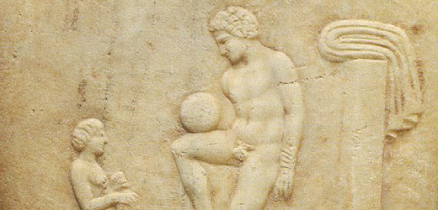
From the beginning…
It has been said that the Romans and Ancient Greeks played many ball games that involved the use of their feet. An on-going theme about sport back long ago seems to be the high level of violence in which these games were played at.
Perhaps earlier versions of soccer were played as far back as the second century BC where the Chinese would play a rather dull kicking game. Many warriors (including the Ancient Greeks) would use soccer related games in preperation for battle.
Furthermore, it appeared the Chinese military as far back as 3000 years ago played a game called cuju (kick-ball). Cuju involved kicking a leather ball through a type of goal made from bamboo canes and silk cloth.

Slide 4
First balls
Balls were not exactly round when the first club and country matches took place. A pig’s bladder was blown up like a balloon, tied at the ends and placed inside a leather case, affording it an egg shape. The discovery of Indian rubber in the 1860s gave the ball greater roundness.
While it is true footballs of yesteryear gained weight in wet conditions, they were in fact lighter than today’s ball. In 1889, the spherical object used had to be between 12-15 ounces (340 – 425 grams) but this increased to 14-16 ounces (397 -454 grams) in 1937.

Slide 5
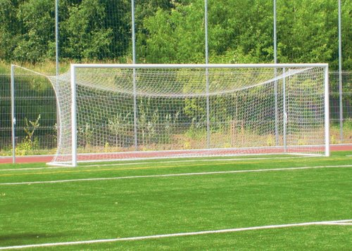
First goals
In the FA rules of 1863, there was no mention of a crossbar. As in rugby today, a goal could be scored at any height as long as the ball went between the sticks or posts. A tape was used to close the goal during the first internationals before a crossbar replaced it in 1875.

Slide 6
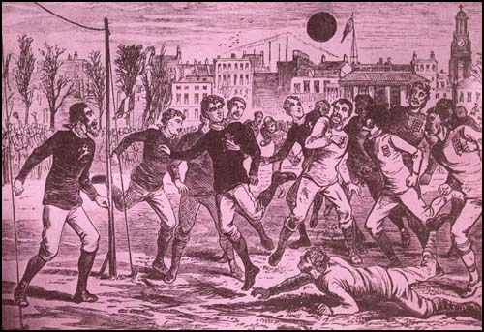
First Match
During the very first international football match between Scotland and England in 1872, players not only wore “knickerbockers” or long pants but bobble hats or caps too. The head dresses were a normal part of the footballing attire at the time and lasted well into the 20th century.

Slide 7
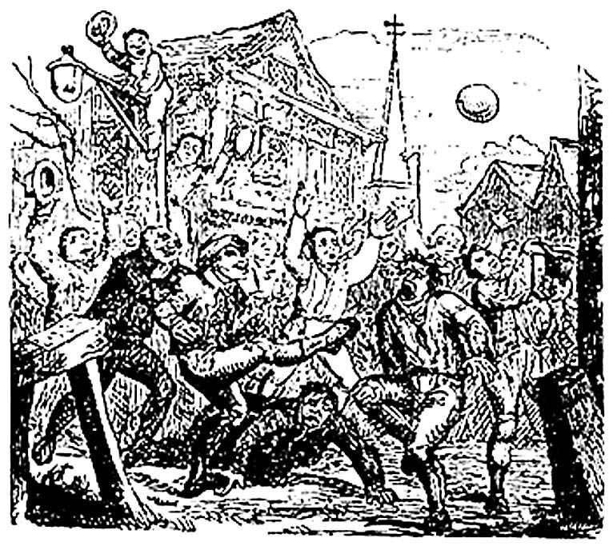
Mob football
Mob football, a descendant of the modern game, stormed into England around the 12th Century and caught on to such an extent it was banned by Royal decree by many kings and queens. It was a violent game in which “murder and manslaughter” were allegedly the only barriers to transporting the ball to village ends. King Henry VIII, however, is believed to have been a keen player.

Slide 8
Some of the first soccer rules

Slide 9
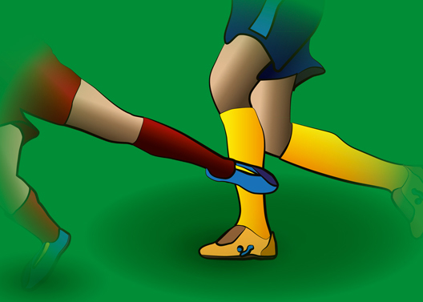
Penalties or referees found no place in the original rules of the game. Gentlemen would never intentionally foul, it was assumed. In fact debating techniques were almost as important as ball skills in those days as players could appeal against decisions first to captains and then to umpires before referees, named so because they had originally been referred to by umpires, found their place on the pitch in 1891.

Slide 10
It was only in the 20th Century that the penalty spot was introduced. In the decade before penalties, originally called the kick of death, could be taken anywhere along a line 12-yards from goal.

Slide 11
Goalkeepers, in their own half, could handle the ball both inside and outside the penalty area before 1912.

Slide 12
The curiosities

Slide 13
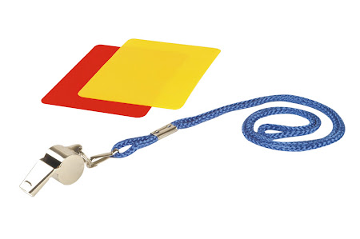
London’s Kensington High Street traffic lights are the inspiration for the red and yellow cards used in today’s game. English referee and then FIFA’s Head of Refereeing Ken Aston was driving through central London thinking of ways to better illustrate a caution or sending off when the change of green to yellow to red of the lights gave him the idea

Slide 14
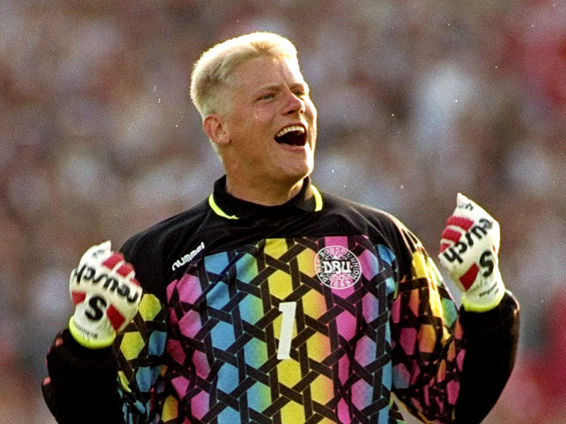
The first act of a goalkeeper on a Saturday morning was not always to throw open the doors of his wardrobe before selecting his mood colour that day. Back in 1909, he was given a choice of royal blue, white or scarlet. If a goalkeeper became his country’s number 1 in 1921, he wore yellow.

Slide 15
Referees attempted to catch up with play around the turn of the century decked in black trousers, blazer and bow tie!

Slide 16
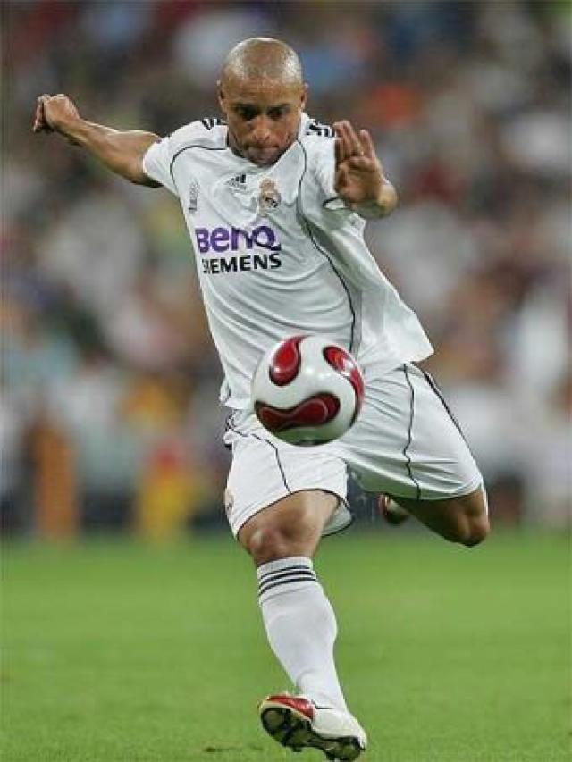
There were no David Beckham or Roberto Carlos’ before 1927 as goals could not be scored from direct free kicks.

Slide 17
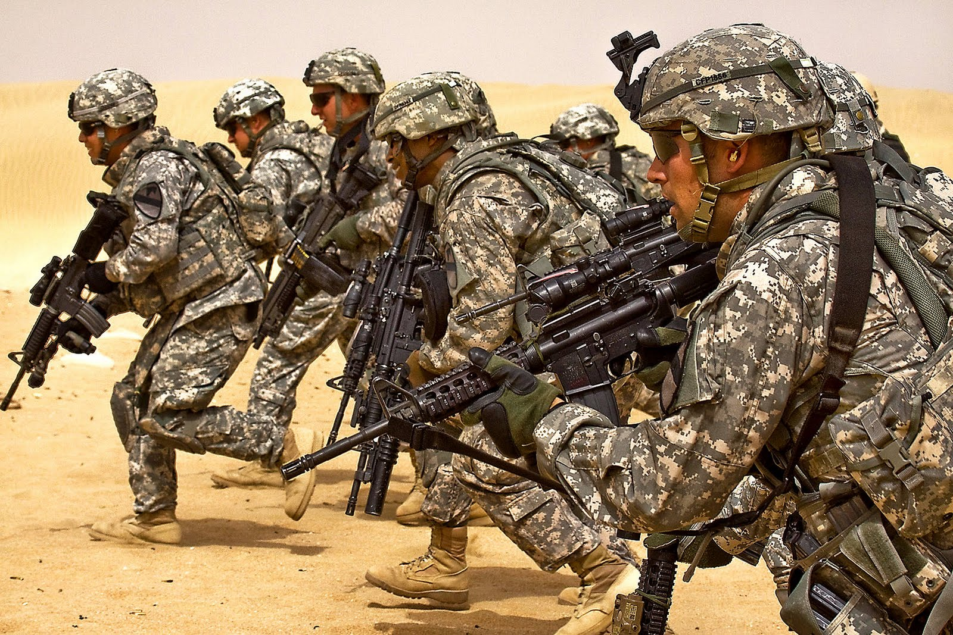
Many of football’s terms and expressions are of military origin: defence, back line, offside, winger, forward, attack.

Slide 18
Thanks for watching ;)

