Slide 1
OLYMPIC GAMES
The symbols

Slide 2
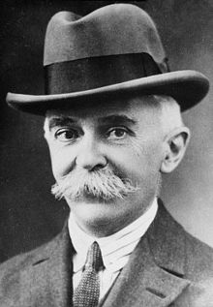
Citius, Altius, Fortius, in Latin that means "Faster, Higher, Stronger. That’s the motto of the Olympic Games. It was proposed for the International Olympic Committee in 1894 by Pierre de Coubertin who was its founder. The motto was introduced in 1924 at the Olympic Games in Paris. More informal but well known motto, also introduced by Coubertin, is "The most important thing is not to win but to take part!"
Pierre de Coubertin

Slide 3
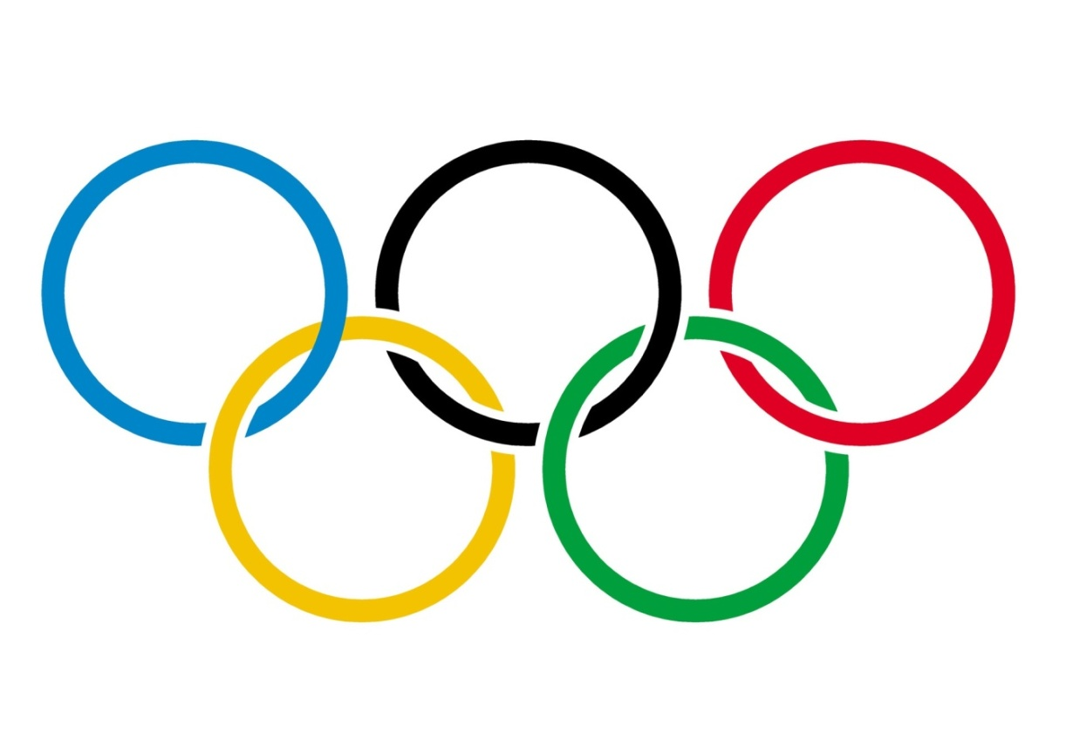
Olympic rings
The primary symbol of the Olympic Games is composed of five interlocking rings, colored blue, yellow, black, green and red on a white field. The symbol was originally designed in 1912 by Baron Pierre de Coubertin, co-founder of the modern Olympic Games.
Blue - Europe
Yellow - Asia
Black - Africa
Green - Australia
Red - America

Slide 4
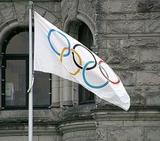
Flag
The Olympic flag was created by Pierre de Coubertin in 1914. There are specific Olympic flags that are displayed by cities that will be hosting the next Olympic Games. During each Olympic closing ceremony, the flag is passed from the mayor of one host city to the next host, where it will then be taken to the new host and displayed at city hall.

Slide 5
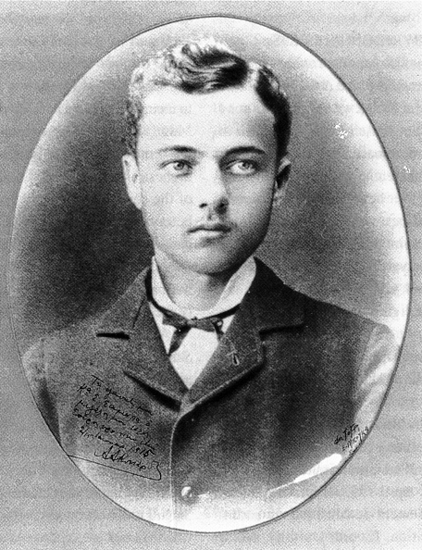
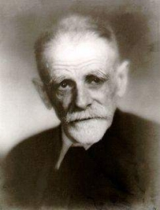
Olympic anthem
The Olympic Hymn, officially known as the Olympic Anthem, is played when the Olympic Flag is raised. It is a musical piece composed by Spyridon Samaras with words written from a poem of the Greek poet and writer Kostis Palamas.
The anthem was performed for the first time for the ceremony of opening of the 1896 Athens Olympic Games but wasn't declared as the official hymn by the IOC until 1957.
Spyridon Samaras
Kostis Palamas

Slide 6
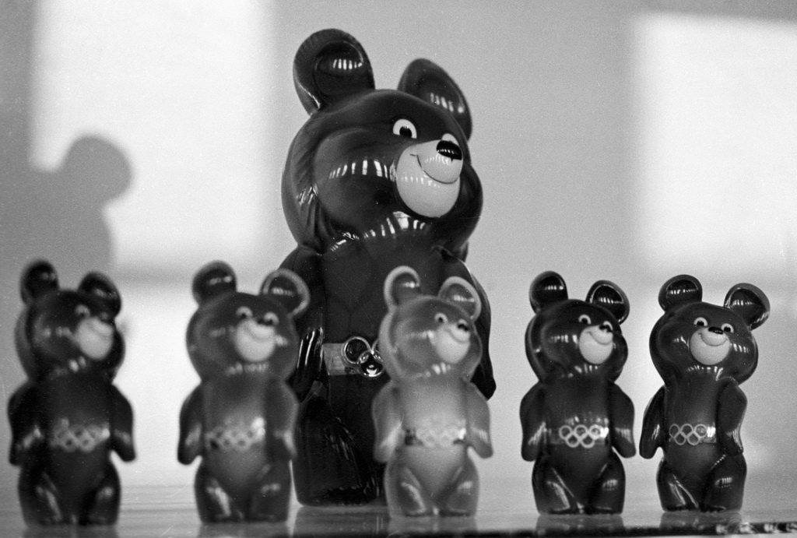
Mascots
Since the 1968 Winter Olympics in Grenoble (France) the Olympic Games have had a mascot. The first major mascot in the Olympic Games was Misha in the 1980 Summer Olympics in Moscow. Misha was used during the opening and closing ceremonies, had a TV animated cartoon and appeared on several merchandise products. Nowadays, most of the merchandise aimed at young people focuses on the mascots.
Misha

Slide 7
Olympic flame and torch relay
The modern tradition of moving the Olympic Flame via a relay system from Greece to the Olympic venue began with the Berlin Games in 1936. Months before the Games are held, the Olympic Flame is lit on a torch, with the rays of the Sun concentrated by a parabolic reflector, at the site of the Ancient Olympics in Olympia, Greece. The torch is then taken out of Greece, most often to be taken around the country or continent where the Games are held. The Olympic torch is carried for example by athletes, leaders, celebrities. On the final day of the torch relay, the day of the Opening Ceremony, the Flame reaches the main stadium and is used to light a cauldron situated in a prominent part of the venue to signify the beginning of the Games.

Slide 8
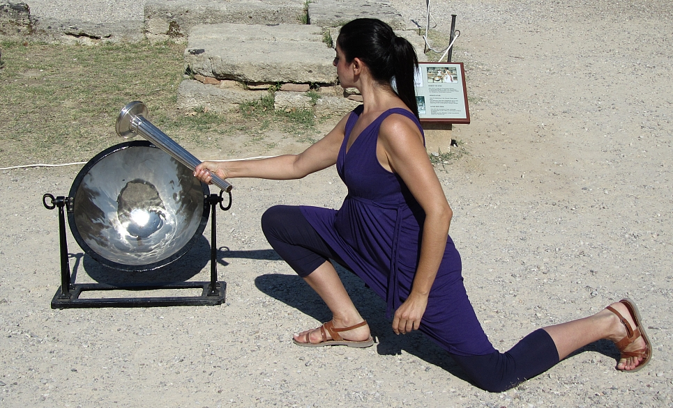
Lighting the Olympic flame in Greece

Slide 9
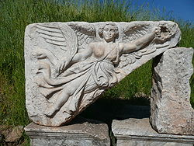
Medals
The Olympic medals awarded to winners are another symbol associated with the Olympic Games. The medals are made of gold, silver, or bronze, and awarded to the top 3 finishers in a particular event. Each medal for an Olympiad has a common design, decided by the organizers for the particular games. From 1928 the obverse side of the medals contains an image of Nike, the traditional goddess of victory.
Nike

Slide 10
Olive wreath
The kotinos is an olive branch, originally of wild olive-tree, intertwined to form a circle or a horse-shoe, introduced by Heracles. In the ancient Olympic Games there were no gold, silver, or bronze medals. There was only one winner per event, crowned with an olive wreath made of wild olive leaves from a sacred tree near the temple of Zeus at Olympia.
„Kotinos”

Slide 11
Thank you for watching
☺
The work was made by:
Joanna Tomczewska, Izabela Rogowska

