Slide 1
Olympians from Zgierz

Slide 2
Table of Contents
Admission
Michał Antuszewicz
Włodzimierz Cieślak
Józef Jaworski
Lesław Kropp
Tomasz Krzeszewski
Tomasz Andrzej Kupis
Stanisław Olczyk
Jan Stopczyk
Jadwiga Wajsówna

Slide 3
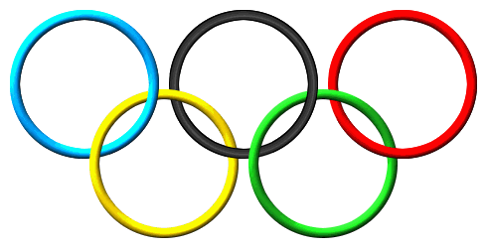
Admission
Did you know that we have some people who were conected with Zgierz and they took part in Olympic Games? May you know some of them?

Slide 4
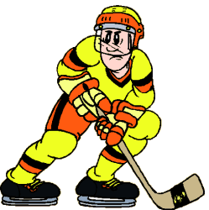
Michal Antuszewicz
Michal Antuszewicz - Polish hockey player, Olympian .
He came from a family settled in Manchuria after the Russo - Japanese war. He performed in local clubs and 12- fold in the Representation of Manchuria in ice hockey .
In 1949, he returned with his family to Poland . He played as a defender . (in Włókniarz Zgierz). He won the Polish championship twice with Legia (1951 and 1952). In 1951 he made his debut in Polish National Team , in which he played 14 matches. In 1952 he took part in Oslo Olympics with Team they occupyed sixth place.

Slide 5
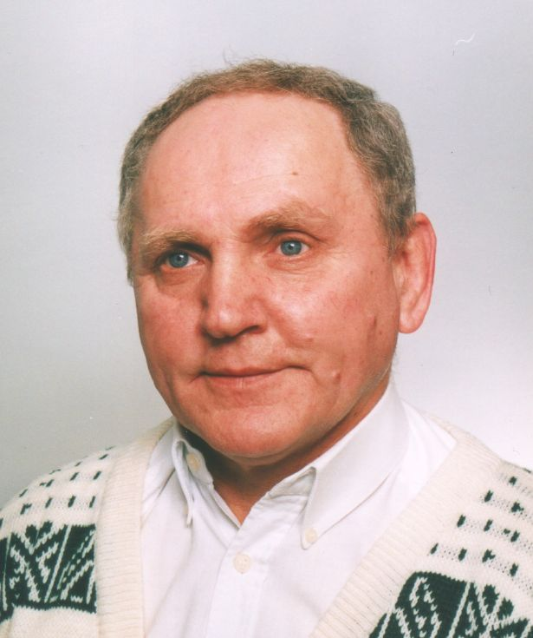
Włodzimierz Cieślak
Włodzimierz Cieślak
(b. April 23, 1950 on. In Zgierz ) - Polish wrestler, Olympian from Munich, a 3 - times Polish champion. In the years 1961-1977 Boruta Zgierz player.

Slide 6
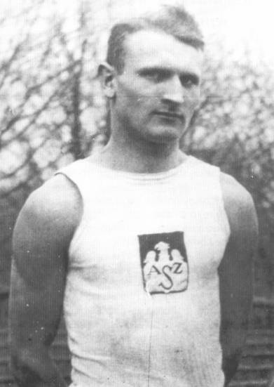
Józef Jaworski
Joseph Jaworski (b. October 19, 1903 in Zgierz , d. September 19, 1939 at Oksywie.
Athletics has already covered high school. In 1924 in Warsaw during the Academic World Championships he won gold medals in the running for 3000 and relay 4 x 400 meters and took part in the Olympic Games in Paris.
In 1926 he won the National race a year later in Rome again was a gold medalist at the Academic World Championships in men's 3000 m. In 1928 again he represented Poland at the Olympics Amsterdam, where he took fourth place in the run up to 1500 m .

Slide 7
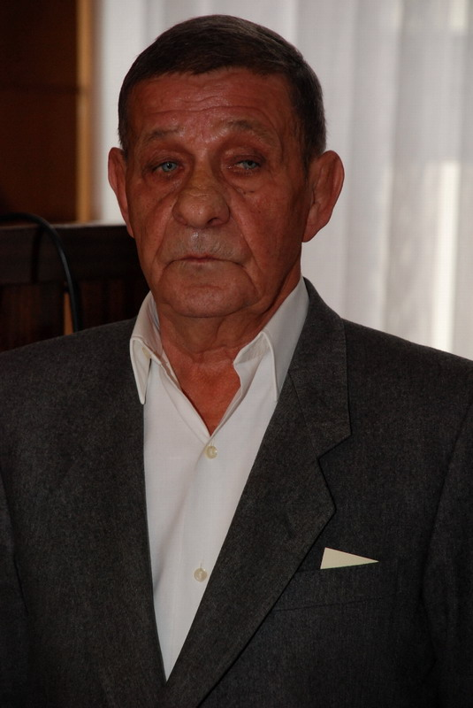
Lesław Kropp
Lesław Kropp (b. 22 November 1936 r . in Bronowo, d.October 12, 2013 r . in Zgierz ) - Polish wrestler , Olympian from Rome , 5 -times Polish champion.
In the years 1953-1973 Boruta Zgierz player and then as an instructor of that section of the wrestling club.Since 1991, the Municipal Association of Athletic trainer in Zgierz.He was awarded the Knight's Cross of the Order of the Rebirth of Polish in 2002 . And a silver Medal for Outstanding

Slide 8
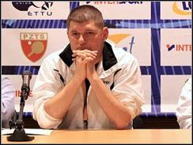
Tomasz Krzeszewski
Tomasz Krzeszewski (b. September 19, 1974 in Zgierz), Polish table tennis player.
In his career ITTF World Ranking came in 23rd place. Athlete's career ended in 2007, because of problems related to the spine. As of June 2008 was coach of the junior national team . He is currently coach of the national senior team . Since 2007, the club's tennis coach MLKS Ostródzianka Ostróda ( club takes part in competitions league men).

Slide 9
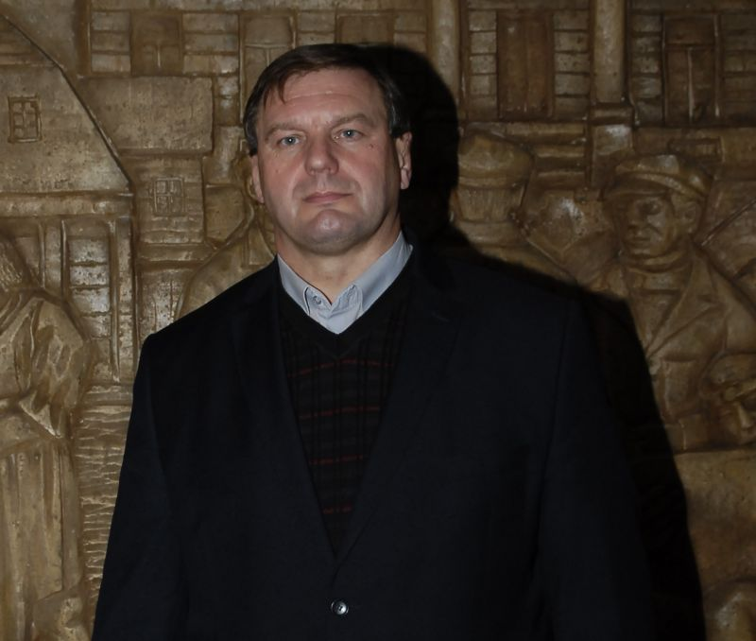
Tomasz Andrzej Kupis
Tomasz Andzrej Kupis (b.April 4, 1964 in Grabow near Łęczyca).
Free style wrestler ( 186 cm , 130 kg) Ozorkow wheel of MKS Nightingale ( 1979-1980 ), Eagle WAM boat and Boruta Zgierz (up to 1992). 5 -times Polish champion in freestyle , the Olympian from Barcelona (1992 ) , After the end of their sporting career (1992 ) the owner Enterprises Shopping and Service in Zgierz ( casual dealt with the training of youth wrestling Boruta 1992-1993) . He lives in Zgierz.

Slide 10
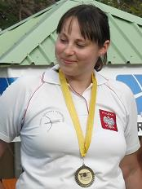
Justyna Mospinek
Justin Mospinek (b.November 8, 1983 r . in Zgierz ) - Polish archer.
In 2002 . He graduated from High School. AGH University of Science Zgierz. Then she studied at the Academy of Physical Education in Warsaw .She was awarded the Bronze Cross of Merit in 2005. For sporting achievements. September 27, 2008 , she won the World Cup in archery .

Slide 11
Stanisław Olczyk
Stanisław Olczyk (b. October 15, 1932 in Zgierz , d. January 23, 1996 in Zgierz ) - Polish hockey player , OlympianThe player who plays as a defender.
Alumnus and longtime player Włókniarz Zgierz . In the years 1954-1963 he represented Legia Warsaw , with whom he won the Polish championship seven times and twice runners-up .Performed twice at the Olympic Games : in Cortina d 'Ampezzo in 1956, and in Innsbruck in 1964. He also participated in five world championship tournaments : 1955 , 1958 , 1959 , 1961 , 1963 .

Slide 12
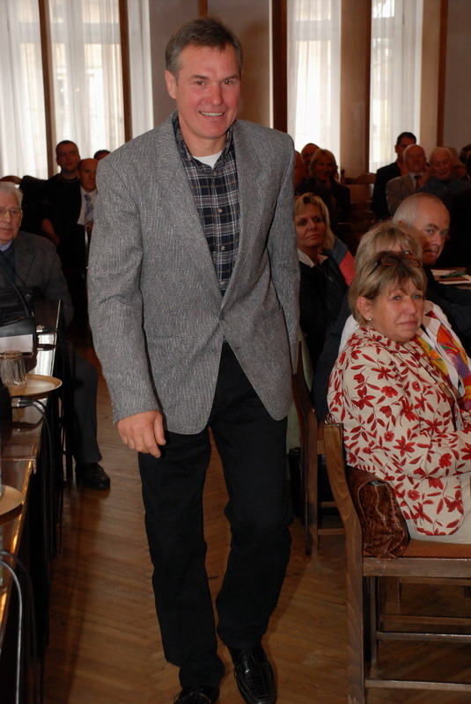
Jan Stopczyk
Jan Stopczyk - one of the best strikers in the history of Polish ice hockey. The player Boruta Zgierz (1975-1977) , winner of the Golden Stick editorial "Sport " for the best hockey player in the season 1986/1987 the country . The winner of " scoring Canadian " in the same year and top scorer of Polish league season 1983/1984 the above . A participant of the Olympic Games in Sarajevo ( 1984) and Calgary ( 1988) and five world championship tournaments .

Slide 13
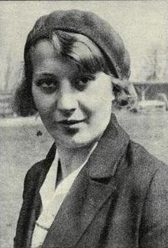
Jadwiga Wajsówna
Jadwiga Wajsówna (b. January 30, 1912 in Pabianice , d. February 1, 1990) - Polish athlete , Olympic medalist .Falcon competitor Pabianice (1926-1936) , Boruta Zgierz (1937-1939) , DKS Lodz (1945-1948) and LKS Lodz ( 1949-1958 ) .She cultivated many athletics events , but enjoyed the greatest success in the discus throw . Three times represented Poland in this competition at the Olympic Games , always taking place at the forefront . In Los Angeles in 1932 he won the bronze medal. On the next Olympic Games in Berlin in 1936 was the silver medal in the same improved its own record Polish , who was beaten until 20 years later .

Slide 14
Thank you for attention ☺

