Slide 1
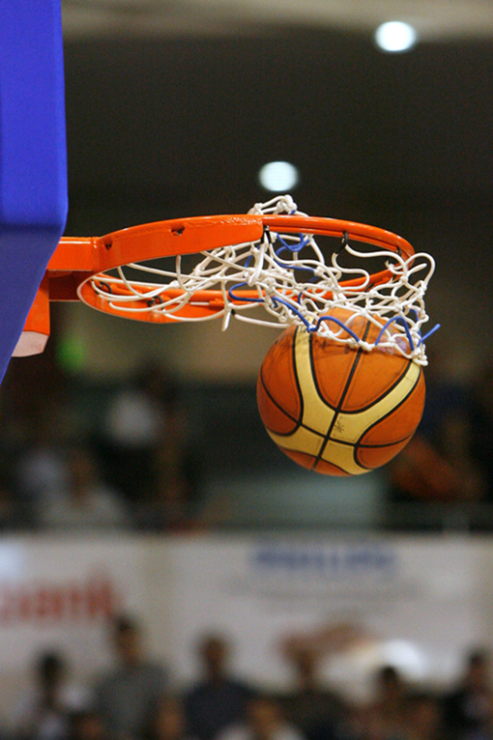
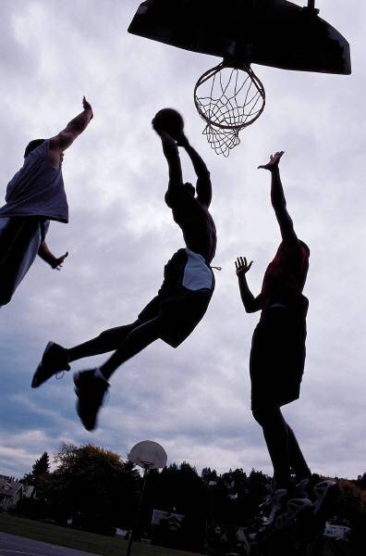
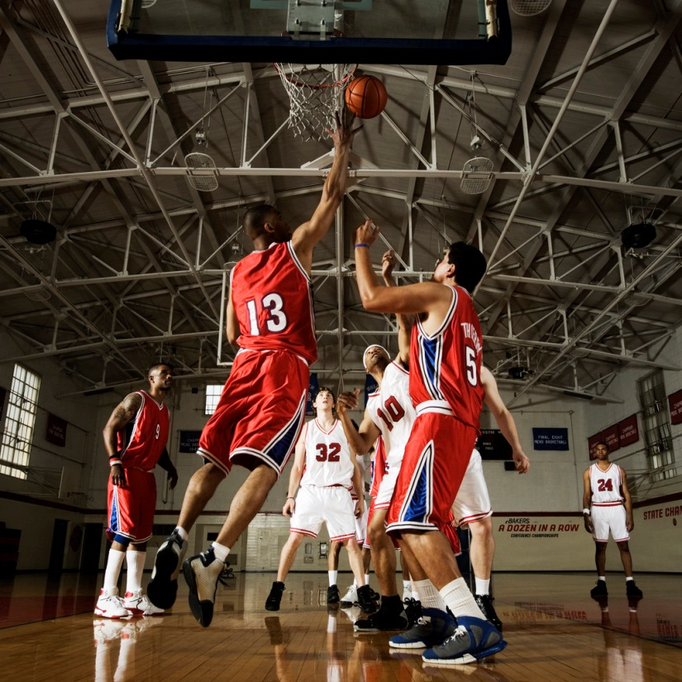
Basketball

Slide 2
Lebron James
LeBron Raymone James was born 30 December 1984 . He is an American professional basketball player for the Miami Heat of the National Basketball Association (NBA). Standing at 6 ft 8 in (2.03 m) and weighing 250 lb (113 kg), he has played the small forward and power forward positions. James has won two NBA championships, four NBA Most Valuable Player Awards, two NBA Finals MVP Awards, two Olympic gold medals, an NBA scoring title, and the NBA Rookie of the Year Award. He has also been selected to ten NBA All-Star teams, nine All-NBA teams, and five All-Defensive teams, and is the Cleveland Cavaliers' all-time leading scorer.

Slide 3
Rajon Rondo
Rajon Pierre Rondo (born February 22, 1986) is an American professional basketball point guard with the Boston Celtics of the National Basketball Association (NBA). Born in Louisville, Kentucky, Rondo attended Eastern High School and Oak Hill Academy before receiving a scholarship from the University of Kentucky. He played for two years at Kentucky before declaring for the 2006 NBA Draft. During the draft, he was selected 21st overall by the Phoenix Suns, and was subsequently traded to the Boston Celtics, where he made his NBA debut as a rookie during the 2006–07 season.

Slide 4
Dwight Howard
Dwight David Howard (born December 8, 1985) is an American professional basketball player for the Houston Rockets of the National Basketball Association (NBA). Howard, who usually plays center but can also play power forward, had an outstanding high school career at Southwest Atlanta Christian Academy. He chose to forgo college and entered the 2004 NBA Draft, and was selected first overall by the Orlando Magic. An eight-time All-Star, seven-time All-NBA team selection, five-time All-Defensive member, and three-time Defensive Player of the Year

Slide 5
Blake Austin Griffin (born March 16, 1989) is an American professional basketball player who currently plays for the Los Angeles Clippers of the National Basketball Association (NBA). Griffin had a renowned high school career at Oklahoma Christian School, winning state titles each of his four years under his father, Tommy Griffin, who was the head coach. He played college basketball for the University of Oklahoma Sooners and received numerous accolades in his second year, including the Naismith College Player of the Year, Oscar Robertson Trophy and the John Wooden Award.

Slide 6
Dirk Werner Nowitzki (born June 19, 1978) is a German professional basketball player for the Dallas Mavericks of the National Basketball Association (NBA). An alumnus of Röntgen Gymnasium and the DJK Würzburg basketball club, Nowitzki was chosen as the ninth pick in the 1998 NBA Draft by the Milwaukee Bucks and immediately traded to the Mavericks, where he has played since. A 7 ft 0 in (2.13 m) power forward, he has the athleticism and shooting ability to play either center or small forward. He is considered one of the greatest power forwards in NBA history.

Slide 7
Marcin Gortat
Marcin Gortat (born February 17, 1984) is a Polish professional basketball player with the Washington Wizards of the National Basketball Association (NBA). The 6 ft 11 in, 240-pound center is the son of boxer Janusz Gortat. He was a second-round draft choice of the Phoenix Suns in the 2005 NBA draft and was traded for future cash considerations to the Orlando Magic. In 2010, he was traded back to Phoenix.

Slide 8
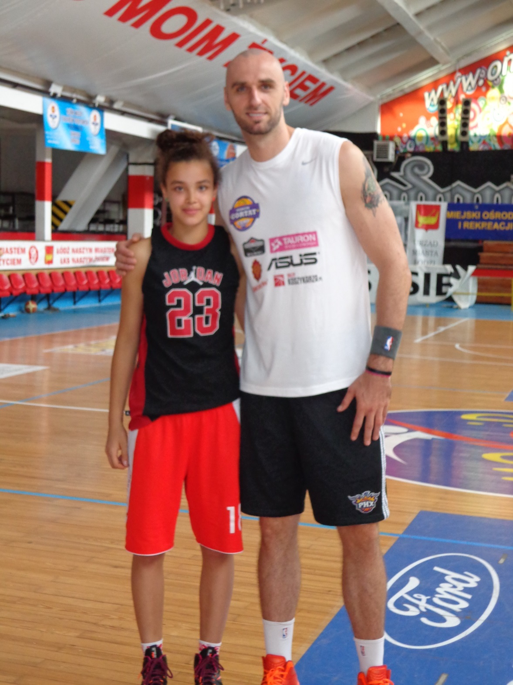

Slide 9
Kobe Bryant
Kobe Bean Bryant (born August 23, 1978) is an American professional basketball player for the Los Angeles Lakers of the National Basketball Association (NBA). He entered the NBA directly from high school, and has played for the Lakers his entire career, winning five NBA championships. Bryant is a 16-time All-Star, 15-time member of the All-NBA Team, and 12-time member of the All-Defensive team. As of March 2013, he ranks third and fourth[3] on the league's all-time postseason scoring and all-time regular season scoring lists, respectively.

Slide 10
Paul Gasol
Pau Gasol Sáez (born July 6, 1980) is a Spanish professional basketball player for the Los Angeles Lakers of the National Basketball Association (NBA). He is a four-time All-Star, and a three-time All-NBA selection, once on the second team and twice on the third team. He has won two NBA championships, both with the Lakers. He was the NBA Rookie of the Year in 2002 with the Memphis Grizzlies.

Slide 11
Michael Jordan
Michael Jeffrey Jordan (born February 17, 1963), also known by his initials, MJ, is an American former professional basketball player, entrepreneur, and majority owner and chairman of the Charlotte Bobcats. His biography on the National Basketball Association (NBA) website states, "By acclamation, Michael Jordan is the greatest basketball player of all time." Jordan was one of the most effectively marketed athletes of his generation and was considered instrumental in popularizing the NBA around the world in the 1980s and 1990s

Slide 12
Dwayne Wade
Dwyane Tyrone Wade, Jr. (born January 17, 1982) is an American professional basketball player who currently plays for the Miami Heat of the NBA. He has established himself as one of the most well-known and popular players in the league. He had the top selling jersey in the NBA for nearly two years, as he led the NBA in jersey sales from the 2005 NBA Playoffs, until the midpoint of the 2006–07 season. His first name is pronounced /dwɛɪn/, the same as the more common spellings "Duane" and "Dwayne.

Slide 13
Carmelo Kyam Anthony (born May 29, 1984)[1] is an American professional basketball player who plays for the New York Knicks of the National Basketball Association (NBA). After a successful high school career at Towson Catholic High School and Oak Hill Academy, Anthony attended Syracuse for college where he led the Orangemen to their first National Championship in 2003.
He earned the tournament's Most Outstanding Player award and was named the Most Valuable Player of NCAA East Regional. After one season at Syracuse University, Anthony left college to enter the 2003 NBA Draft, where he was selected as the third pick by the Nuggets. He was traded to the Knicks several days prior to the 2011 trade deadline.

Slide 15
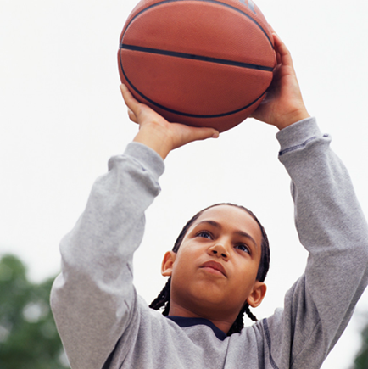
Thanks for watching ☺

