Slide 1

ANNA KAŹMIERCZAK
MARTA KAŁKUSIŃSKA

Slide 2
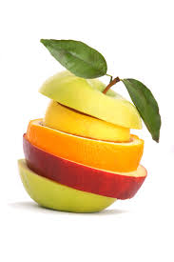
Table of Contents
More Water
Less Sugar
Less Salt
Vegetables-Why it’s good?
Brown instead White
How to prepare food?
How your plate should look?
You are not really hungry
Exercise which help you reduce fat

Slide 3
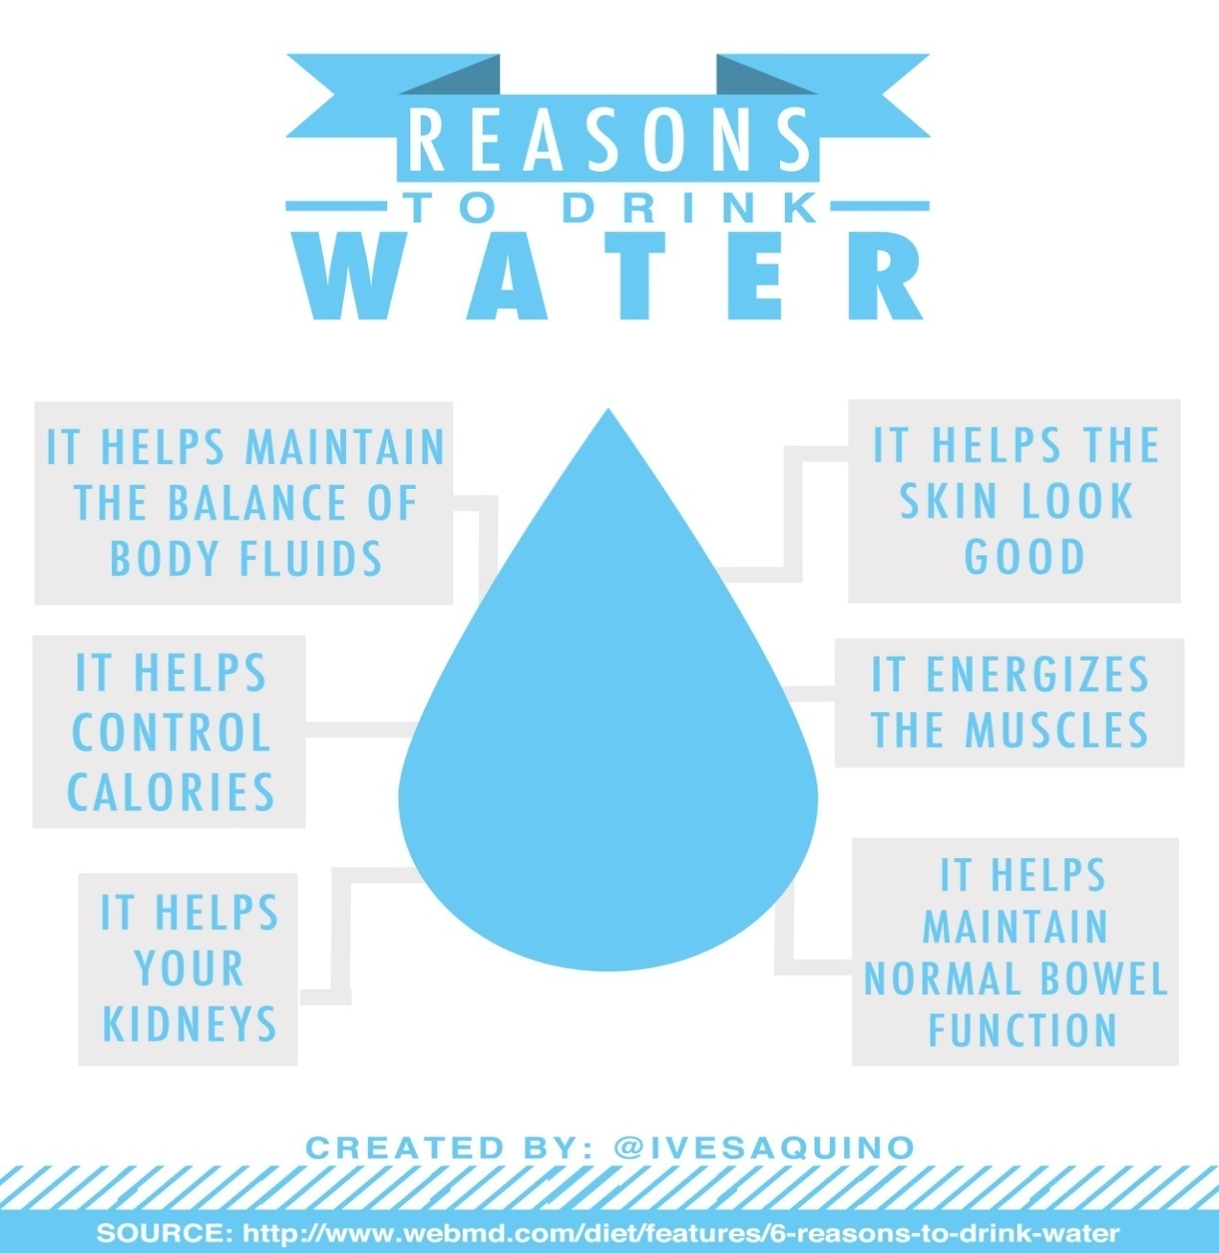
DRINK WATER
back

Slide 4
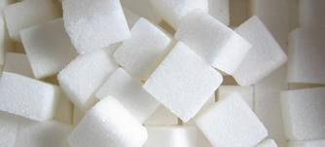
USE LESS SUGAR
choosing food and drinks that are lower in sugar or have no added
sugar
back

Slide 5
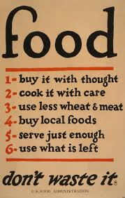
back

Slide 6
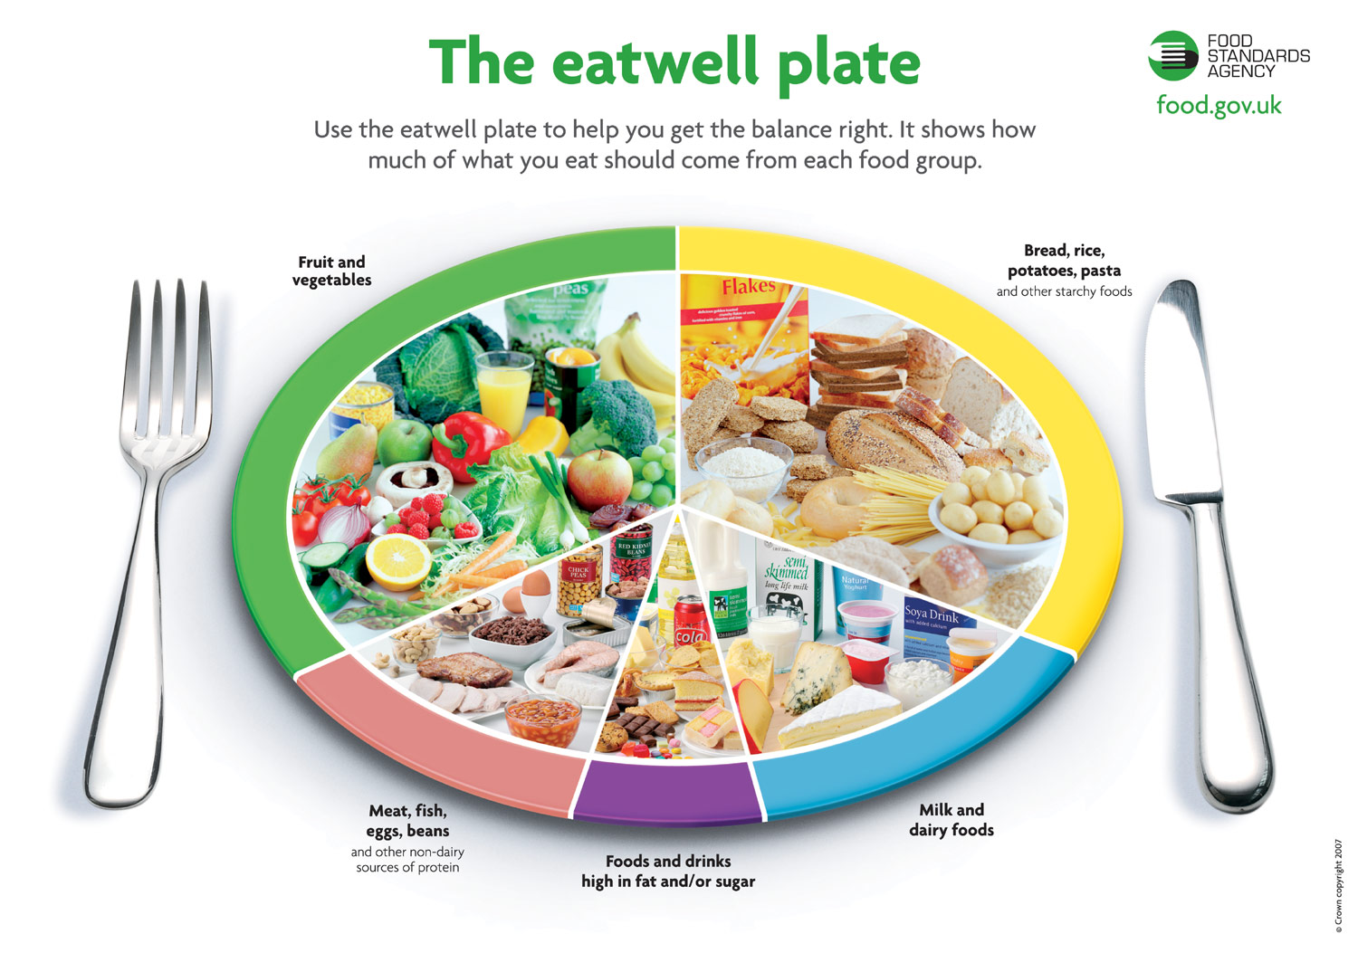
Eat Healtly
back

Slide 7

RUNNING
SWIMMING
CYCLING
back

Slide 8
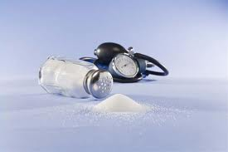
Eating too much salt can cause high blood pressure
back

Slide 9
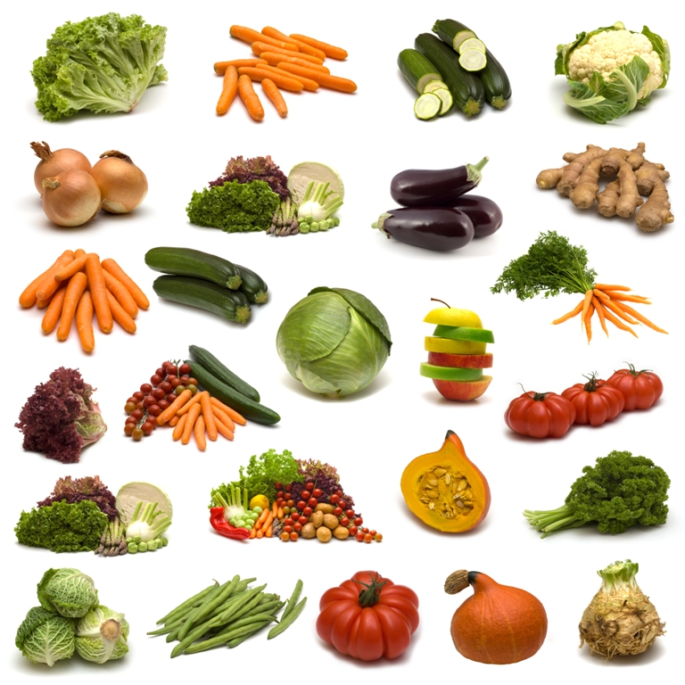
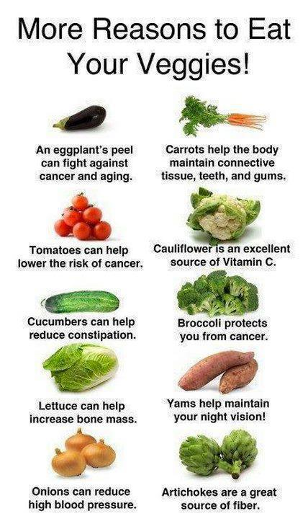
back

Slide 10
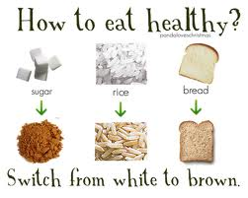
back

Slide 11
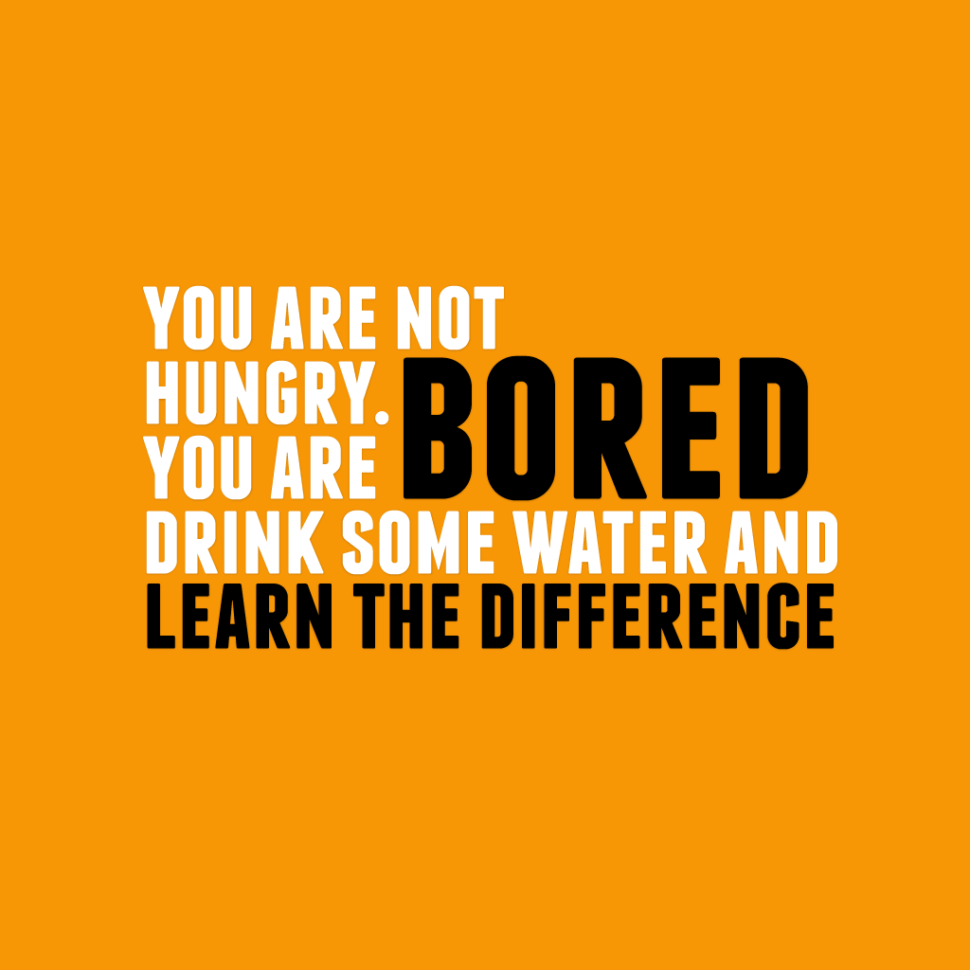
BACK

