Slide 1
Rhythmic gymnastics
Marta Similska
Magdalena Kochaniak
Monika Ślawska
IIIA

Slide 2
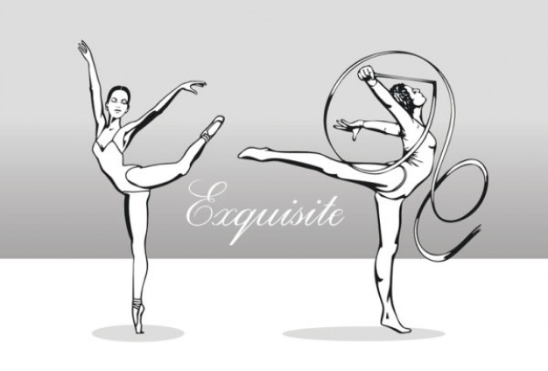
Contents :
What is it?
Rules
The most important tournament
Apparatus
Rhythmic Gymnastics Individual
Rhythmic Gymnastics Groups
Famous gymnasts
Roots

Slide 3
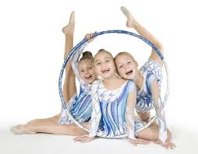
What is it?
Rhythmic gymnastics is olympic sport in which compete only women.
Players participate in individuals or teams, use one or two apparatus. The performs are combination of dance, gymnastics and acrobatics.
Gymnasts use: ball, hoop, ribbon, rope, juggling club, but they can perform without apparatus too.

Slide 4
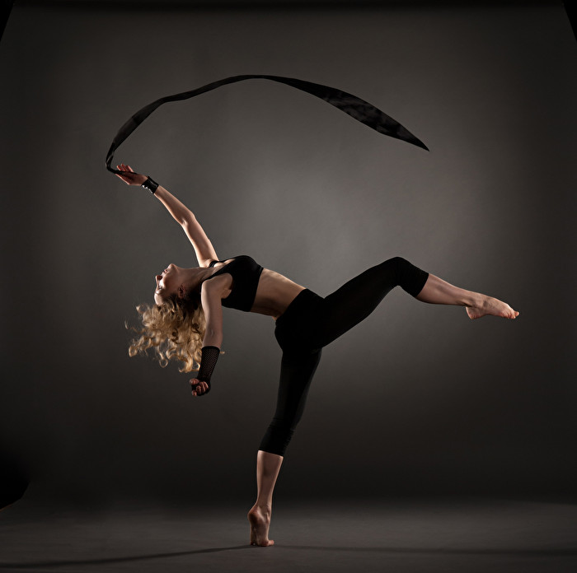
Rules
International competitions are split between Juniors, under sixteen by their year of birth, and Seniors, for women sixteen and over again by their year
of birth. Shows continue from 1,5 to 2,5 minutes. Juniors have to do one choreography, seniors have to do two.
The music must be without lyrics.

Slide 5
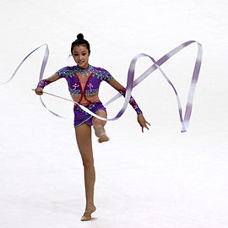
The most important tournament
Olimpic Games
World Cup
Europe Cup
Corbeil – Essonnes
Deriugina Cup
Cariprato

Slide 6
Apparatus
Ball
Hoop
Ribbon
Rope
Juggling club

Slide 7
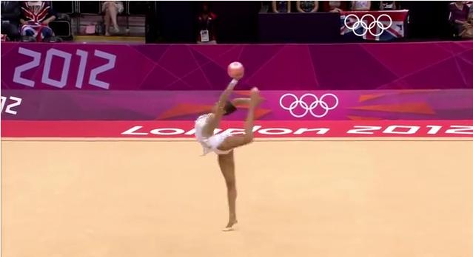
Rhythmic Gymnastics Individual
CLICK
https://www.youtube.com/watch?v=Gp34G2eZGtM

Slide 8
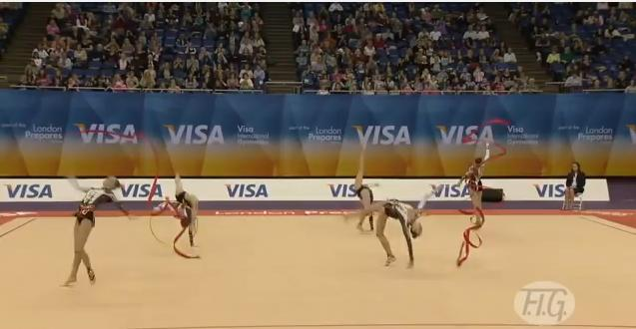
Rhythmic Gymnastics Groups
CLICK
https://www.youtube.com/watch?v=o2LRtampR7o

Slide 9
Famous gymnasts
Yulia Barsukova
Liubov Charkashyna
Aliya Garayeva
Anna Bessonova

Slide 10
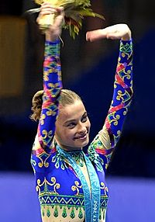
Yulia Barsukova
She is a Russian retired individual rhythmic gymnast. She is the 2000 Olympic champion in the All-Around, the 2000 Grand Prix Final All-around champion, the 1999 World All-around bronze medalist, 2000 European All-around bronze medalist and 1999 Grand Prix Final All-around bronze medalist.

Slide 11
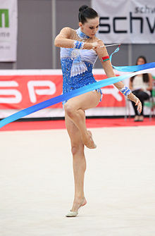
Liubov Charkashyna
She is a Belarusian individual rhythmic gymnast.
She is the 2012 Olympic all-around bronze medalist, the 2011 European ball and clubs gold medalist and two time
(2012, 2011) World Cup Final all-around bronze medalist.

Slide 12
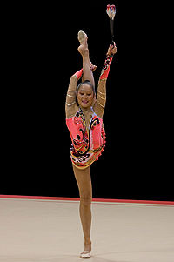
Aliya Garayeva
She is a retired Azerbaijani gymnast. She is the 2011 World All-around bronze medalist,
a two-time (2010, 2012) European All-around bronze medalist, two time (2007, 2011) Grand Prix Final All-around bronze medalist and five-time Azerbaijanii National champion.

Slide 13
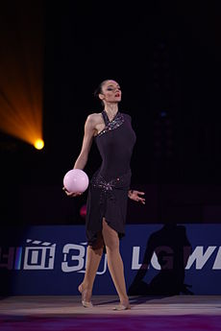
Anna Bessonova
She is a Ukrainian former individual rhythmic gymnast. She is
a two-time (2004, 2008) Olympic bronze medalist, the 2007
World All-around Champion, the (2005, 2003) World All-around silver medalist, (2009, 2001) World All-around bronze medalist,
a four-time European All-around medalist (2004, 2008) silver, (2002, 2006) bronze, the 2003 Grand Prix Final All-around champion, the
( 2002, 2005) Grand Prix Final All-around silver medalist and 2004 Grand Prix Final All-around bronze medalist. She is one of the most decorated rhythmic gymnasts.

Slide 14
Roots
http://en.wikipedia.org/wiki/Yulia_Barsukova
http://en.wikipedia.org/wiki/Liubov_Charkashyna
http://en.wikipedia.org/wiki/Aliya_Garayeva
http://en.wikipedia.org/wiki/Anna_Bessonova
http://en.wikipedia.org/wiki/Rhythmic_gymnastics#The_gymnast
Book „101 wspaniałych sportów”

Slide 15
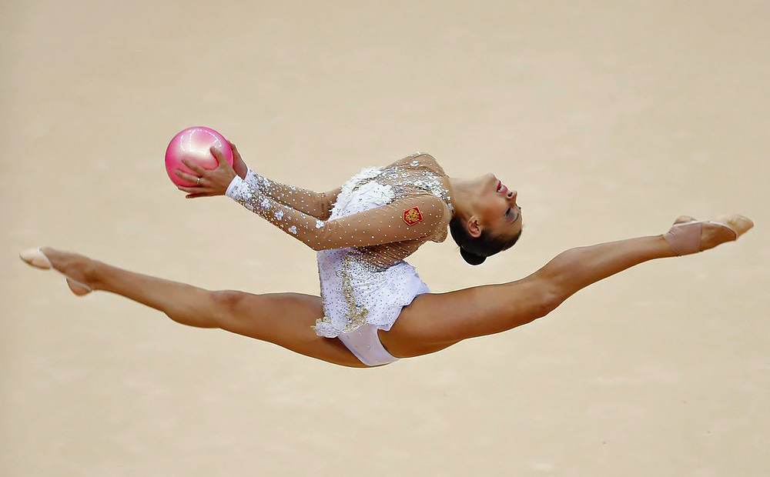
The End

