Slide 1
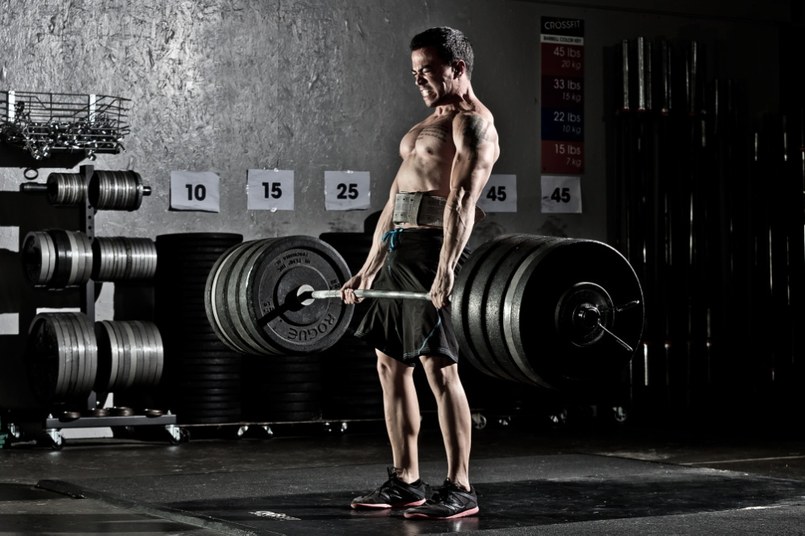
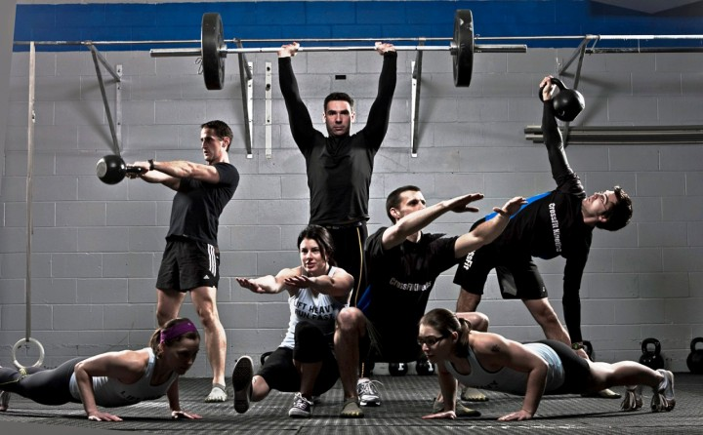
Crossfit

Slide 2
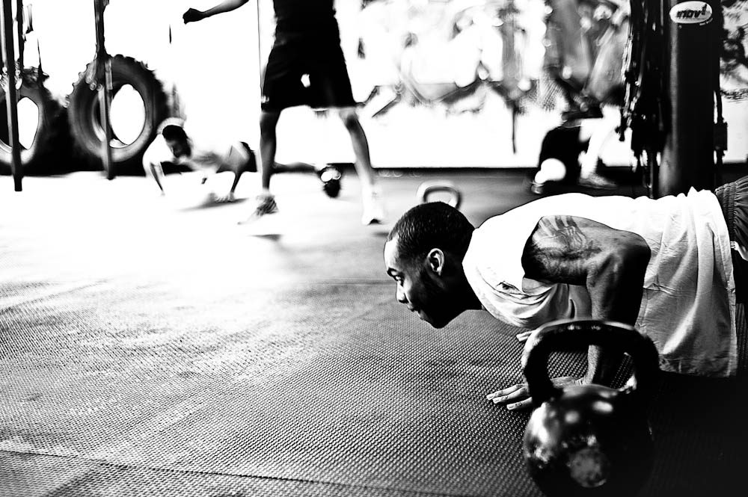
What crossfit is?
CrossFit – a strength and stamina training program. It main goal is to enhance our
muscles mass which is very important not only
in sport but also in real life.

Slide 3
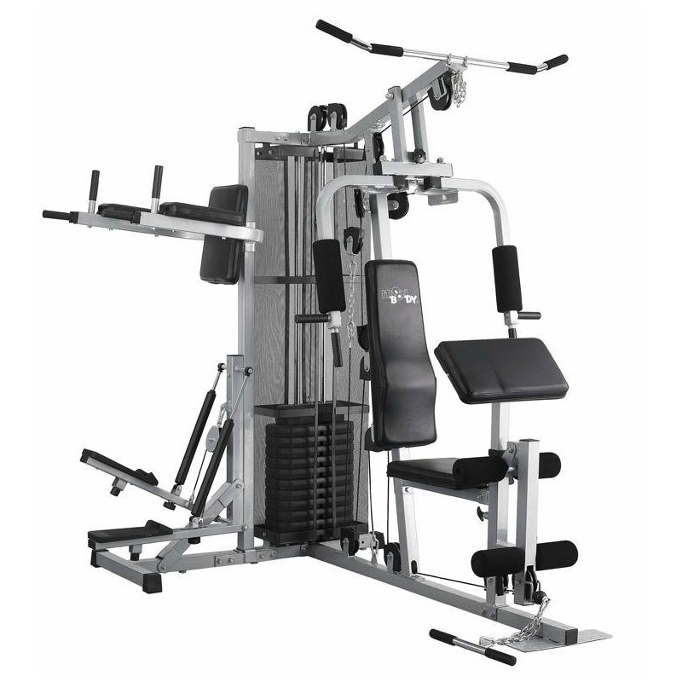
description
The main idea of CrossFit is intense training with very short breaks or even without it. The exercises are mix of many different sports and movements, like: weight lifitng, athletic and gymnastic.
CrossFit training can improve lots of physical abillities and our health. It has affect on our circulatory and respiratory, endurance, speed, agility, balance and precision.

Slide 4
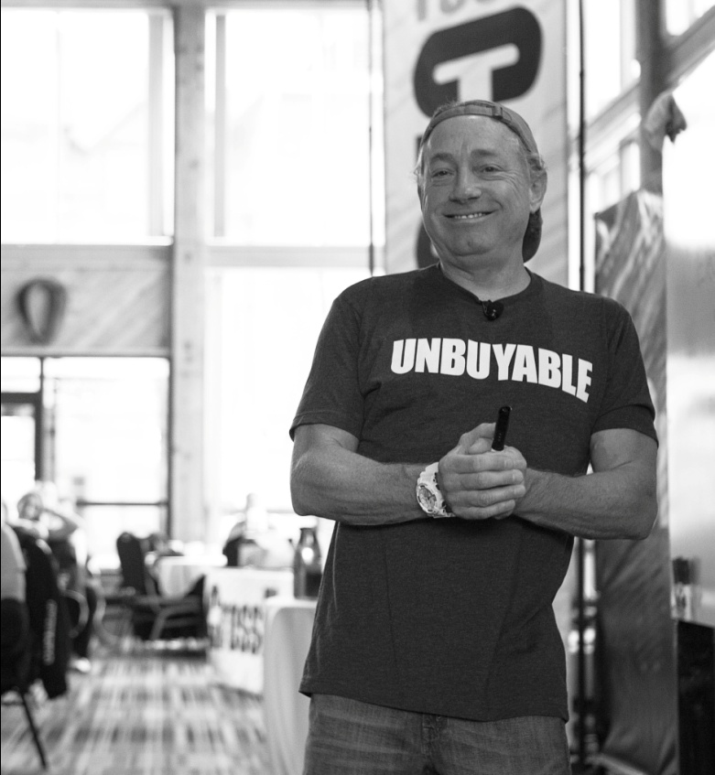
history
Crossfit was created in 2001, when American Greg Glassman started to use this program for training the police in California. Then he started to train Marines, fire-fighters and US troops.

Slide 5
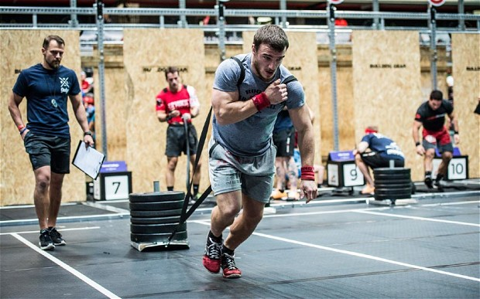
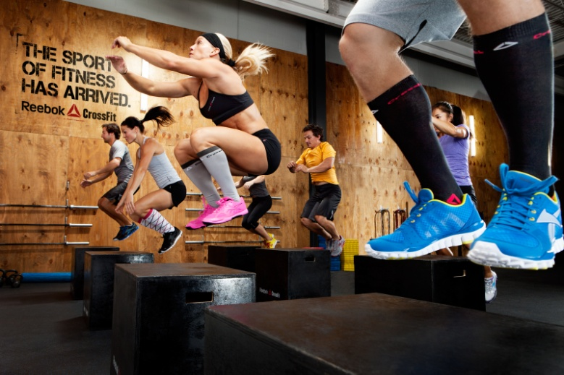
photos

Slide 6
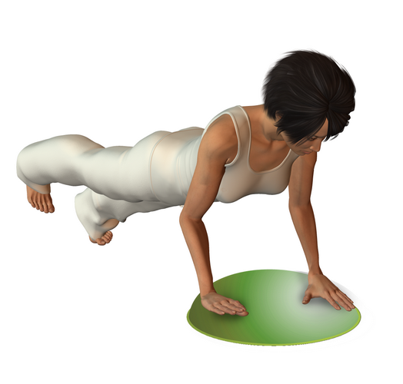
1 exercise
Exercise 1 – push up on one leg in reliance on the tree or wall. Support a tree or a wall (hands should be at shoulder height). Elbows should be straight. Raise and straighten your right leg backwards. Then try to do push-ups, or bend your elbows, approaching the same head in hands, while keeping the leg straight at the knee, and his head was at the height of her hand. When leaving a breath needs to be done, and when lifting, exhale. During this exercise, the are involved muscles of smaller chest, shoulder and triceps muscles smaller muscles of the shoulder girdle.

Slide 7
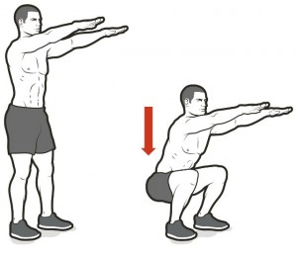
2 exercise
Exercise 2 - squat with a 1-second pause Number of 1-second pause is free. A larger number of blocks will increase the intensity of exercise. Your legs, knees straight, hands in front of you at shoulder height. Then do a squat, keeping in mind the 1-second pause. Buttocks should be placed on the knees, and feet below the knees. The back should be straight. During each of the insert should exhale, and before making the remaining traffic breath. During this exercise they involve muscles of the buttocks and lower muscles of the thighs.

Slide 8
3 exercise
Exercise 3 - spikes up alternating with hands Stand on one leg and the other in the knee bend (angle of 90 ° at the knee and hip). Then lift and straighten the arm opposite to the bulging legs. The exercise consists in performing alternating antics (remember to opposite arms and legs). During this exercise should breathe naturally. During this exercise, the muscles involved are smaller shoulder girdle, lower girdle muscles and calves.

Slide 9
4 exercise
Exercise 4 - lunges to the side with the extrusion dumbbell Grasp a dumbbell (or liter bottles of water), stand on your feet slightly apart, raise your arm and bend your elbows at shoulder height (angle 90 °). Then, follow the alternating lunges to the side while tilted hands with weights above her head. Return to starting position. Performing stride with elevation of weights, do exhale, and returning to the starting position, inhale. During this exercise, the muscles involved are smaller shoulder, buttocks, thigh muscles smaller.

Slide 10
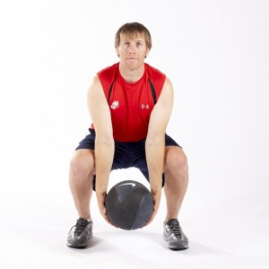
5 exercise
Activity 5 - medicine ball throw "into the basket" Put the ball in front of you (regular or medical). Follow the slope on bent legs - buttocks should be placed on the knees and the back be straight - and grab the ball. Then get up and do the twist of the torso, raising his hands. In the next półprzysiad do to prepare for a jump shot. The last step is to jump to the top of the snap hands (as the line to the basket).

Slide 11
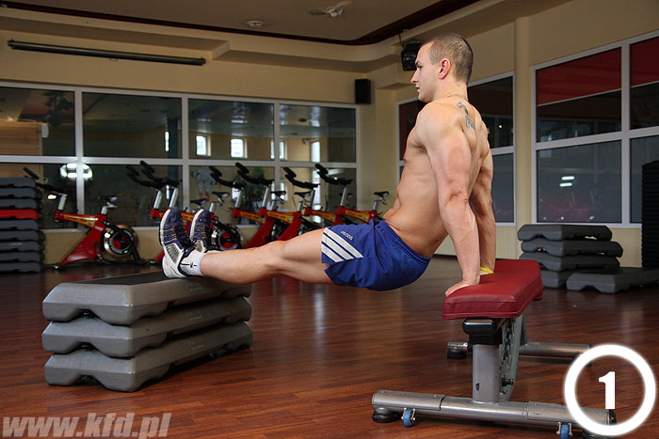
6 exercise
Exercise 6 - pump backwards Lean from the back of your hands on a bench or chair. Shoulders and elbows should be straight, both legs straight. Then bend your arms at the elbows, and feet leave the starting position. Breath should be taken when bending elbows and exhale while straightening follow forearms. During this exercise involving triceps muscle of the arm and the lower back of the thighs.

Slide 12
The end

