Slide 1
Anfield
Wykonanie: Iga Czeremska, Weronika Golis, Martyna Łaszewska

Slide 2
Table of Contents
General Information
Construction and equipment
Events
Events
Important Events
Thanks

Slide 3
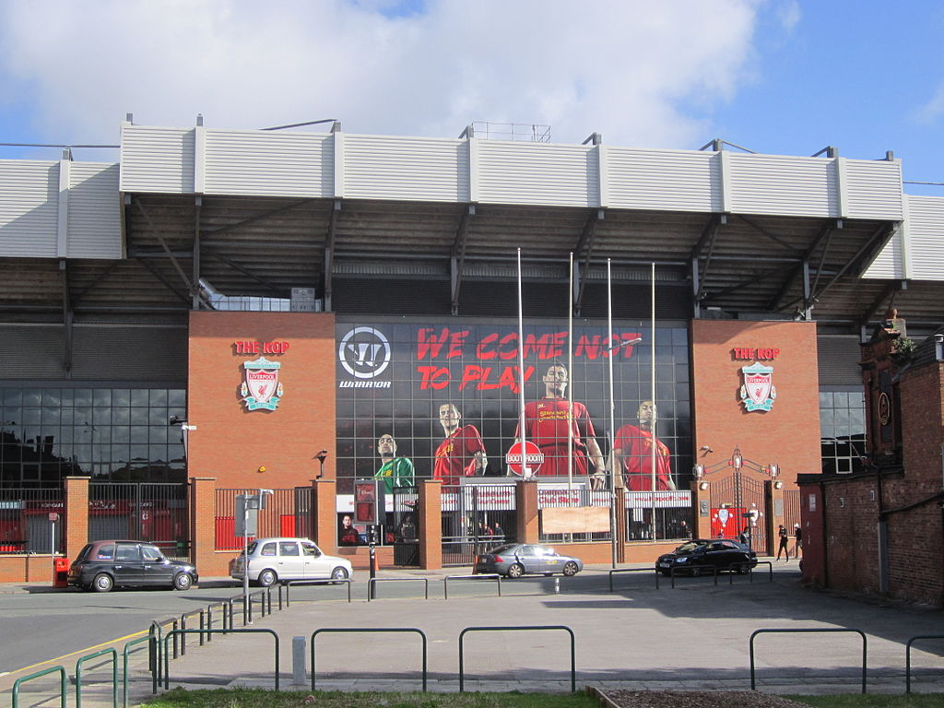
General Information
Anfield - the stadium used by Liverpool Football Club. It was created in 1884 and initially was used by Everton. In 1892 in a dispute over the leadership of the club Everton moved to Goodison Park, and since that time at Anfield matches and Liverpool. The facility can accommodate 45 276 spectators.

Slide 4
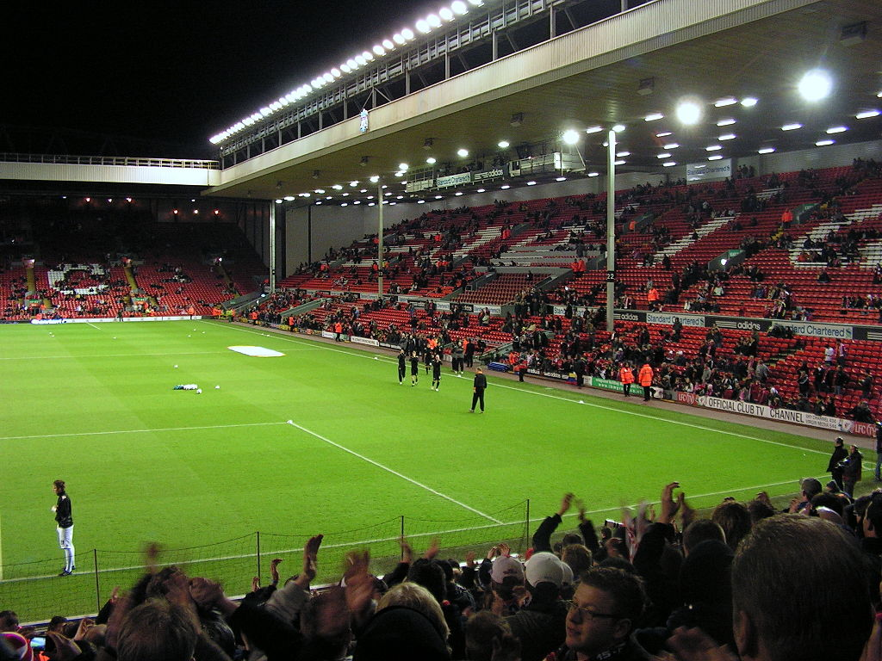
Construction and equipment
The pitch at Anfield has dimensions of 101 x 68 meters, which does not meet the requirements set by UEFA's stadia fourth category
(105 × 68 m). This means that the admission of the stadium for the Champions League or the Europa League requires the consent of the appropriate cell extraordinary UEFA.
The stadium consists of four stands, two of which are single-stage (located at the north-western edge of the field Main Stand and the Kop to her right) and two duplexes (Centenary Stand is located opposite the main stand and the Anfield Road Stand - on the north eastern).

Slide 5
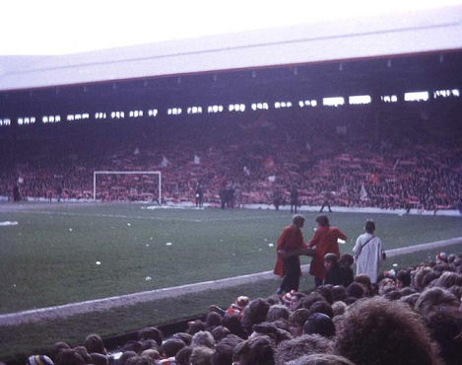
Events
The stadium hosted numerous international matches, including in the framework of Euro 1996. The first international match was a duel of England and Ireland, which was played at Anfield on March 2, 1889. - The hosts won in a ratio of 6: 1.

Slide 6
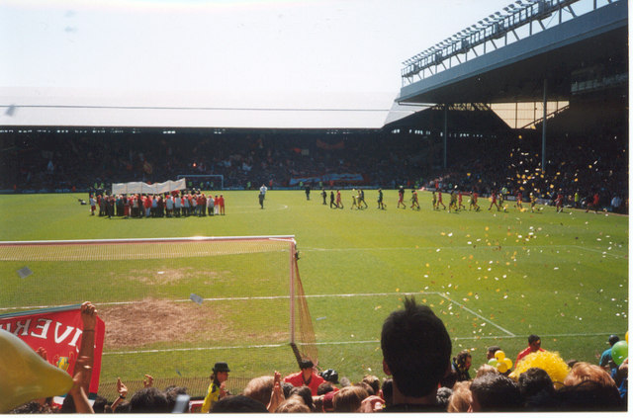
Events
At Anfield they were also held events unrelated to football.
In the mid-20th century the stadium was a meta-city marathon. The annual race began with St. Peter's Square. George in the city center, and ended with a round around Anfield. In the interwar period was the object regularly hosted boxing fights, including the UK Championship

Slide 7
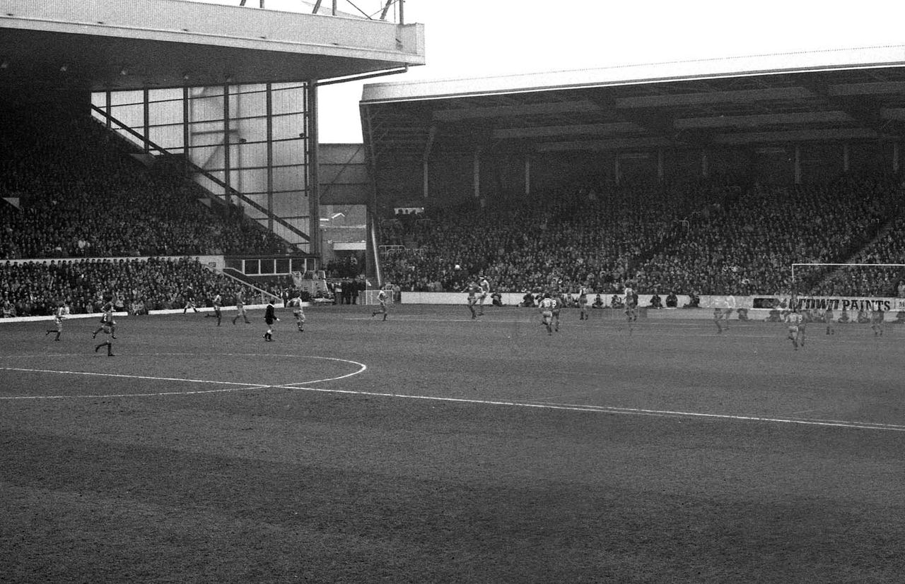
Important Events
The first match on the subject was held on 27 September 1884., And then undertook Earlstown Everton FC.
The first international match was played at Anfield on March 2, 1889., When England won with Ireland 6: 1.
Liverpool's first game in their own stadium took place on 1 September 1892. When the opponent was Rotherdam Town.
Liverpool's biggest win at Anfield fell on 17 September 1974., In the match of the Cup Winners' Cup. The Reds defeated the Norwegian team Strømsgodset IF 11: 0.
The highest defeat Liverpool at Anfield is finished result 0: 6 match in April 1930. Sunderland.

Slide 8
Thanks
Thank you for watching our presentation.

