Slide 1
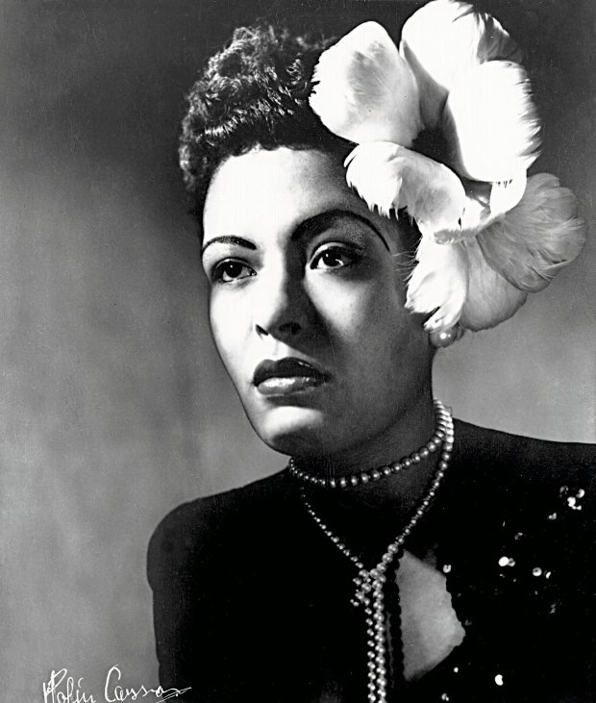
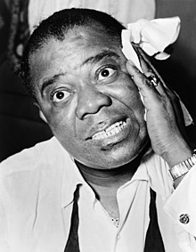
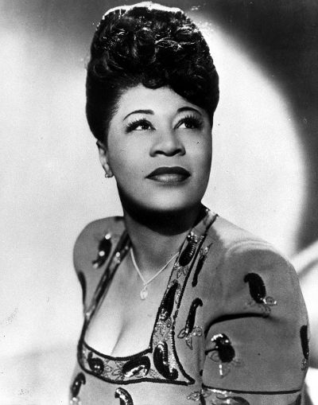
FAMOUS SINGERS OF THE USA
Author: Agata Andrzejewska
SP6 im. Jana Kochanowskiego w Zgierzu z Oddziałami Dwujęzycznymi i Oddziałami Sportowymi
Supervised by: Małgorzata Stasińska

Slide 2
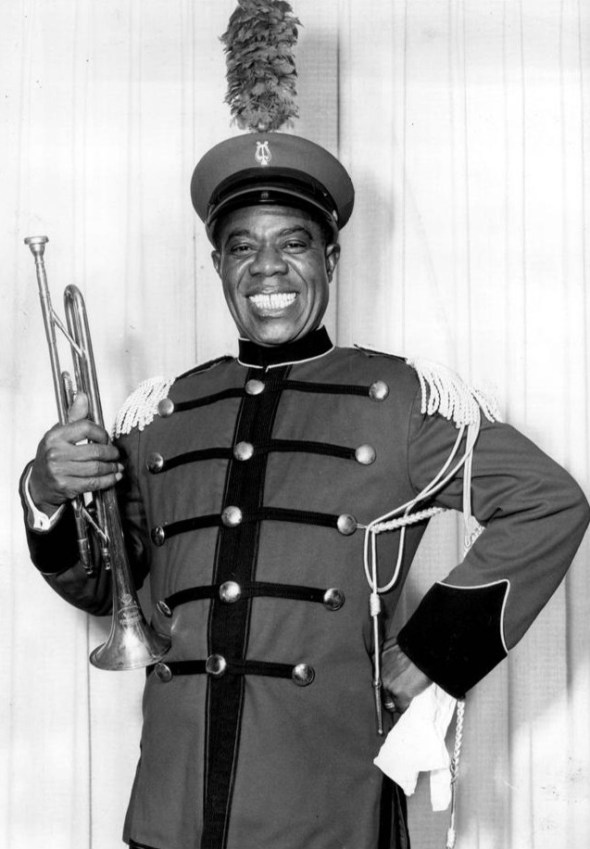
LOUIS DANIEL ARMSTRONG
BORN: August 4, 1901 New Orleans, Louisiana, USA
DIED: July 6, 1971 (aged 69) Corona, Queens, New York
OTHER NAMES: "Satchmo" , "Satch" , "Pops" , "Louie"
OCCUPATION: Musician, composer, singer
INSTRUMENTS: Cornet, trumpet
THE BEST SINGIEL: "What a wonderful world" (1967)
GENRES: Dixieland, jazz, swing, traditional pop

Slide 3
AWARDS AND HONORS
Grammy Hall of Fame: "St. Louis Blues" 1925 "Heebie Jeebies" 1926 "West End Blues" 1928 "Weather Bird" 1928 "St. Louis Blues" 1929 "Blue Yodel No. 9 (Standing on the Corner)" 1930 "All of Me" 1932 "When the Saints Go Marching In" 1938 "Mack the Knife" 1955 Porgy and Bess 1958 (album) "Hello Dolly!" 1964 "What a Wonderful World" 1967
Grammy Award: "Hello, Dolly!" 1964, genre: Pop
Rock and Roll Hall of Fame: "West End Blues" 1928

Slide 4
LOUIS ARMSTRONG CAREER
On New Year's Eve in 1912, Armstrong fired his stepfather's gun in the air during a New Year's Eve celebration and was arrested on the spot. He was then sent to the Colored Waif's Home for Boys.
There, he received musical instruction on the cornet and fell in love with music. In 1914, the institution released him, and he immediately began dreaming of a life making music.
In 1918, he replaced Oliver in Kid Ory's band, then the most popular band in New Orleans.
In the autumn of 1924 Armstrong joined Henderson but he was unhappy there.
In 1925 he returned to Chicago and began playing with his wife Lil's band at the Dreamland Café.

Slide 5
LOUIS ARMSTRONG CAREER
From 1925 to 1928, Armstrong made more than 60 records with the Hot Five and later the Hot Seven.
By 1932, Armstrong, who was now known as Satchmo (such mouth), had begun appearing in movies and made his first tour of England.
Armstrong joined Columbia Records in the mid-'50s, and soon cut some of the finest albums of his career for producer George Avakian.
In 1963 he was called into the studio to record the title number for a Broadway show that hadn't opened yet: Hello, Dolly!

Slide 6
LOUIS ARMSTRONG CAREER
The record was released in 1964 and quickly climbed to the top of the pop music charts, hitting the No. 1 slot in May 1964.
In 1967, Armstrong recorded a new ballad, "What a Wonderful World."
Heart and kidney problems forced him to stop performing in 1969.
Armstrong returned home in May 1971, and though he soon resumed playing again and promised to perform in public once more, he died in his sleep on July 6, 1971, at his home in Queens, New York.

Slide 7
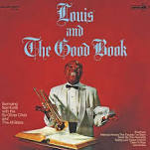
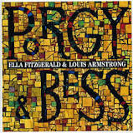
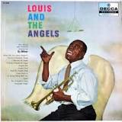
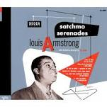
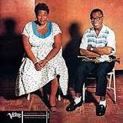
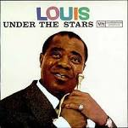
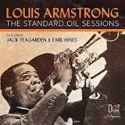
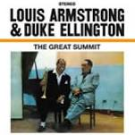
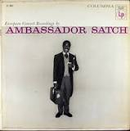
ALBUMS
Louis and the Good Book 1958
Porgy and Bess 1958
Louis and the Angels 1957
Satchmo Serenades 1952
Ella and Louis
1956
Louis Under the Stars 1958
The Great Summit 1961
The Standard Oil Sessions 2017
Ambassador Satch 1956
not all albums

Slide 8
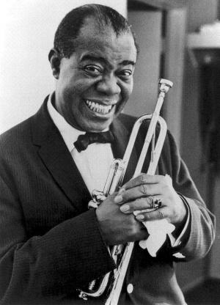
HITS
When You're Smiling Go Down Moses Dream a Little Dream of Me La Vie en Rose
What a Wonderful World Dream A Little Dream Of Me When the Saints Go Marching In Hello Dolly
clicking on the text moves to the song

Slide 9
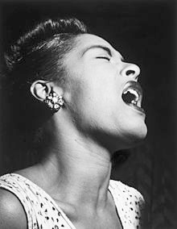
BILLIE HOLIDAY
TRUE NAME AND SURNAME: Eleanora Fagan
BORN: April 7, 1915 Philadelphia, Pennsylvania, USA
DIED: July 17, 1959 (aged 44) Manhattan, New York City
OCCUPATION: Singer
THE BEST SINGIEL: "Blue moon" (1952)
GENRES: Vocal jazz, jazz blues, torch songs, swing, blues, R&B

Slide 10
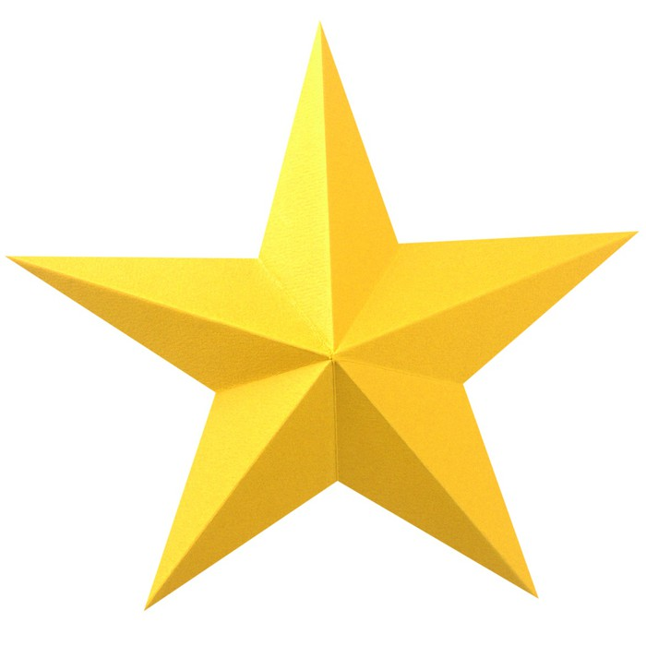
AWARDS AND NOMINATIONS
Billie Holiday received numerous awards and accolades while still alive and posthumously. These include being inducted into the Grammy Hall of Fame, Ertegun Jazz Hall of Fame, Rock and Roll Hall of Fame, and the ASCAP Jazz Wall of Fame.
Television appearances: We the People (U.S. TV series), 1948 Today Show, 1958 Timex All-Star Jazz Show IV, NY, 1959 The Tonight Show, NY, 1955-1956 The Comeback Story, NY, 1953 Telethon, NY, 1958 Stars of Jazz, LA, CA, 1956 Peacock Alley, NY, 1956 Night Beat, NY, 1956
Live Broadcast from Mr. Kelly's, Chicago, 1957 Gilles Margaritis Programme, Paris France, 1958 Eddie Condon's Floor Show, NY, 1949-1950 Club Oasis, NY, 1958 Chelsea at Nine, London, England, 1959 Bandstand USA, NY, 1956 Art Ford's Jazz Party, 1958 Art Ford Show, 1949 Apollo Theatre Show, 1949-1952

Slide 11
BILLIE HOLIDAY CAREER
In her difficult early life, Holiday found solace in music, singing along to the records of Bessie Smith and Louis Armstrong.
Around 1930, Holiday began singing in local clubs and renamed herself "Billie".
Known for her distinctive phrasing and expressive, sometimes melancholy voice, Holiday went on to record with jazz pianist Teddy Wilson and others in 1935.
Young gave Holiday the nickname "Lady Day" in 1937—the same year she joined Basie's band. In return, she called him "Prez," which was her way of saying that she thought it was the greatest.

Slide 12
BILLIE HOLIDAY CAREER
Holiday recorded two of her most famous songs, "God Bless the Child" and "Strange Fruit” about lynch hanging of the African-American people by Ku-Klux-Klan
She was arrested and convicted for narcotics possession in 1947.
Holiday caught the public's attention by sharing her life story with the world in 1956.
Her autobiography, Lady Sings the Blues (1956), was written in collaboration with William Dufty.

Slide 13
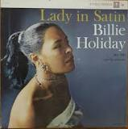
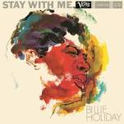
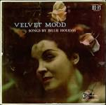
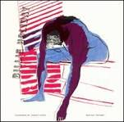
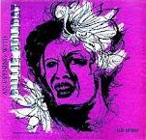
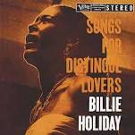
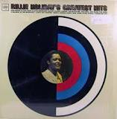
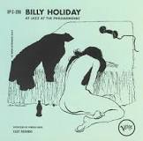
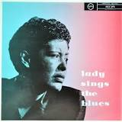
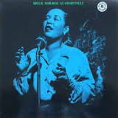
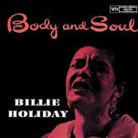
ALBUMS
Lady in Satin 1958
Stay with Me 1958
Velvet Mood 1956
BD Jazz 2003
Billie Holiday Sings 1952
An Evening with Billie Holiday 1953
Billie Holiday's Greatest Hits 1996
Body and Soul 1957
Songs for Distingué Lovers 1957
Lady Sings the Blues 1956
Billie Holiday at Storyville 1999
Billie Holiday at JATP 1954

Slide 14
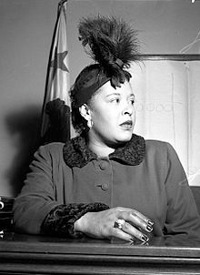
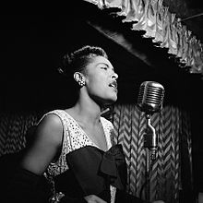
HITS
I'll Be Seeing You All of Me Summertime God Bless the Child
Gloomy Sunday Body and Soul Blue Moon Strange Fruit
clicking on the text moves to the song

Slide 15
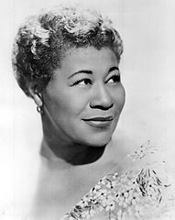
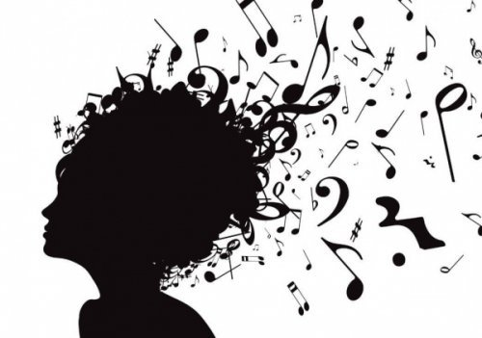
ELLA JANE FITZGERALD
BORN: April 25, 1917 Newport News, Virginia, USA
DIED: June 15, 1996 (aged 79) Beverly Hills, California
OCCUPATION: Singer
THE BEST SINGIEL: Summertime
GENRES: Swing, bebop, traditional pop, vocal jazz, blues

Slide 16
AWARDS AND HONORS
Fitzgerald won thirteen Grammy Awards and received the Grammy Lifetime Achievement Award in 1967.
In 1958 Fitzgerald was the first African American female to sng at the inaugural show.
Other major awards and honors she received during her career were:
Kennedy Center for the Performing Arts Medal of Honor Award,
National Medal of Art, first Society of Singers Lifetime Achievement Award, named "Ella" in her honor,
Presidential Medal of Freedom
George and Ira Gershwin Award for Lifetime Musical Achievement,
USC "Magnum Opus" Award, which hangs in the office of the Ella Fitzgerald Charitable Foundation.
In 1990, she received an honorary doctorate of Music from Harvard University.

Slide 17
ELLA FITZGERALD CAREER
In 1934, Ella was living on the streets, she entered an amateur contest at Harlem's Apollo Theater.
That performance at the Apollo helped set Fitzgerald's career in motion.
She soon met bandleader and drummer Chick Webb and eventually joined his group as a singer.
Fitzgerald recorded "Love and Kisses" with Webb in 1935.
Following Webb's death in 1939, Ella became the leader of the band, which was renamed Ella Fitzgerald and Her Famous Orchestra.
Fitzgerald also made her film debut as Ruby in 1942's comedy western „Ride 'Em Cowboy” with Bud Abbott and Lou Costello.

Slide 18
ELLA FITZGERALD CAREER
In 1956, Fitzgerald recorded „1956's Ella Fitzgerald Sings the Cole Porter Song Book”.
Fitzgerald produced great recordings with such artists as Louis Armstrong and Count Basie.
In 1960, Fitzgerald broke into the pop charts with her rendition of "Mack the Knife"
She made her last recording in 1989 and her last public performance in 1991 at New York's Carnegie Hall.
In all, Fitzgerald recorded more than 200 albums and some 2,000 songs in her lifetime.

Slide 19
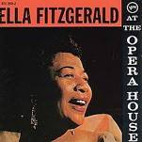
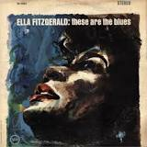
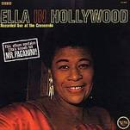
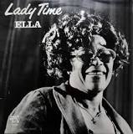
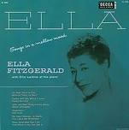
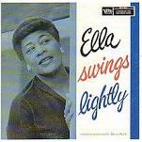
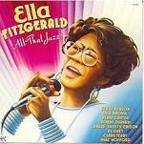
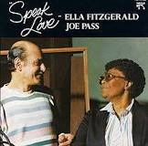
ALBUMS
At the Opera House 1958
These Are the Blues
1963
Ella in Hollywood
1961
Lady Time 1978
Ella and Louis 1956
Songs in a Mellow Mood 1954
Ella Swings Lightly 1958
Speak Love 1983
All That Jazz 1989
not all albums

Slide 20
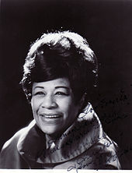
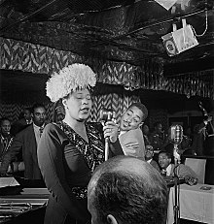
HITS
Summertime Cry Me A River Cheek To Cheek Dream a Little Dream of Me
Bewitched, Bothered and Bewildered Misty How High The Moon My Funny Valentine
clicking on the text moves to the song

Slide 21
BIBLIOGRAPHY
https://pl.wikipedia.org/wiki/Wikipedia:Strona_g%C5%82%C3%B3wna https://www.google.pl/imghp?hl=pl https://www.biography.com/people

