Slide 1
USA music bands
Author: Igor Kubsz
Suppervised by: Małgorzata Stasińska
SP6 w Zgierzu z Oddziałami Dwujęzycznymi i Oddziałami Sportoymi
Igor Kubsz IIA

Slide 2
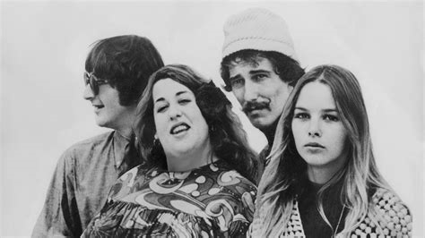
Mamas & Papas
Members:
Denny Doherty (29 November 1940 - 19 January 2007) - singing
John Phillips (30 August 1935 - 18 March 2001) - guitar, singing
Michelle Phillips (June 4, 1944) - singing
Cass Elliot (September 19, 1941 - July 29, 1974) - singing
The group was formed by a husband and a wife, John and Michelle Phillips in 1964.
The group considered calling itself the Magic Circle before switching to „Mamas and the Papas” apparently inspired by the Hells Angels, whose female associates were called "mamas”.
March 1966

Slide 3
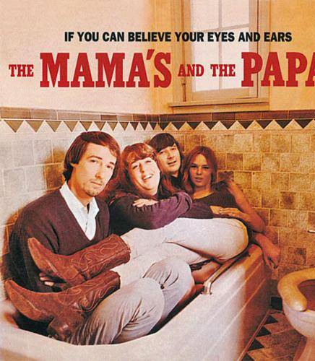
Mamas & Papas
Biggest hits:
„California Dreamin ‚”- December 8, 1965
„Dedicated to the One I Love” - May 1959
„Monday Monday” - March 1966
„Look Through My Window” - 1966

Slide 4
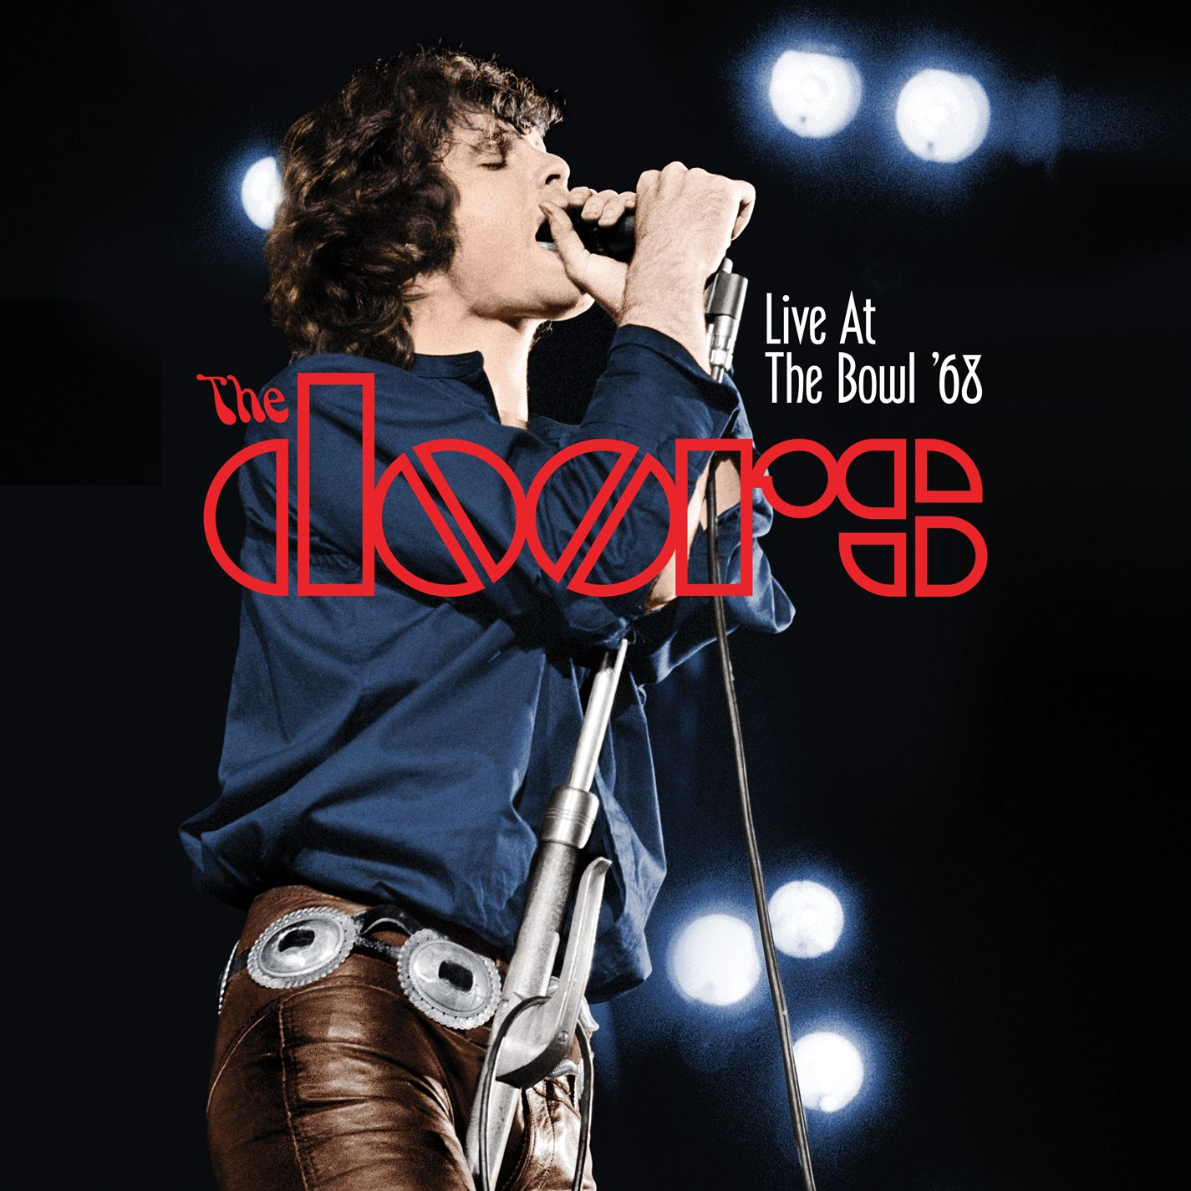
The Doors
Members:
Jim Morrison (December 8, 1943) - singing (1965-1971, deceased)
Ray Manzarek (February 12, 1939) - keyboards, synthesizer of bass guitar (1965-1972)
Robby Krieger (January 8, 1946) - guitar (1965-1972)
John Densmore (December 1, 1944) - drums (1965-1972)
The Doors were an American rock band formed in 1965 in Los Angeles, with vocalist Jim Morrison, keyboardist Ray Manzarek, guitarist Robby Krieger, and John Densmore on drums.
The band got its name, at Morrison's suggestion from the title of Aldous Huxley's book The Doors of Perception, which itself was a reference to a quote made by William Blake, "If the doors of perception were cleansed, everything would appear to man as it is, infinite."
They were unique and among the most controversial and influential rock acts of the 1960s, mostly because of Morrison's lyrics and charismatic but unpredictable stage persona.
After Morrison's death in 1971, the remaining members continued as a trio until disbanding in 1973.

Slide 5
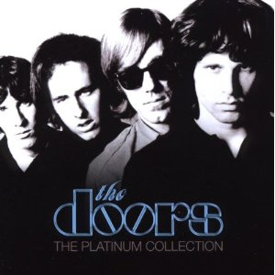
The Doors
Biggest hits:
„Hello, I Love You” - June 1968
„People Are Strange” - September 1967
„Light My Fire” - April 1967
„Riders on the Storm” - June 1971
Awards:
In 2007, the Doors received a Grammy Award for lifetime achievement
In 2007, the Doors received a star on the Hollywood Walk of Fame
In 2010, Riders On The Storm was inducted into the Grammy Hall of Fame under the category Rock

Slide 6
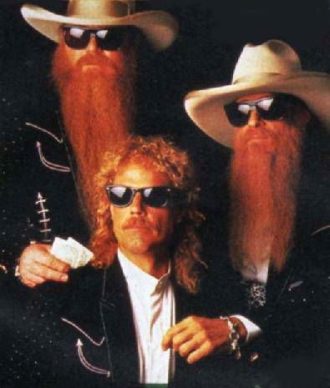
ZZ Top
Current members:
Frank Beard (June 11, 1949) – drums, percussion, backing vocals (since 1969)
Billy Gibbons (December 16, 1949) – guitar, lead and backing vocals (since 1969)
Dusty Hill (May 19, 1949) – bass, keyboards, backing and lead vocals (since 1969)
In 1976, Billy Gibbons had a customized 1933 Ford coupe built.
The car was built with a Corvette-style engine fabricated by the Hand Crafted Metal.[citation needed] It was finished in 1983 and called the Eliminator.
The car has become recognizable for its red finish and graphics, which can be seen in several of the band's music videos.
The Eliminator has also made worldwide appearances in television, movies, auto shows and charity events.
March 23, 1983

Slide 7
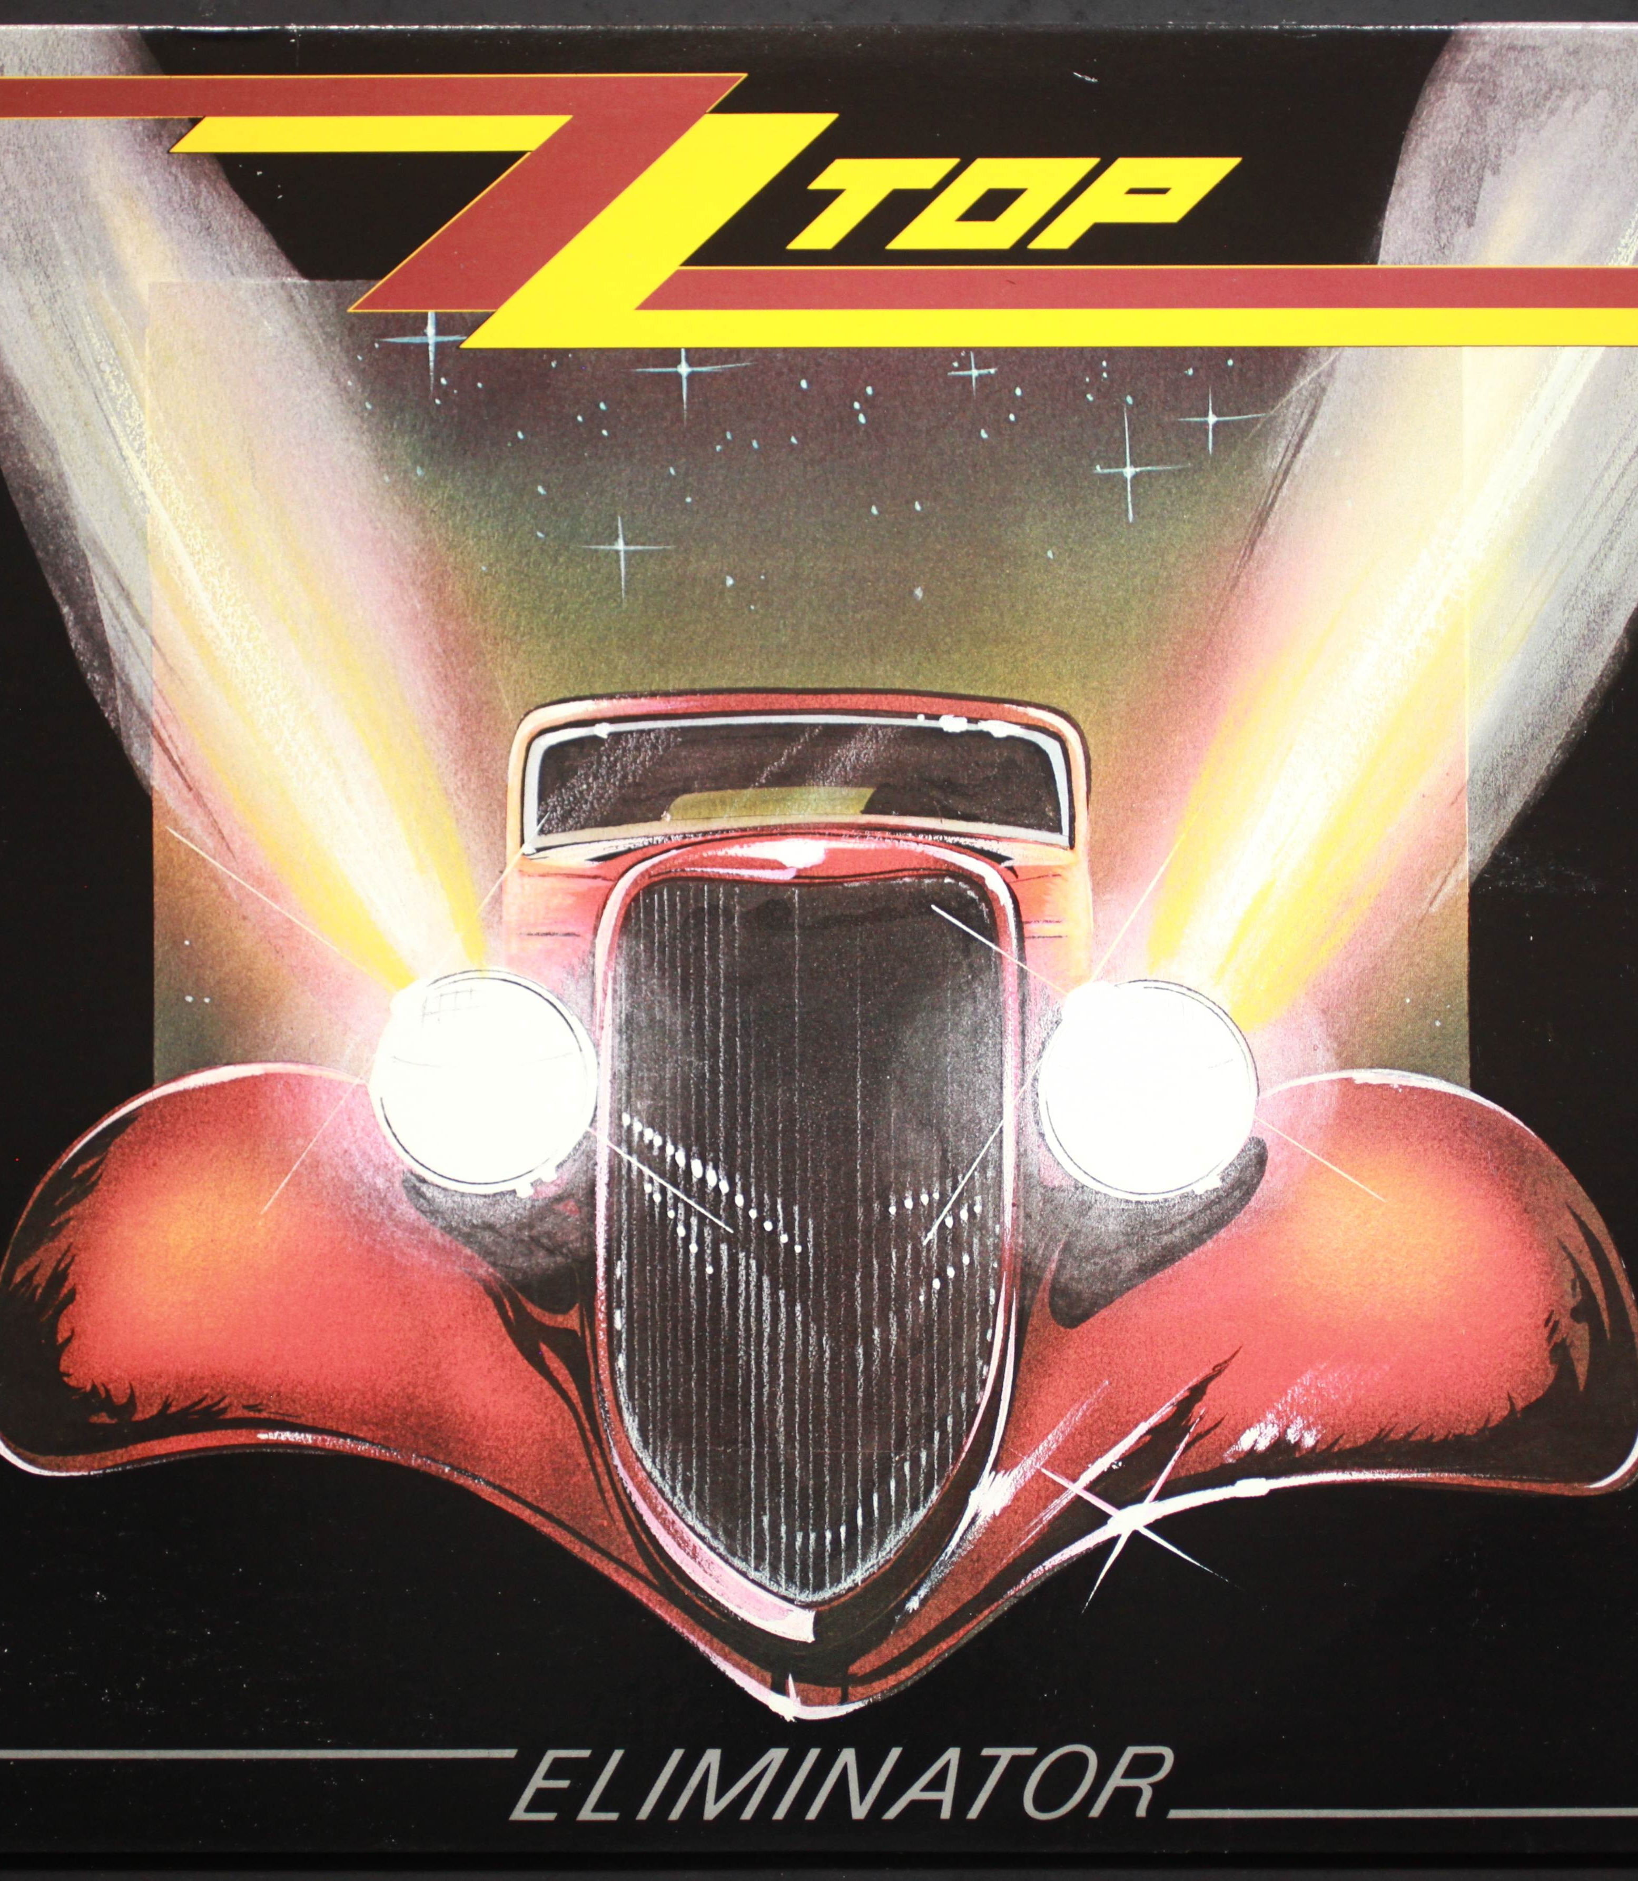
ZZ Top
Biggest hits:
„Sharp Dressed Man" - 1983
„La Grange" - 1973
„Gimme All Your Lovin'" - 1983
„Legs" - 1984

Slide 8
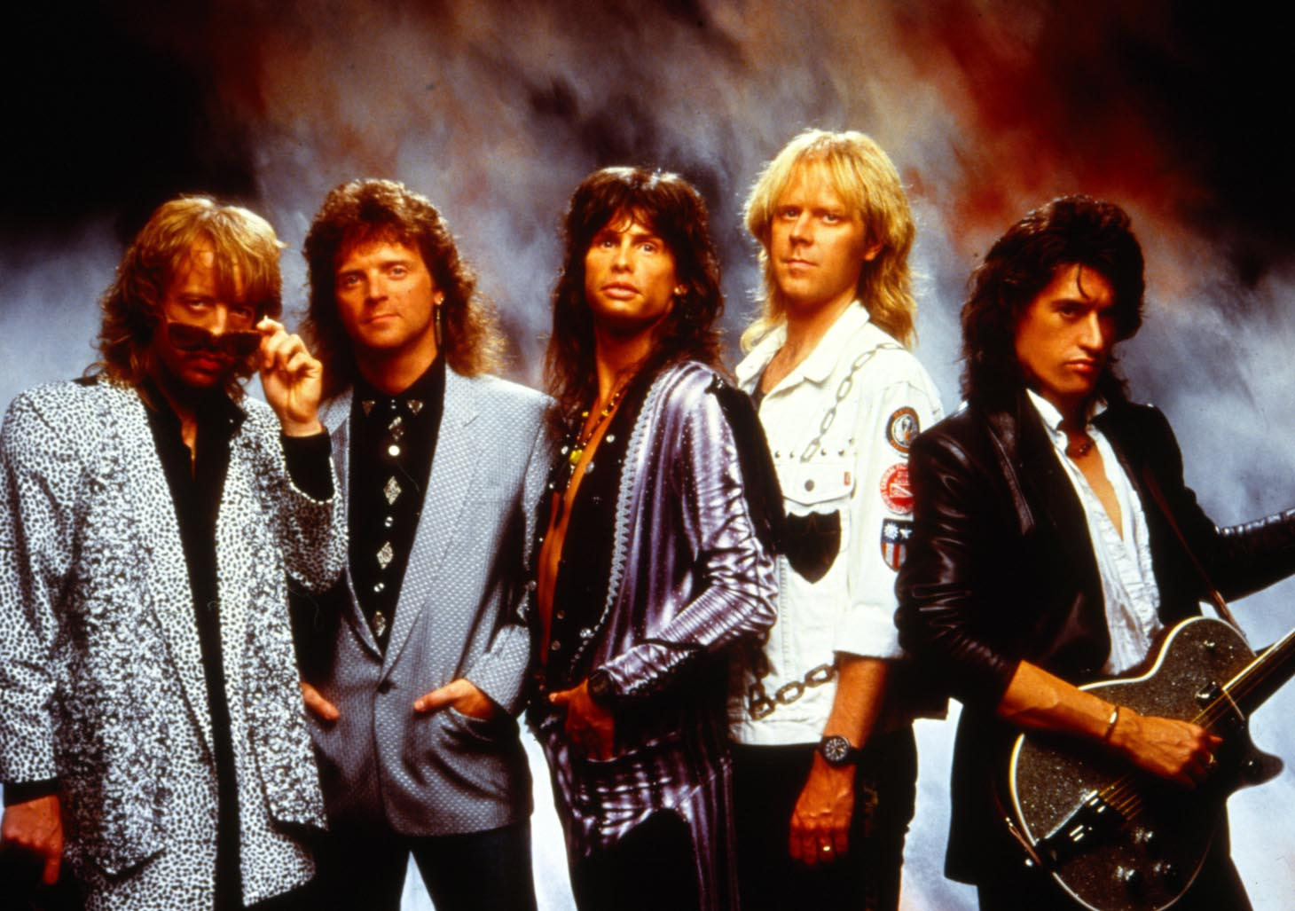
Aerosmith
Members:
Steven Tyler (March 26, 1948) - singing, harmonica, piano, guitar, percussion, banjo (since 1970)
Joe Perry (October 10, 1950) - lead guitar, song (1970-1979)
Tom Hamilton (December 31, 1951) - bass guitar (since 1970)
Joey Kramer (June 21, 1950) - drums (since 1970)
Brad Whitford (February 23, 1952) - rhythm guitar (1971-1981)
The band was formed in the summer of 1970 in Sunapee, New Hampshire. Since autumn of the same year, it was active in Boston.
The group was formed by guitarist Joe Perry and bassist Tom Hamilton after meeting the vocalist Steven Tyler, drummer Joey Kramer and guitarist Ray Tabano.
In 1972 the group signed a contract with Columbia Records and on January 13th 1973 released their debut album - Aerosmith, which sold in two milliones copies.
After the tour, the band recorded their second album Get Your Wings, released in March 1974.
Night in the ruts - November 1, 1979

Slide 9
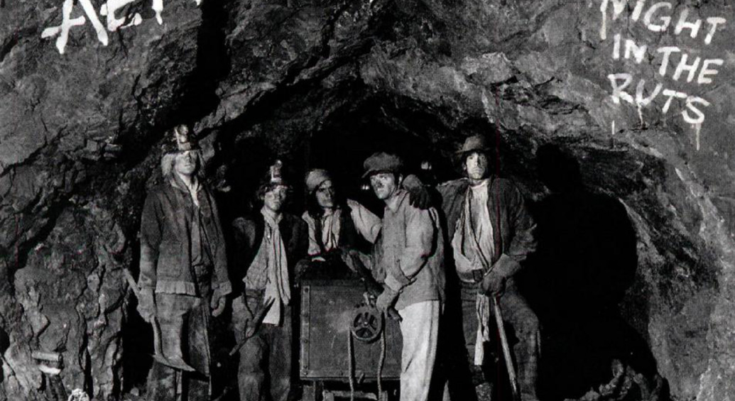
Aerosmith
Biggest hits:
„Toys in the Attic" - April 8 1975
„Get a Grip" - April 20, 1993
„Pump" - September 12 1989
„Permanent Vacation" - August 18 1987
Awards:
1990 Janie's Got a Gun in category - The best rock song performed by a duet or group
1993 Livin 'on the Edge in category - The best rock song performed by a duet or group
1994 Crazy in category - The best rock song performed by a duet or group
1998 Pink in category - The best rock song performed by a duet or group

Slide 10
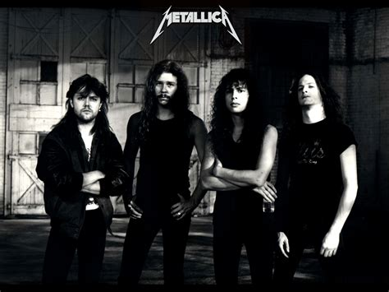
Metallica
Members:
James Hetfield (August 3, 1963) - lead vocal, rhythm guitar (from 1981)
Lars Ulrich (December 26, 1963) - drums (from 1981)
Kirk Hammett (November 18, 1962) - lead guitar, supporting vocal (since 1983)
Robert Trujillo (October 23, 1964) - bass guitar, supporting vocal (since 2003)
Biggest hits:
„Master of Puppets” - March 3, 1986
„One” - January 10, 1989
„Fade to Black” - September 30, 1984
„For Whom the Bell Tolls” - July 2, 1986
July 27, 1984

Slide 11
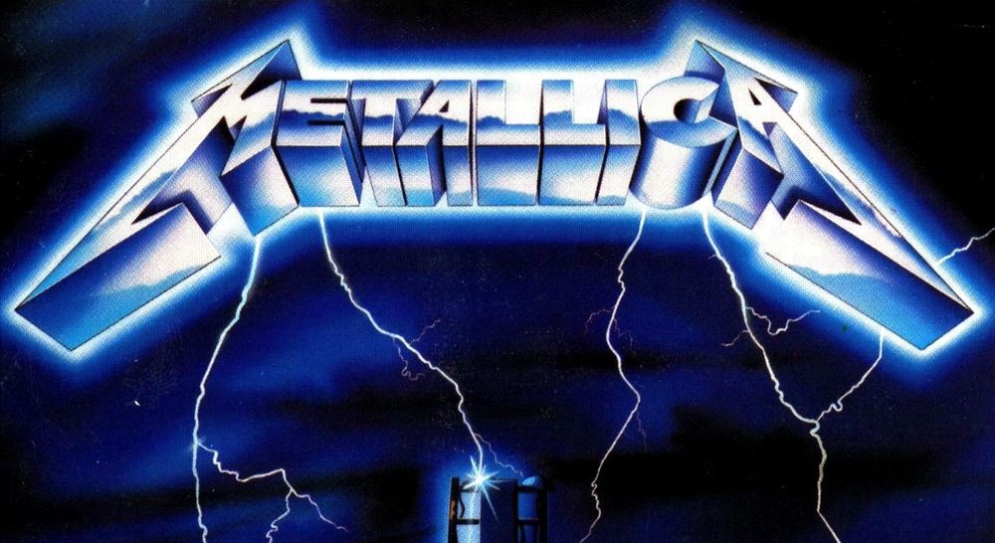
Metallica
Metallica was formed in Los Angeles, California, in late 1981 when Danish-born drummer Lars Ulrich placed an advertisement in a Los Angeles newspaper,
The Guitarists James Hetfield and Hugh Tanner of Leather Charm answered the advertisement. Ulrich recruited Hetfield to sing and play the rhythm guitar.
The band was officially formed on October 28th, 1981, five months after Ulrich and Hetfield first met.

Slide 12
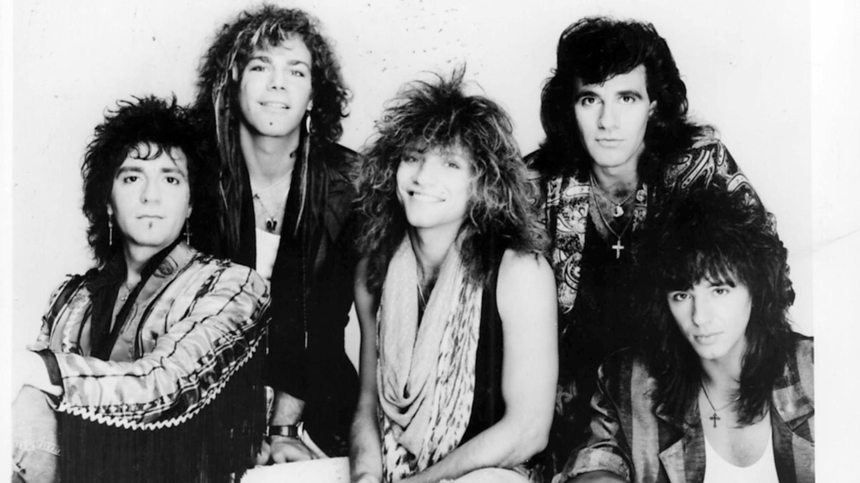
Bon Jovi
Members:
Jon Bon Jovi (March 2, 1962) - lead vocal, guitar (since 1983)
Tico Torres (October 7, 1953) - drums, percussion instruments (since 1983)
David Bryan (February 7, 1962) - keyboards, supporting vocal (since 1983)
Phil Xenidis (March 10, 1966) - guitar (since 2016, 2011, 2013)
Hugh McDonald (December 28, 1950) - bass guitar (since 2016)
Biggest hits:
„Livin 'on a Prayer” - October 31, 1986
„It's My Life” - May 23, 2000
„You Give Love and Bad Name” - July 23, 1986
„Wanted Dead or Alive” - March 3, 1987
January 21, 1984

Slide 13
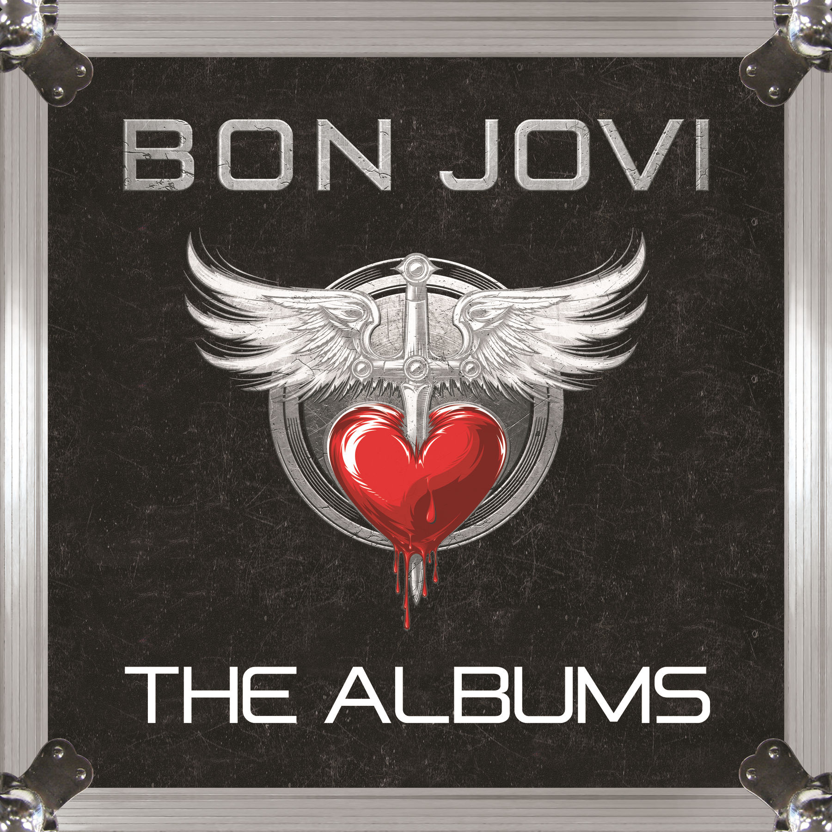
Bon Jovi
Awards:
American Music Awards:
1988 - (category) Favorite Pop/Rock Band/Duo/Group)
2004 - Award of Merit
CMT Music Awards:
2006 - Collaborative Video of the Year
2008 - Collaborative Video of the Year

Slide 14
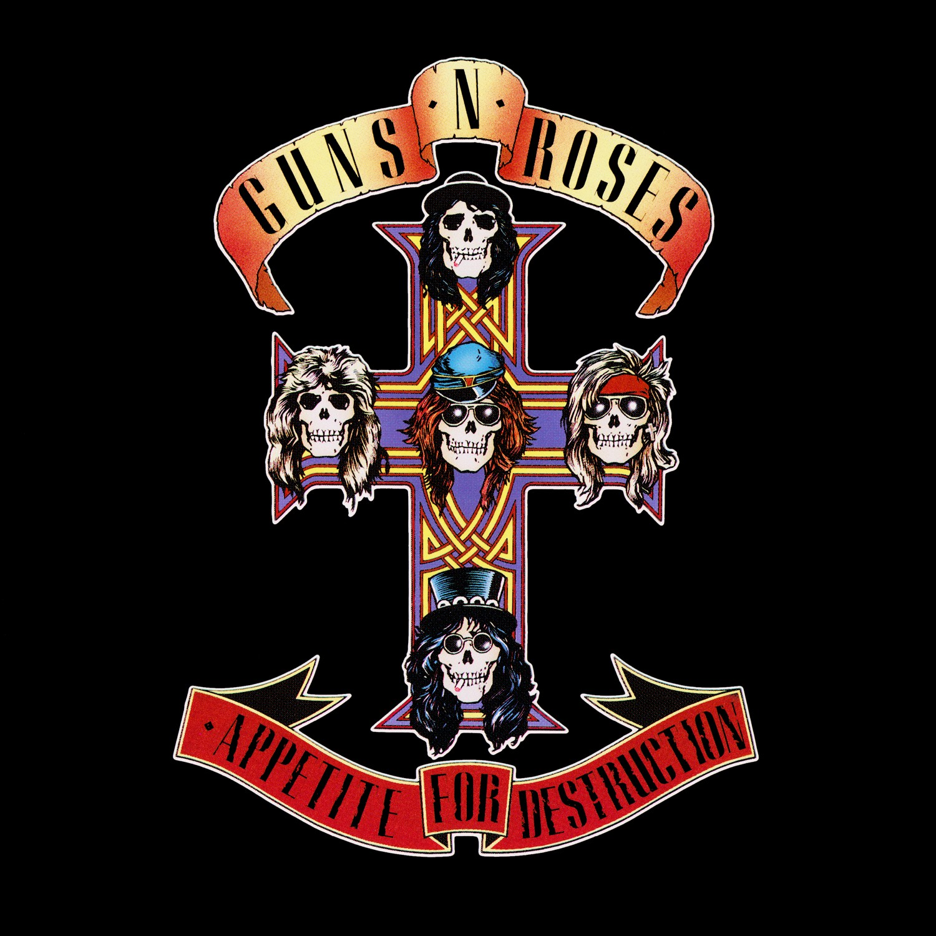
Gun N’ Roses
Guns N' Roses was formed in March 1985 by Axel Rose and rhythm guitarist Stradlin, along with the lead guitarist Tracii Guns, the bassist Ole Beich, and the drummer Rob Gardner.
The band coined its name by combining the names of both previous groups. Rejected names for the band included "Heads of Amazon" and "AIDS".
Biggest hits:
„Welcome to the Jungle" - September 28, 1987
„Sweet Child of Mine" - August 17, 1988
„Yesterdays" - 1993
„Out Ta Get Me" - July 21, 1987

Slide 15
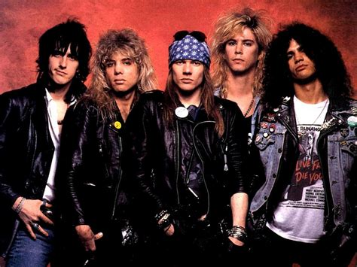
Gun N’ Roses
Members:
Axl Rose (February 6, 1962 [) - lead vocal, piano (since 1985)
Michael McKagan (February 5, 1964) - bass guitar, supporting vocal (1985-1997, 2014, since 2016)
Saul Hudson (July 23, 1965) - lead guitar, supporting vocal (1985-1996, since 2016)
Darren Reed (June 18, 1963) - keyboards, supporting vocal (since 1990)
Richard Fortus (November 17, 1966) - rhythm guitar (since 2002)
Frank Ferrer (March 25, 1966) - drums, percussion instruments (since 2006)
Melissa Reese (March 1, 1985) - keyboards, supporting vocal (since 2016)
July 21, 1987

Slide 16
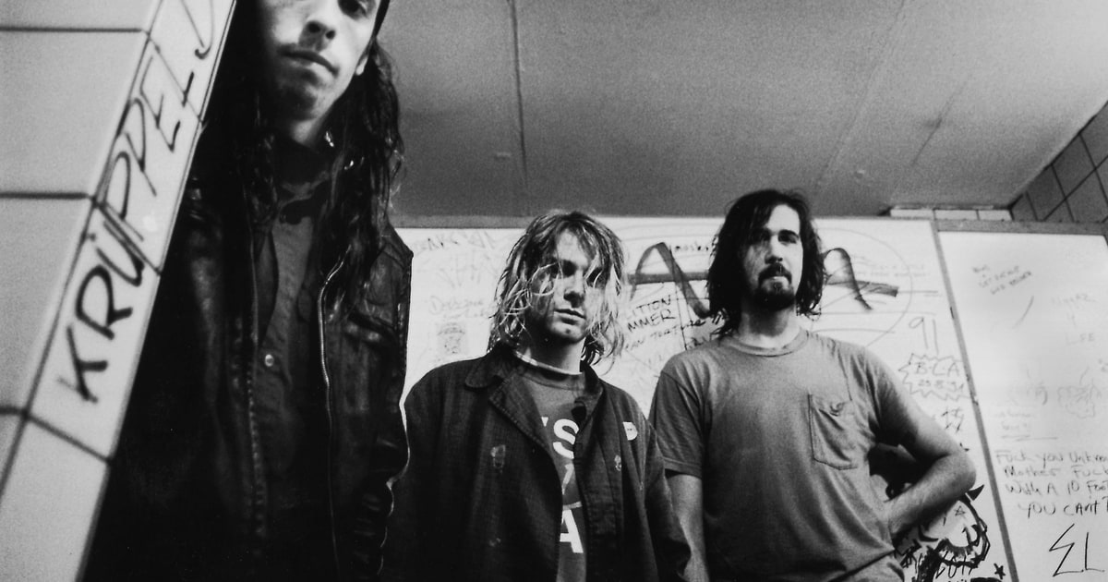
Nirvana
Current members:
Kurt Cobain (February 20, 1967) - singing, guitar (1987-1994)
Krist Novoselic (May 16, 1965) - bass guitar (1987-1994)
Dave Grohl (January 14, 1969) - drums, supporting vocal (1990-1994)
Biggest hits:
„Smells Like Teen Spirit" - September 10, 1991
„Apologies" - 6 December 1993
„About a Girl" - October 24, 1994
„Heart-Shaped Box" - August 30, 1993
November 3, 2009

Slide 17
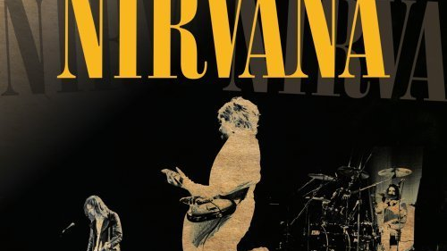
Nirvana
Cobain and Novoselic met while attending Aberdeen High school
The pair eventually became friends.
Cobain wanted to form a band with Novoselic, but Novoselic did not respond for a long time.
Three years after the two first met, Novoselic told Cobain that he had finally listened to the Fecal Matter demo and suggested they start a group.
In early 1987, Cobain and Novoselic recruited drummer Aaron Burckhard. The three practiced material from Cobain's Fecal Matter tape but started writing new material soon after forming.

Slide 18
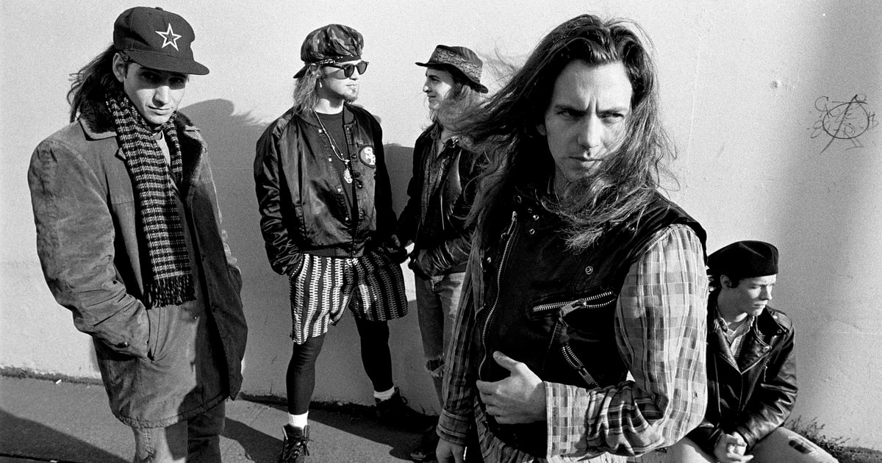
Pearl Jam
Members:
Eddie Vedder (December 23, 1964) – lead vocals, rhythm guitar (since 1990)
Mike McCready (April 5, 1966) – lead guitar, backing vocals (since 1990)
Stone Gossard (July 20, 1966) – rhythm guitar, backing vocals (since 1990)
Jeff Ament (March 10, 1963) – bass, backing vocals (since 1990)
Matt Cameron (November 28, 1962) – drums, percussion, backing vocals (since 1998)
The group played their first offficial show at the Off Ramp Cafe in Seattle in 1990.
Supposedly they named their band after Vedder’s grandmother Pearl who made a wonderful jam.
They recorded their debut album Ten in 1991
With this album Pearl Jam became a key member of the Seattle grunge explosion along with Alice in Chain, Nirvana and Soundgarden
November 22, 1994

Slide 19
Pearl Jam
Biggest hits:
„Black” - August 27, 1991
„Even Flow” - April 6, 1992
„Alive” - 1991
„Jeremy” - September 27, 1992

Slide 20
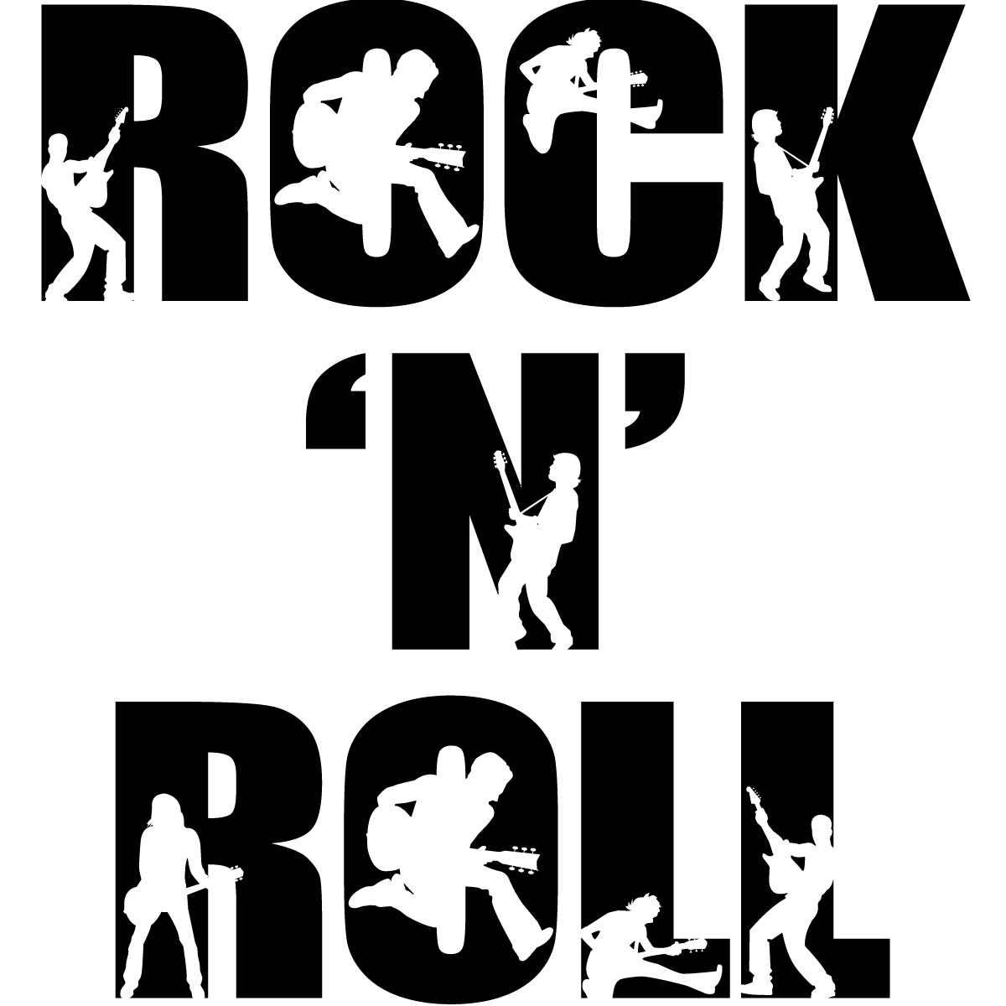
Thanks for watching

