Slide 1
FAMoUS ACTORs OF THE USA
Łukasz Paduch
Suppervised by:
Małgorzata Stasińska

Slide 2
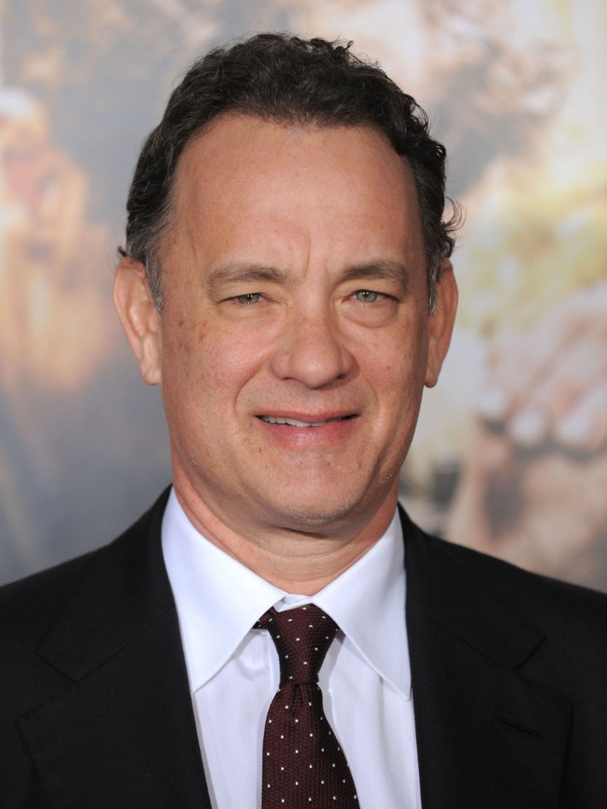
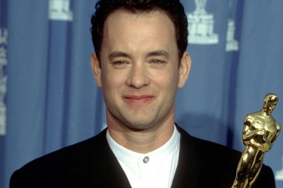
TOM HANKS

Slide 3
TOM HANKS
He was born on July 9th 1956 . He is an American actor, director, a film producer and a writer.
He was born as Thomas Jeffrey Hanks.
He began his acting career in 1993 in Philadelphia.
Some of this most successful films include:
Forrest Gump (1994) Apollo 13 (1995),
Sleepless in Seattle (1993),
Saving Private Ryan (1998),
You’ve got mail (1998),
Green Mile (1999),
Cast Away (2000),
Catch me if you can (2002),
Terminal (2004)
The Da Vinci Code (2006),
Cloud Atlas (2012),
Captain Phllips (2013).
Academy Awards (Oscars) in category Best Actor for Philadelphia (1993) and Forest Gump (1994).
Golden Globes Best Actor for Big (1989), Philadelphia (1993), Forest Gump (1994),Cast Away (2000)
Silver Bear in Berlin for Philadelphia (1994)

Slide 4
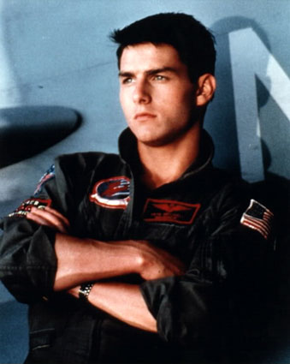
TOM CRUISE

Slide 5
Tom Cruise
He was born on July 3rd 1962. He is an American actor and a film producer.
He was born as Thomas Cruise Mapother IV.
He began his acting career in 1983 in Risky business. Some of this most successful films include:
Risky business (1983),
Top Gun (1986),
Rain Man (1988),
Born on July 4th (1989),
Firm (1993),
The Intrview with a vampire (1994),
Mission Impossible (1996, 2000, 2006, 2011, 2015),
Jerry Maguire 1996),
Eyes Wide Closed (1999),
The Minority Report (2002),
The Last Samurai (2003),
Valkirie (2008),
Worlds War (2005),
Jack Reacher (2012, 2016)
Golden Globe for the Best Actor in Born on July 4th (1989), Jerry Maguire 1996)
Golden Globe for the best supporting actor in Magnolia (1999)

Slide 6
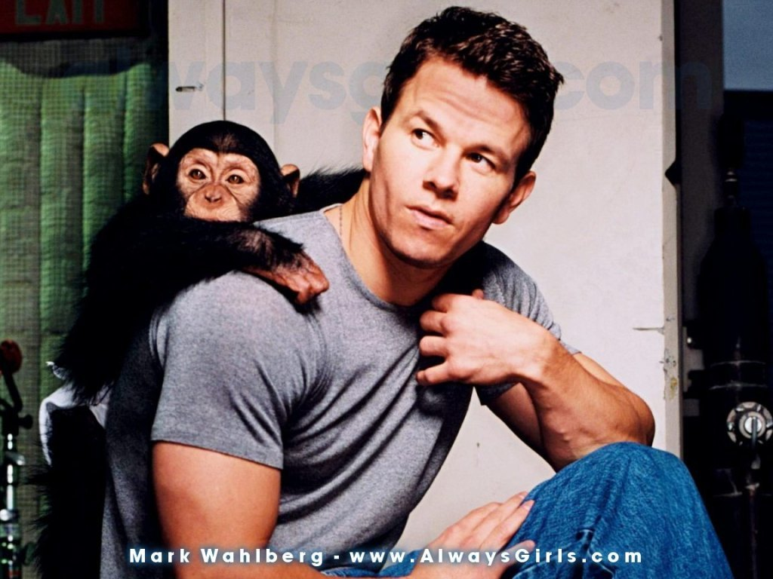
MARK WAHLBERG

Slide 7
Mark Wahlberg
He was born on June 5th 1971 . He is an American actor, a film producer, a rapper and a model.
He is known by his stage name Marky Mark.
He began his acting career in 1993. Some of this most critically successful films include:
Boogie Nights (1997)
The perfect storm (2000)
Planet of apes (2001)
The Italian job (2003)
The Deported (2006)
The Fighter (2010)
Transformers (2014,2017)
British Academy Television Award for the Best International Programme Entourage (2007).

Slide 8
THANK YOU FOR YOUR ATTENTION

