Slide 1
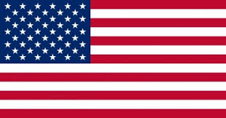
JOHN FITZGERALD KENNEDY

Slide 2
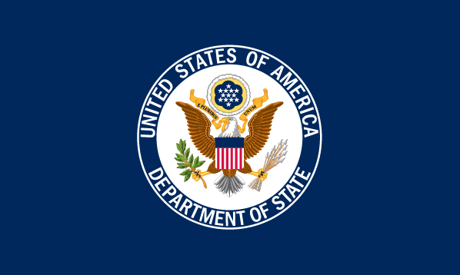
JOHN FITZGERALD KENNEDY
AUTHOR
RAFAŁ KAMIŃSKI
SUPPERVISED BY:
MAŁGORZATA STASIŃSKA

Slide 3
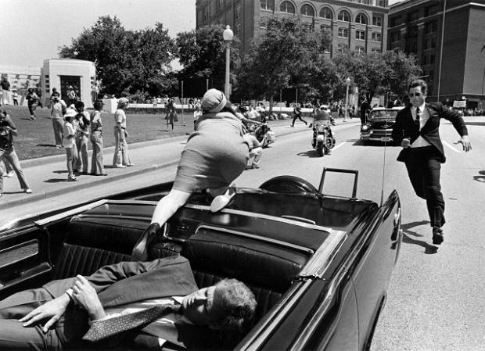
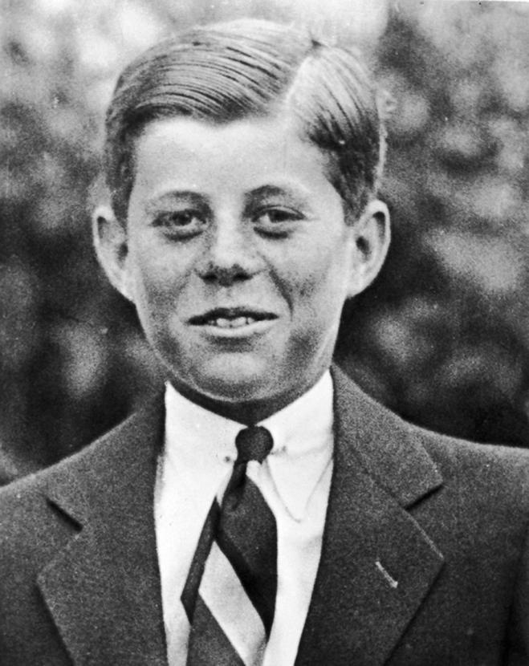
DATE OF BIRTH AND DEATH
35th US President John Fitzgerald Kennedy was born on 29th May 1917 in Brookline, Massachusetts. The president died in an assassination in Dallas, Texas on 22 ^{th} November 1963. Lee Harvey Oswald was charged with his assassination.

Slide 4
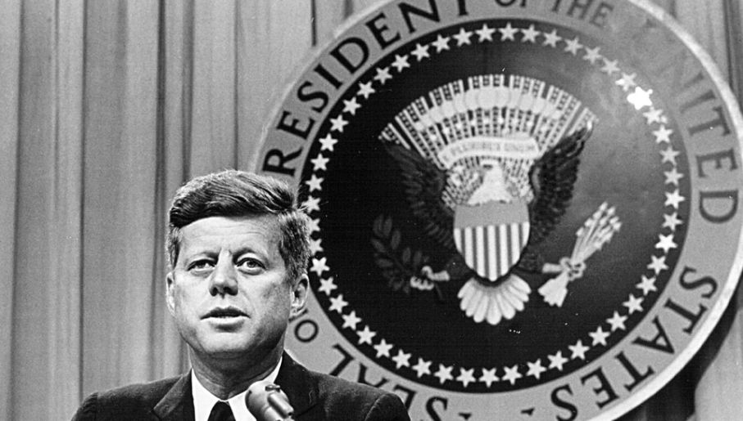
35th US PRESIDENT
John Kennedy was elected the president in 1961. He was the 35th President of the United States.

Slide 5
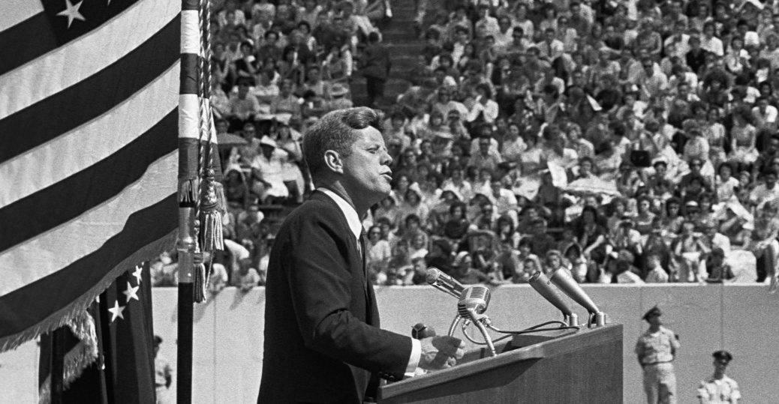
DATES OF PRESIDENCY
John Kennedy governed the US from 20th January 1961 to 22nd November 1963. The president ruled less than a full term because he was shot dead during his term.

Slide 6
POLITICAL PARTY
President John F. Kennedy belonged to the Democratic Party.

Slide 7
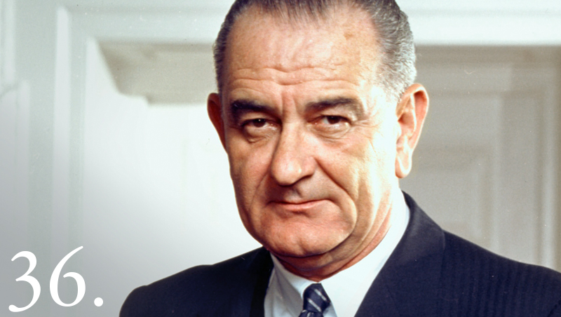
VICE-PRESIDENT
The US vice president during the presidency of John Fitzgerald Kennedy was Lyndon Baines Johnson. After the death of Kennedy, he became the 36th president of the United States. He held this office until 1969.

Slide 8
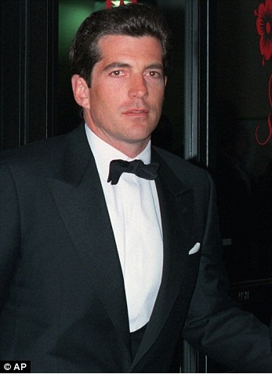
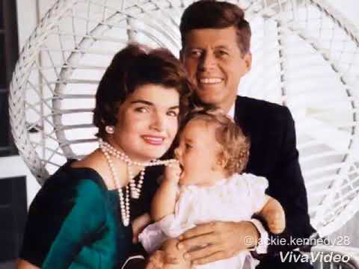
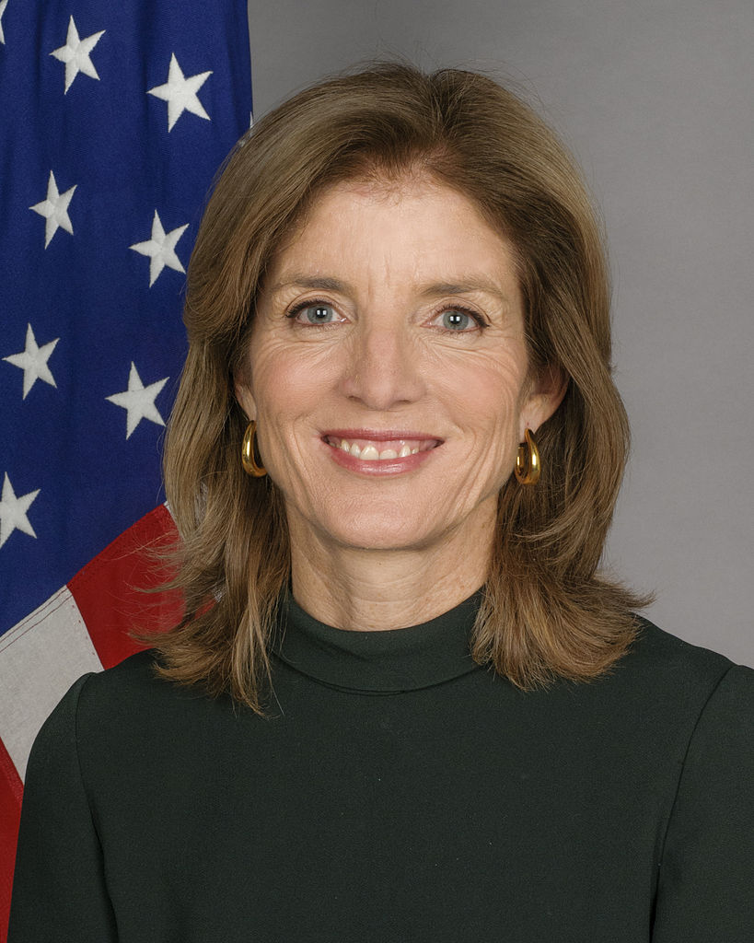
WIFE AND CHILDREN
Jacqueline Lee "Jackie" Bouvier became the wife of John Kennedy in 1953. She was the first lady from 1961 to 1963.They had three children: Caroline (born in 1957), John Fitzgerald Jr. (born in 1960 died 1999 in a plane crash) and Patrick Bouvier (born in 1963, died two days after childbirth).

Slide 9
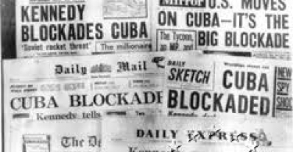
KENNEDY'S PRESIDENCY
President John Kennedy was the author of famous words that are still cited by politicians from around the world: "Do not ask what your country can do for you, ask what you can do for your country." John Kennedy created the Peace Corps. He introduced a ban on nuclear weapons tests. In 1962, during the Cuba Crisis, his decisive influence forced the Russians to withdraw their nuclear missiles from Cuba.
To zdjęcie, autor: Nieznany autor, licencja: CC BY-SA

