Slide 1
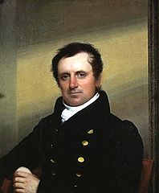
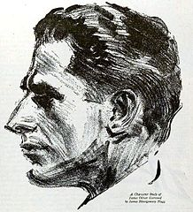
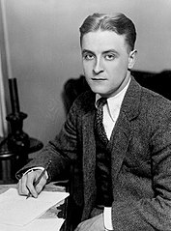
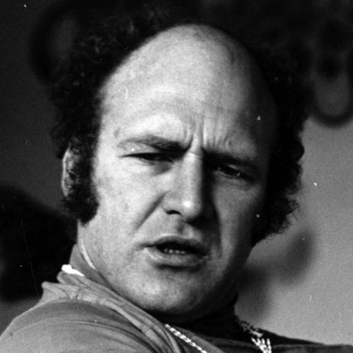
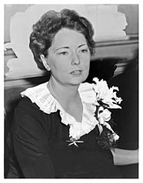
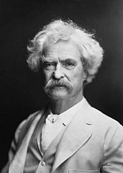
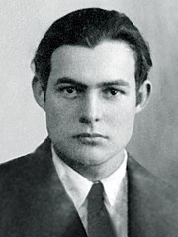
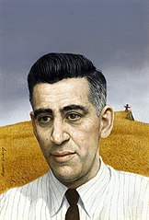
Famous writers
Author: Alicja
Zając
Suppervised by:
M. Stasińska

Slide 2

James F. Cooper
Name: James Fenimore Cooper
The date of birth: 15th September 1789
The date of death: 14th September 1851
He debuted as an anonim in 1820 with the novel Care (Ostrożność).
Books:
White fang – Biały Kieł
Leather-Stocking Tales
Opowieści Skórzanej Pończochy
Pięcioksiąg przygód Sokolego Oka
Paluch szatana (Satan's finger)
Pojęcie o Amerykanach 1828 (The concept of Americans)
Czerwony korsarz 1827 (Red corsair)

Slide 3
James O. Curwood
Name: James Oliver Curwood
The date of birth: 12th June 1878
The date of death: 13rd August 1927
In 1908 he published his first book The Courage of Captain Plum (Śród Mormonów).
Books:
Nomads of the North
Włóczęgi Północy 1919
Kazan
Szara Wilczyca 1914
The Wolf Hunters
Łowcy wilków 1908
The Gold Hunters
Łowcy złota 1909
The Valley of Silent Men
Dolina Ludzi Milczących 1920
Isobel: A Romance of the Northern Trail
Najdziksze serca 1913

Slide 4
Mark Twain
Name: Mark Twain
Real name: Samuel Langhorne Clemens
The date of birth: 30th November 1835
The date of death: 21nd April 1910
Books:
The Adventures of Tom Sawyer
Przygody Tomka Sawyera 1876
Nourman Taurog and George Cukor made a film based on this book in 1938.
The Adventures of Huckelberry Finn
Przygody Hucka Finna 1884
Life on the Mississippi
Życie na Missisipi 1883
The Celebrated Jumping Frog of Calaveras County
O sławnej skaczącej żabie z Calaveras 1885
It was his first story and he debuted with it as a journalist.

Slide 5
Francis Scott Fitzgerald
Name: Francis Scott Fitzgerald
The date of birth: 24th September 1896
The date of death: 21st December 1940
This Side of Paradise
Po tej stronie raju 1920
The Beautiful and Damned
Piękni i przeklęci 1922
The Great Gatsby
Wielki Gatsby 1925
Tender is the Night
Czuła jest noc 1934
The Love of the Last Tycoon
Ostatni z wielkich 1941
He also wrote a lot of stories, in Poland were published:
Historia jednego wyjazdu (1962)
Odwiedziny w Babilonie (1963)
Popołudnie pisarza i inne opowiadania (1989)
In Poland there were also published the letters to his daughter - Francis Scott Fitzgerald. Listy do córki (1982).

Slide 6
Margaret Mitchell
Name: Margaret Munnerlyn Mitchell Marsh
The date of birth: 8th November 1900
The date of death: 16th August 1949
Mitchell started writing a novel, which was her biggest bestseller „Gone with the wind” in 1926 when she couldn’t leave the bed because she was ill. Her husband, John Marsh, bought her first used typewriter.
She was featured in 1937 with Pulitzer Prize for Gone with the Wind (Przeminęło z wiatrem).
In 1939 a film based on the book was directed by Victor Fleming.
She was awarded:
National Book Award (1936)
Pulitzer Prize (1937)
Shining Light Award
In 2000 a collection of stories and novels Before Scarlett which she wrote when she was between 7 and 18 years old was published.

Slide 7
Ernest Hemingway
Name: Ernest Miller Hemingway
The date of birth: 21st July 1899
The date of death: 2nd July 1961
The most of his novels were translated in Polish
by his friend – Bronisław Zieliński.
Novels
The Torrents of Spring Wiosenne potoki 1926
The Sun Also Rises Słońce też wschodzi 1926
A Farewell to Arms Pożegnanie z bronią 1929
To Have and To Have Not Mieć i nie mieć 1937
Across the River and Into the Trees
Za rzekę, w cień drzew 1950
For Whom the Bell Tolls Komu bije dzwon 1940
Posthumously (pośmiertnie)
Islands in the Stream Wyspy na Golfsztromie 1970
The Garden of Eden Rajski ogród 1986
Hemingway was a journalist, a writer, a hunter and a traveller. He was also a soldier and an abulance driver. He survived two plane crashes and he got a Nobel Prize for literature. Unfortunately he had a depression and shot himself.

Slide 8

Stories
Three Stories and Ten Poems, 1923
In Our Time, 1925
Men Without Women, 1927
Winner Take Nothing, 1933
The Essential Hemingway, 1947
The Snows of Kilimanjaro and Other Stories, 1961
The Nick Adams Stories, 1972
The Complete Short Stories of Ernest Hemingway, 1987
Other
The Fifth Column and the First Forty-Nine Stories, 1938 (Piąta kolumna, 1999)
Death in the Afternoon (Śmierć po południu, 1932)
The Green Hills of Africa (Zielone wzgórza Afryki, 1935)
Hemingway, The Wild Years, 1962
A Moveable Feast (Ruchome święto, 1964)
By-Line: Ernest Hemingway, 1967
Ernest Hemingway: Cub Reporter, 1970
88 Poems, 1979
The Dangerous Summer, 1985
Dateline: Toronto, 1985
True at First Light, 1999 (To co prawdziwe o świcie)
Under Kilimanjaro, 2005

Slide 9

Film adaptations
(1932) Pożegnanie z bronią (Gary Cooper, Helen Hayes)
(1943) Komu bije dzwon (Gary Cooper, Ingrid Bergman)
(1944) Mieć i nie mieć (Humphrey Bogart, Lauren Bacall)
(1946) Zabójcy (Burt Lancaster)
(1947) The Macomber Affair (Gregory Peck, Joan Bennett)
(1950) The Breaking Point (John Garfield, Patricia Neal)
(1950) Under My Skin (John Garfield)
(1952) Śniegi Kilimandżaro (Gregory Peck, Susan Hayward)
(1957) Pożegnanie z bronią (Rock Hudson, Jennifer Jones)
(1957) Słońce też wschodzi (Tyrone Power, Ava Gardner)
(1958) Stary człowiek i morze (Spencer Tracy)
(1962) Przygody młodego człowieka (Richard Beymer)
(1964) Zabójcy (Lee Marvin)
(1977) Wyspy na Golfsztromie (George C. Scott)
(1990) Stary człowiek i morze (Anthony Quinn)
(1999) Stary człowiek i morze (Aleksandr Pietrow)
(2008) The Garden of Eden (Mena Suvari, Jack Huston)

Slide 10
Jerome David Salinger
Name: Jerome David Salinger
The date of birth: 1st January 1919
The date of death: 27th January 2010
He started writing when he was 15. His only published novel is The Catcher in the Rye.
The Catcher in the Rye Buszujący w zbożu 1951
Nine Stories Dziewięć opowiadań 1953
Franny and Zooey Franny i Zooey 1961
Raise High the Roof Beam, Carpenters and Seymour: An Introduction Wyżej podnieście strop, cieśle i Seymour – introdukcja 1963
"A Perfect Day for Bananafish", 1948 ("Idealny dzień na ryby’’)
"Uncle Wiggily in Connecticut", 1948 ("Pan Kostek w Connecticut")
"W przeddzień wojny z Eskimosami" (1948)
"The Laughing Man", 1949 ("Człowiek Śmiechu")
"Down at the Dinghy", 1949 ("Nad jeziorem")
"For Esmé – with Love and Squalor", 1950 ("Opowiadanie dla Esmé")
"Pretty Mouth and Green My Eyes", 1951 ("Śliczne usta moje i oczy zielone")
"De Daumier-Smith's Blue Period", 1952 ("Niebieski okres de Daumier-Smitha")
"Teddy" (1953)
"Franny" 1955
"Zooey" 1957

Slide 11

Stories
"Go See Eddie"
"The Hang of It"
"The Long Debut of Lois Taggett"
"A Boy in France"
"This Sandwich Has No Mayonnaise"
"A Girl I Knew"
"Slight Rebellion off Madison"
"The Young Folks" (1940)
"The Heart of a Broken Story" (1941)
"Personal Notes of an Infantryman" (1942)
"The Varioni Brothers" (1943)
"Both Parties Concerned" (1944)
"Soft-Boiled Sergeant" (1944)
"Last Day of the Last Furlough" (1944)
"Once a Week Won't Kill You" (1944)
"Elaine" (1945)
"The Stranger" (1945)
"I'm Crazy" (1945)
"A Young Girl in 1941 with No Waist at All" (1947)
"The Inverted Forest" (1947)
"Blue Melody" (1948)
"Hapworth 16, 1924" (1965)
Unpublished
"The Ocean Full of Bowling Balls" (the date is unknown)
"The Last and Best of the Peter Pans" (the date is unknown)
"Two Lonely Men" (1944)
"The Children's Echelon" (1944)
"The Magic Foxhole" (1945)

Slide 12

Ken Kesey
Name: Ken Elton Kesey
The date of birth: 17th September 1935
The date of death: 10th November 2001
He said about himself: I’m too young to be a beatnik but too old to be a hippis.
a young person in the 1950s and early 1960s belonging to a subculture associated with the beat generation
His first novel was One Flew Over the Cuckoo’s Nest. It was sold in 8 million copies in the United States.
One Flew Over the Cuckoo’s Nest Lot nad kukułczym gniazdem 1962
Sometimes a Great Notion Czasem wielka chętka 1964
Kesey’s Garage Sale 1973
Demon Box 1986
Little Tricker the Squirrel Meets Big Double the Bear 1990
The Sea Lion 1991
Pieśń żeglarzy 1992

Slide 13

The end

