Slide 1
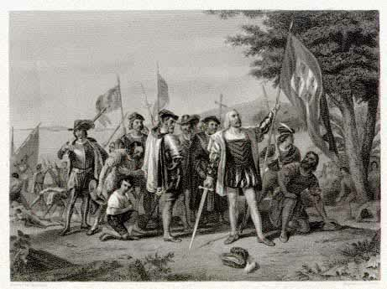
THE Discovery of America
Anna Antczak, Angelika Kowalińska, Robert Pawłowski III a
SUPPERVISED BY MAŁGORZATA STASIŃSKA

Slide 2
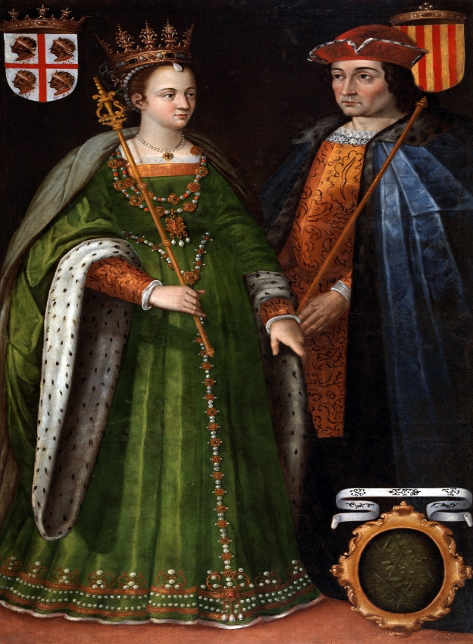
The Discovery of America involves the voyages of discovery of many famous and courageous explorers of America who undertook the 3000 mile journey from Europe to North America across perilous, unchartered seas. These adventurous men were searching for:
New trade routes
New enterprises and riches
New lands to build an empire for their mother country
Many were looking to spread Christianity among
indigenous people
Queen Isabelle and King Ferdinand - the sponsors of
Christopher Columbus’s first voyage to the New World
To zdjęcie, autor: Nieznany autor, licencja: CC BY-SA

Slide 3
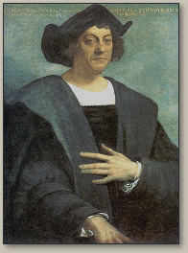
1492
Christopher Columbus was an Italian explorer, navigator, and colonizer. Under the auspices of the Catholic Monarchs of Spain, he completed four voyages across the Atlantic Ocean that led to general European awareness of the American continents. Those voyages, and his efforts to establish permanent settlements on the island of Hispaniola, initiated the Spanish colonization of the New World.

Slide 4
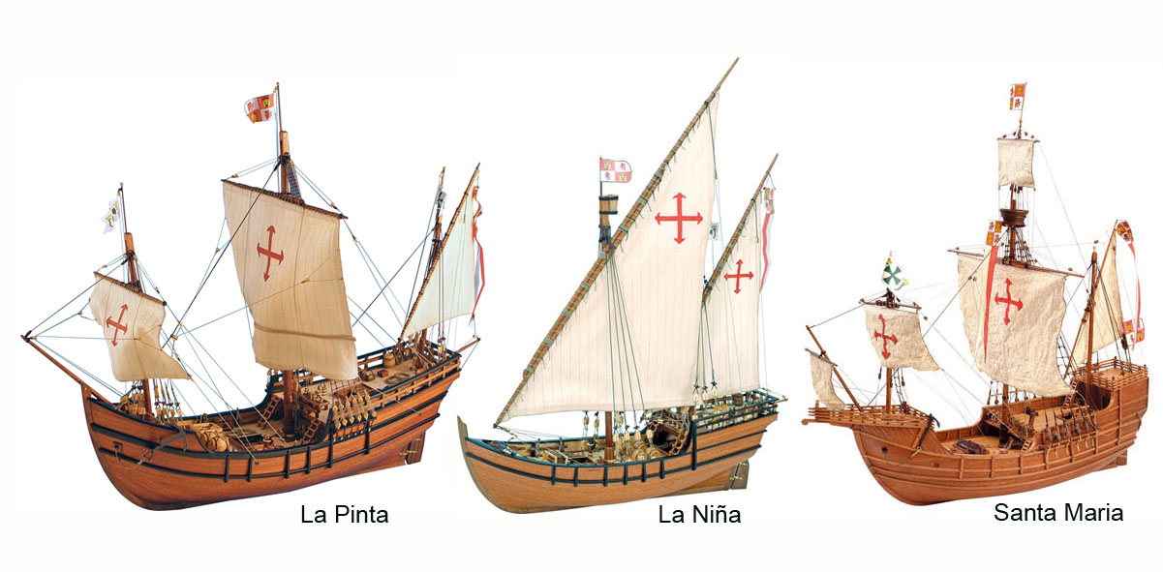
The first voyage
Christopher Columbus using his cartographic knowledge, came to the conclusion that to find the way to eastern Asia, specifically to India, he has to go west, across the Atlantic Ocean. Since then, he began to try to organize the expedition and to prove the validity of his believes. However, European rulers did not seem to like the idea. It was not until Queen Isabella I of Castile decided to finance the expedition, then he went on the voyage.
The journey began in 1492, Christopher Columbus received three well-equipped ships - Pinta, Nina and Santa Maria from the Castilian queen .
The sailors stopped for a short time off the coast of Africa and then turned to the west. It was September 6th, 1492.

Slide 5
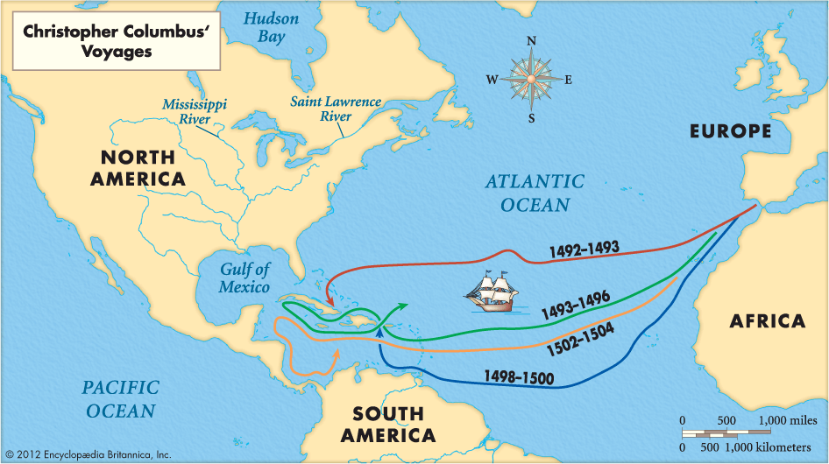
The history of the discovery.
After some weeks, the travelers began to worry, there was no land in sight. They decided to turn back from their path but Columbus insisted on continuing the trip. And he was right. On October 12th, 1492, one of the sailors saw the land ahead. Everybody cheered.
However, Columbus to his dying days, did not know, that he did not sail to India, but discovered a completely new continent. Thinking that came to India he even called the natives whom he met- Indians.
It was long after his death, that successive researchers and explorers, among them Amerigo Vespucci, learned that it was a really new continent.

Slide 6
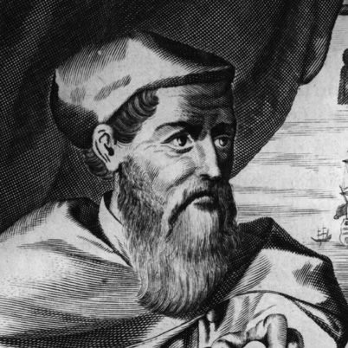
The story continues
20 years after the death of Christopher Columbus, a cartographer Amerigo Vespucci stated that the continent visited by him, wasn’t Asia, but a new so far unknown to Europeans land.
Because Vespucci was the first person who guessed it, the “new land” was named in his honour.
Even though he wasn’t there, even once.

Slide 7
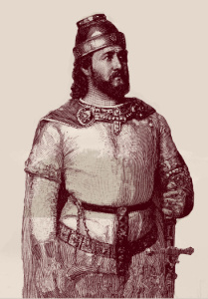
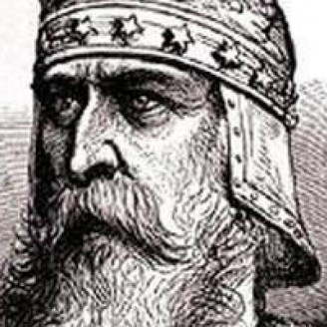
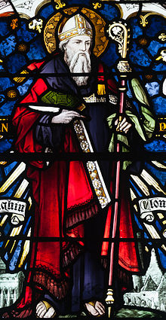
Other theories about the discovery of America.
In 500 AD an Irish monk, Saint Brendan, left Ireland on a seven-year sea journey, in search of the Garden of Eden. When he reached America he walked for 40 days to find the opposite coast, but when he couldn’t find it, he returned home.
A welsh Prince Madoc, left Wales in 1176 to escape fighting. He returned some years later speaking of a „warm and golden land, far across the sea”
A Viking Leif Erikson travelled to North America in 1001 AD. Erikson grow up in Iceland. When his father was banished from Iceland by the Viking council, his family set sail and discovered Greenland. When Leif grew up he discovered Newfoundland in Canada.

Slide 8
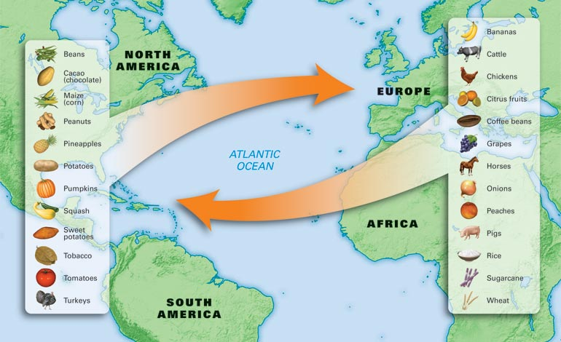
Colonization of America
The famous European explorers came from England, Spain, Italy, Portugal and France - The voyages of the first explorers and the countries of Europe were motivated by various reasons, the foremost being to build great empires - which led to the Colonization of America. They thought they will find gold but instead they found many other useful things such as :

Slide 9
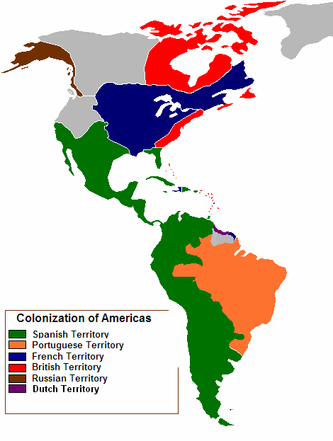
Colonization of America in the 1500's
During the 1500's the Colonization of America was left almost entirely to Spain. Their program of colonization concentrated on South America but the Spanish also explored the regions of New Mexico and Texas and had established the Spanish colony of St. Augustine, in Florida. The Colonization of South America also had a significant presence from the Portuguese. North America, from the Gulf of Mexico to the Arctic Ocean, had not been explored and the lands were inhabited by the Native Indian Tribes.

Slide 10
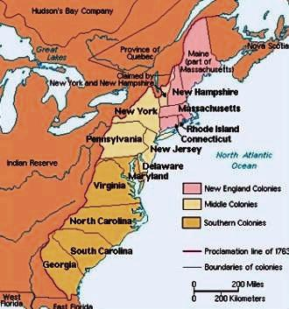
The 1600's saw the first era of the Colonization of America which was mainly undertaken by England and France and to a minor extent by the Netherlands and Sweden. The first 13 Colonies were established by English people and consisted of Delaware, Pennsylvania, Massachusetts Bay Colony (which included Maine), New Jersey, Georgia, Connecticut, Maryland, South Carolina, New Hampshire, Virginia, New York, North Carolina, and Rhode Island and Providence Plantations.

Slide 11
The End
Thanks for watching

