Slide 1
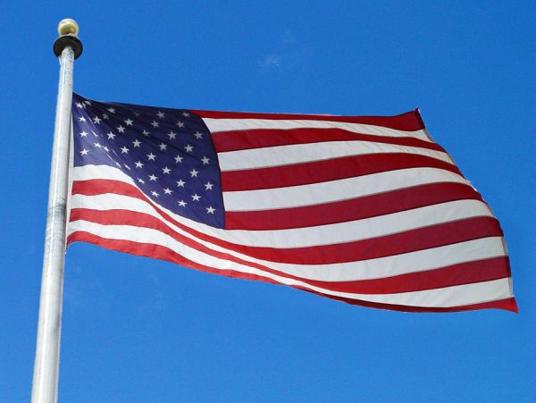
The United States Of America
Agata Pokora
Karolina Witczak
Klaudia Kowalska
Suppervised by Małgorzata Stasińska

Slide 2
The story of the U.S. national anthem
The Star-Spangled Banner is the national anthem of the United States.
Lyrics to the tune of John Stafford Smith from 1780 were written by Francis Scott Key in 1814 when he was a witness of the British bombardment of Fort McHenry near Baltimore .
The American mediator and lawyer - Francis Scott Key, was detained while trying to negotiate watched the shelling of Baltimore by the British. On a piece of paper he wrote: „Oh, say, can you see ....”
Eventually, the British retreated and people of Baltimore, celebrating the victory, began to sing the line to a known melody by John Smith Anachreon In Heaven. It was a piece of music dedicated to the indigenous Anacreon Society of London.
The song of The Star-Spangled Banner was approved by the U.S. Congress as the official national anthem in 1931.

Slide 3
The anthem of the United States is always sung on the national stadium during the most important sporting events.

Slide 4
The Star-Spangled Banner
Oh, say can you see, by the dawn's early light,
What so proudly we hailed at the twilight's last gleaming?
Whose broad stripes and bright stars, through the perilous fight,
O'er the ramparts we watched, were so gallantly streaming?
And the rockets' red glare, the bombs bursting in air,
Gave proof through the night that our flag was still there.
Chorus:
O say, does that star-spangled banner yet wave
O'er the land of the free and the home of the brave?
On the shore, dimly seen through the mists of the deep,
Where the foe's haughty host in dread silence reposes,
What is that which the breeze, o'er the towering steep,
As it fitfully blows, now conceals, now discloses?
Now it catches the gleam of the morning's first beam,
In full glory reflected now shines on the stream:
Chorus
And where is that band who so vauntingly swore
That the havoc of war and the battle's confusion
A home and a country should leave us no more?
Their blood has wiped out their foul footstep's pollution.
No refuge could save the hireling and slave
From the terror of flight, or the gloom of the grave:
Chorus
Oh! thus be it ever, when freemen shall stand
Between their loved home and the war's desolation!
Blest with victory and peace, may the heaven-rescued land
Praise the Power that hath made and preserved us a nation.
Then conquer we must, when our cause it is just,
And this be our motto: "In God is our trust."
Chorus

Slide 5
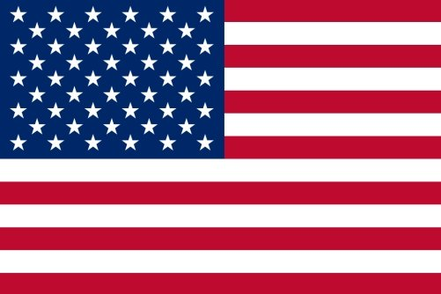
Flag of United States
The national flag of the United States of America, consists of thirteen equal horizontal stripes of red (top and bottom) alternating with white, with a blue rectangle in the canton bearing fifty small, white, five-pointed stars arranged in nine offset horizontal rows of six stars alternating with rows of five stars.
The 50 stars on the flag represent the 50 states of the United States of America and the 13 stripes represent the original thirteen British colonies .

Slide 6
How did the flag of the United States changed with every new state?

Slide 10
The American Revolutionary War (1775–1783)
The American War of Independence, began as a war between the Kingdom of Great Britain and the Thirteen Colonies, but gradually grew into a world war between Britain on one side and the newly formed United States, France, Netherlands and Spain on the other. The main result was an American victory and European recognition of the independence of the United States.

Slide 11
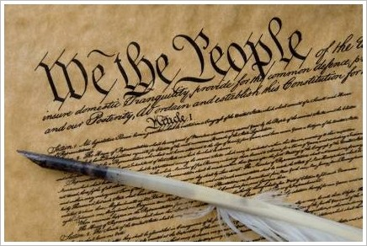
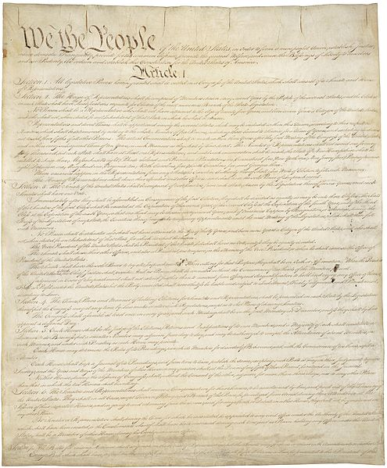
The Constitution was adopted on September 17, 1787

Slide 12
The Constitution of the United States is the supreme law of the United States of America. The first three Articles of the Constitution establish the rules and separate powers of the three branches of the federal government:
- a legislature, the bicameral Congress (The House of Representatives and Senate);
- an executive branch led by the President;
- a federal judiciary headed by the Supreme Court.

Slide 13
Thank you for watching ;-)

