Slide 1
The most famous places in USA.
Mateusz Jędrzejec, Łukasz Kochaniak, Natalia Wojciechowska, Michał Zapała
2012/2013
Suppervised by Małgorzata Stasińska

Slide 2
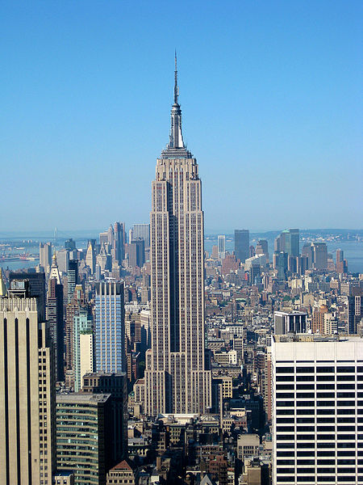
Empire State Building
The Empire State Building is a 102-story skyscraper located in New York.
It was the tallest building in the world from 1931 to 1972.

Slide 3
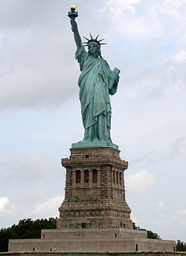
The Statue of Liberty
The Statue of Liberty is a colossal neoclassical sculpture on Liberty Island in New York Harbor, designed by Frédéric Bartholdi and dedicated to the American Nation by the French Goverment on October 28, 1886.
The face of the statue is said to be based on the face of the sculptor’s mother, who was very strict and serious. ☺

Slide 4
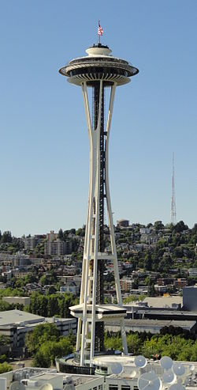
Space Needle
The Space Needle is a viewing tower in Seattle.
Located at the Seattle Center, it was built for the 1962 World Fair
During the fair, nearly 20,000 people used the elevators every day and admired the views from the tower
Over 2.3 million visitors in total came to visit the 1962 World Fair.

Slide 5
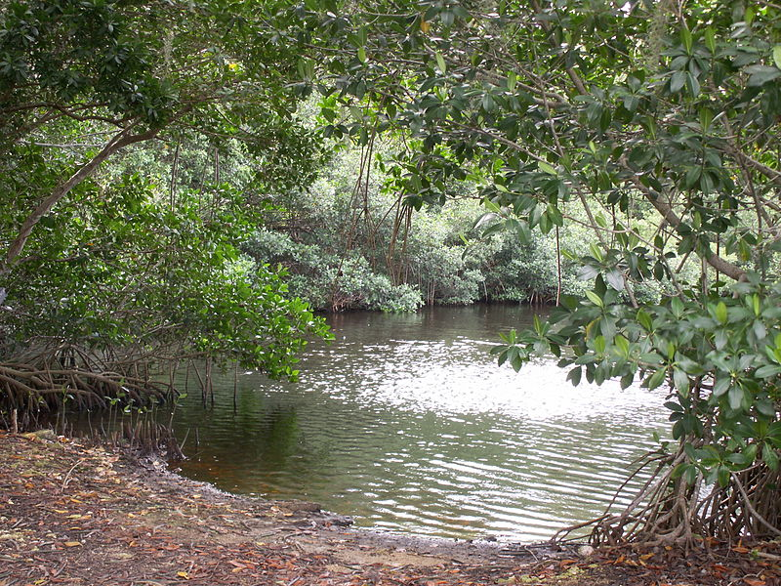
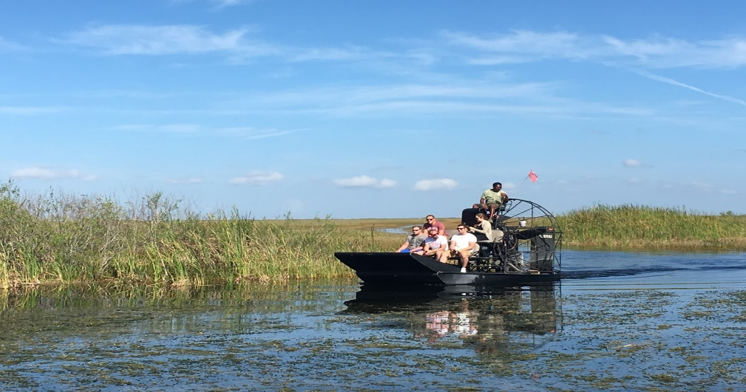
Everglades
The Everglades are a natural region of subtropical
wetlands in the southern portion of Florida Peninsula.
You can see Everglades in the title sequence of CSI: Miami

Slide 6
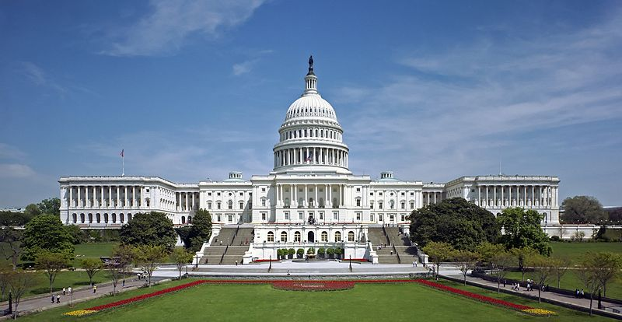
US Capitol
The United States Capitol
in Washington is the
meeting place of the
United States Congress,
the legislature of the
federal government of
the United States.
Located in Washington,
it was the fourth destination of the attacks on
11th September 2001 but the brave passangers
prevented it and died while trying to disarm the terrorists.

Slide 7
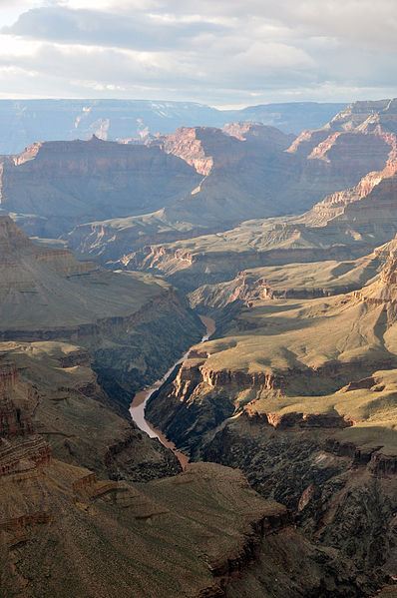
Grand Canyon
The Grand Canyon is a steep-sided canyon carved by the Colorado River in the United States in the state of Arizona.

Slide 8
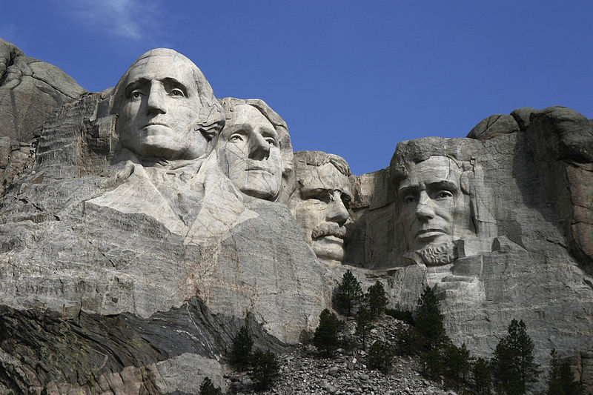
Mount Rushmore
The Mount Rushmore
National Memorial is a
sculpture carved into the
granite face of Mount
Rushmore near Keystone,
South Dakota.
The sculpture shows heads of four United States presidents:
George Washington,
Thomas Jefferson,
Theodore Roosevelt
Abraham Lincoln.

Slide 9
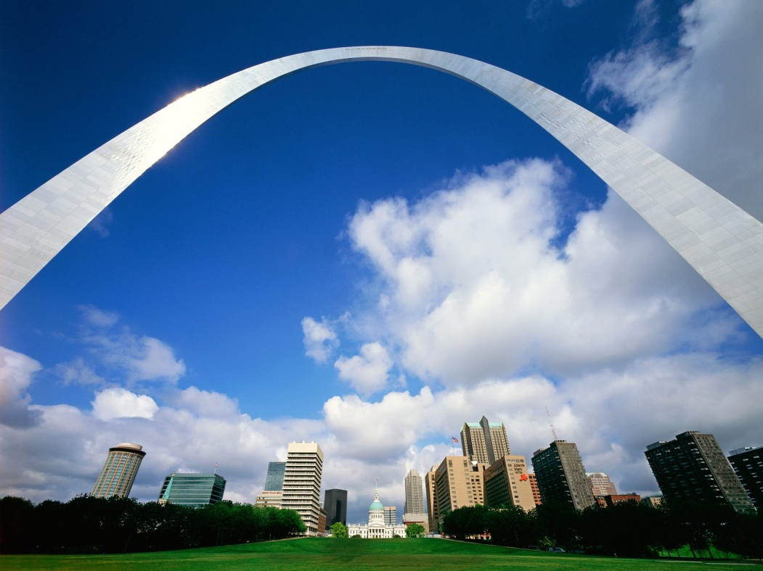
Gateway Arch
The Gateway Arch is an arch that is the centerpiece of the Jefferson National Expansion Memorial in
St. Louis, Missouri.
It was built as a monument to the westward expansion of the United States.

Slide 10
Golden Gate
Suspension bridge that connects San Francisco with Marin County, the Golden Gate Strait. Opened on May 27 in 1937. Construction of the Golden Gate Bridge began in January 1933 and lasted until 1937. The construction was extremely difficult and cost a lot of victims. The bridge was designed by an engineer Joseph Strauss.

Slide 11
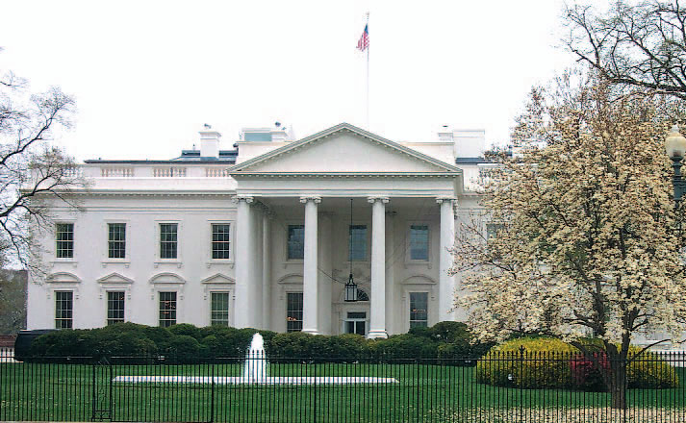
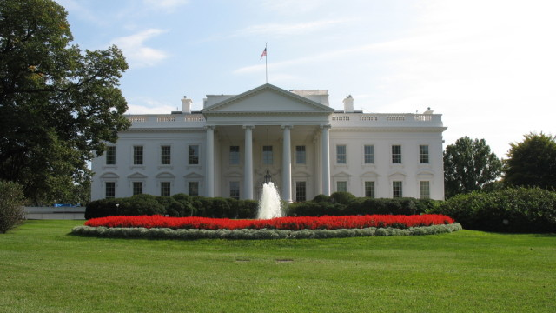
White House
The White House is the official residence and principal workplace of the President of the United States
It is located at 1600 Pennsylvania Avenue Northwest, Washington, D.C.
The name was given to the building on September , 14th 1901, by President Roosevelt.
The first president to live in it, was John Adams.

Slide 12
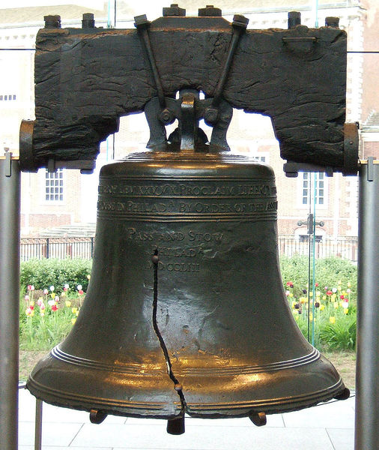
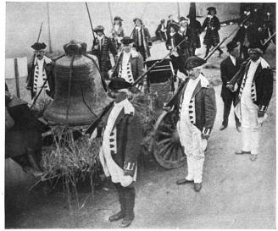
The Liberty Bell
Is an iconic symbol of American independence, located in Philadelphia, Pennsylvania.
It was bulit in 1752.

Slide 13
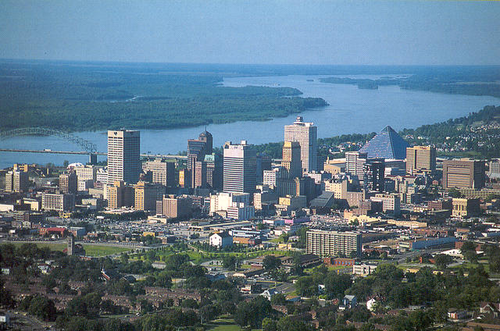
Memphis
A home town of Elvis Presley . It is a city in the south-western corner of Tennessee.
The city is located on the south of the Wolf and the Mississippi rivers.

Slide 14
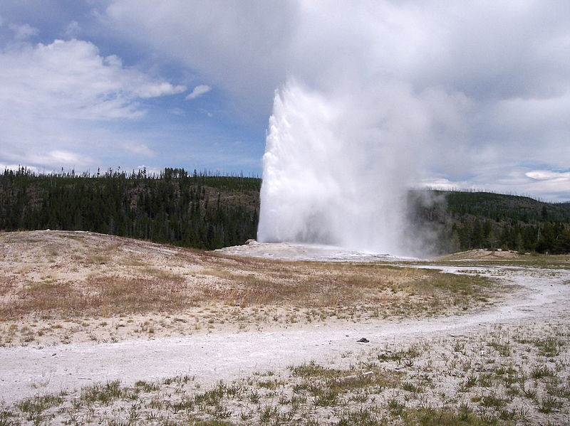
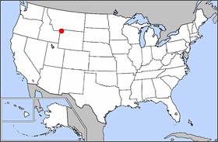
Yellowstone National Park
It is a national park located primarily in the state of Wyoming, although it also extends into Montana and Idaho.
It is the oldest national park in the world with more than 200 geisers with the most famous Old Faithful because it erupts regulary almost every hour

Slide 15
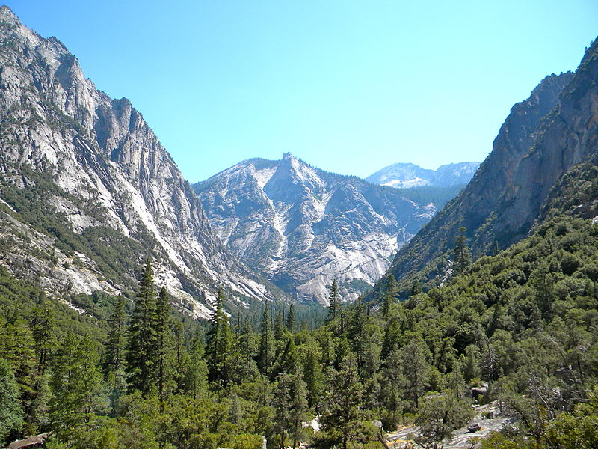
Kings Canyon National Park
Kings Canyon Park is a national park in the southern Sierra Nevada, east of Fresno, California.

Slide 16
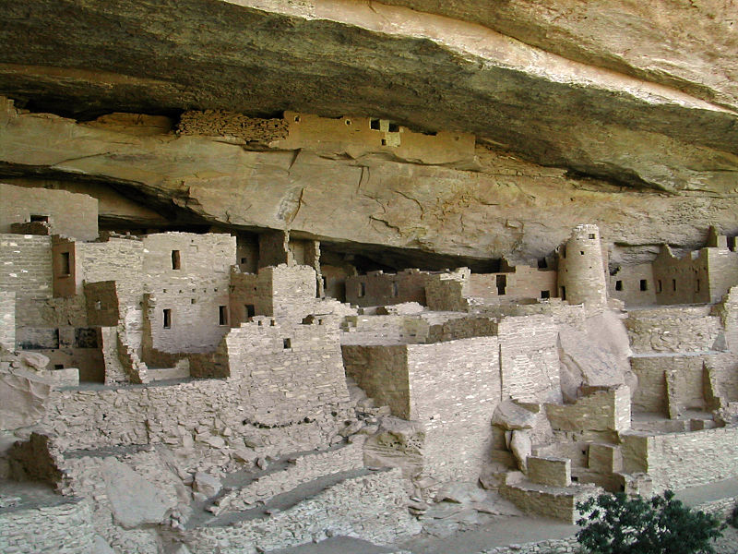
Mesa Verde National Park
It is a U.S. National Park and UNESCO World Heritage Site located in Montezuma County, Colorado, United States.

Slide 17
Thanks for watching
THE END

