Slide 1
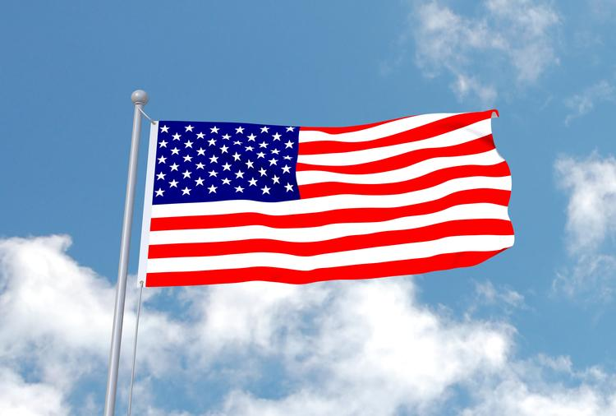
American writers
Author: Julia Miśkiewicz
Suppervised by: Małgorzata Stasińska
SZKOŁA PODSTAWOWA NR 6 IM. JANA KOCHANOWSKIEGO W ZGIERZU Z ODDZIAŁAMI DWUJĘZYCZNYMI I ODDZIAŁAMI SPORTOWYMI

Slide 2
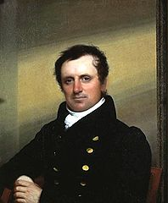
James Fenimore Cooper
James Fenimore Cooper (born September 15, 1789 in Burlington, New Jersey, died September 14, 1851 in Cooperstown, New York) - American novelist and one of the founders of American literature. Author of adventure and adventurous novels, about the battles with the Indians and the French in the second half of the eighteenth century. James Fenimore Cooper has not received any awards for his work.

Slide 3
James F. Cooper biography
He came from a wealthy landowning family, settled in a property named after the family.
His father, William, was a judge and member of the American Congress.
At the age of 14, Cooper joined the Yale University and began studying law. But in 1806 he was expelled from the University.
For five years, he served as an officer in the US Navy.
After his marriage in 1811, he retired and settled in Westchester County.
He spent five years traveling around Europe and then became a Consul in Lyon, France.
In 1826 he moved to Paris.
In 1830 he met Adam Mickiewicz in Rome and in 1831, he founded the American-Polish Committee in Paris, directing help for the November Uprising.
In addition to the novels, he wrote political essays and historical books.
In 1834 he returned to America, where he lived on his family estate.

Slide 4
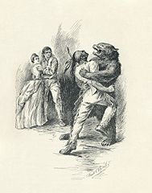
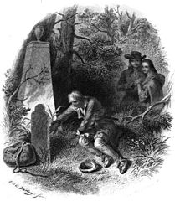
Best known novels
Ostatni Mohikanin (published in1826) (ang. The Last of the Mohicans)
Pionierowie (published in1823) (ang. The Pioneers: The Sources of the Susquehanna; a Descriptive Tale )

Slide 5
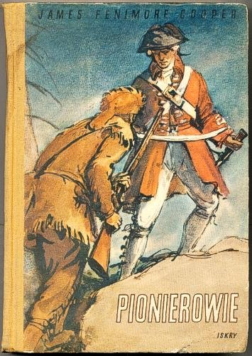
The best known novels reworked for the movies
Ostatni Mohikanin (ang. The Last of the Mohicans) – US production adventure film made in 1992.
Unfortunately, the Pioniers has not been re-made as a film.
Cast: Daniel Day-Lewis - Sokole Oko / Nathaniel Poe Madeleine Stowe - Cora Munro Russell Means Chingachgook Eric Schweig - Uncas Jodhi May - Alice Munro
Steven Waddington - Major Duncan Heyward
Wes Studi - Magua
Maurice Roëves - Pułkownik Edmund Munro

Slide 6
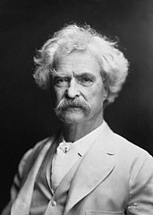
Mark Twain
Mark Twain real name Samuel Langhorne Clemens (born November 30, 1835 in Florida, d. April 21, 1910 In Redding)- an American writer of Scottish descent, satirist, humorist, and Freemason. Mark Twain has not received any awards for his work.

Slide 7
Mark Twain's biography
When Mark Twain was 12, he lost his father. For this reason, he had to find a job.
At first he was an errand boy (chłopiec na posyłki), later he worked in a printing house, educating himself as a printer.
When he was old enough he became a pilot of steamers sailing the Mississippi.
He also tried his luck as a miner in a silver mine and a gold digger.
At that time, he also made extra money by writing short articles and press reports.
He soon became famous thanks to the short story The Celebrated Jumping Frog of Calaveras County O sławnej skaczącej żabie z Calaveras 1885
His artistic talent was widely appreciated, and local newspapers commissioned him to create more and more articles.

Slide 8
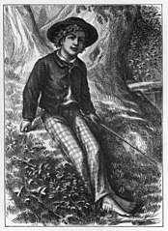
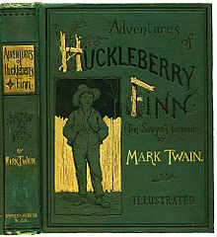
Best known novels
Przygody Tomka Sawyera (published in1876) (tytuł oryginalny The Adventures of Tom Sawyer)
Przygody Hucka Finna (published in1884) (tytuł oryginalny Adventures of Huckleberry Finn)

Slide 9
The best known novels reworked for the movies
Cast: Tommy Kelly - Tomek Sawyer
Jackie Moran - Huckelberry Finn
Mickey Rentschler - Joe Harper
Ann Girls - Becky Thacher
Mary Robson - ciotka Polly
David Solt - Sid Sawyer
Marcia Mae Jones - Mary Sawyer
The Adventures of Tom Sawyer - 1938 directed by Norman Taurog and George Cukor
Cast:
Elijah Wood - Huckleberry "Huck" Finn
Courtney B. Vance - Jim
Jason Robards - King
Robbie Coltrane - Duke
Ron Perlman - Pap Finn
Dana Ivey - Widow Douglas
Mary Louise Wilson - panna Watson
Anne Heche - Mary Jane Wilks
Paxton Whitehead - Harvey Wilks
Renée O’Connor - Julia Wilks
Laura Bundy - Susan Wilks
Daniel Tamberelli - Ben Rodgers
Garette Ratliff Henson - Billy Grangerford
The Adventures of Huck Finn- American adventure film from 1993 directed by Stephen Sommers, produced by Walt Disney Pictures. The film was made on the basis of a novel

Slide 10
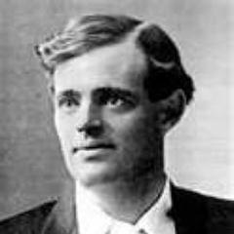
James Olivier Curwood
James Olivier Curwood (born June 12, 1878 in Owosso, Michigan, died August 13, 1927) - an American writer.
James Olivier Curwood has not received any awards for his work.

Slide 11
James O.Curwood biography
His father was related to the English marine writer Frederick Marryat, his mother - to an Indian princess from the Mohawk tribe.
At the age of 12, he set out on a long journey to neighboring states; he hunted wild animals, tried to trade skins, and above all he met and loved the wild nature that later became the background of his novels.
Between 1898-1900 Curwood studied at the University of Michigan, and then worked in Detroit as a reporter.
In 1908 he published his first book entitled "The Courage of Captain Plum". Soon, literary creativity became his passion.
He drew the material for his novels from his travels in the vast spaces of the United States and Canada.
He ventured into areas hundreds of miles from civilization, explored the hard life of trappers and gold seekers, as well as the lives of the Far North animals.

Slide 12
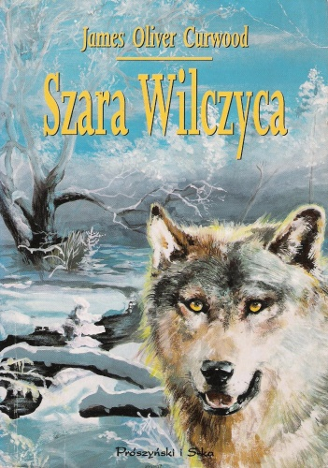
Best known novels
Szara Wilczyca (published in1914)
(ang. Kazan)
Włóczęgi północy (published in1919)
(ang. Nomads of the North)

Slide 13
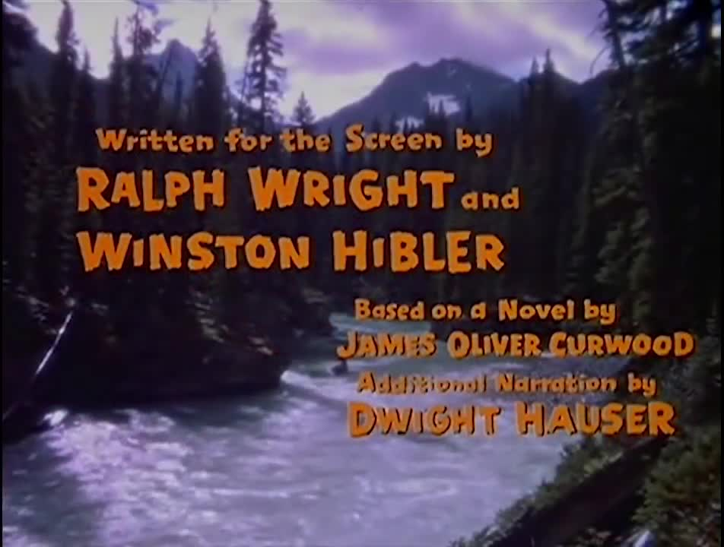
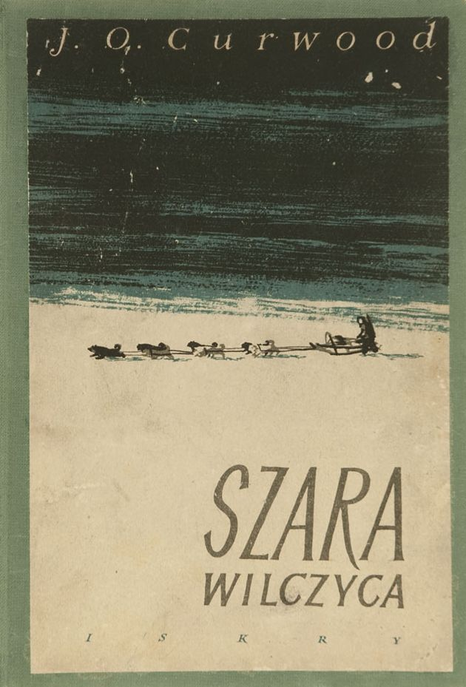
The best known novels reworked for the movie
Włóczęgi północy (ang. Nomads of the North) American family film produced in 1961.
Cast:
Jean Coutu - Andre Dupas
Émile Genest - Jacques Lebeau
Uriel Luft - Makoki
Robert Rivard - Durante
Jacques Fauteux - (narrator)
Unfortunately Kazan
book has not been re-made as a film.

Slide 14
Bibliografia:
https://www.google.pl/imghp?hl=pl&tab=wi https://pl.wikipedia.org/wiki/Wikipedia:Strona_g%C5%82%C3%B3wna http://www.filmweb.pl/

Slide 15
I hoped you enjoyed my presentation.

