Slide 1
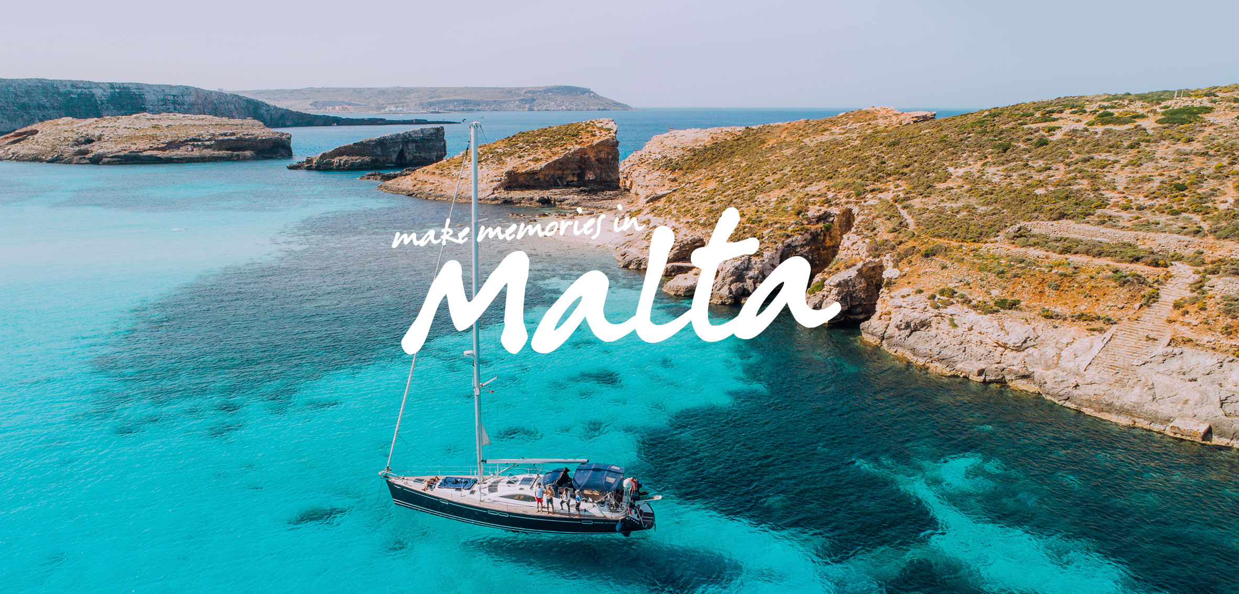
MEMORIES FROM
19.05.18-26.05.18
BY LAURA LENA WIECZOREK
Suppervised by M. Stasińska
Szkoła Podstawowa nr 6 im. J. Kochanowskiego z Oddziałami Dwujęzycznymi i Oddziałami Sportowymi

Slide 2
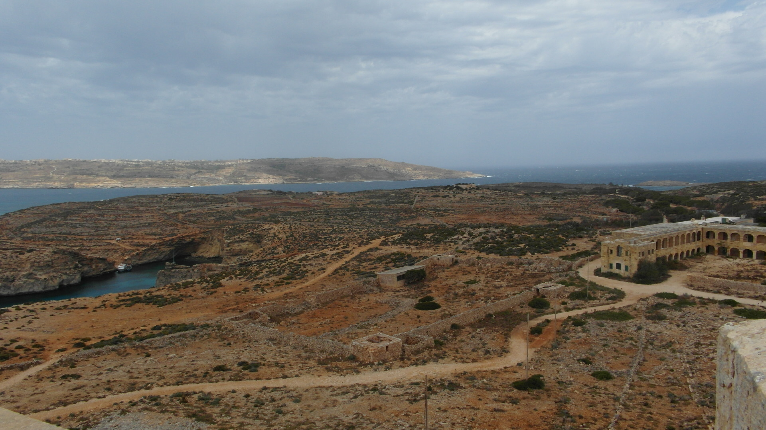
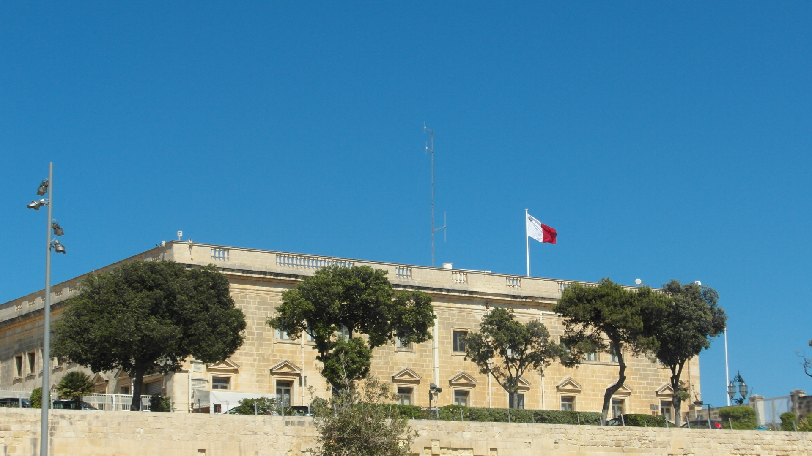
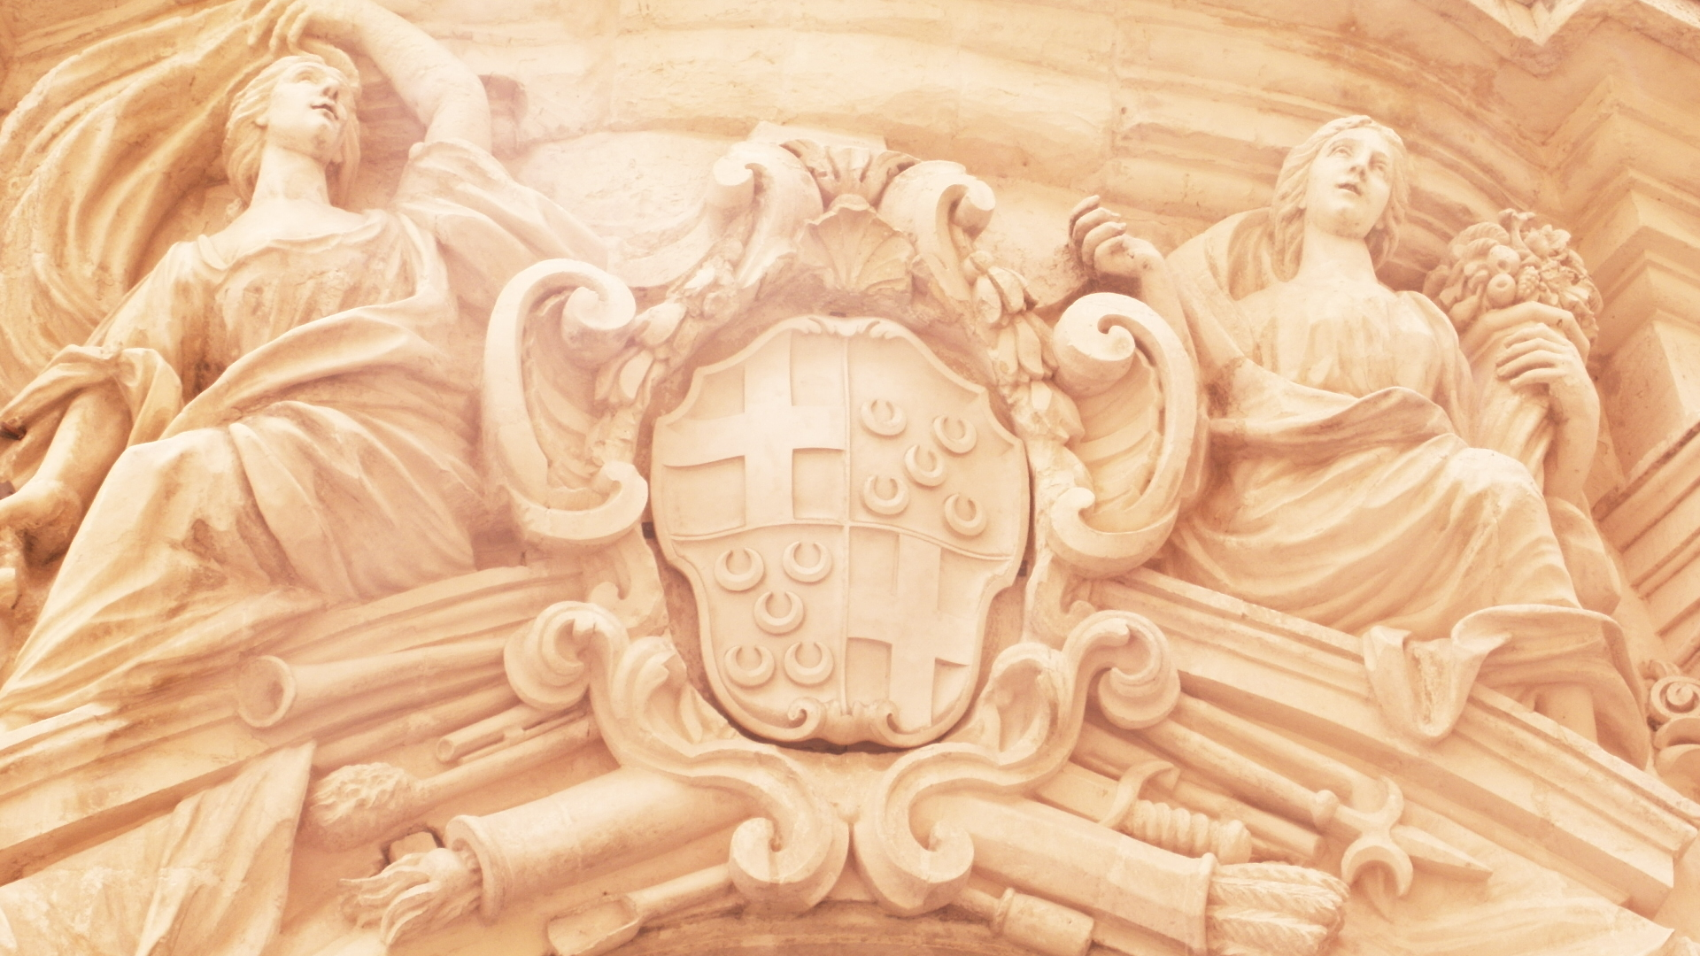
Top view on an old city and a hospital from a watch tower in Comino
Beautiful colour of the sea in Blue Lagoon
Valletta – The capital city of Malta
My favourite photo from Mdina. Two women showing that the owners of this place were really rich (a basket with lots of fruit) and that everyone should be aware of this place (a sword)
Photos from Malta

Slide 3
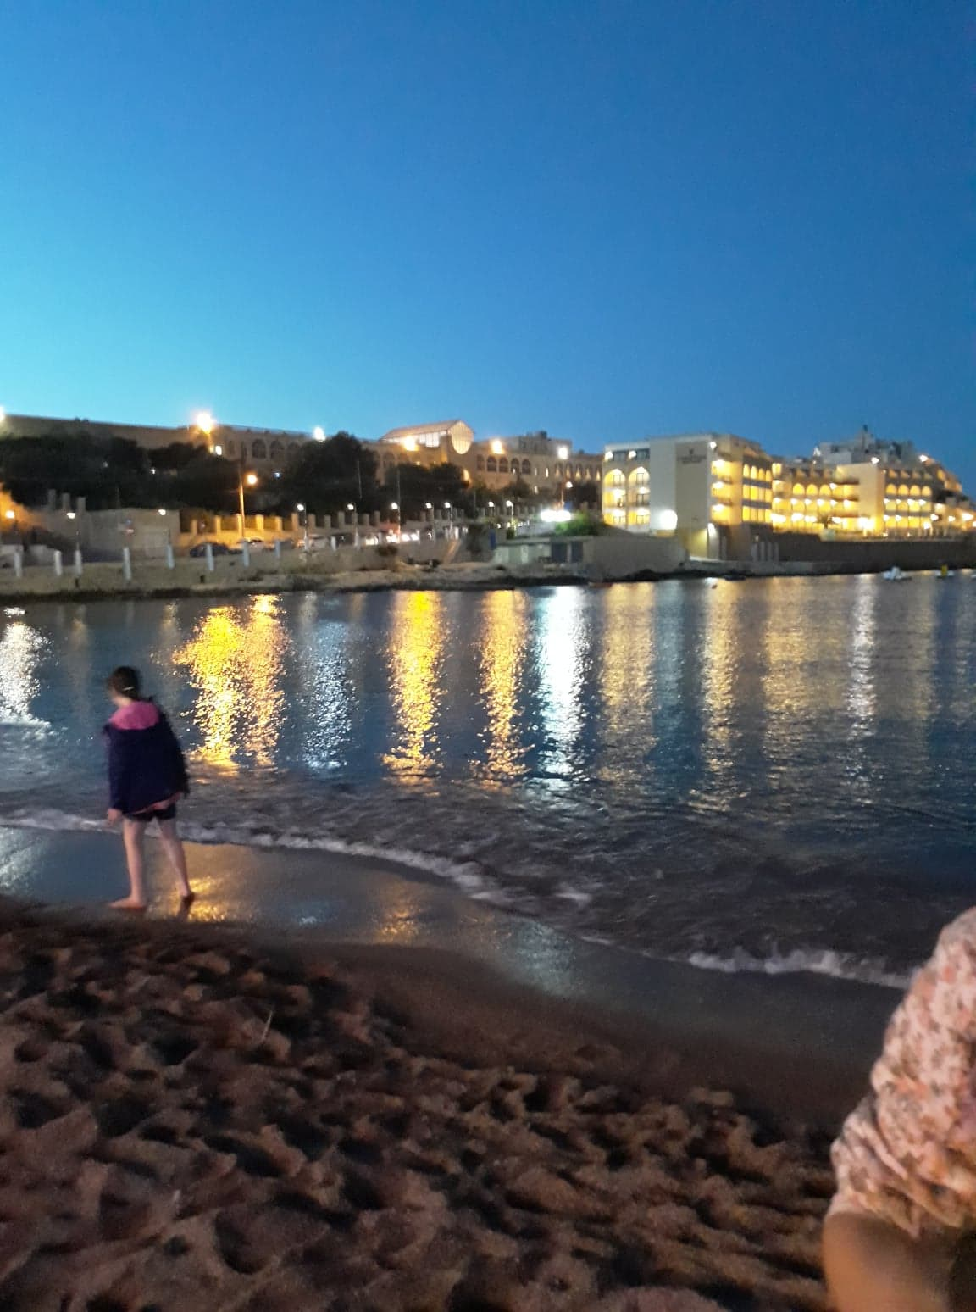
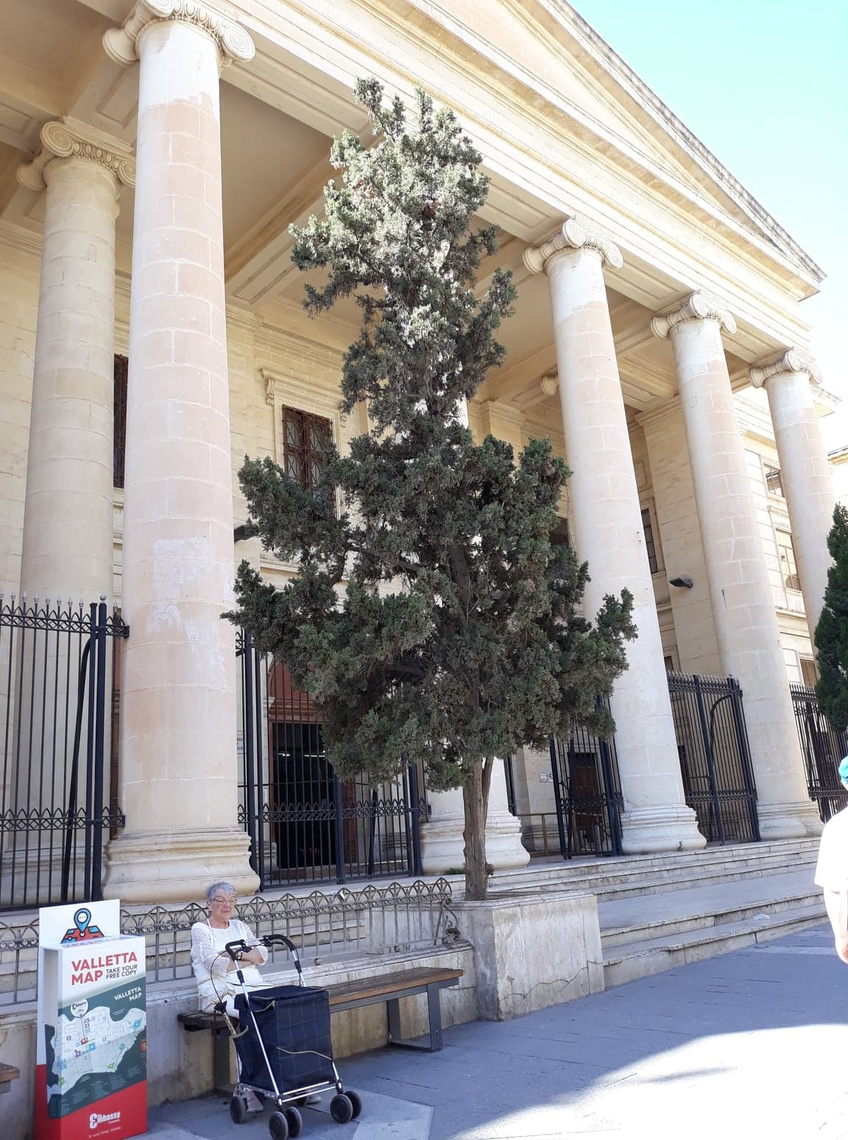
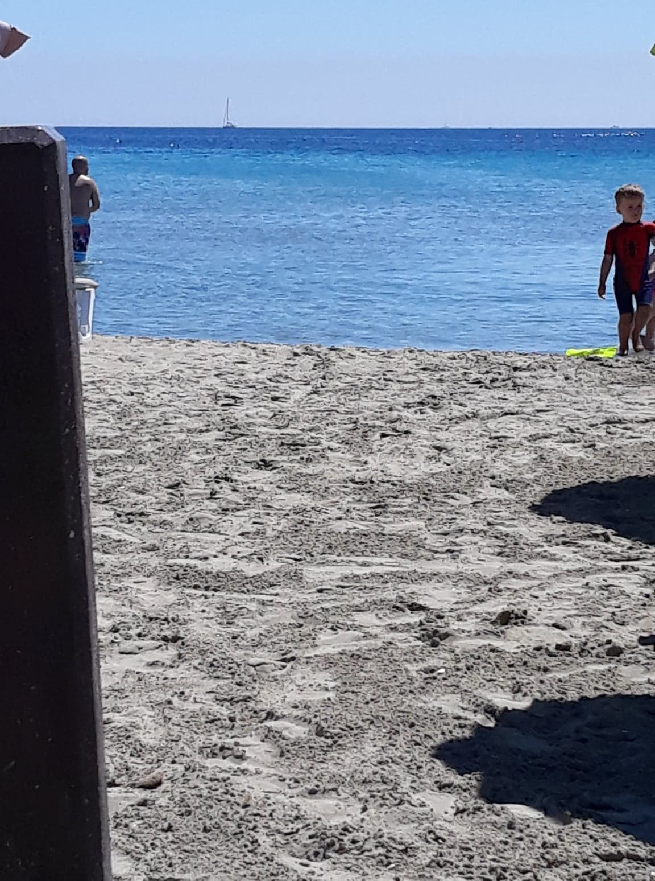
Beaches
Malta reminds me of Rome !

Slide 4
My favourite things about Malta...
Why?
I like the architecture and seeing these amazing buildings was very exciting!
At my host family, I have tried a lot of delicious food. Also on the trips with our teachers, we have tried delicious meals.
I was amazed when I saw the sea. I have drawn it a million times, the colours of it were so beautiful!
I loved the opportunity to talk in English on a daily basis
My favourite things in Malta were...
buildings
food
sea
talking in English!

Slide 5
TRAVELLING TO MALTA
To be honest, I was really stressed about travelling to Malta. The most stressful part was the plane flight, (it was my first time). My friend has told me everything about it but you have to experience it to know how it really feels! Not that bad after all!
First we checked in our suitcases. Next, we went to a place at the airport where guards had to check if we don’t have anything on us that is not allowed on the plane.
The flight itself was really calm, at the end I was surprised that I was so stressed about it!

Slide 6
FIRST AND SECOND DAY IN MALTA
FIRST DAY –Saturday, 19th May
When we arrived, our families had taken responsibility for us. Our hostess was really nice! Her name was Mary Anne Cachia. She made a pie for us, because she thought we had a long trip, after eating the pie she showed us our rooms and where the toilet is. Next, we went to sleep.
SECOND DAY – Sunday, 20th May
After getting dressed the four of us staying with Mary Anne, went to eat our breakfast. We had some toasts with jam, tea, water, juice and cornflakes. When we ended our breakfast Mary showed us the way to our school from where we went to Comino! It's an island with a stone beach. It was nice and I saw the Blue Lagoon.

Slide 7
The first task – Self presentations
Me, Zuzia, Hania and Zosia talked about ourselves. We showed Mary Ann the photos of us and our families. We told her about our likes and dislikes, what we do in our free time and what we like to eat, to listen and to watch.
We also asked her about her family, her hobbies and the places she goes on holidays.

Slide 8
My host family
I was really surprised when I first saw our host family. Mary is an old woman. She has 2 grandchildren and one son, but she has 4 siblings. She was born in Malta, but she wasn't born in Swieqi. Mary has 2 old female turtles. Her hobby is reading books. I and Zosia stayed in her library near the garden. She had many jobs, now she is retired but still helps others with addictions, by writing e-mails to them. She is very kind and her cooking skill is on the highest level! Her home was like a mini museum, there were even bullets from World War I. I miss her already.

Slide 9
THIRD DAY – Monday, 21st May
We had a placement test at the Link School!
It was stressful, because we had grammar, reading and speaking tasks to do.
After taking it, which took an hour, we waited to get our scores. Then the teachers came to us and divided us into groups. My level was B2.
After school, we had an Orientation Walk with an organiser from the Link School, around our area so we knew how to get around Swieqi.

Slide 10
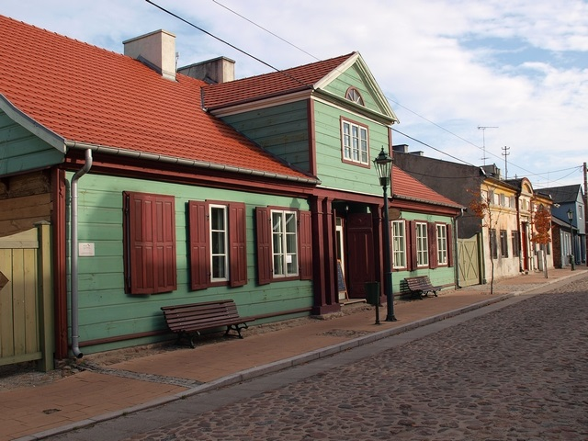
Second task – Presentation about Zgierz
We showed Mary Anne a presentation about Zgierz. She liked the places we showed her a lot.
She said that for her the best was the city park because there were so many trees, a very rare sight in Malta.
She also liked the Weavers’ Houses because nothing like that could be find in Malta.

Slide 11
Fourth day - Tuesday, 22nd May
On the fourth day, we had our lessons in the Link School. We worked with a course book but later we had some language games.
After the lessons, we visited Mdina, an ancient capital city of Malta. I was amazed by it! The buildings were really beautiful.
The city is also called a „Silent City” because you can only walk around it or ride in a horse-driven cab.
The Knights of St. John moved the capital city to La Valletta in 1571 because Mdina was too far from the coast.

Slide 12
The third task – Presentation about Poland
In the evening we showed our hostess the presentation about Poland but first she had to answer a quiz. We wanted to see how much she knew about our country and we were really surprised that she answered almost every question correctly. But after all she likes history and reading.
She enjoyed the presentation quite a lot. And promised to tell us a lot about Malta.

Slide 13
FIFTH DAY - Wednesday 22nd May
Our lessons lasted from 9:00 to 12:30 as every day. Afer the normal lessons we had a session about Film & Literature. We watched a film where two friends became rivals. It was filmed in Malta! The title of it was „Count Monte Cristo”.
After watching the film, we had a little game called Treasure Hunt. We needed to find some objects from the list, take pictures of the things in shops and solve riddles.
It was okay, in my opinion but we didn’t win.
I and Zosia bought Kinnie, a very popular local beverage drink. It is made of bitter oranges and 16 different herbs. The taste is quite original but Zosia liked it a lot.

Slide 14
Sixth day – Thursday, 23rd May
Our breakfast was good as always. During the lessons we did our work in exercises book and had a game where one person had to guess what they are (they had a piece of paper attached to their backs with the name they had to guess), and we answered their questions. It was real fun.
Finally, our teachers gave us the end of school diplomas from the Link School.
In the afternoon we visited Valletta! The capital city of Malta. It's a really old town. We saw a very colourful garden with lots of flowers and a fountain and an old church with a clock and we watched a ceremony of gun fire in the Great Harbour.
We also had an amazing chocolate cake. I'd love to visit Valletta again...

Slide 15
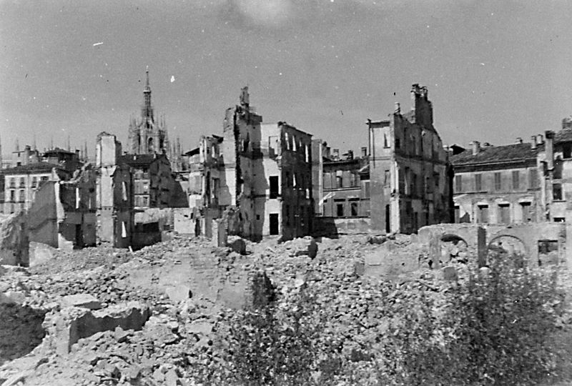
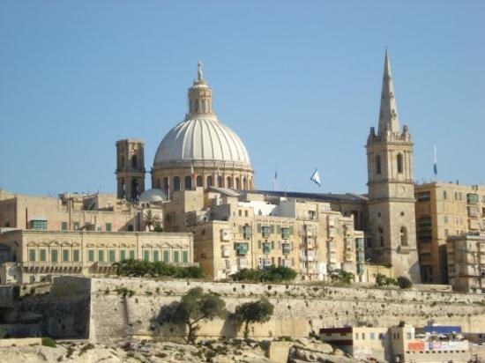
The fourth task – Finding information about Malta
5. W czwartek 24 maja lub piątek 25 maja w rodzinach goszczących uzyskać odpowiedzi na następujące pytania:
What is the area of Malta and how many people live there?
When did people start living in Malta?
What constructions are oldest than Egyptian pyramids and where are they?
What nations ruled Malta in the ancient times?
Was Malta ever a Muslim country and how it happened?
Which saint was shipwrecked on Malta?
When did the Knights of St. John come to Malta and why?
What happened in 1565, how was it called?
Why do Maltese people speak English?
What happened during the Second World War, how was it called?
When did Maltese women get the rights to vote?
When did Malta become a member of the European Union?
Are there any Maltese Nobel Prize winners?
What is the most popular dish/dessert in Malta?
What Maltese people eat for Christmas?
Our last task was to get the answers to 15 questions about Malta from our host family. We weren’t really surprised that Mary Anne answered all our questions and even showed us some pictures in some of her many books.
We learned a lot about the history of Malta and some of the information were really amazing, especially about the food and what happened during World War 2, how Malta was destroyed by the Fasists bombing.

Slide 16
SEVENTH DAY – Friday, 25th May AND THE RETURN TO POLAND...
Friday, the last day in Malta...
Of course, we were all sad about leaving a place like Malta, but on the last day, we went to another beach! The most beautiful sandy Melieha Beach
It was such an amazing experience. I loved every single thing about it. I was drawing for an hour and then I decided to go swimming with my friends! We had a lot of fun in the shallow clear waters of the Mediterranian Sea. Unfortunately, we couldn’t stay there for ever.
The next day we packed our suitcases and went shopping for the last souvenirs and to take the last pictures. At 4:30 we left our host families to go to the airport.
The flight was calm and nothing happened, so now I’m not that scared of flying as before!
Bye Malta :-( Hope to see you soon! ;-)

Slide 17
THANK YOU FOR WATCHING !
One of many watch towers in Malta, this one I visited on Comino

