Slide 1
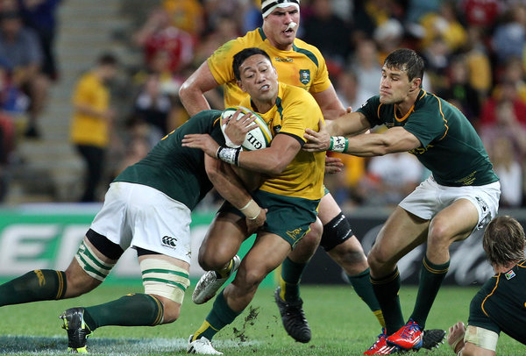
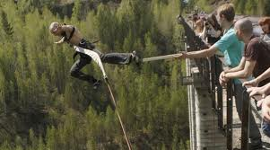
Sport in New Zealand
Wykonał: Wiktor Kliza Opiekun: Małgorzata Stasińska

Slide 2
Rugby – New Zealand’s favourite sport
New Zealand’s national rugby team is called The All Blacks. When New Zeland toured England in the early 1900s, a British reporter first used the phrase ‘’All Blacks’’ because the players all had black costumes.

Slide 4
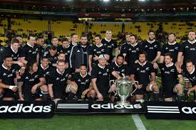
All Blacks team

Slide 5
History of Rugby
Most people believe that the sport began in 1823 at a school, in Rugby, Warwickshire, England. Many English schools played football, but one day a boy called William Webb Ellis from a school in Rugby, decided to pick up the ball and run with it in his hands. And so the game of rugby was born.

Slide 7
Haka – traditional dance
The Maori word ‘haka’ means a war dance, and it is traditionally performed before a battle. However, in 1987 it was performed for the first time at the Rugby World Cup. Today, it is always performed before an international match.

Slide 8
HAKA DANCE

Slide 9
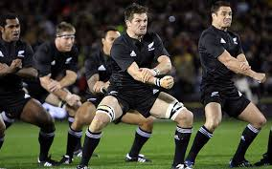
HAKA

Slide 10
HAKA DANCE

Slide 11
Bungee jumping in New Zeland
New Zeland is known as ‘’Bungyland’’
Acording to a legend, bungee jumping started 150 years ago. When a husband and wife had an argument. The wife ran away and climbed a tree. Her husband ran after her and climbed the tree too. So she tied her ankles to the tree with long vines, and jumped. He jumped too, but without the vines and he was killed. His wife survived, and then the local people realised how strong the vines were and started to jump for fun.

Slide 12
Bungee jumping in New Zealand

Slide 13
Bungee jumping in New Zealand

Slide 14
Bungee jumping in New Zealand

Slide 15
Bungee jumping in New Zealand

Slide 16
THE END Thank you for watching

