Slide 1
Famous New Zelander – Sir Edmund Hillary
Wykonawca: Izabela Rogowska IIIa
Opiekun: Małgorzata Stasińska

Slide 2
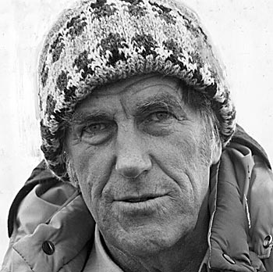
Biography
Edmund Hillary was born on 20th July 1919, in Auckland, New Zeland. He grew up in a small town called Tuakau. A the age of 11, he started a new school. The teacher thought he looked very thin, and sent him to special lessons to improve his physical skills.

Slide 3
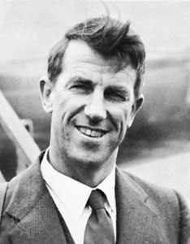
Youth
Edmund Hillary always loved reading adventure stories. His hero was a famous mountaineer named Eric Shipton. He had his first experience of the mountains, when he went on a class trip to Mount Ruapehu. Hillary’s first climb was the 7,500-foot Mount Oliver in southern New Zeland.

Slide 4
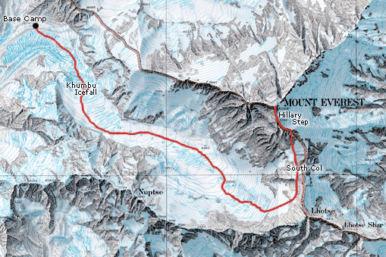
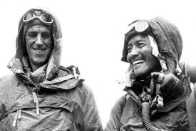
Mount Everest First Expedition
In 1951, Hillary trakked in the Himalayan Mountains with a New Zeland climbing team. Later, he was part of an Everest exploration team led by his old hero, Eric Shipton. On 29 May, 1953, Edmund Hillary and Sherpa, Tenzing Norgay became the first two men to stand on top of the world’s highest mountain, Mount Everest.

Slide 5
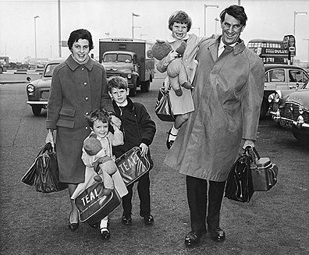
Personal life
In 1953, Edmund and his wife, Louise, travelled all over the world, where he gave lectures about his trip to Everest. He had got three children (Peter, Sarah and Belinda). His first wife and Belinda died in a helicopter crash in 1975.

Slide 6
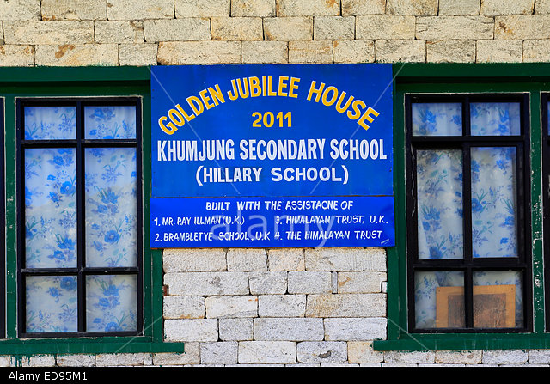
Help for Sherpas
Hillary always wanted to thank the Sherpa people, who live around Mount Everest, for helping him on the Everest expedition. So in 1961, he went back to Nepal and helped to build them their first school..

Slide 7
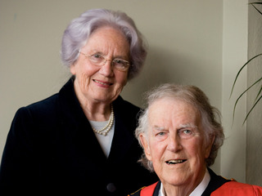
Second marriage
Many years later he
married again. His
wife, June, also loved
Nepal and mountains.
They worked with
the Sherpa people. Their
work has led to more than 27 schools in the area, two hospitals, and many other facilities. Unfortunately, the schools in Nepal were destroyed in the 2015 earthquake. Edmund Hillary died in 2008.

Slide 8
Thanks for watching ☺

