Slide 1
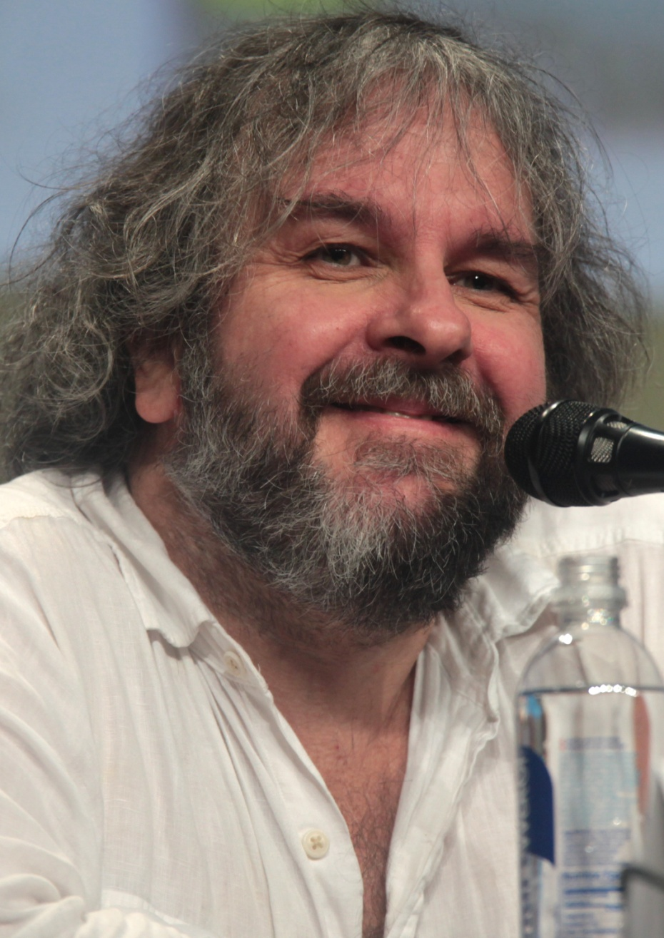
Peter Jackson
Wykonał: Karol Woliński Opiekun: Małgorzata Stasińska

Slide 2
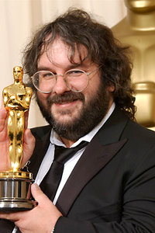
Peter Jackson
Date of Birth: 1961/10/31 (Yes, he was born on Halloween)
Place of birth: Pukerua Bay, New Zealand
Height: 169 cm
Marital status: wife Fran Walsh ( since 1987 ), 2 children: son Billy (b. 1995) and daughter Katie (b. 1996)

Slide 3
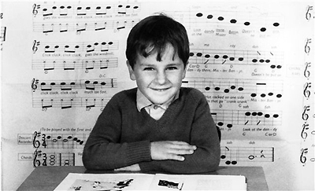
Childhood & Early years
Since he was a young boy he has been interested in filmmaking. One of his main interests was watching horror films, maybe because of his birthday date?
He stopped his education when he was 17. He never finished high school.

Slide 4
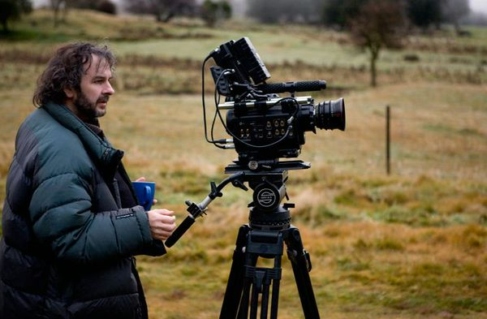
Career
His first Film was „Bad Taste” and the film was funded with his own money.

Slide 5
Nominations
Oscars:
2004- best film „The Lord of the Rings”
2003- best script „The Lord of the Rings”
Golden Globes:
2005- best director „King Kong”
Total Awards: 77

Slide 6
Photos

Slide 7
Photos

Slide 8
Photos

Slide 9
Photos

