Slide 1
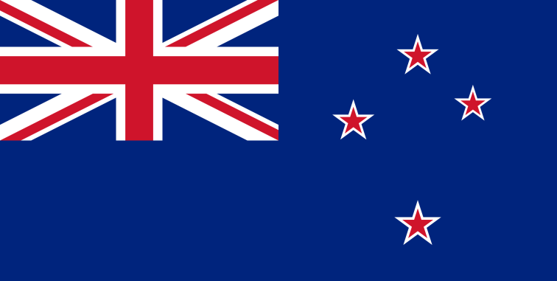
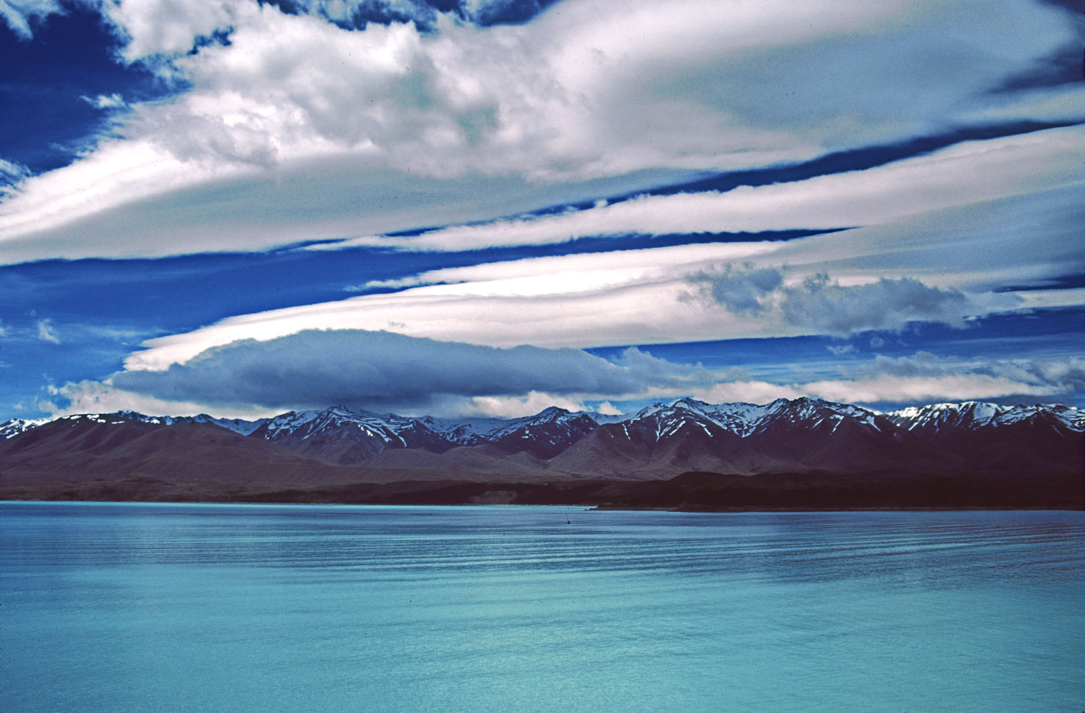
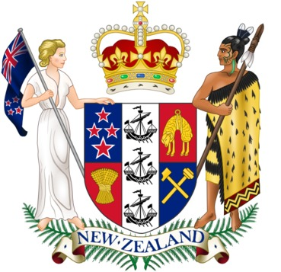
New Zealand-
The land of the Long White Cloud
Wykonał : Kajetan Wojtaszczyk Opiekun : Małgorzata Stasińska

Slide 2
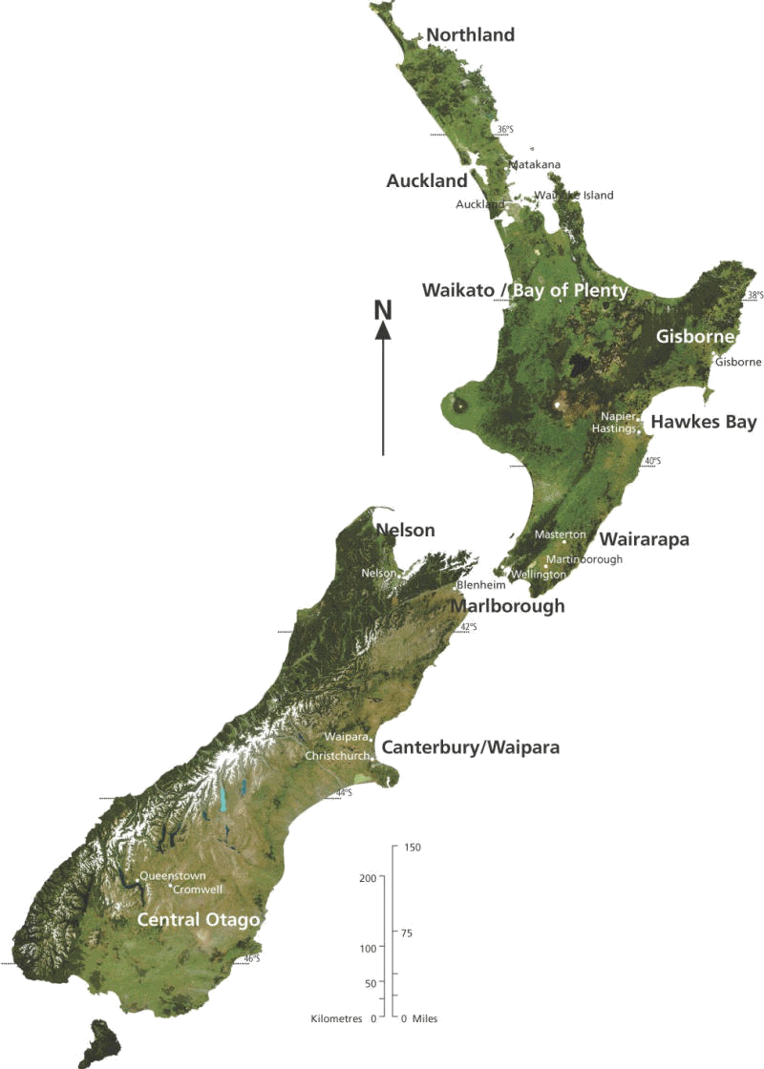
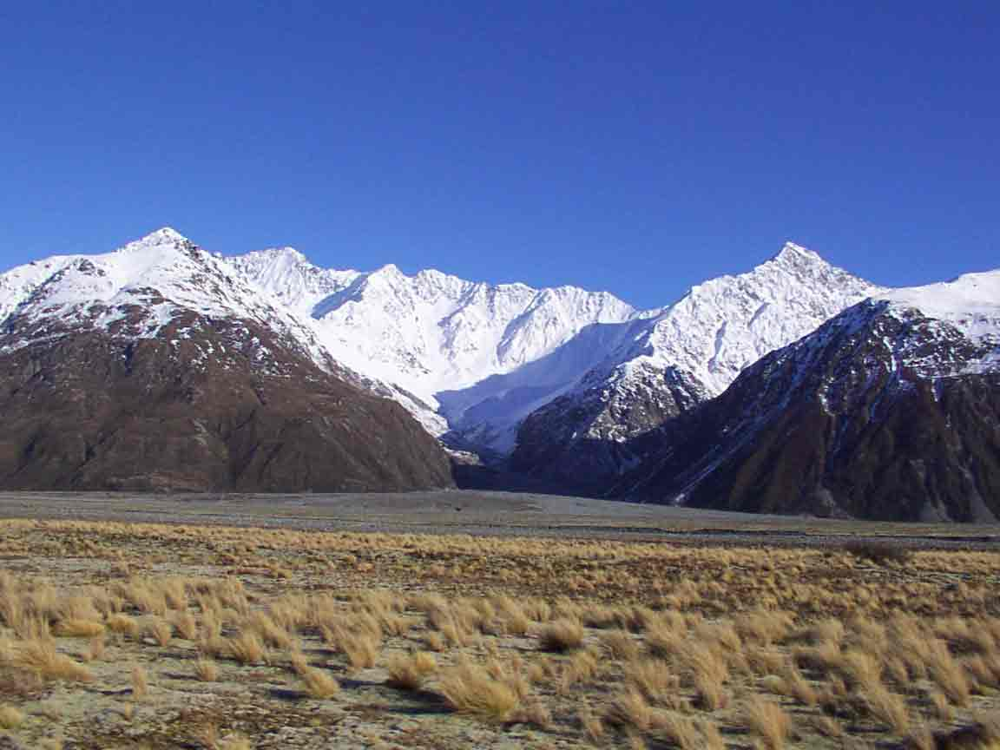
History and Geography
New Zealand is an island and a country in the southwestern Pacific Ocean.
The country consists of the North Island and the South Island – and numerous smaller islands.
During its long isolation, New Zealand developed a distinctive diversity of animal and plant life. The country's varied topography and its sharp mountain peaks, such as the Southern Alps came into being due to the tectonic uplift of land and volcanic eruptions.
Southern Alps

Slide 3
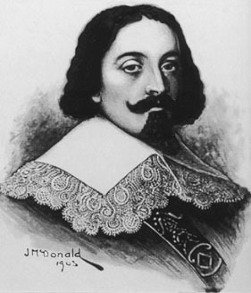
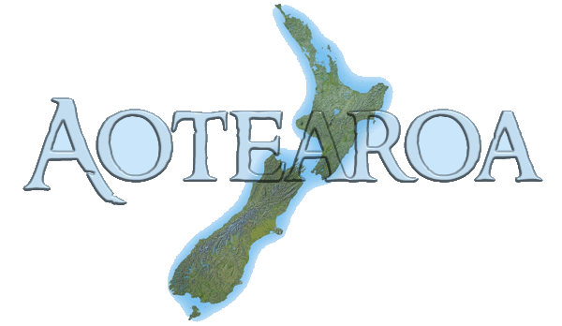
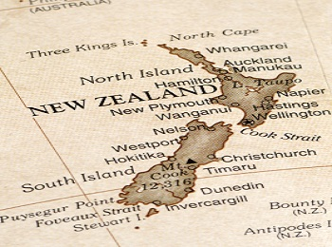
The early Polynesian settlers in New Zealand called the country Aotearoa, which means The Land of the Long White Cloud. New Zealand is still often referred to by this beautiful name.
In 1642 Abel Tasman, a Dutch explorer was the first European to discover New Zealand. The country was named after the province of Zeeland in the Netherlands. Because of its remoteness, it was one of the last lands to be settled by humans. Abel Tasman had unpleasant conntact with the Maori people and had never come back to New Zealand.
It was James Cook, a discoverer of Australia who brought settlers to New Zealand.
Abel Tasman

Slide 4
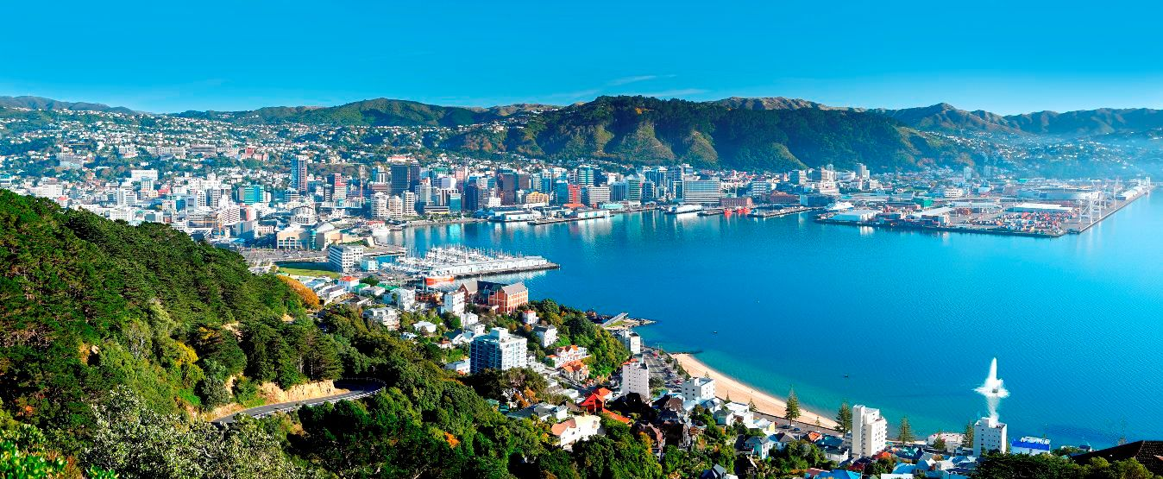
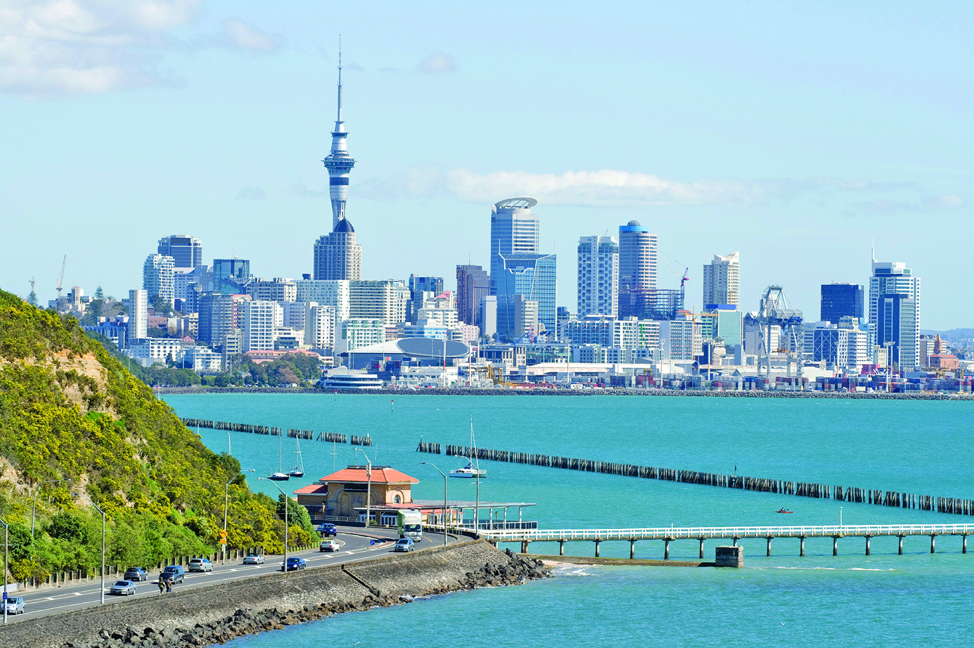
New Zealand's capital city is Wellington( population: 192 800),
but most populous city in New Zealand is Auckland (440 710).
Wellington
Auckland

Slide 5
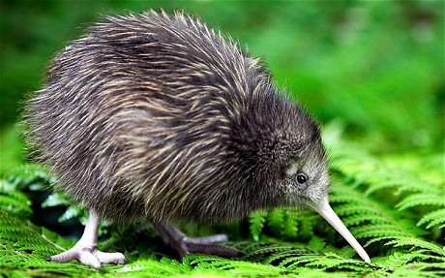
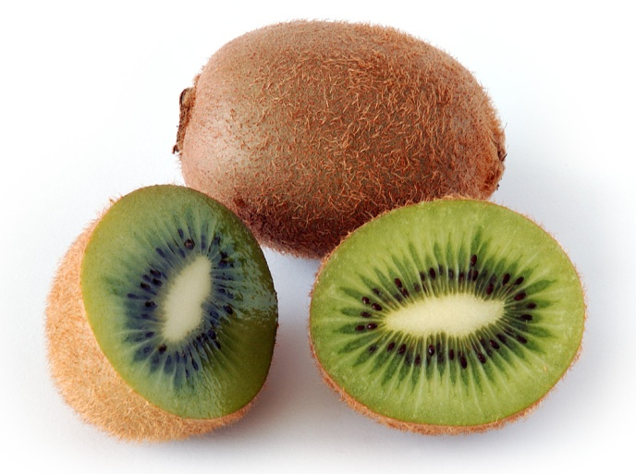
Things New Zealand is famous for
- kiwifruit - kiwifruit are actually of Chinese origin, but are grown on a large scale in New Zealand. And New Zealanders are known by the name Kiwi, throughout the world
-kiwi birds- are flightless birds native to New Zealand, about the size of a chicken
kiwi-bird
kiwifruit

Slide 6
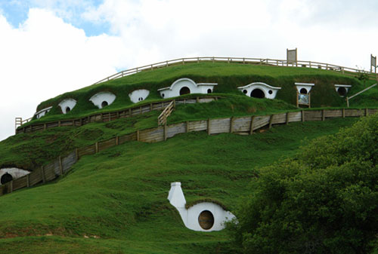
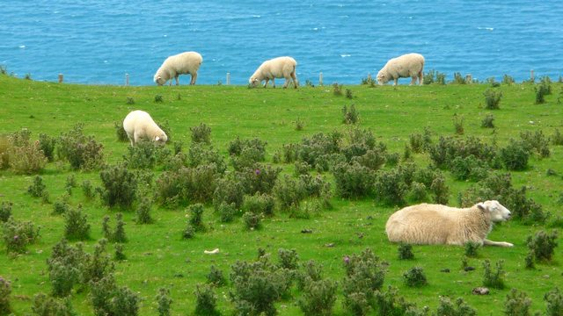
-sheep – in fact there are more sheep than people living in New Zealand
-The Lord of The Ring was filmed in various locations in New Zealand
Hobbiton in New Zealand
New Zealand’s sheep

Slide 7
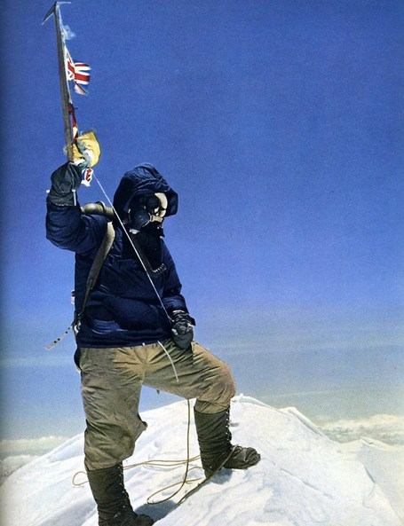
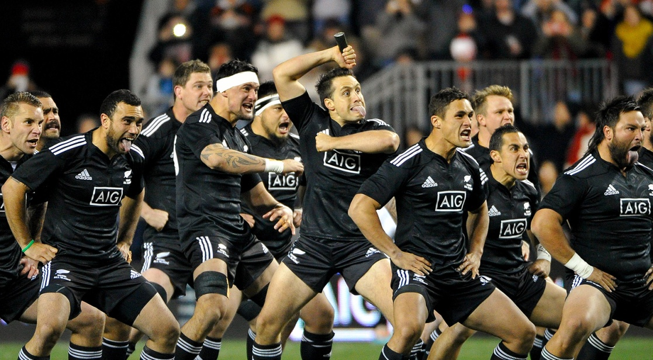
Sir Edmund Hillary - the first white man who climbed Mount Everest, came from New Zealand
- National sport of New Zealand is Rugby and national rugby team is called “The All Blacks”
Sir Edmund Hillary on Mount Everest
The All Blacks

Slide 8
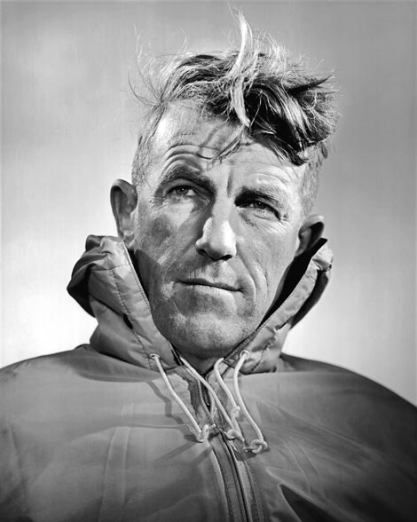
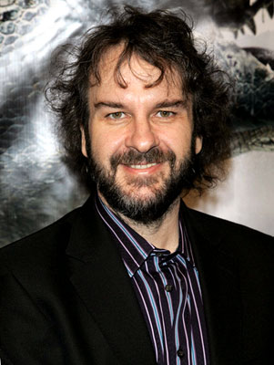
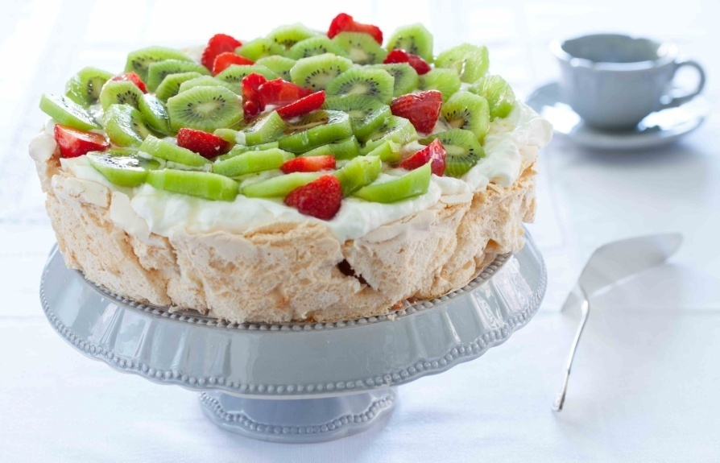
-The Pavlova dessert was invented by a New Zealand hotel chef impressed by Anna Pavlova’s dress (She was a famous Russian ballet dancer)
-Many famous people come from New Zealand for example: Kiri Te Kanawa -a well- known opera singer and Peter Jackson – a famous film director.
Sir Edmund Hillary
Peter Jackson
Kiri Te Kanawa
Pavlova’s dessert

Slide 9
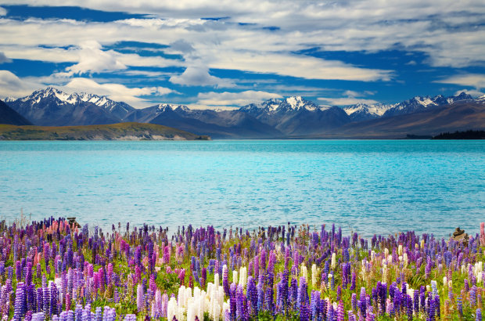
The famous places in
New Zealand

Slide 10
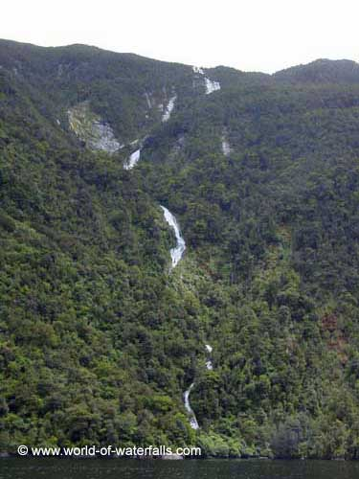
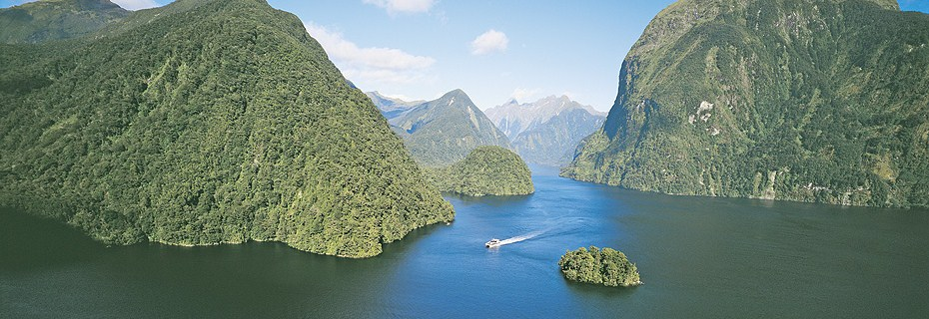
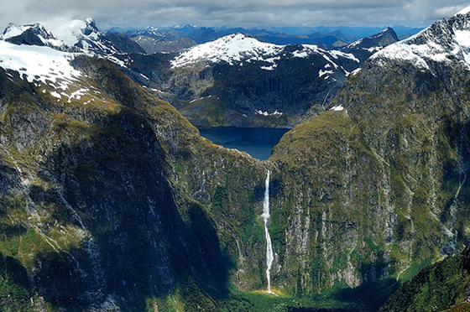
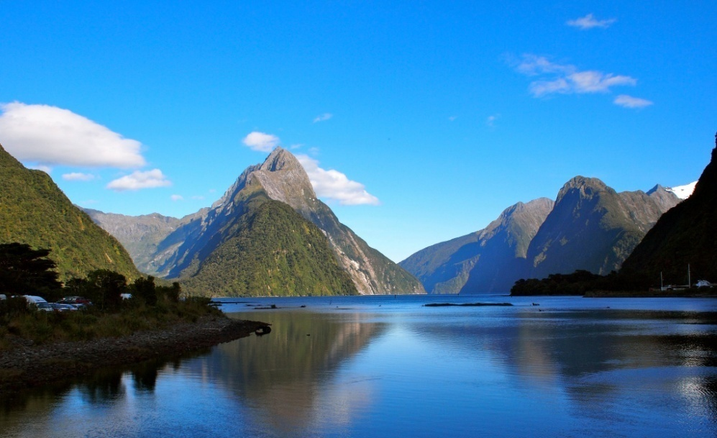
- Fiordland – a region of mountains and valleys in the south west corner of New Zealand. Fiord is a narrow finger of the land, between steep mountains on either side. Fiords are made by glaciers, as they move from the mountain valleys down to the sea. The best known fiords are: Milford Sound and Doubtful Sound -Waterfalls The tallest waterfalls in the world: Browne Falls(619m) and Sutherland Falls(580m) are located in the Fiordland
Browne Falls
Doubtful Sound
Milford Sound
Sutherland Falls

Slide 11
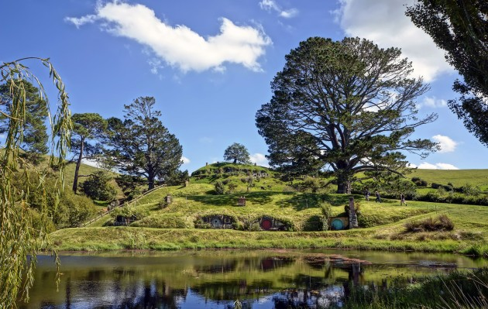
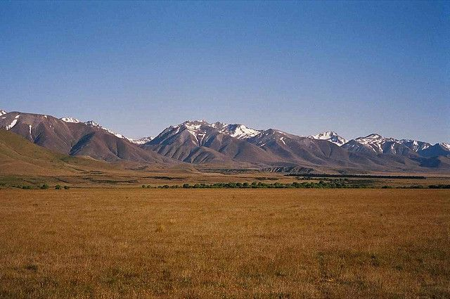
locations from Lord of The Rings for example:
“The Shire” (the real name is Matamata) or “Pelennor Battle Fields”(Twizel Feld)
Alexander Farm (The Shire)
Twizel Field (Pelennor Battle Fields)

Slide 12
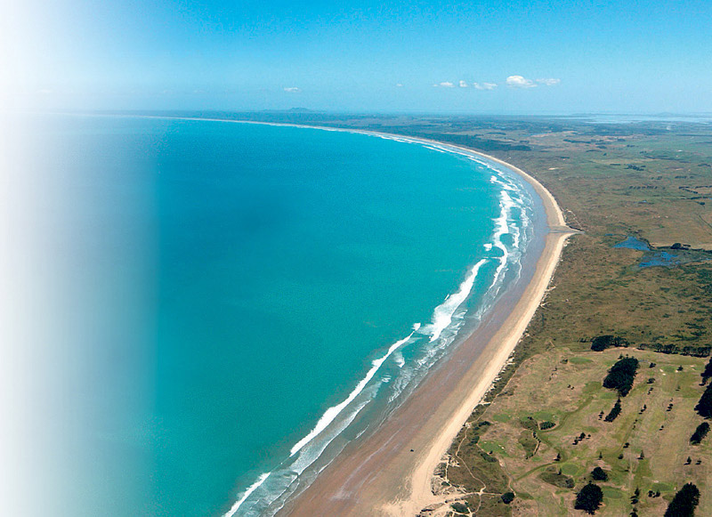
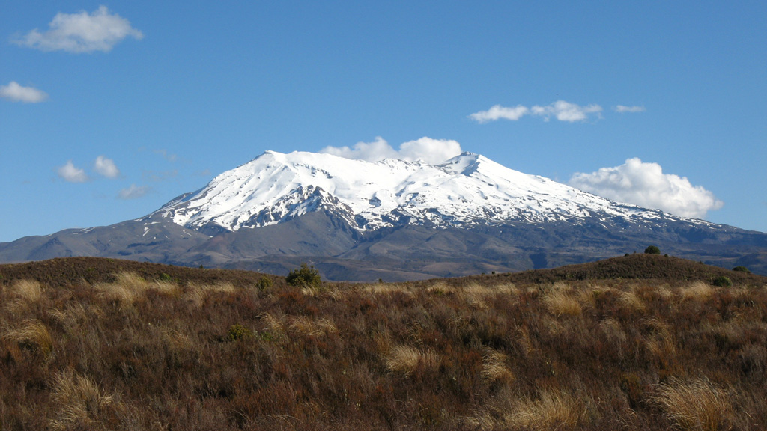
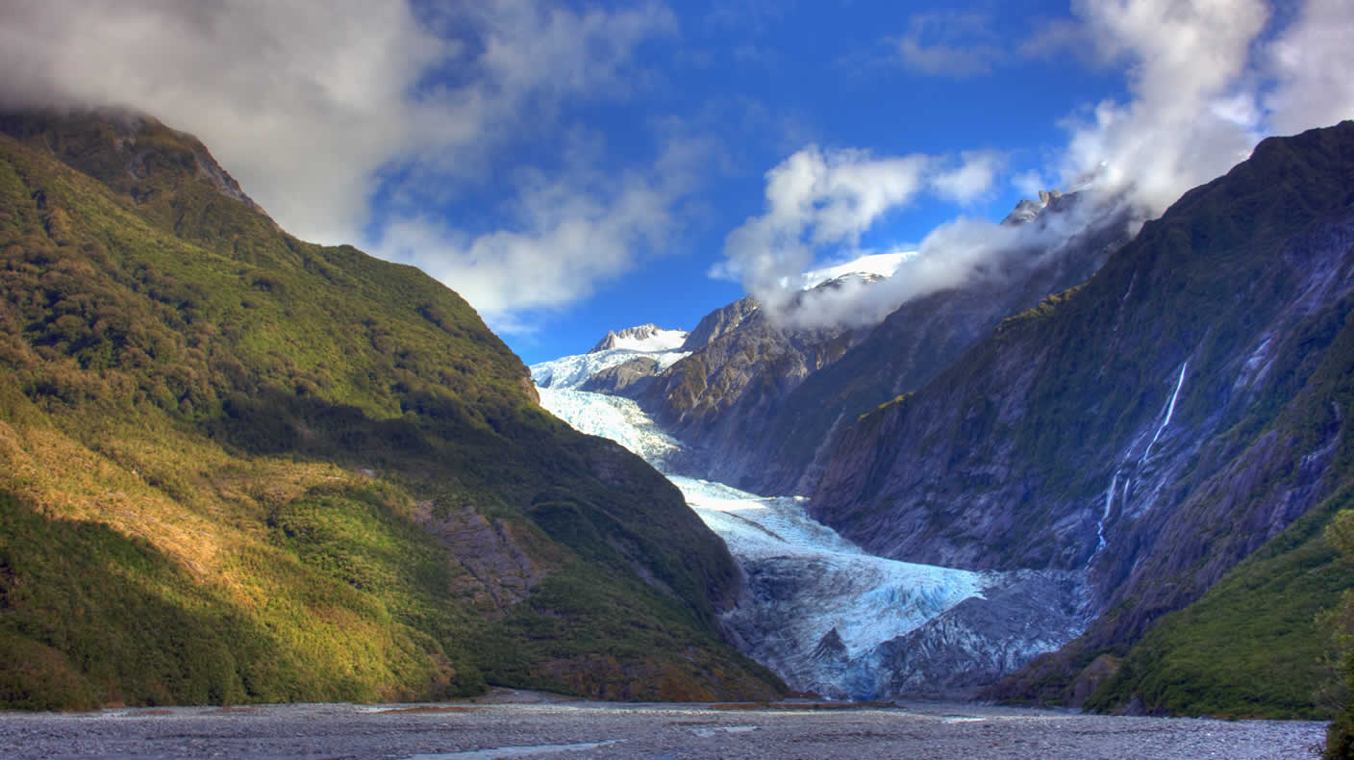
- Franz Joseph Glacier - is a 12 km long glacier located in Westland Tai Poutini National Park on the West Coast of New Zealand's South Island. - Ruapehu Volcano - Mount Ruapehu, or just Ruapehu, is an active volcano at the southern end of the Volcanic Zone in New Zealand. - Ninety Mile Beach - Ninety Mile Beach, is on the western coast of the North Island of New Zealand. It is actually just 88 kilometers long.
Ninety Mile Beach
Ruapehu Volcano
Franz Joseph Glacier

Slide 13
THANK YOU FOR WATCHING

