Slide 1
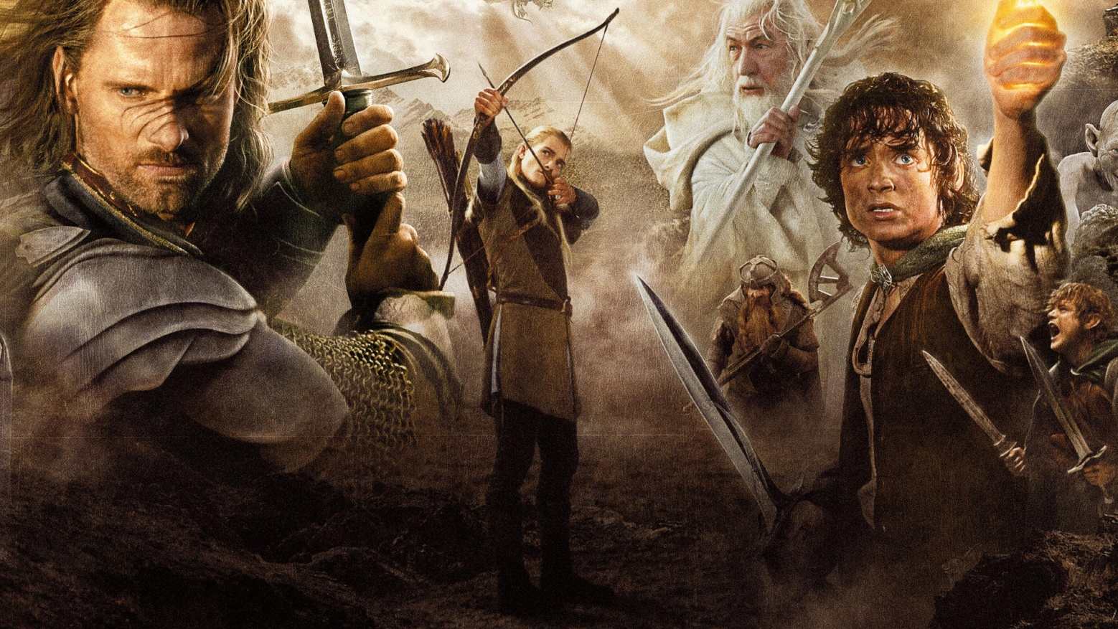
New zeland – The middle earth Author: Patryk Amsolik III A opiekun: Małgorzata Stasińska
Przygotował: Patryk Amsiolik
Opiekun: M. Stasińska

Slide 2
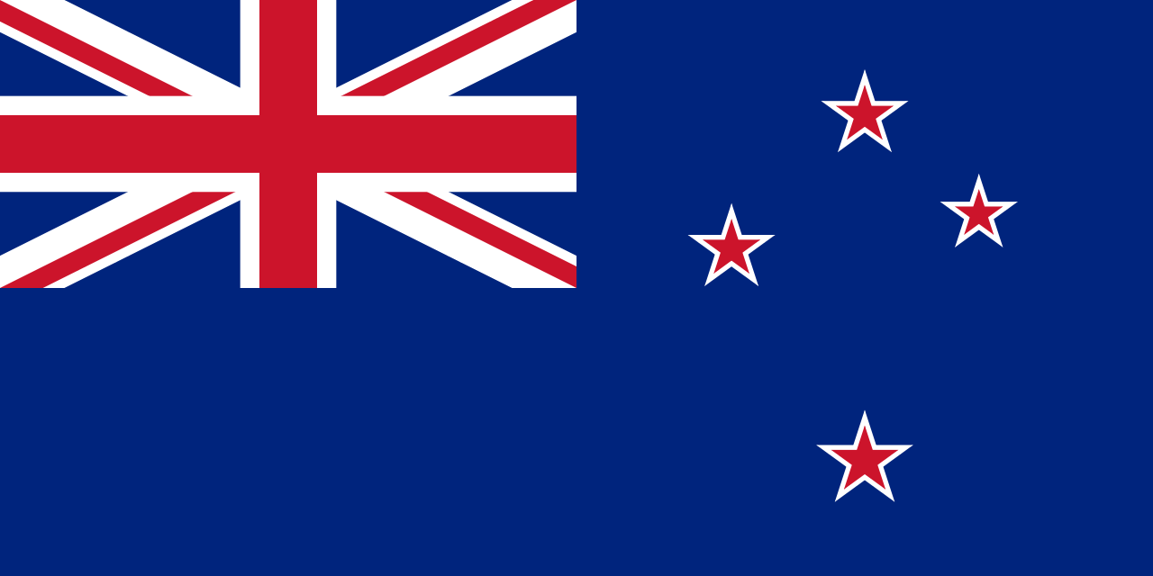
Why new zeland ?
Peter Jackson, the film director, is from New Zeland. His team of location scouts travelled all over the country to find the most suitable locations.They chose New Zealand for its untouched landscapes. The filming took over 274 days, in more then 150 locations.

Slide 3
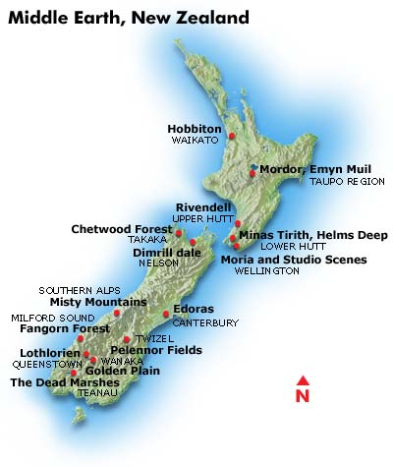
The most known locations

Slide 4
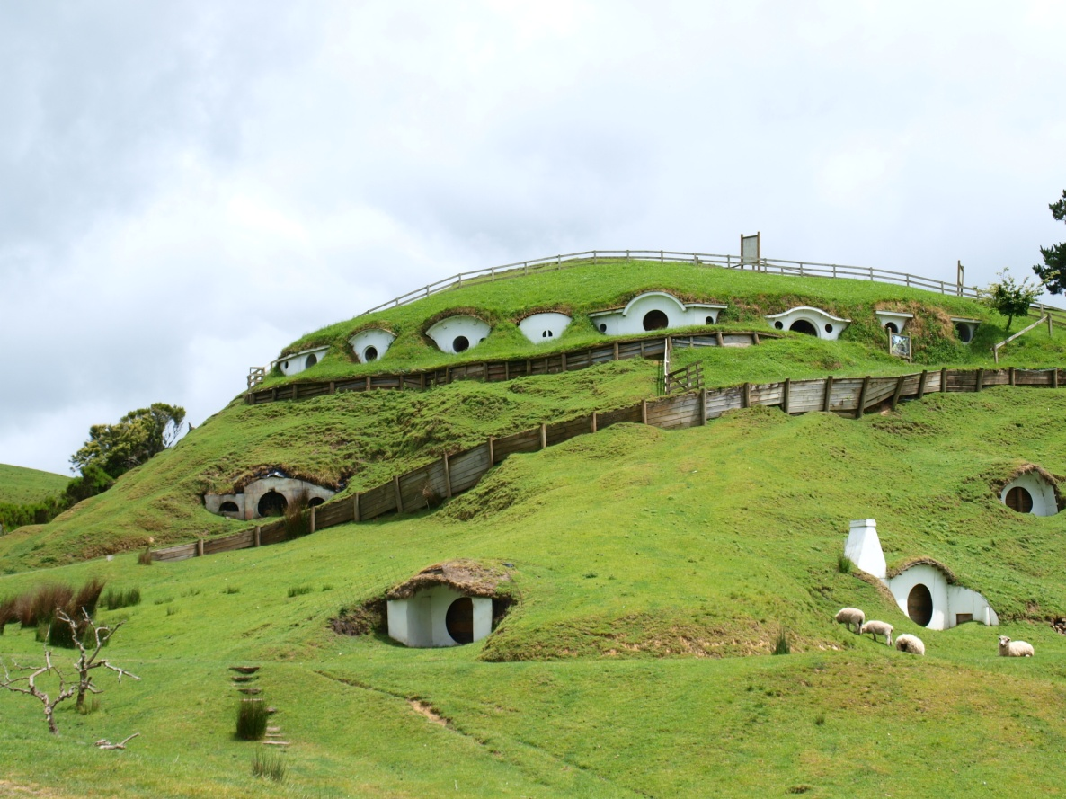
Hobbiton
The set was built entirely for The Hobbit and will remain as it was seen in the Hobbit films and The Lord of the Rings film trilogy.

Slide 5
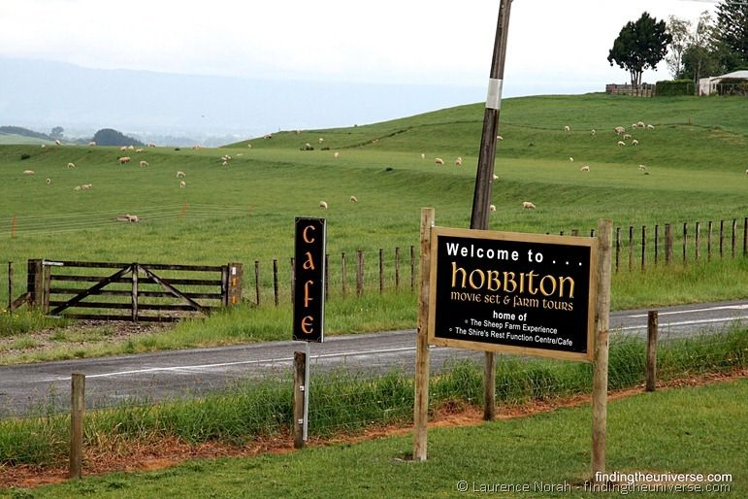
Hobbiton
Hobbiton is one of the oldest villages of the Shire and it is roughly in its center. It is the home of many illustrious Hobbits, including Bilbo Baggins, Frodo Baggins, and Samwise Gamgee. Notable locations in Hobbiton include the Mill, the Baggins Hobbit Hole in the Hill and Bag End. During the War of the Ring, Saruman's treachery destroyed much of the Shire, and Hobbiton suffered greatly. The Old Mill had been replaced with a noxious factory-like structure, and many trees were cut down.

Slide 6
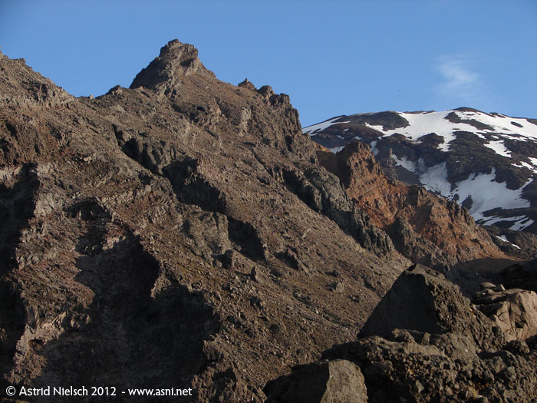
Mordor & Emyn Muil
The scenes involving Frodo, Sam and Gollum's trek through the "razor sharp rocks" of the Emyn Muil, and later through the desert flats of Mordor, were largely shot on Whakapapa Ski Field, on the slopes of Mt Ruapehu. The location is a short walk from the parking space at the top of the access road to the ski field, which branches off the main highway a few km past National Park.

Slide 7
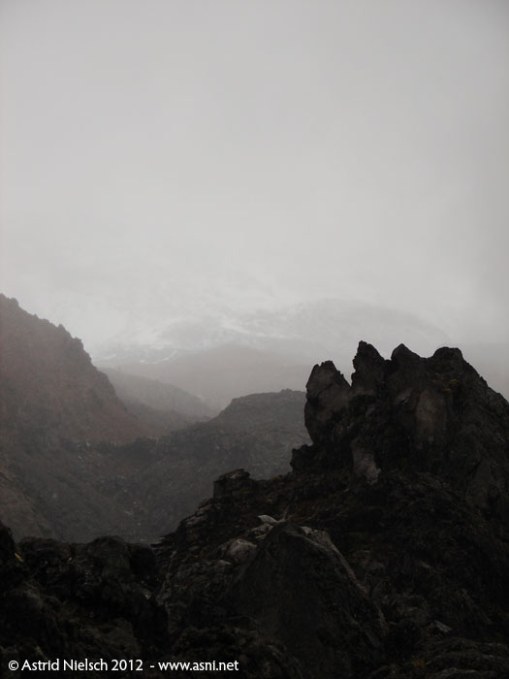
Mordor & Emyn Muil
Warm clothing and solid footwear are recommended! The weather is prone to quick changes, and cold winds, rain, and even snow should be reckoned with even in summer. If the weather is nice, it is a good place to view
Mt Ngauruhoe, aka Mt. Doom.

Slide 8
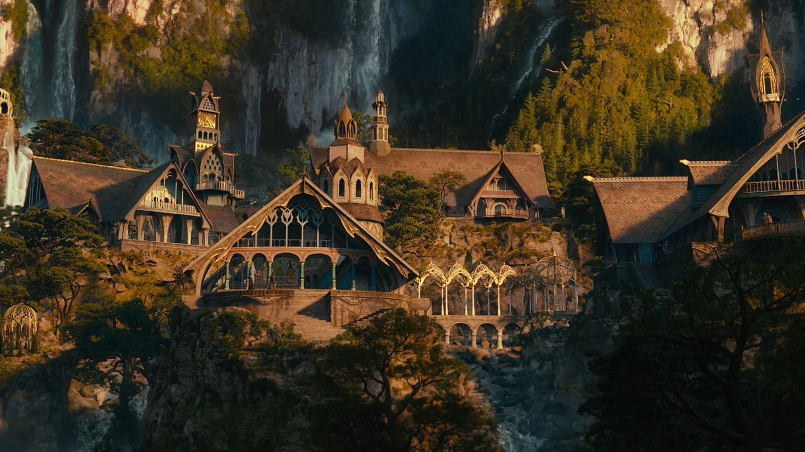
rivendell

Slide 9
RIVENDELL
Rivendell is also known as Imladris, it’s an Elven outpost in Middle-earth. It is an important location in Tolkien's legendarium and is featured in The Hobbit, The Lord of the Rings, The Silmarillion, and Unfinished Tales. It was established and ruled by Elrond Half-elven in the Second Age of Middle-earth (four or five thousand years before the events of The Lord of the Rings), and was protected by the powers of its Lord and his elven ring Vilya.
Rivendell was located at the edge of a narrow gorge of the river Loudwater (one of the main approaches to Rivendell comes from the nearby Ford of Bruinen), but well hidden in the moorlands and foothills of the Misty Mountains.

Slide 10
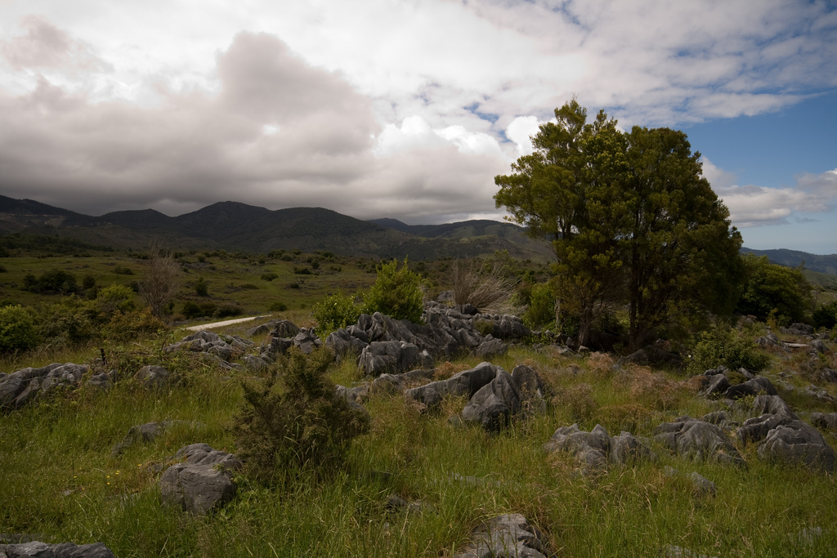
chetwood forest
Chetwood is a small forest in the realm of Bree Land. The town of Archetis is located at its edge. It is on the East-West Road northeast of Bree. Combe is situated on the borders of Chetwood. The Great East Road runs through the southern edge of Chetwood, while the Greenway runs through the western edge. On the east side of Chetwood there are the Midgewater Marshes.

Slide 11
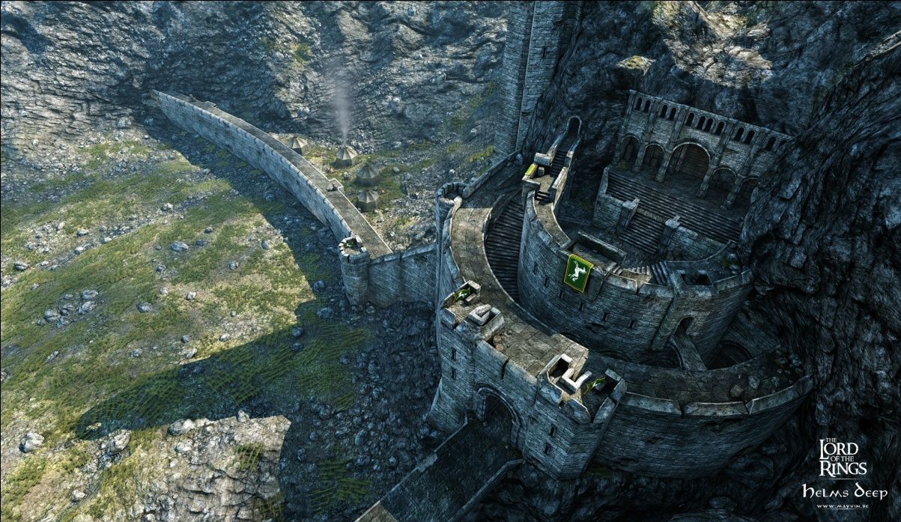
minas tirith & helm's deep
Helm's Deep
The valley is surrounded by the natural series of hills called Helm's Dike and behind that lay the fortress of Aglarond
or the Hornburg, at the entrance to the Glittering Caves. A long causeway winds up to the great gate of the fortress itself. Inside the keep there are stables and an armory, as well as a great hall in the rear which is dug out in the mountainside. There is also a great tower, at the top of which there is the great horn of Helm Hammerhand.

Slide 12
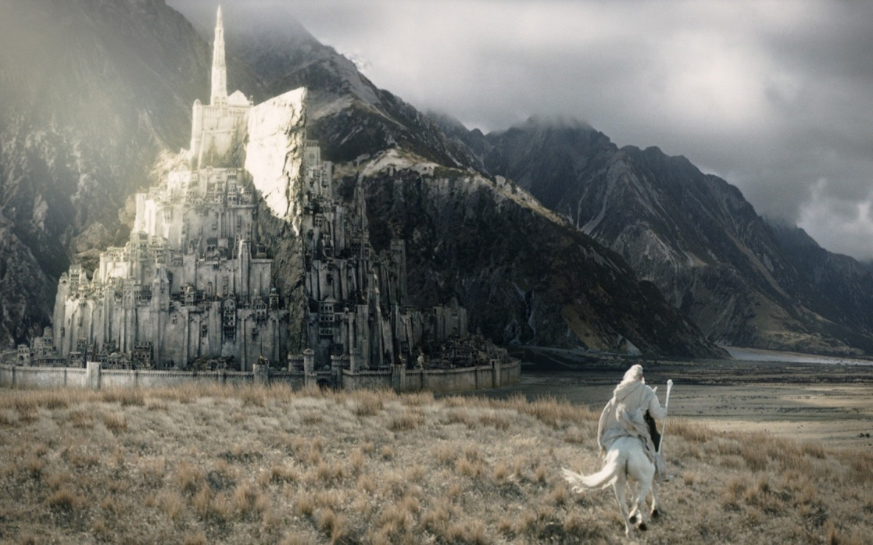
Minas Trith
Minas Tirith originally named Minas AnorIt became the heavily fortified capital of Gondor in the second half of the Third Age. It was originally built to guard the former capital, Osgiliath, against attacks from the west, but became the capital when Osgiliath fell into ruin following the Kin-strife and the Great Plague. It is often referred to as the White City (though that name is not in the book) or the City of the Kings.

Slide 13
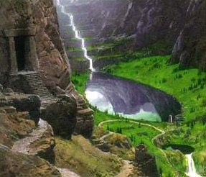
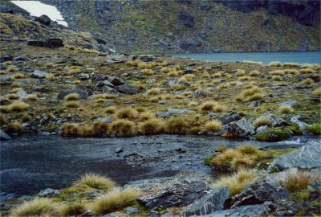
Dimrill Dale
Dimrill Dale is a valley on the east side of the Misty Mountains, beneath the Redhorn, Silvertine and Cloudyhead peaks. It is the eastern end of Redhorn Pass and is bordered by the Dimrill Stair.
Dimrill Dale is the source of the Silverlode river. At its southeast corner there is Mirrormere, a sacred lake to the Dwarves of Durin's Folk.

Slide 14
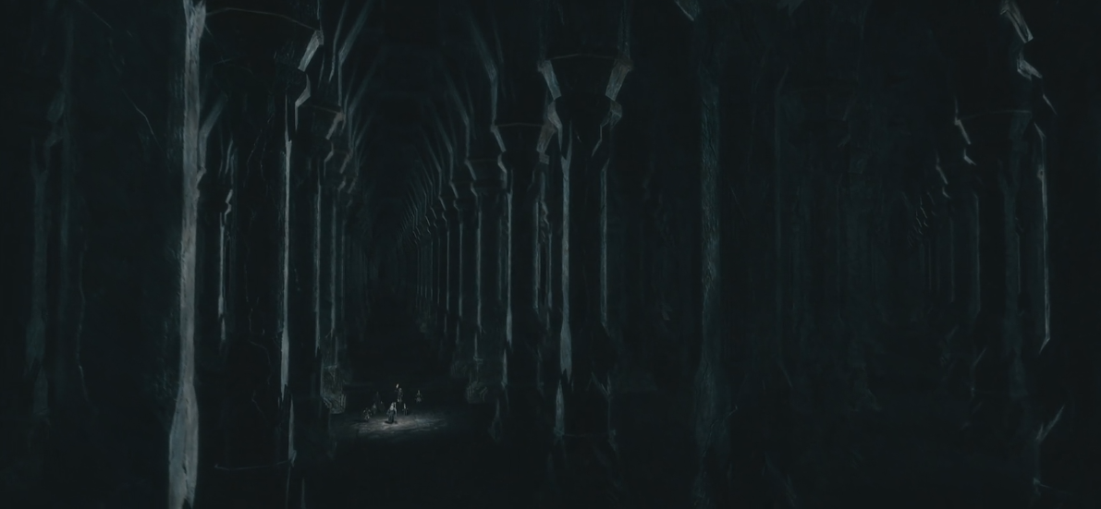
moria
Moria was the Dwarven underground city beneath the Misty Mountains. For thousands of years, a thriving Dwarvish community had delved deep below the mountains seeking to build their lives there, and to find sources of treasure, gold and Mithril. The city was abandoned during the Third Age after excavations accidentally released a Balrog.

Slide 15
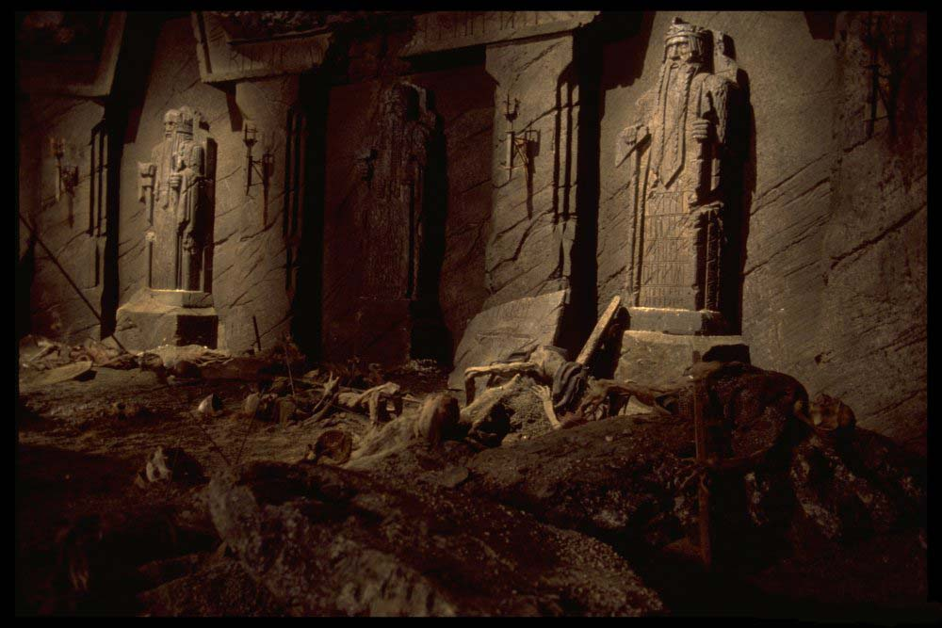
Moria
After the events in The Hobbit, some of the Dwarven Company, namely: Balin, Oin, and Ori led an expedition to reclaim and recolonize the city. However, the group encountered significant Orc resistance, who still occupied the mines. Unfortunatelly they all died in the fight with Orcs.

Slide 16
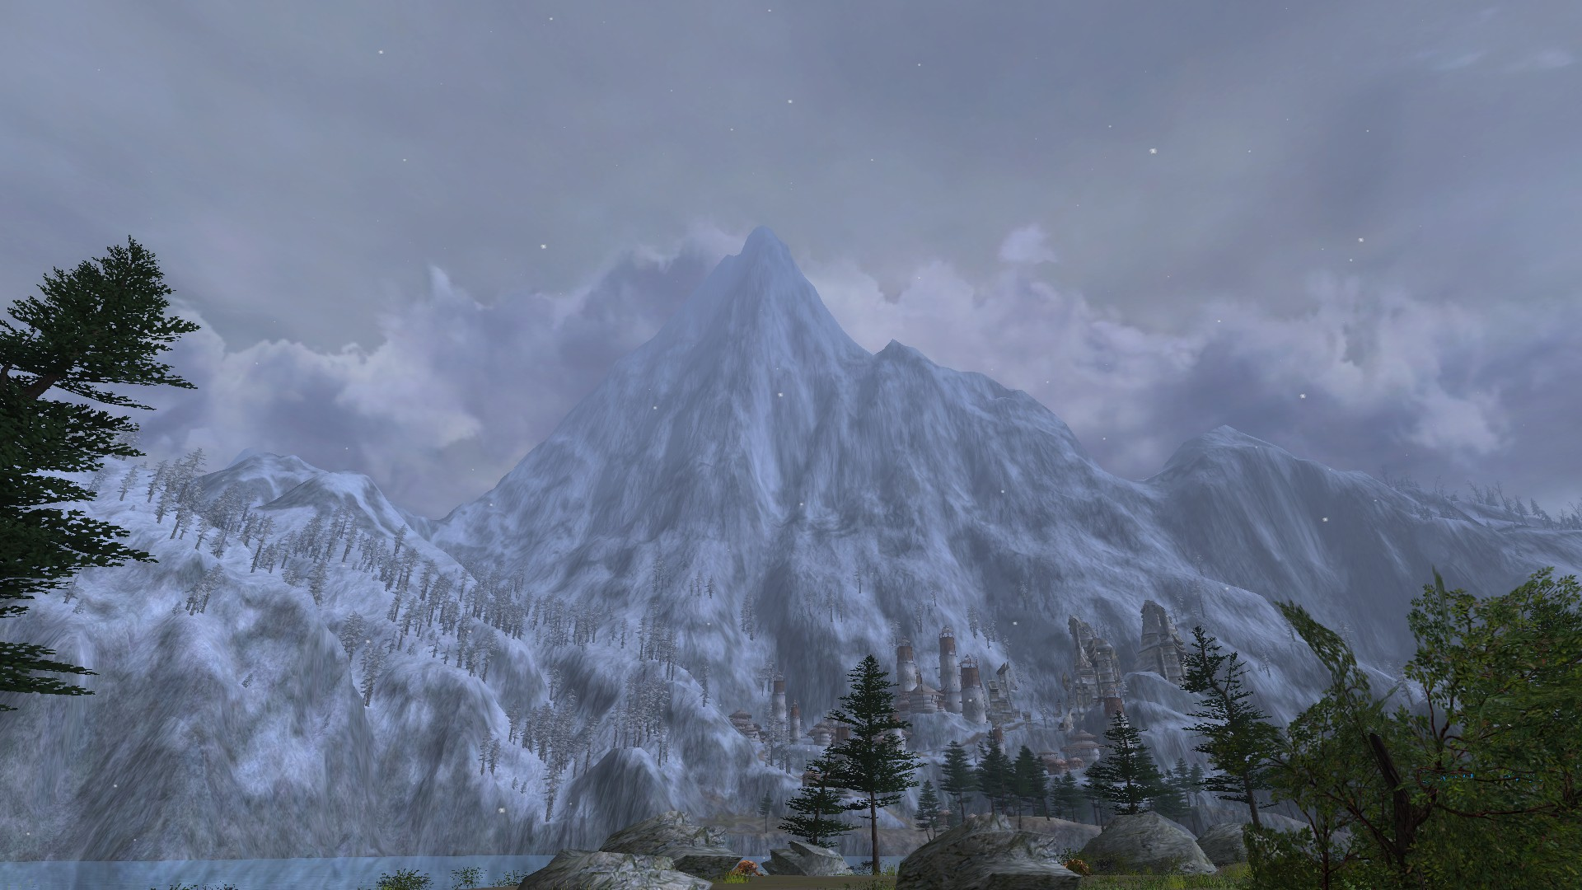
misty mountains
The Misty Mountains, or Hithaeglir, is a mountain range that runs 1280 kilometres from north to south between Eriador and the valley of the Great River, Anduin, and from Mount Gundabad in the far north to Methedras in the south. An early version of its name was Ered Hithui

Slide 17
Misty Mountains
The northernmost peak of the Misty Mountains is Mount Gundabad; where according to legend, Durin (the eldest of the Seven Fathers of the Dwarves) awoke, unfortunatelly, after waking up Balrog, it became an abode and mountain-fortress of Orcs.
The greatest Dwarven realm in Middle-Earth, Khazad-dûm (later named Moria), was located at the midpoint of the Misty Mountains. The three peaks that were part of Khazad-dûm were Caradhras (Redhorn), Celebdil (Silvertine) and Fanuidhol (Cloudyhead). Inside Celebdil, the Dwarves built the Endless Stairs, from the foundations of the mountain to the top of it. The southernmost peak of the Misty Mountains is Methedras, meaning "the Last Peak".

Slide 18
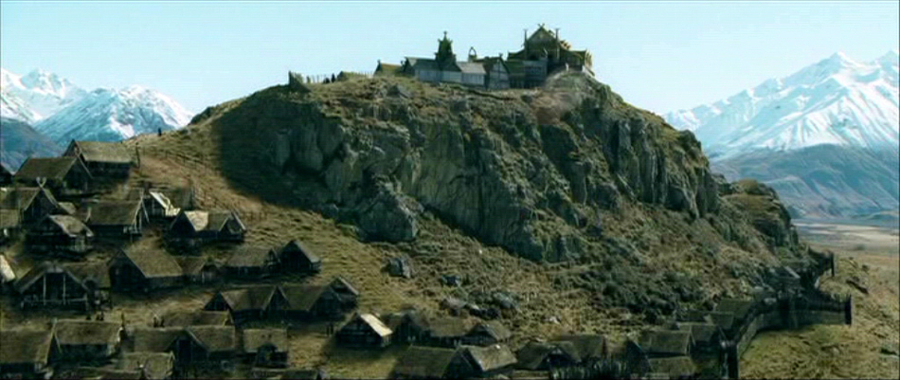
edoras
The city of Edoras was built on a hill in a valley of the White Mountains by Rohan's second King, Brego son of Eorl the Young. Before this, Rohan's capital was at Aldburg in the Folde.

Slide 19
Edoras was built at the end of the valley of Harrowdale, which lay under the great mountain Starkhorn. The river Snowbourn flowed past the city on its way west towards the Entwash. As Rohan consisted of mostly small villages and farmsteads, Edoras was the closest thing Rohan had to a city, and held the Golden Hall of Meduseld. It was here that Aragorn, Gimli, Legolas, and Gandalf met with King Theoden.

Slide 20
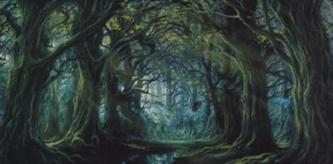
fangorn forest
Fangorn is the home of the tree shepherds, the Ents. The Forest of Fangorn provided an important role in The Lord of the Rings novel as did Mirkwood and Lothlorien in the Third Age, a time when Sauron challenged Middle-earth to a battle for domination.

Slide 21
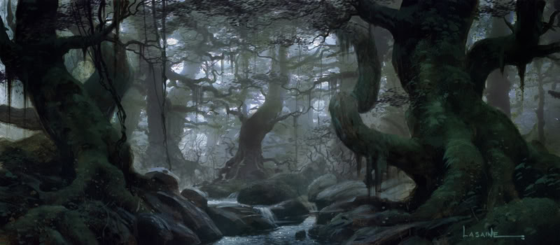
Fangorn Forest
Merry Brandybuck and Peregrin Took were the first to discover the Ents were still alive but dwindling in numbers due to the loss of their Entwives, who were lost because of the events at the Last Alliance of Elves and Men. The forest was again severely damaged during the War of the Ring by the forces of Saruman who lived close by, in the fortress of Isengard.

Slide 22
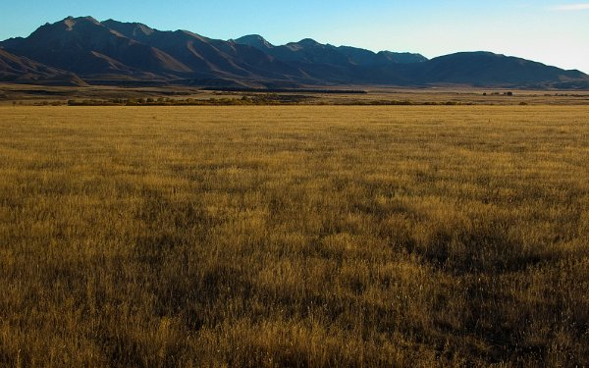
pelennor fields
After Minas Ithil had fallen and was renamed Minas Morgul, the Pelennor Fields were walled by the Rammas Echor, to prevent attacks from Mordor.

Slide 23
Pelennor Fields
During the War of the Ring, the Pelennor Fields were the location of a battle whereSauron's Orcs and Easterling armies overran the Rammas Echor and besieged the city.
It was on these fields that King Theoden was slain, along with the Witch-king of Angmar, and that most of this great battle was fought.
After the War of the Ring, the Rammas Echor was rebuilt by the Dwarves of the Glittering Caves.
The Battle of the Pelennor Fields was a battle for the city of Minas Tirith, and ultimately for Gondor, during the War of the Ring. It was the greatest battle of the War of the Ring, and indeed the largest of the entire Third Age.
Major casualties resulted from this battle - including the deaths of King Theoden and the Witch-king of Angmar.

Slide 24
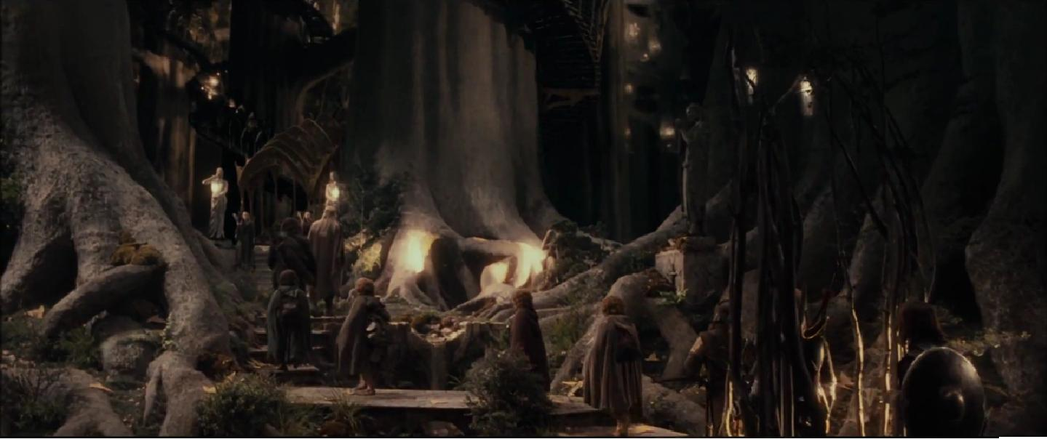
lothlorien
Lothlorien is a forest located next to the lower Misty Mountains. It was first settled by Nandorin elves, but later enriched by Noldor and Sindar, under Celeborn of Doriath and Galadriel, daughter of Finarfin.

Slide 25
Lothlorien
Two places in Arda are also known as Lorien, and both were exceptionally beautiful. The first was the gardens of the Vala Irmo in Valinor (Irmo was usually called Lorien as well). The second is Lothlórien, where Galadriel dwelled during the events of The Lord of the Rings.
Although Sauron's recovery of the One Ring was a great threat to Lorien. The power of Nenya would fade and Lothlorien would cease to be a magical realm, if Frodo destroyed the Ring. The Elves agreed to that because the alternative would be the enslavement of the Elves if Sauron was victorious.

Slide 26
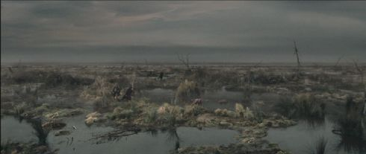
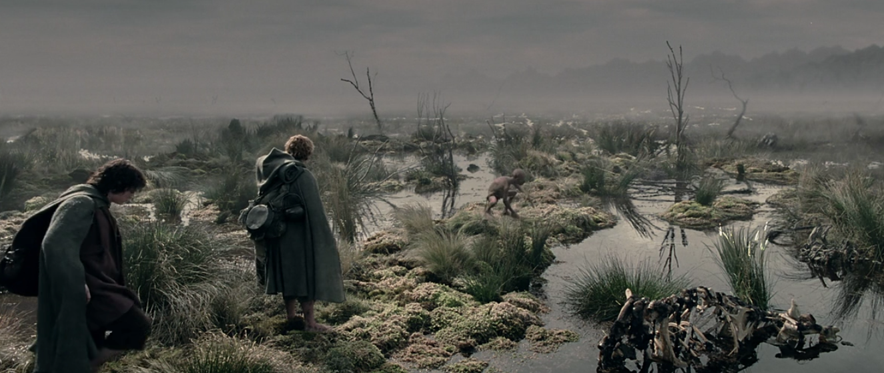
The Dead Marshes
The Dead Marshes was an area of swampland east of the Emyn Muil and bordered on the east by the Dagorlad plain, site of the ancient Battle of Dagorlad during the Last Alliance of Elves and Men.

Slide 27
THE END
Thanks for watching

