Slide 1

The Maoris
Author:
Anna Dorociak III A
Supervisor: Małgorzata Stasińska

Slide 2
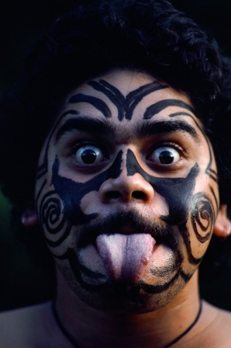
The Maoris
Who are Maoris ?
First Polynesian people arrived in New Zealand in the 12 th century by crossing the Pacigic Ocean in their wooden canoes. They were advanced sailors who navigated by observing stars, clouds, birds and waves. Maori people who live today in New Zealand are their descendents.
Maoris were engaged in cultivation of plants, farming and fishing. They also practiced cannibalism. They became famous for their artistic talents in the field of sculpture, building and very *widespread tattoo and for their *valiance in wars.

Slide 3
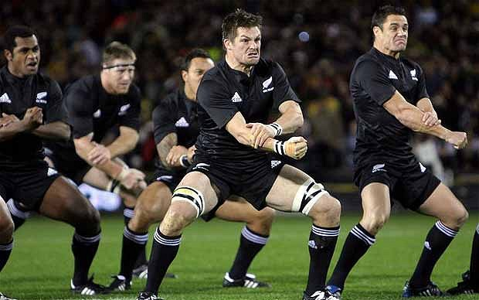
The culture and customs
Haka:
The most characteristic feature of Maori culture is the famous war dance called Haka.
It is danced in order to scare the opponents and prepare warriors for a batlle.
Haka, which consist of making distinctive faces with wide open eyes and tongue sticking out,
makes a big impression on spectators, even if it is danced only by a few dancers

Slide 4
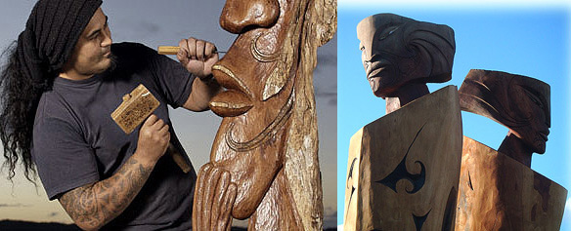
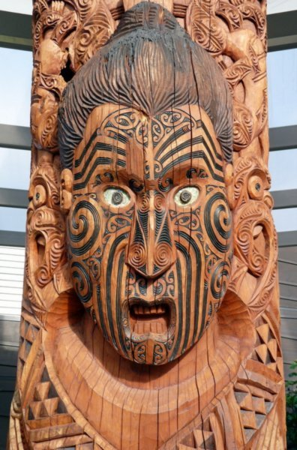
Art:
The traditional Maori art uses all available materials such as wood, stones (including greenish colored jadeite), bone, feathers and shells.
It's worth emphasizing that white, red and black colors are usually used in the Maori works, because these colours have symbolic meaning for them, For example: red is the color of prestige and power.

Slide 5
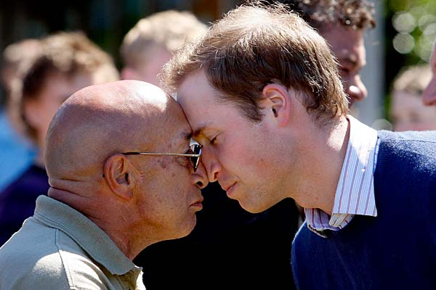
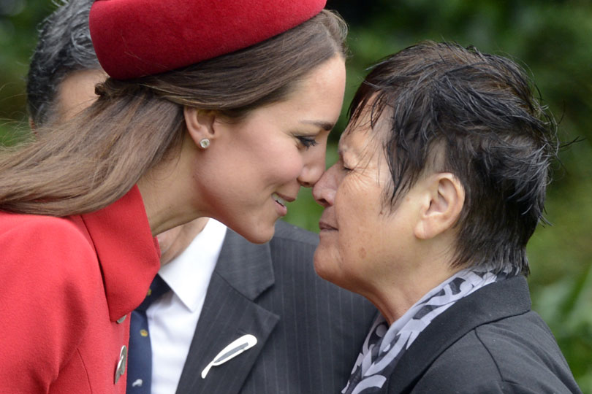
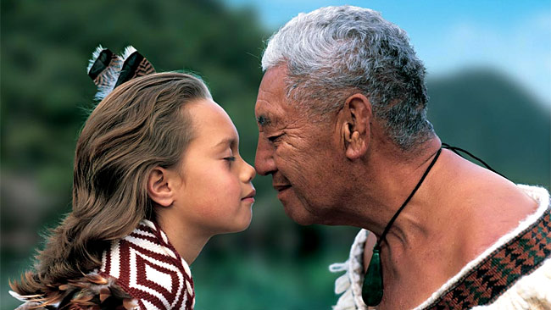
Hongi
A hongi is a traditional Māori greeting
in New Zealand. It is done by pressing
one's nose and forehead (at the same time)
to another person at an encounter.
It is used at traditional meetings among Māori people and on major ceremonies
and serves a similar purpose to a formal handshake in modern western culture,
and indeed a hongi is often used in conjunction with one.

Slide 6
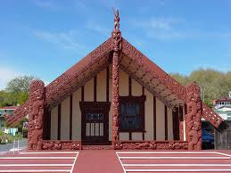
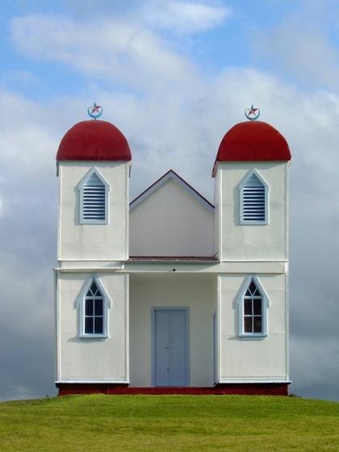
Beliefs
The ancient faith of Maoris consisted of believing in magic and nature.
Nowadays many Maori belong to different types of Protestant Church.
Maori Meeting House
Ratana Church near Raetih

Slide 7
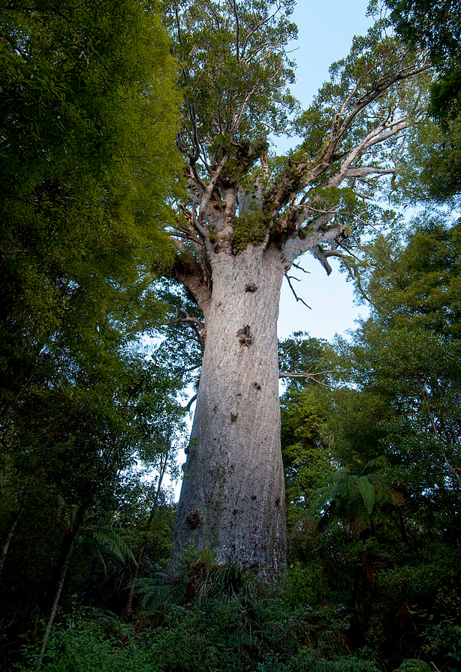
Maoris god
Tane Mahuta
In Māori mythology, Tāne (also called Tāne Mahuta, Tāne nui a Rangi, and several other names) is the god of forests and of birds, and the son of Ranginui and Papatuanuku, the sky father and the earth mother, who lie in a tight embrace.

Slide 8
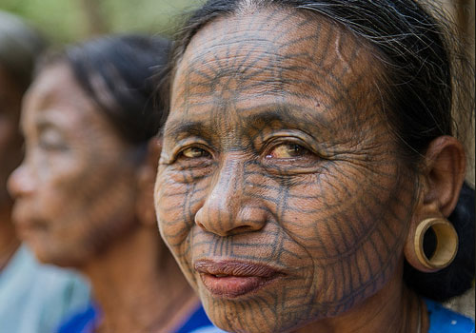
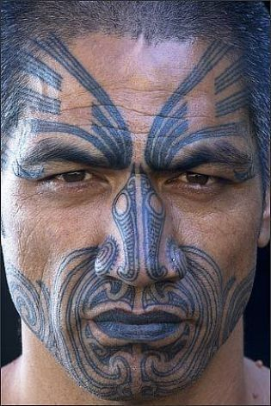
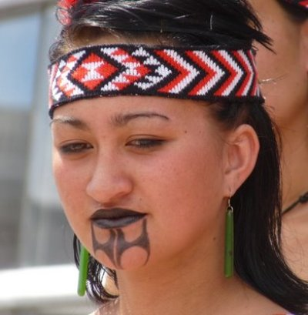
Tatoes and their meaning
Maori paint them on their bodies and faces. Traditionally, they aren't punctured by needle, but with the use of *chisel, for example made of albatross bone. As a result, their texture is *uneven, *convex. Having a tattoo is understood as paying respect and affection for the traditions and Maori culture. Men wear them usually on their faces, butocks, thighs and arms, while women on their chins, noses and mouths. Tattoes, like mask express the identity of the person who wears them : her origin, status and achievements.

Slide 9
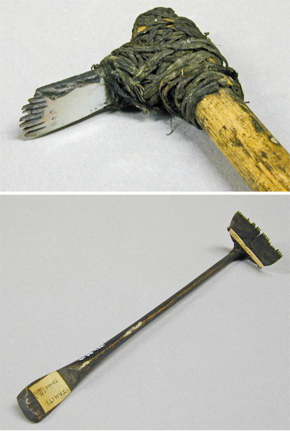
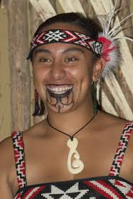
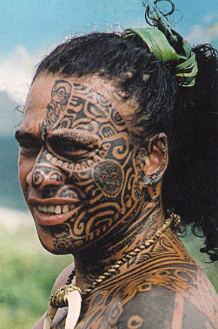

Slide 10
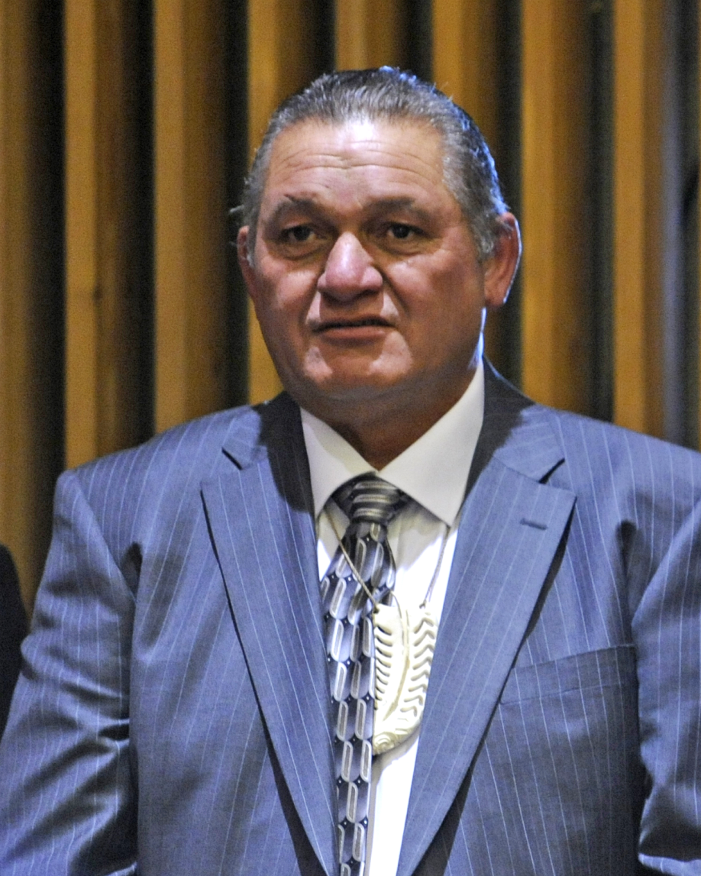
King : Tuheitia Paki
Tuheitia Paki is the Maori's king since 21st August, 2006.

Slide 11
Vocabulary
* widespread - rozpowszechniony
* valiance - męstwo
* chisel - dłuto
* uneven - nierówny
* convex - wypukły

Slide 12
Thanks for watching

