Slide 1
Fauna and Fauna of New Zealand
Izabella Zalewska IIIA

Slide 2
Birds od New Zealand

Slide 3
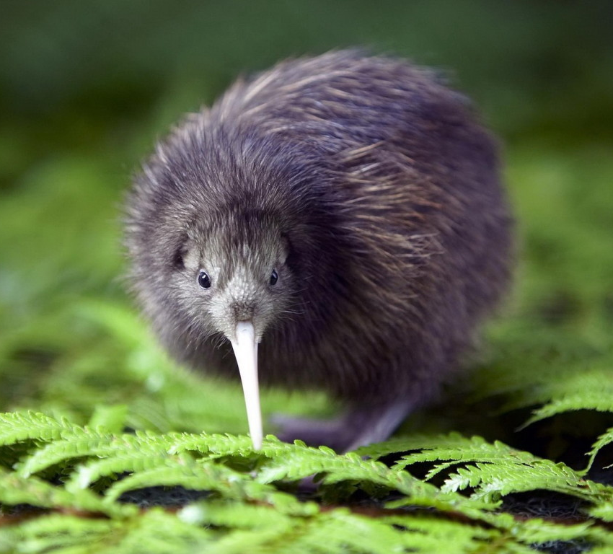
Kiwi

Slide 4
Kiwi - flightless bird native to New Zealand. It is 35-65 cm in length and weighs about 3.5 kg. It doesn’t have a tail. It feeds on invertebrates and plants. It’s nocturnal.

Slide 5
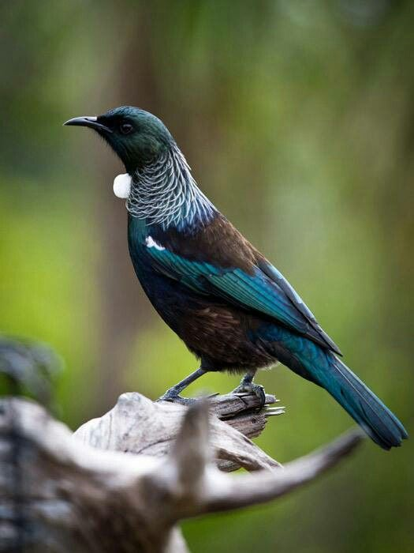
Tui

Slide 6
Tui - bird of honeyeater family. It reaches 28 cm in length. It is characterized by shiny metallic, green feathers. It has the ability to imitate the voices of other birds.

Slide 7
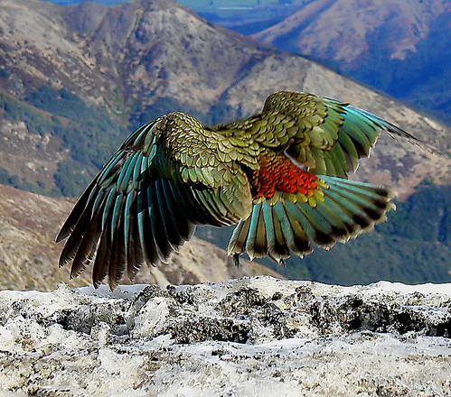
Kea

Slide 8
Kea - omnivorous, carnivorous parrot. It is 46 cm in length and weighs about 1 kg.

Slide 9
Geckos of New Zealand

Slide 10
Auckland green gecko

Slide 11
Auckland green gecko - is found only in the northern half of the North Island of New Zealand. Its length is up to 145 mm (without tail).
It lives in scrub and forest areas.

Slide 12
Mammals of New Zealand

Slide 13
Hector's dolphin

Slide 14
Hector's dolphin - is the best-known dolphin in New Zealand. Adults are 1.2 to 1.6 m in total length and weigh between 40–60 kg.

Slide 15
New Zealand long-tailed bat

Slide 16
New Zealand long-tailed bat – also known as the long-tailed wattled bat or pekapeka-tou-roa. It can fly at 60 kilometres per hour. It weighs 8 - 12g.

Slide 17
Spiders of New Zealand

Slide 18
Delena cancerides

Slide 19
Delena Cancerides - is a large, brown huntsman spider native to Australia. It has been introduced to New Zealand. This was the species used at the beginning of the movie “Spider-Man” and in “Arachnophobia”, but it is generally considered harmless to humans. Its body length is about 25-30 millimetres.

Slide 20
Dolomedes aquaticus

Slide 21
Dolomedes Aquaticus - is a fishing spider that lives and hunts along the gravel banks of unforested New Zealand rivers. It prefers open riverbanks where it lives under rocks, usually less than 5 metres from the river. Its colouring allows it to blend in with river stones. Normally nocturnal, it sits and waits for its prey after dark, and can survive for short periods under the water. The total length of this spider is 18 mm.

Slide 22
Flora of New Zealand

Slide 23
Kiwifruit

Slide 24
Kiwifruit - is native to China, but is grown on a large scale in New Zealand. New Zealanders are known by their nickname Kiwi, throughout the world.

Slide 25
The Mighty Kauri Tree

Slide 26
Kauri - is a coniferous tree found on the New Zealand's North Island. It is the largest (by volume) but not tallest species of trees in New Zealand, standing up to 50 m tall.

