Slide 1
Sports in Canada.
Gimnazjum nr 2 im. Jana Kochanowskiego w Zgierzu z Oddziałami Dwujęzycznymi
Opiekun: Małgorzata Stasińska
Łukasz Kochaniak, Robert Pawłowski, Michał Zapała IIIa

Slide 2
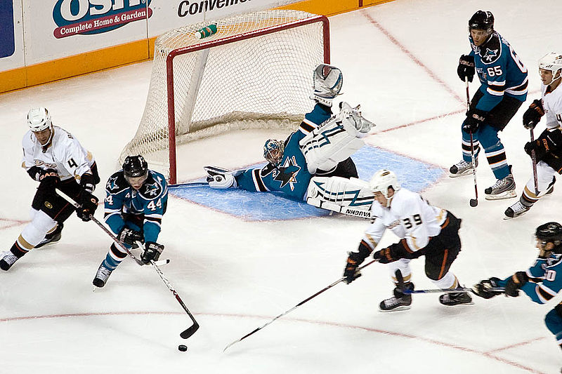
Ice Hockey
Ice hockey is a team sport played on ice.
The game is played between two teams of six players, who use wooden or composite sticks to shoot a hard rubber hockey puck into their opponents’ net to score points.
Hockey is known as the fastest
game on earth.

Slide 3
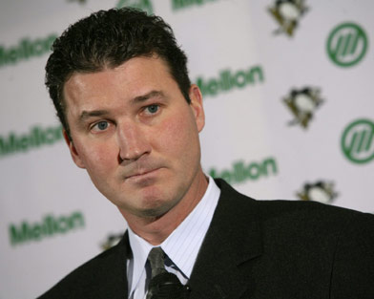
Mario Lemieux
Mario Lemieux, is widely acknowledged to be one of the best players of all time. He was born inCanada. He played 17 seasons as a forward for the Pittsburgh Penguins.

Slide 4
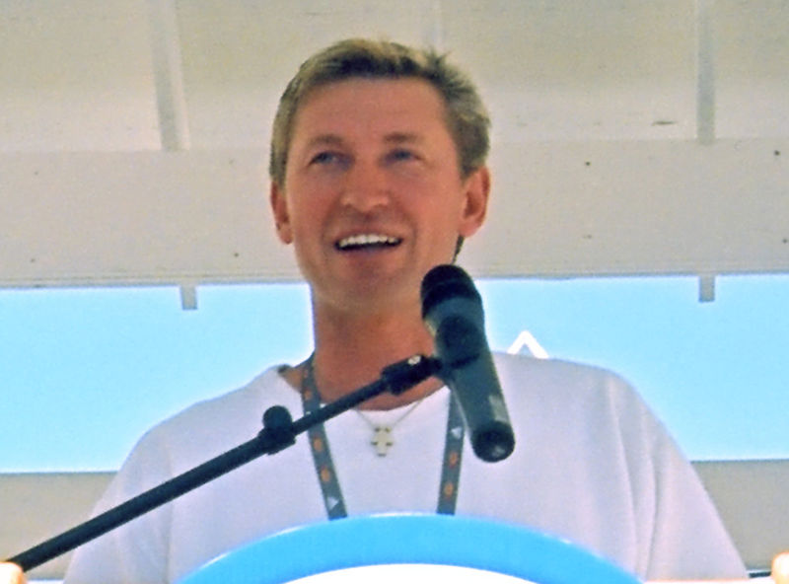
Wayne Gretzky
Wayne Gretzky is a Canadian ice hockey player and former head coach, widely regarded as the greatest hockey player of all time.
Nicknamed "The Great One", he has been called "the greatest hockey player ever” by many sportswriters, players, and the NHL itself.
He played 20 seasons in the NHL playing in four teams from 1979 to 1999.

Slide 5
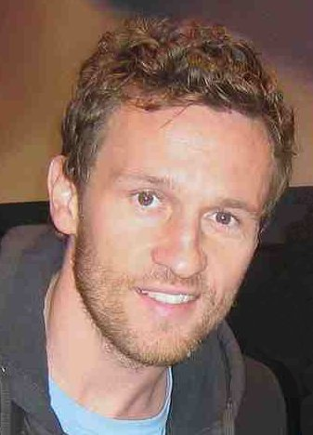
Mariusz Czerkawski
Czerkawski is a retired Polish ice hockey player. He played for the Boston Bruins, Edmonton Oilers, New York Islanders, Montreal Canadiens and Toronto Maple Leafs in the NHL. He was the first person born and trained in Poland to play in the NHL.

Slide 6
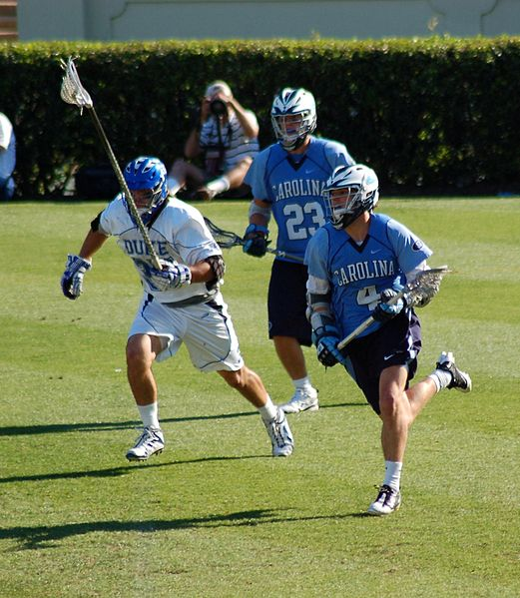
Lacrosse
Lacrosse is a team sport of Native Americans.
It is played using a small rubber ball and a long-handled stick with a net at the end, called a crosse or lacrosse stick.
The ball has to be caught in the net of the stick and thrown again.

Slide 7
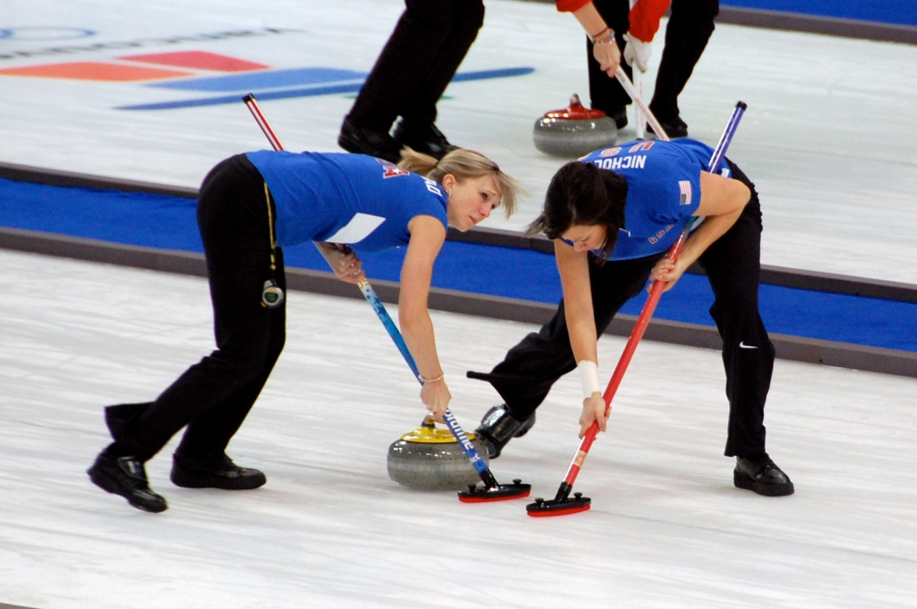
Curling
Curling is a sport in which players slide stones across a sheet of ice towards a target area which is segmented into four rings. It is related to bowls, French boule and
shuffleboard.
Two teams, each of four players, take turns sliding heavy, polished granite stones, also called "rocks", across the ice curling sheet towards the house, a circular target marked on the ice.

Slide 8
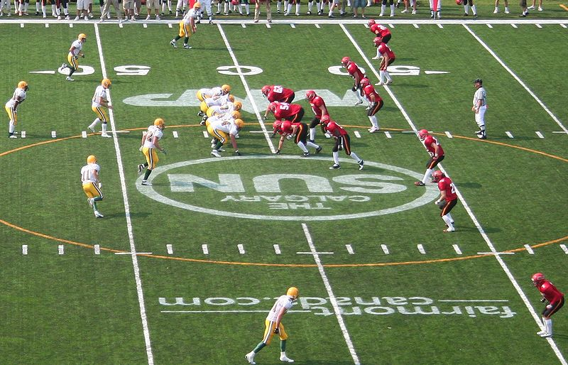
Canadian Football
Canadian football is a form of game played in Canada in which two teams of 12 players each compete for territorial control of a field.
The field is 110 yards (101 m) long and 65 yards (59 m) wide.
They try to get a pointed spheroid ball into the opposing team's scoring area (end zone).
Gridiron – a special football pitch for American football with lines every few metres

Slide 9
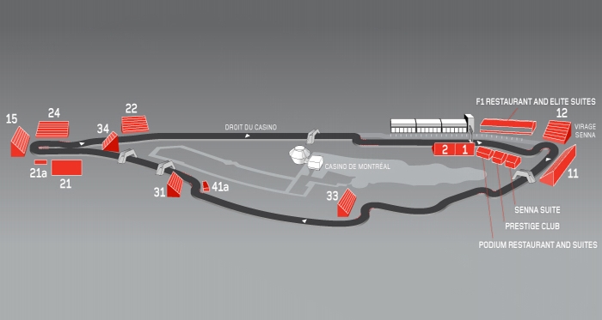
Grand Prix Canadian F1
The Canadian Grand Prix is an annual car race held in Canada. It was organised in 1961 for the first time.
It has been part of the Formula One World Championship since 1967.

Slide 10
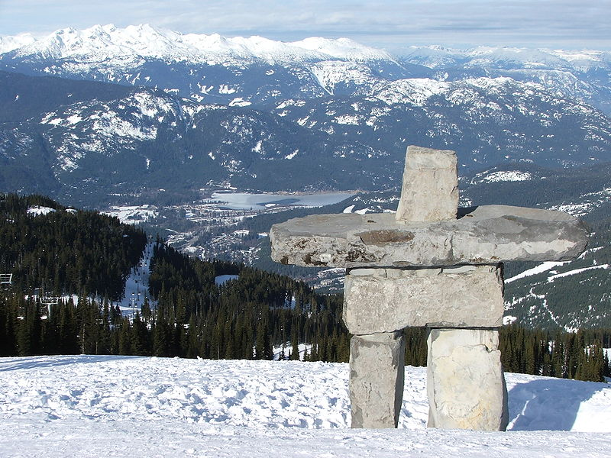
Olympic Games
Canada organized Winter Olympic Games in Vancouver, in 2010.

Slide 11
Skateboarding
Skateboarding is one of the fastets-growing in popularity sports among young people in Canada.
People need special shoes, boards and helmets to do skateboarding.
The most famous brands are: DC, Vans, Circa, Element and Obey.

Slide 12
SKiing
Skiing is recreational activity and competitive sport. People use skies, special boots, helmets and gogles to ski on top of the snow.

Slide 13
Snowboarding
Snowboarding is the sport in which you have to ride on the edge of a board.
Snowboarders must have special winter wear, boards, boots, gloves and helmets.
The most famous brands are: Raven, Salomon, Flow, Ride, Nidecker and Voelkhl.

Slide 14
Thanks for watching our presentation.
The materials were taken from: Wikipedia, Google and hand outs.
☺

