Slide 1
FAMOUS CANADIANS

Slide 2
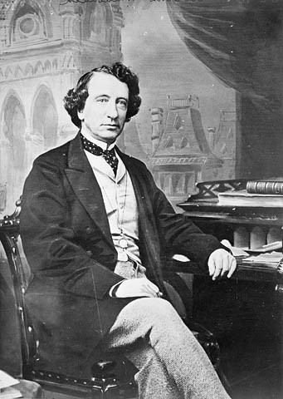
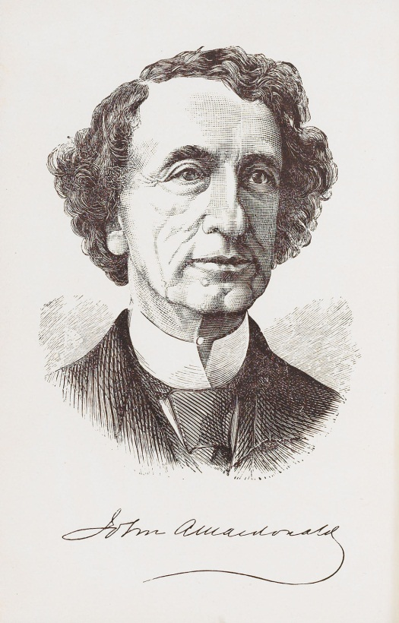
John Alexander Macdonald
The first Prime Minister of Canada. He held his office twice since July 1, 1867 to November 5, 1873 and the second time since October 17, 1878 to June 6, 1891. Macdonald was one of the Conservative Party. He was a lawyer.

Slide 3
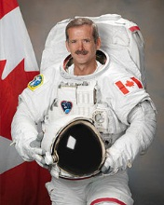
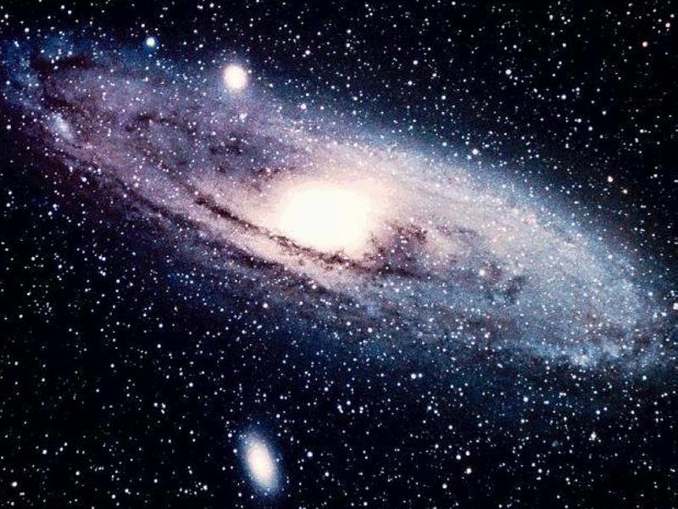
Chris Hadfield
Canadian astronaut who was the first Canadian took a walk in space. He participated in two flights.

Slide 4
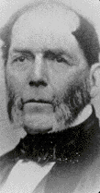
Abraham Gesner
Canadian physician and geologist, inventor of kerosene, considered one of the fathers of the petrochemical industry.

Slide 5
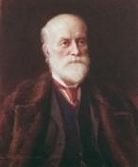
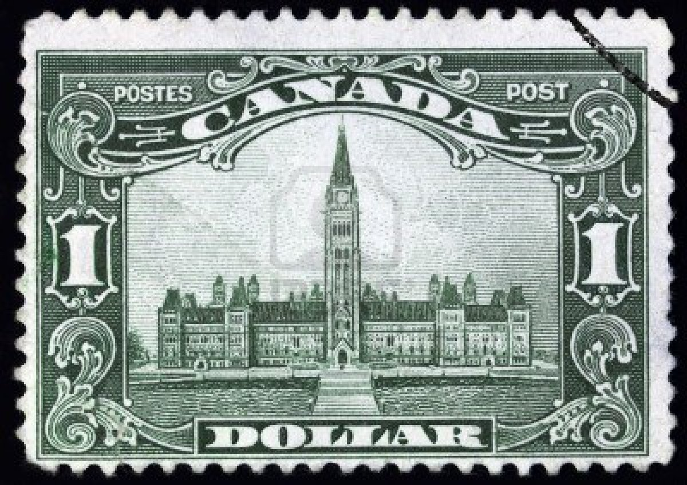
Sandford Fleming
Canadian engineer and inventor. He became famous with the introduction of universal time and time zone. He was the founder of the first Canadian postage stamp.

Slide 6
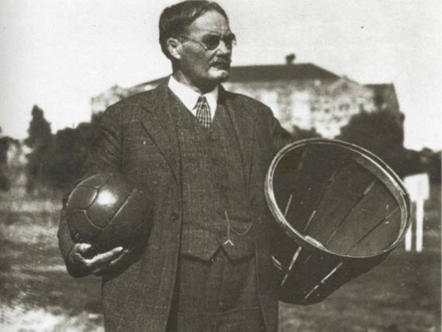
James Naismith
Canadian physician, founder of basketball. The first game took place on December 15, 1891. Naismith placed in the hall two baskets and divided its students into two nine-person teams. January 15, 1892 basketball rules were published

Slide 7
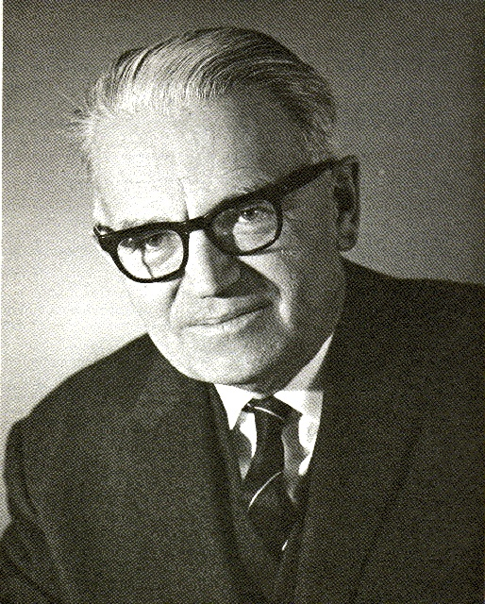
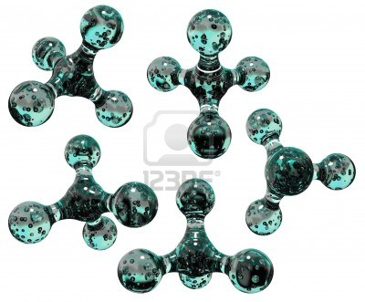
Gerhard Herzbeg
Canadian physicist and chemist of German origin, Nobel Prize 1971 in the field of chemistry for his work on the electronic structure and geometry of molecules.

Slide 8
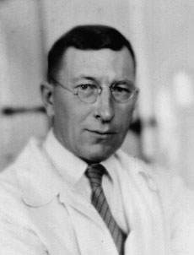
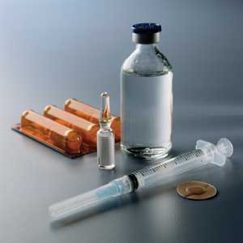
Fredric Banting
Canadian physiologist who discovered insulin. Winner of the Nobel Prize in Physiology or Medicine.

Slide 9
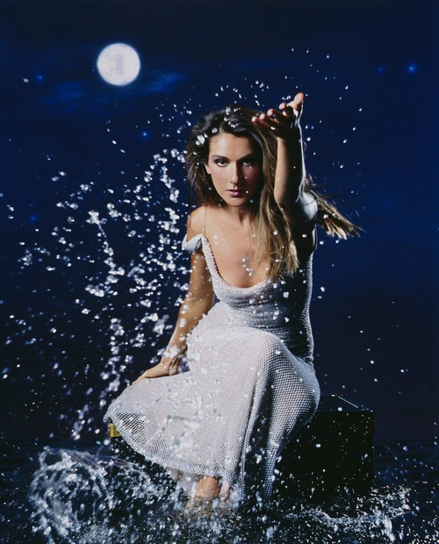
Celine Dion
was born 30 March 1968. She is a Canadian singer, who was born into a large family from Charlemagne, Quebec. In 1990, she released the English-language album Unison, establishing herself as a viable pop artist in North America and other English-speaking areas of the world.

Slide 10
Justin Bieber
was born March 1, 1994 in Stanford. He is a Canadian pop musician, actor, and singer-songwriter. Justin Bieber was discovered in 2008 by American manager Scooter Braun, who came across Bieber's videos on YouTube and later became his manager. Braun arranged for him to meet with entertainer Usher Raymond in Atlanta, Bieber was signed to an Island Records recording contract. His debut extended play, the seven-track My World, was released in November 2009, and was certified platinum in the United States. Justin Bieber, despite his young age, is the most influential man in the world.

Slide 11
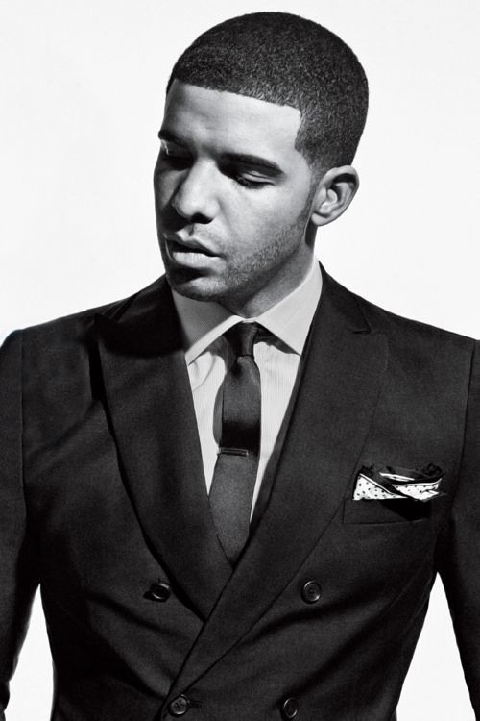
Aubrey Drake Graham
was born October 24, 1986, who records under the nickname Drake, is a Canadian recording artist, rapper, songwriter, and actor. He was born in Toronto, Ontario, and became known for playing Jimmy Brooks on the television series Degrassi: The Next Generation. He later rose to prominence as a rapper, releasing several mixtapes before signing to Young Money Entertainment. Drake has sold over 5 million albums worldwide and his work has earned him a Grammy Award, the most important for musicians.

Slide 12
Avril Lavigne
was born 27 September 1984. She is a Canadian singer-songwriter. She was born in Belleville, Ontario, but spent most of her youth in the small town of Napanee. By the age of 16, she had signed a two-album recording contract with Arista Records worth more than $2 million. In 2002, when she was 17 years old, Lavigne broke onto the music scene with her debut album Let Go. Since her professional debut, she has become one of the most successful artists in the world.

Slide 13
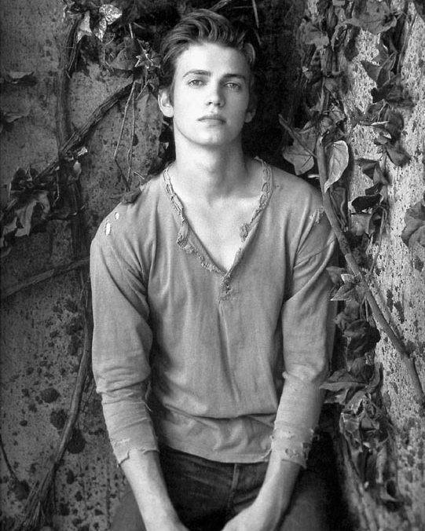
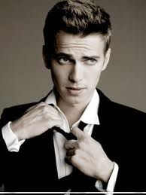
Hayden Christensen
is a Canadian actor. He appeared in Canadian television programs when he was young, then diversified into American television in the late 1990s. He moved on to minor acting roles before being praised for his role of Sam in Life as a House, for which he was nominated for a Golden Globe Award and Screen Actors Guild Award.

Slide 14
Nicole Lilly
is a Canadian actress, known as Kate Austen in the ABC television drama Lost, from 2004 to 2010, and as Tauriel from The Hobbit: The Desolation of Smaug.

Slide 15
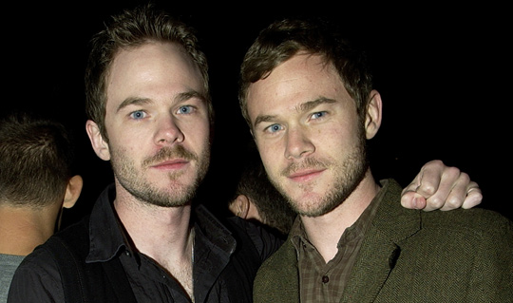
Aaron Ashmore and Shawn Ashmore
(best known for playing Marc Hall in the 2004 Canadian TV movie Prom Queen: The Marc Hall Story. Since then, he has appeared in the films Safe, A Separate Peace, and A Bear Named Winnie) and his brother Shawn Robert Ashmore (best known for his role as Jake in the Animorphs television series and Iceman in the X-Men films) both are born October 7, 1979 are a Canadian film and television actors.
Shawn Robert :
2000 - X-Men ~ Bobby Drake / Iceman
2010 - The Quiet ~ Connor Kennedy
2012 - Mariachi Gringo ~ Edward
Aaron :
1993 - Are You Afraid of the Dark? ~ Billy
2000 - La Femme Nikita ~ Neil Hudson
2010 - Fringe ~ Matthew Rose

Slide 16
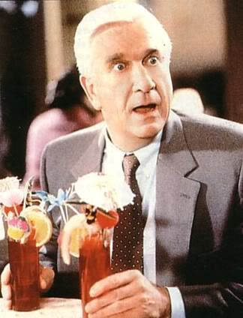
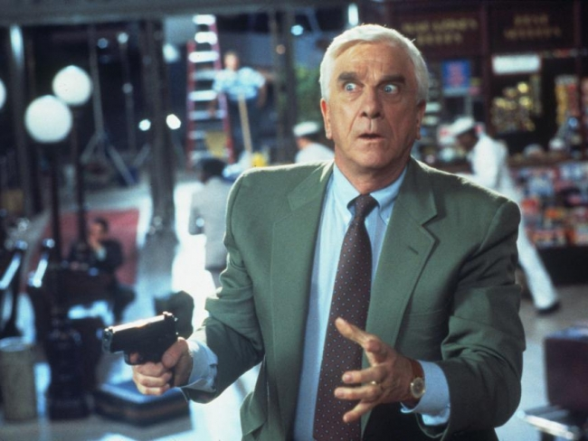
Leslie Nielsen
was a Canadian and naturalized American actor and comedian. Nielsen appeared in more than one hundred films and 1,500 television programs over the span of his career, portraying more than 220 characters.

Slide 17
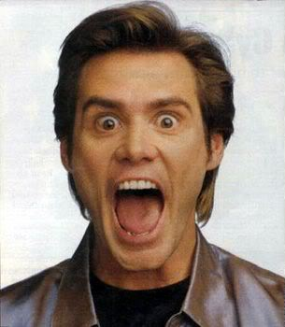
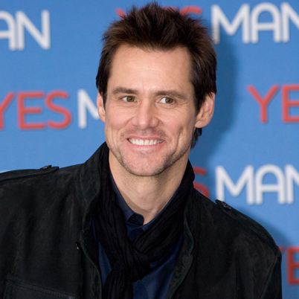
Jim Carrey
is a Canadian American actor, comedian, and producer. Carrey has received four Golden Globe Award nominations, winning two. Known for his highly energetic slapstick performances, he has been described as one of the biggest movie stars in Hollywood.

Slide 18
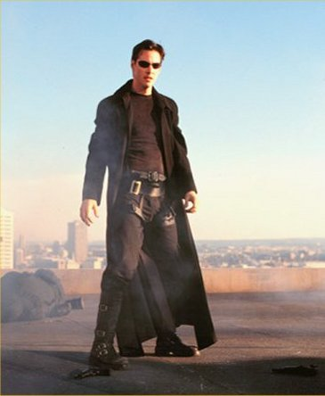
Keanu Reeves
is an Canadian actor. Reeves is known for his roles in Bill & Ted's Excellent Adventure, Speed, Point Break, and The Matrix trilogy as Neo. He has collaborated with major directors such as Stephen 1986 - Youngblood ~ Heaver, Flying ~ Tommy Wernicke, Young Again ~ Mike Riley
1988 - The Prince of Pennsylvania ~ Rupert Marshetta, Parenthood ~ Tod Higgins
1994 – Speed ~ Officer Jack Traven
1997 - The Devil's Advocate ~ Kevin Lomax
1999 - The Matrix, 2003 - The Matrix Reloaded, 2003 - The Matrix Revolutions ~ Thomas Anderson/Neo
2001 - Sweet November ~ Nelson Moss
2005 – Constantine ~ John Constantine

Slide 19
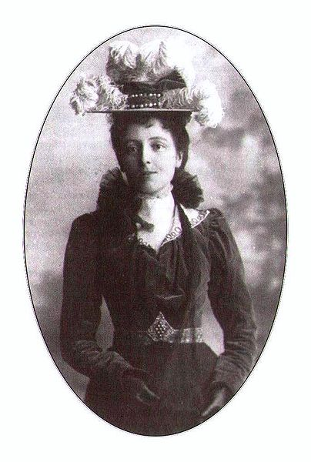
Lucy Maud Montgomery
born November 30, 1874 in Clifton, d. April 24, 1942 in Toronto, Ontario- Canadian writer, among others, series of novels Anne of Green Gables.

Slide 20
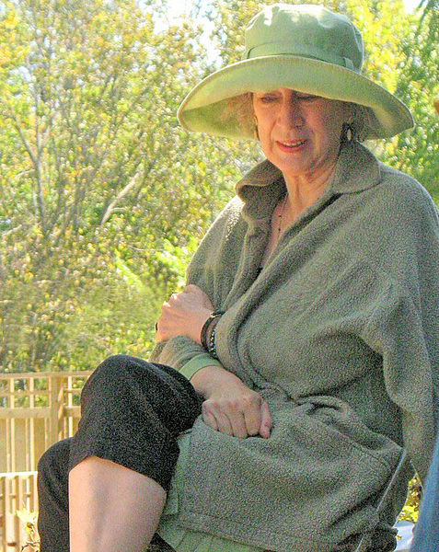
Margaret „Peggy” Atwood
Canadian writer, poet and literary critic, social and environmental activist. She won the Booker Prize in 2000, awarded the Prince of Asturias Prize in 2008, mentioned among the most serious candidates for the Nobel Prize for Literature.

Slide 21
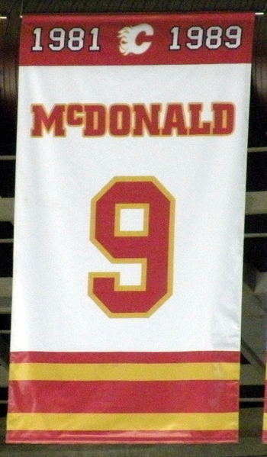
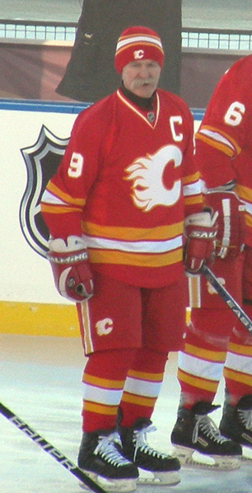
Lanny McDonald
is a Canadian former professional ice hockey player for the Toronto Maple Leafs, Colorado Rockies and Calgary Flames of the National Hockey League (NHL). He played over 1,100 games during a 16-year NHL career in which he scored 500 goals and over 1,000 points. His total of 66 goals in 1982–83 remains the Flames' franchise record.

Slide 22
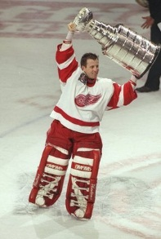
Michael Vernon
is a Canadian former professional ice hockey goaltender. He played 19 seasons in the National Hockey League (NHL) for the Calgary Flames, Detroit Red Wings, San Jose Sharks and Florida Panthers. He is a two-time Stanley Cup champion, with the Flames in 1989 and the Red Wings in 1997. He appeared in five NHL All-Star games, was named a second team All-Star in 1989, shared the William M. Jennings Trophy in 1996 and was named the winner of the Conn Smythe Trophy as most valuable player of the playoffs in 1997. Vernon won over 300 games in his NHL career.

Slide 23
WYKONAŁY : KLAUDIA -KOWALSKA -AGATA POKORA -KAROLINA WITCZAK -NATALIA WOJCIECHOWSKA
ŹRÓDŁA: WIKIPEDIA.PL

