Slide 1
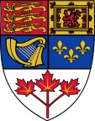
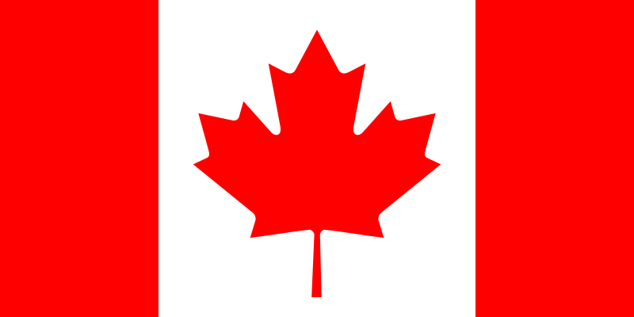
Canada
Gimnazjum nr 2 im. Jana Kochanowskiego w Zgierzu z Oddziałami Dwujęzycznymi
Opiekun: Małgorzata Stasińska
Ola Matysiak, 3a

Slide 2
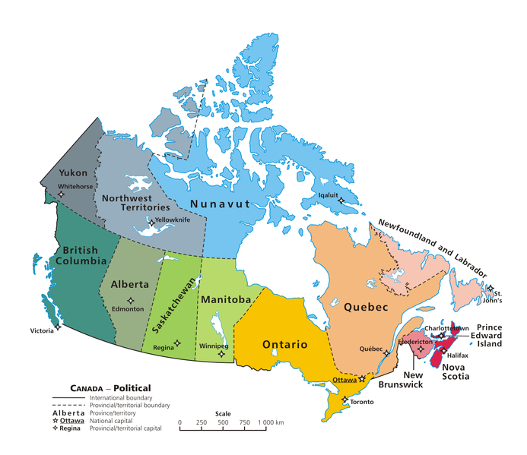
About Canada
Capital city – Ottawa
Population – 34,8 mln
Area – about 10 mln km2
Languages – English, French
Currency – Canadian dollar

Slide 3
Geography
Canada is situated in North America.
It borders with the USA in the south and in the west (Alaska).
It is surrounded by Pacific Ocean in the west, Arctic Ocean in the north and Atlantic Ocean in the east.
Canada is the second-largest country in the world.
The longest river in Canada is Mackenzie (4241 km)
The highest peak is Mount Logan (5959 m).

Slide 4
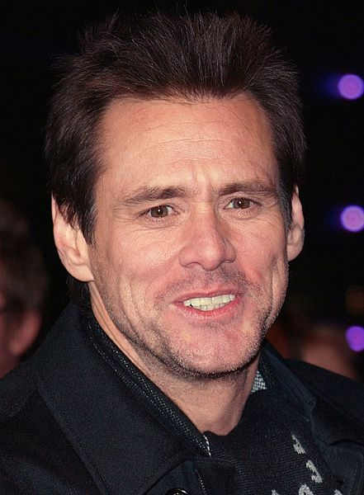
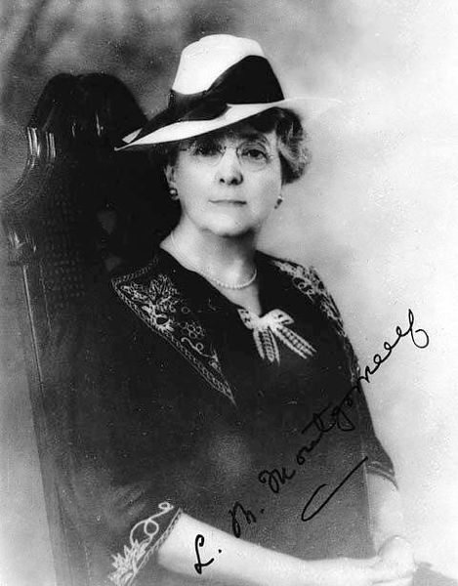
Famous Canadians
Celine Dion
Justin Bieber
Jim Carrey
Nelly Furtado
Lucy Maud Montgomery
(Anne of Green Gables)
Pamela Anderson

Slide 5
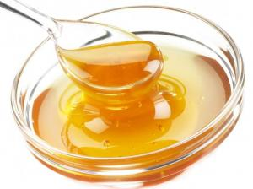
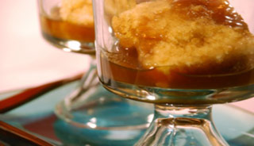
Canadian cuisine
Oysters, mussels with fry fern shoots and seaweed
Lobsters
Solomon Grundy
Calgary beef bash, (corned beef with stewed green beans and chips)
Smoked caribou
Pudding au chomeur – kind of cake with carmel
Maple syroup
Fruit tarts

Slide 6
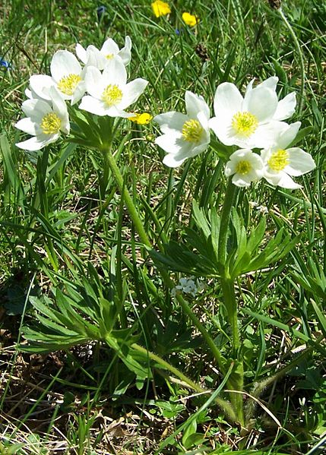
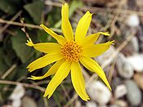
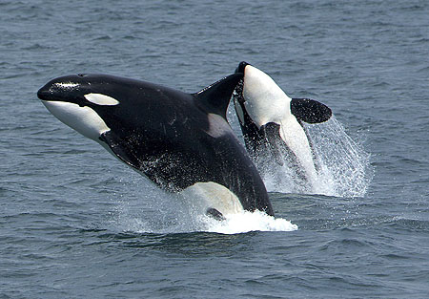
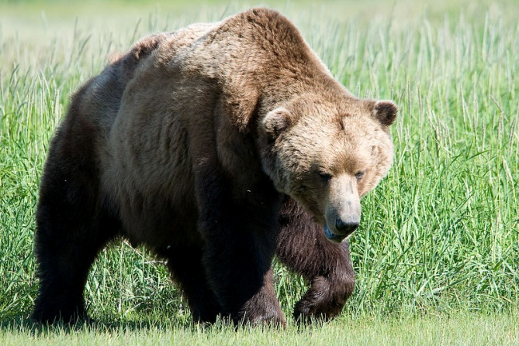
Flora and fauna
Coniferous forests with spruces, firs, pines and larches dominates in Canada. They are called taiga. On the coast of Pacific Ocean grows temperate rainforests with sequoias and maples. In the mountains we can see lilies, narcissus-flowered anemone, arnica.
Narcissus-flowered
anemone
Typical animals of Canada are grizzly, brown and polar bears, caribou and mousse. In the oceans we can meet killer whales.
Arnica

Slide 7
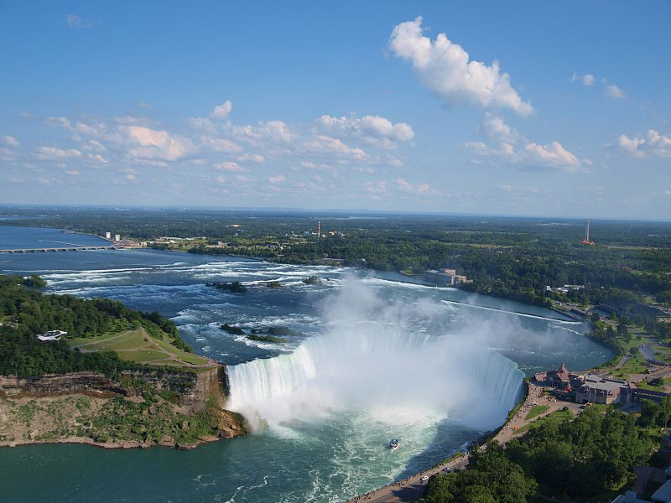
Niagara Falls
There are propably the most famous falls in the world. Niagara falls are on border of Canada and the USA on Niagara River between Erie and Ontario Lake. Some part of water from the falls is used in two power stations. There’s better view on falls from Canada and this side is more
atractive for tourists.
Nearby the Niagara Falls
are many atractions.
For example you can
voyage by ship or visit
‘The Winds’ Cave’.
The falls are lighten
up at night.
Notes:
Szczególnie interesująco wyglądają zimą, kiedy zamarzająca woda tworzy dużych rozmiarów sople.

Slide 8
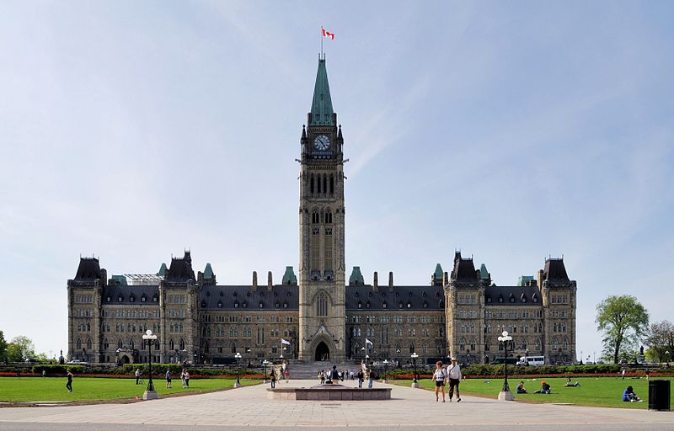
Ottawa
Ottawa is the capital city of Canada since 31st December 1857. It is situated on East part of Ontario upon Ottawa River. The population of the city is about 400,000 people. The most famous places in Ottawa are:
Canadian Museum
of Civilisation,
Parliament Hill
National Gallery
of Canada
Notes:
Canadian museum of civilisaton w Ottawieto muzeum historii ludzkości zaliczane donajbardziej popularnych i najczę ściej odwiedzanych w kanadzie
Parliament hill zespol neogot gmachow z lat 1859 1875 i rozbudowanych w 1916

Slide 9
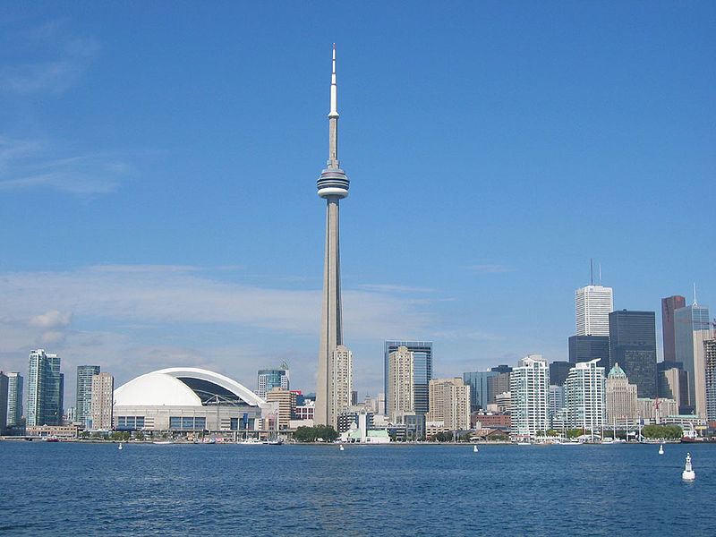
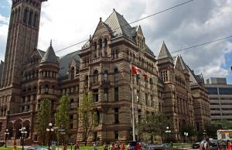
Toronto
Toronto is the biggest city in Canada (841 km²). The population is about 5,9 mln. About 20% of the area of the city is covered with green spaces. Some people say that this is ‘the greenest’ metropoly in the world.
Many events take place in Toronto, i.e.:
The parade of Santa Claus,
Caribana
International Films Festival.
The great atractions are:
Air Canada Centre (famous hockey arena),
Exhibition Place,
Dundas Square,
CN Tower
The Toronto Islands.
Other interesting places are:
Museum of Dolls and
Museum of Sugar.

Slide 10
Information and photos from:
lovetotravel.pl
wikipedia.org
www.recettes.qc.ca

