Slide 1
Canada
The Inuits of Canada
Gimnazjum nr 2 im. Jana Kochanowskiego w Zgierzu z Oddziałami Dwujęzycznymi
Opiekun: Małgorzata Stasińska

Slide 2
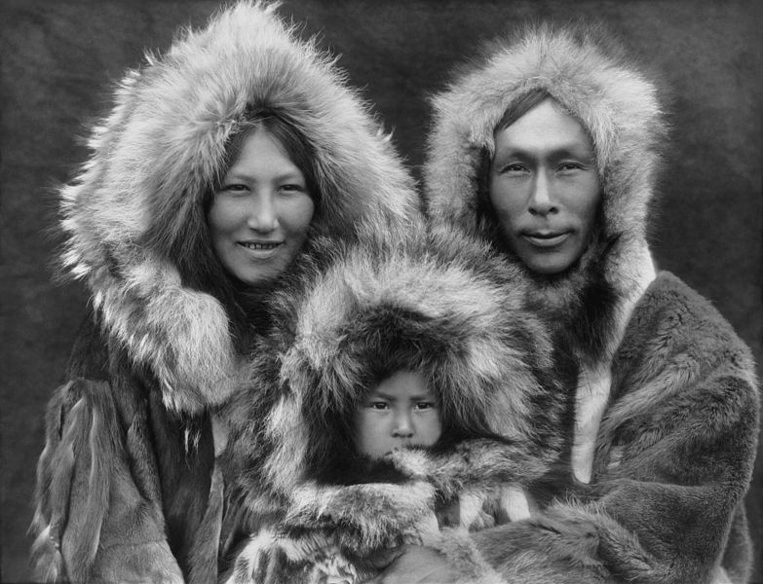
The Inuit of Canada
The Inuit population in Canada is about 25,000.
„Inuit” means „the people” but for a long time, the Europeans called them Eskimos.
These people moved to the Arctic Region about 1,000 years ago.
In 1999, the Canadian goverment gave the Northwestern part of Canada, called Nunavut, to Inuits as their own terroritory.

Slide 3
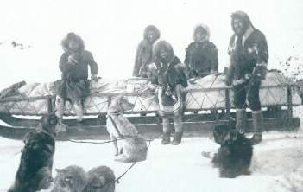
History
The Inuit arrived in their territory around 1,000 years ago from the Alaska region. They had come east, hunting the bowhead whale. Originally there had been other people living in the area where some of them settled, in the areas we now call the Northwest Territories, Northern Quebec and Northern Ontario. This other groups have been called the Dorset culture by archeologists. It is believed that the Dorset culture left around the same time as the Inuit arrived. They may have fought one another.

Slide 4
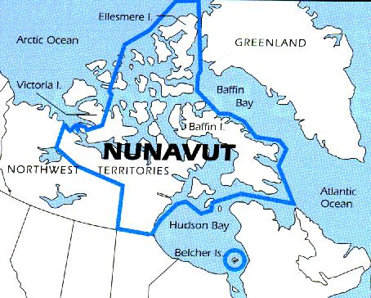
Nunavut
The Canadian Arctic is one of the coldest and harshest environments in the world. Also it is one of the most remote places in the world. Imagine long, cold winters, very little sunlight during a year, freezing fierce storms, and a treeless barren landscape. During winter all you can see is snow. When the snow melts, the ground is rough and rocky. Fighting with the tough weather and harsh environments, the Inuit people have survived in the Arctic for thousands of years.

Slide 5
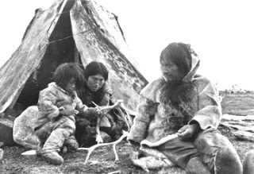
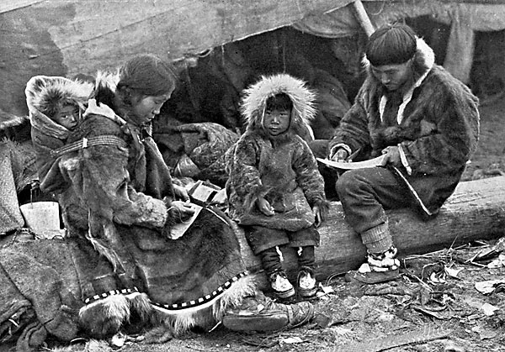
Daily Life
Way of Life
When you live in an environment that has few plants, there is a very good chance you will become a hunter. The Inuit pride themselves on being great hunters. The Inuit had lots of sea and land animals to hunt. The most important of these were the caribou and the seal. These two animals provided the Inuit with food. Their skin was used for clothing, blankets, tents and boats and their oil was used for cooking and lamps. Bones, ivory and wood were used to make tools. Other animals the Inuit hunted were the walrus, whale, polar bear, musk ox, fox and wolf.

Slide 6
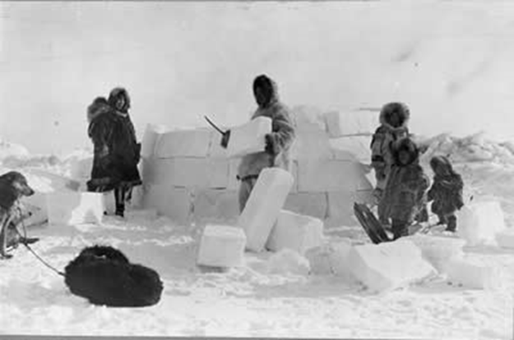
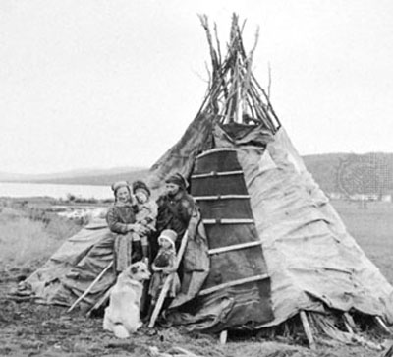
Inuit Homes – in the past
In the tundra, where Inuit communities are found, there are not many building materials. No trees grow in the tundra so in the past, houses couldn’t be made from wood unless it was transported from elsewhere. However, during a large part of the year, the cold part, there is a lot of snow in the tundra. And it turns out that snow could be a very good construction material. In the winter, Inuit lived in round houses made from blocks of snow called "igloos". In the summer, when the snow melted, Inuit lived in tent-like huts made of animal skins stretched over a frame.

Slide 7
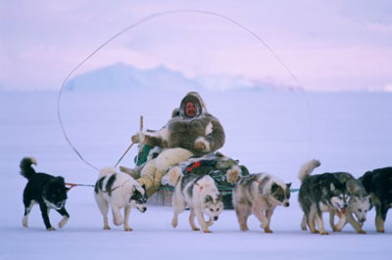
Traditions
Although Inuit life has changed significantly over the past century, many traditions continue. Traditional storytelling, mythology, and dancing remain important parts of their culture. Family and community are very important. The Inuktitut language is still spoken in many areas of the Arctic and is common on radio and on TV.

Slide 8
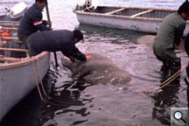
Food
Because Inuit live in places where most plants cannot grow, the traditional diet consisted of almost entirely meat. Inuit fished and hunted to get their food. Whales, walruses, seals, fish were very important in their diet.

Slide 9
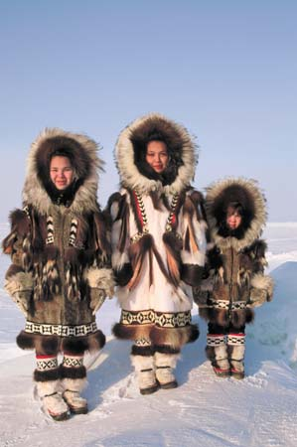
Clothing for staying warm
Traditional Inuit clothing was made from animal leather and fur. Boots were also made from animal leather. Large, thick coats with big hoods called “anoraks” were worn as an outer layer. Today the anorak style of coat is worn in other places in the world and it is made of many other materials.

Slide 10
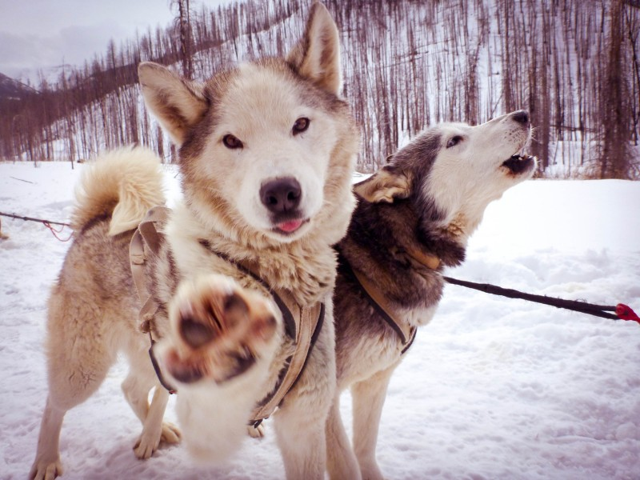
Thanks for watching ;)
Ania Antczak, Angelika Kowalińska, Kasia Marciniak kl IIIa

