Slide 1
The history of Canada
Gimnazjum nr 2 im. Jana Kochanowskiego w Zgierzu z Oddziałami Dwujęzycznymi
Opiekun: Małgorzata Stasińska

Slide 2
Table of Contents:
The first inhabitants
Europeans travels
French conquests
France vs. England
Loyal Canadians
The influx of immigrants
England establishes Canada
The legal situation in Canada
Authority in Canada

Slide 3
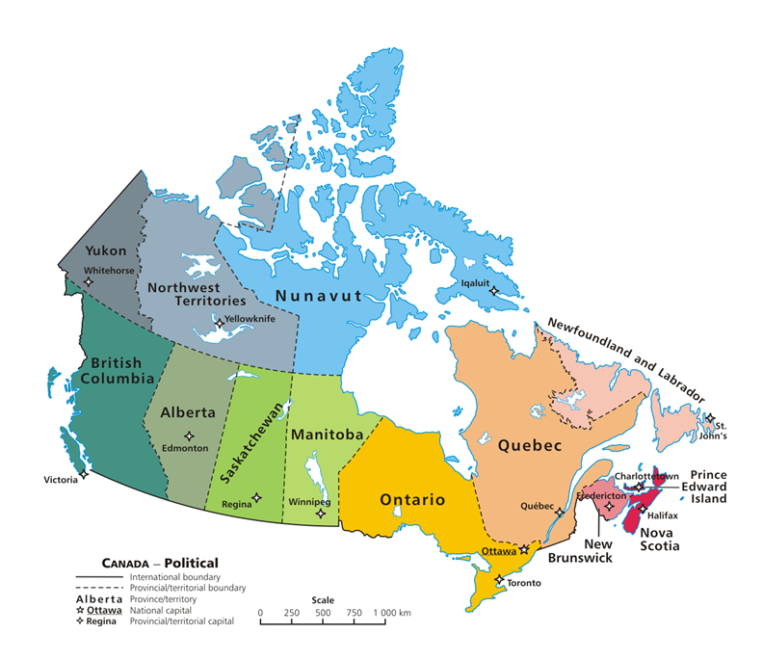
Map

Slide 4
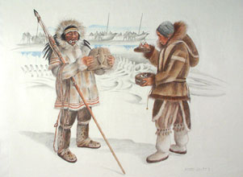
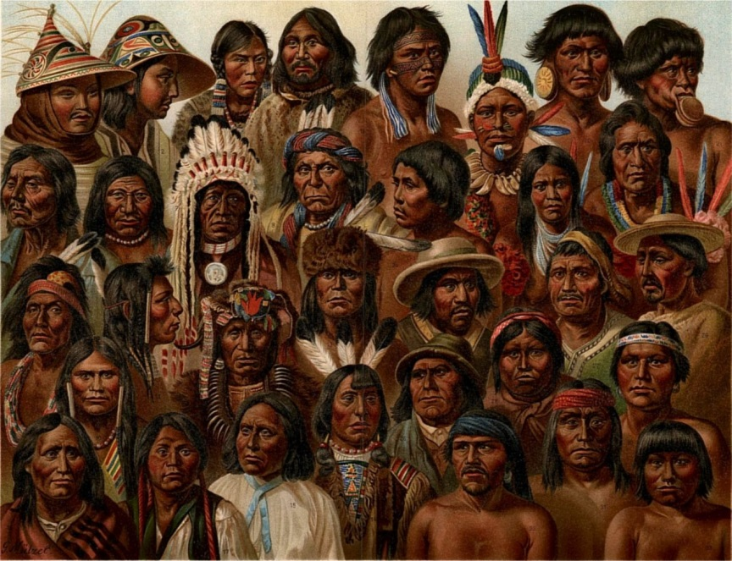
The first inhabitants
It is believed that the Indians and Inuits are the only true native Canadians. They had been living in the land that is now Canada for over 10 000 years before any Europeans had even seen the country. The rest of the people living in Canada are new Canadians, who have been transplanted there from other parts of the world, particularly from Europe.
The Inuits
The Indians

Slide 5
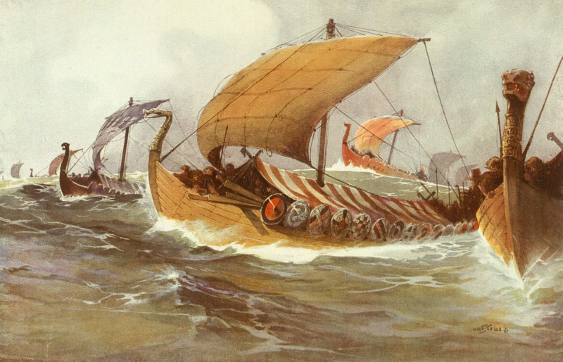
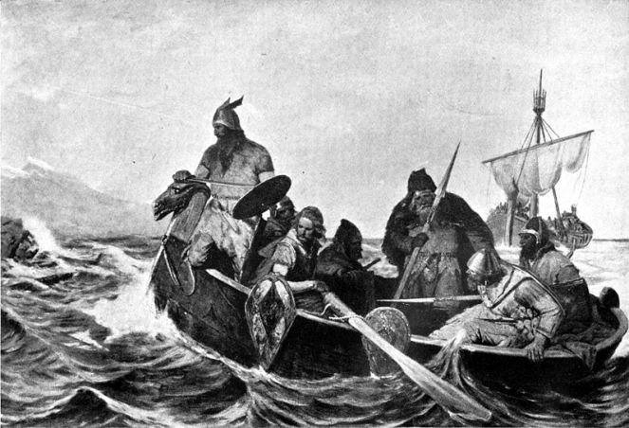
Europeans travels
The first Europeans to come to North America were probably the Icelandic colonizers of Greenland. According to Icelandic sagas, Leif Ericson landed at a place called Vinland around 1000 AD. Archeological evidence suggests that Nordic people established some settlements in Labrador and Newfoundland. However, they were not permanent and thus not very important in the story of development of Canada.

Slide 6
French conquests
The second wave of European exploration took place after CH. Columbus landed on San Salvador in 1492. In the years that followed, explorers kept running into North America. Many of them, under government auspices, attempted to reach the Asia's riches by crossing the Atlantic Ocean. John Cabot, an Italian seaman in the service of the King of England, reached Newfoundland and Cape Breton in 1497. On the basis of his voyage, England later claimed the entire territory. Another explorer, who was very important for Canada's history, was Jacques Cartier. He sailed up the Saint Lawrence River, claiming the land for France. The first permanent settlers were the French who came in the 17th century and called their colony in the St. Lawrence valley - New France. The adventures of the first explorers are still very exciting to read, however the hardship and tortures they endured are hard to believe.

Slide 7
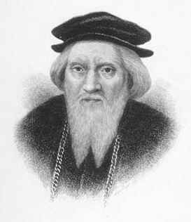
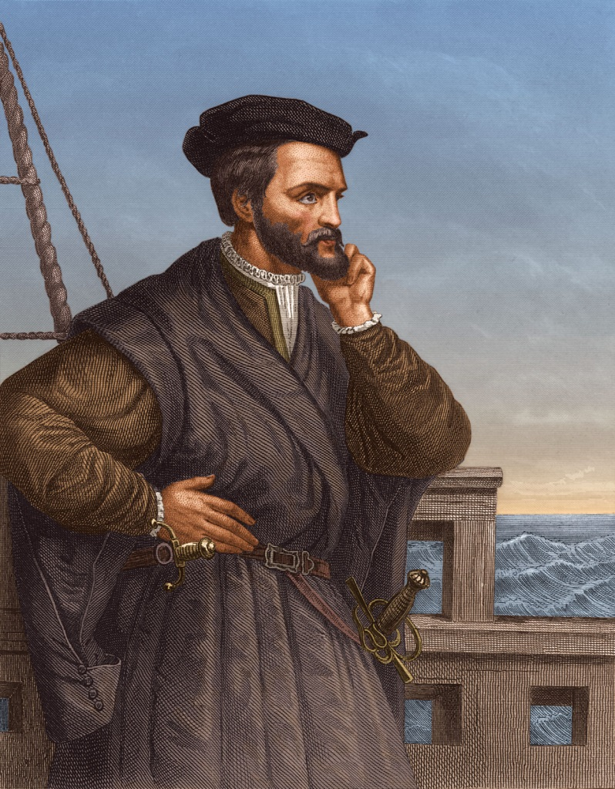
French explorers
John Cabot
Jacques Cartier

Slide 8
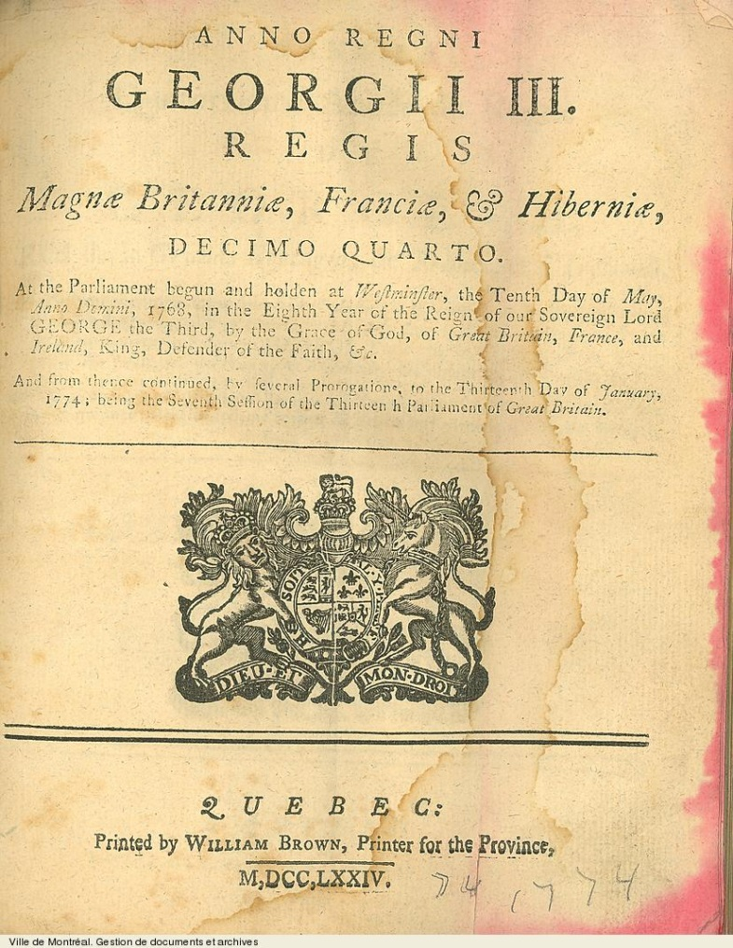
France vs. England
The main rivals of the French in the colonization process were the English. They were constantly in war. When the Seven Years' War ended in 1763 with the Peace of Paris, New France was turned over to Britain. The only places left to France were the islands of St. Pierre and Miquelon. The conquest of the France placed the British as rulers of French colonists. To avoid troubles, two successive governors, James Murray and Sir Guy Carleton persuaded the Crown to pass the Quebec Act in 1774. This Act extended the territory of Quebec. It also permitted the French to use their civil law and gave the Roman Catholic Church some special privileges. This was very important for the French Canadians in Quebec, because they could keep their traditions and customs.

Slide 9
Loyal Canadians
During the American War of Independence, the thirteen colonies thought that the Canadian colonies should join them in fighting the mother country. However, the Canadians remained loyal to Britain and after the war a new boundary between the United States and the British territory was drawn along the Great Lakes.
During and after the American Revolution, Canadian provinces had to accommodate thousands of refugees who settled in Nova Scotia and the upper St. Lawrence. These people soon began to agitate for greater political and property rights. Partly in response to their demands, the Crown created New Brunswick out of Nova Scotia in 1784 and by the Constitution Act of 1791 it also divided Quebec into Lower Canada (mostly French) and Upper Canada (mostly English).

Slide 10
The influx of immigrants
A new wave of newcomers came in the early 1800's when plenty of cheap land in Upper Canada attracted people from Europe and the United States. Some other parts, for example British Columbia, owed its early settlement boom to discovery of gold. Within a few months, thousands of people, mostly from the United States, poured into the British Columbia to "become rich". New land continued to be settled in Western Canada in the early 1900's. People from many countries of the world came and settled down. A large number of immigrants have continued to come to Canada also nowadays. Most of them have stayed in large cities where it is easier to find a job. However there are large areas still not densely populated and in some places, a person could travel for hundreds of kilometers without coming across even a small village.

Slide 11
England establishes Canada
The name "Canada" was first officially used when Lower and Upper Canada were formed. Later, they were joined to form the province of Canada. However, Canada's real birth was in 1867 when the British Parliament passed the British North America Act, under which Canada was granted self-government and became the first Dominion in the British Empire. The Dominion included the provinces Nova Scotia, New Brunswick, Quebec, and Ontario. One of the reasons for Canadian Confederation was the fear of being taken over by the United States. For this fear the Fathers of Confederation included a clause in the Act that welcomed additional provinces.

Slide 12
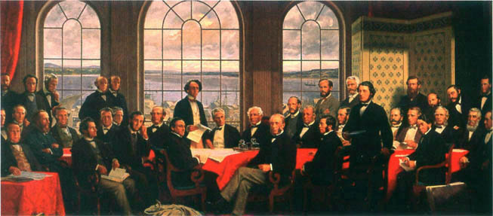
Fathers of Confederation
The Fathers of Confederation are the people who attended the Charlottetown and Quebec Conferences in 1864 and the London Conference of 1866 in England. There were 36 original Fathers of Confederation.

Slide 13
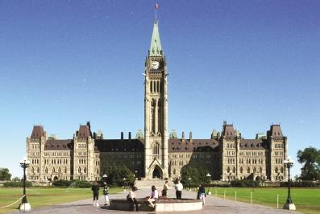
The legal situation in Canada
In the early 1900's Canada had its own government elected by the people. The government collected and spent its own taxes, made its own laws but its powers were still very limited. Canada could not sign treaties with other countries, had no representatives at international meetings, and had no foreign embassies. This situation changed shortly after World War I. Canada was given a membership in the League of Nations and in 1920, it established its first treaty with a foreign country. Finally the Statue of Westminster in 1931 made Canada an independent nation.
The Centre Block of the Canadian parliament buildings on Parliament Hill

Slide 14
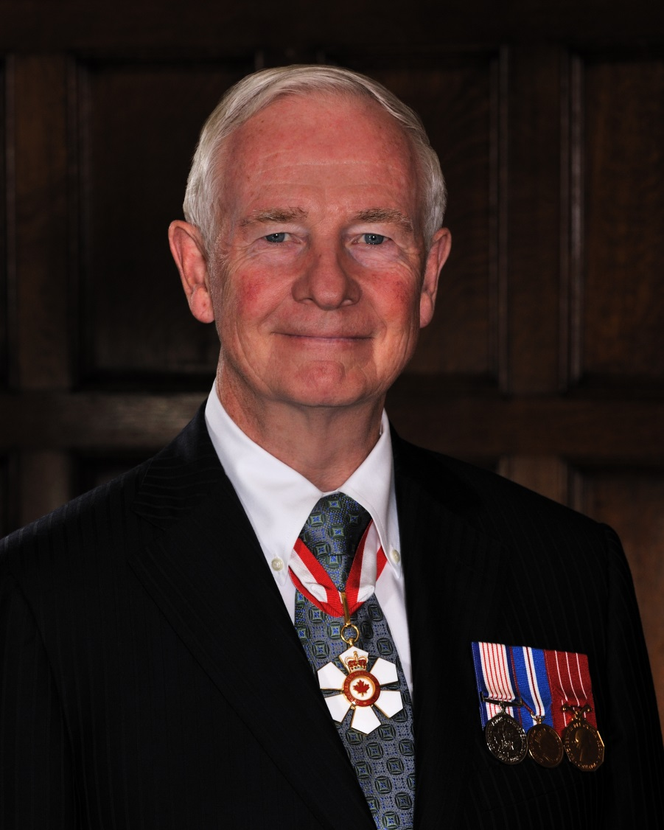
Authority in Canada
As a member of the Commonwealth of Nations, Canada regards the monarch of England as its sovereign. The monarch's representative in Canada is the Governor General who is appointed by the monarch on the advice of the Canadian Government. The Governor General is a symbol of unity and has no real powers, but opens Parliament, signs bills that have been passed by Parliament, welcomes important guests to the country, and attends special functions on behalf of the monarch. ( Krueger, Corder 1982)
The actual Governor General of Canada

Slide 15
Thanks for watching
Natalia Bień IIIa Natalia Ciesielska IIIa Michalina Barylska IIIa

