Slide 1
Canada
Gimnazjum nr 2 im. Jana Kochanowskiego w Zgierzu z Oddziałami Dwujęzycznymi
Opiekun: Małgorzata Stasińska

Slide 2
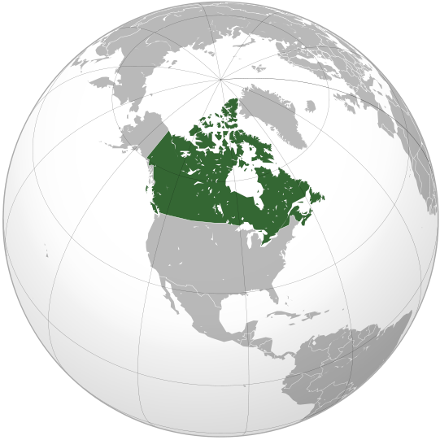
Canada
Is a North American country consisting of ten provinces and three territories. Located in the northern part of the continent, it extends from the Atlantic to the Pacific and northward into the Arctic Ocean. Canada is the world's second-largest country by total area, and its common border with the United States is the world's longest land border shared by the same two countries.

Slide 3
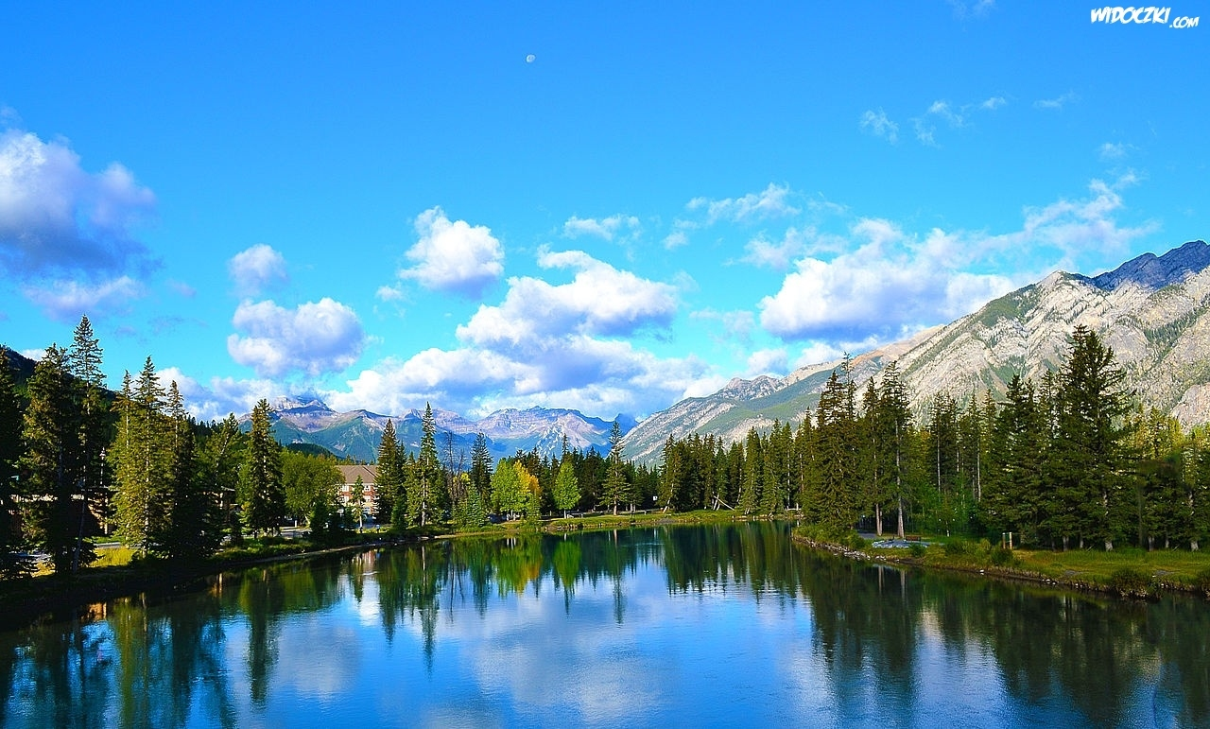
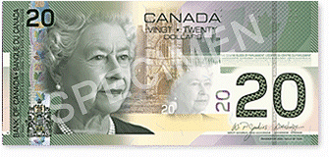
Capital
Ottawa
Official languages
English
French
Area -9,984,670 km2
Population -33,476,688
Currency -Canadian dollar

Slide 4
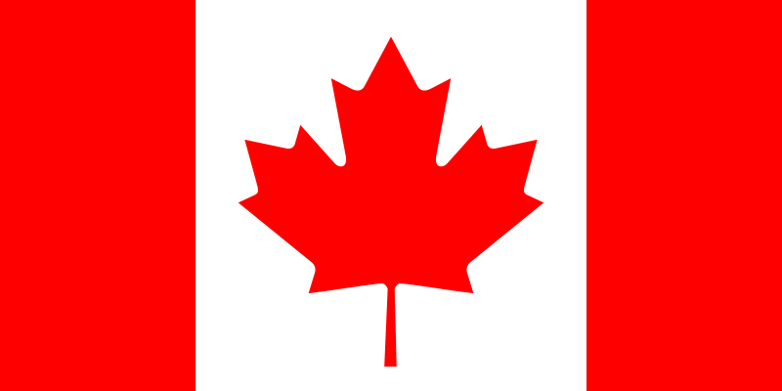
Flag
The national flag of Canada is the work of several people. Jacques St. Cyr introduced the stylized maple leaf, George Bist set the proportions and Gunter Wyszecki chose the color. The final appearance of the flag was aproved by the 15-person committee. Officially, it became the national flag of Canada on 15th February 1965.

Slide 5
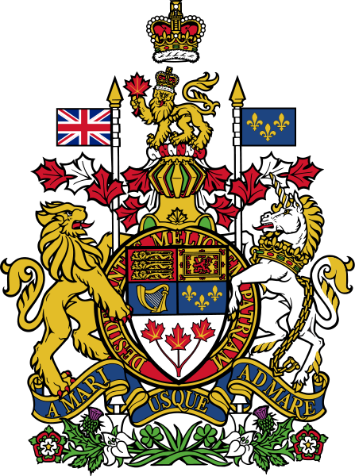
Anthem
The song “O Canada” was composed in 1880 by Calixa Lavallee to the words of Judge Adolphe-Basile Routhier.
A century after its premiere, on 1st July 1980, the song “O Canada” was proclaimed the national anthem.

Slide 6
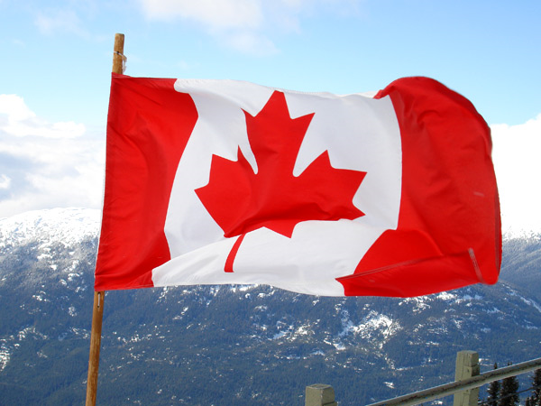
History of Canada

Slide 7
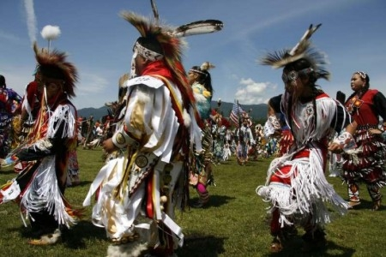
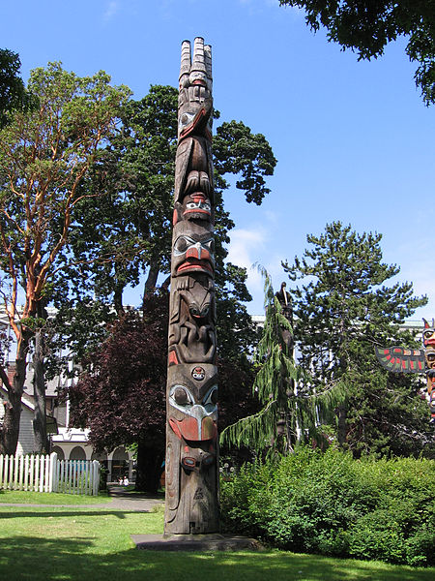
Before Columbus
The history of Canada covers the period from the arrival of Paleo-Indians thousands of years ago to the present day. Canada has been inhabited for millennia by distinctive groups of Aboriginal peoples, with distinct trade networks, spiritual beliefs, and social hierarchies. Some of these civilizations had long faded by the time of the first European arrivals and have been discovered through archaeological investigations. Various treaties and laws have been enacted between European settlers and the Aboriginal populations
Indians from Canada

Slide 8
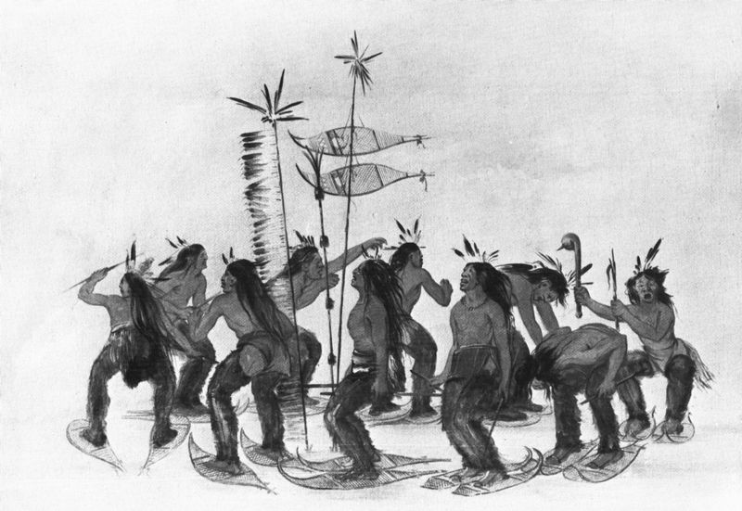
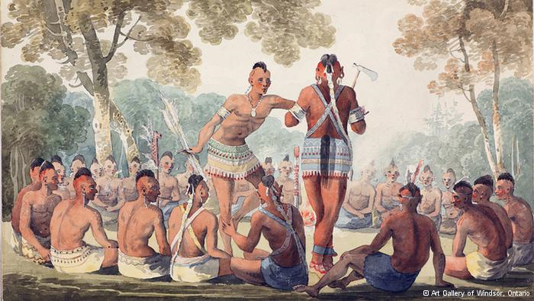
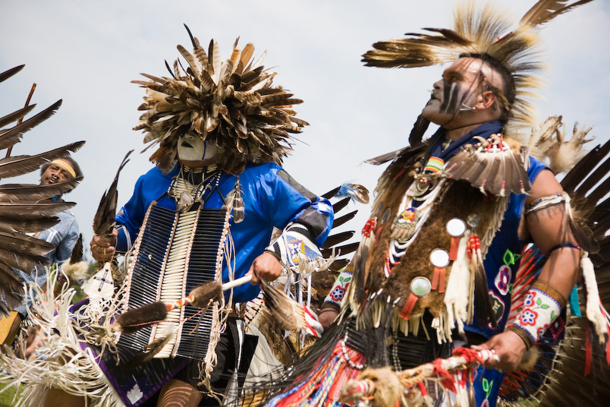
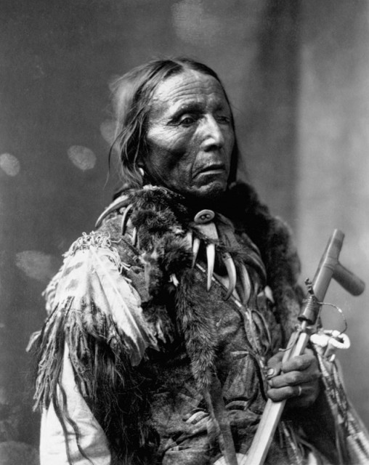
Indian’s dance
Indians from Irokez trible

Slide 9
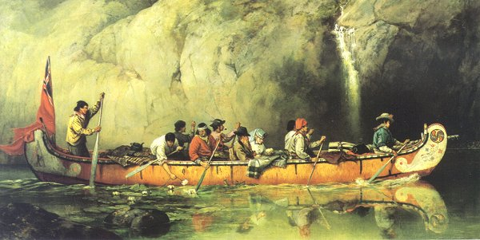
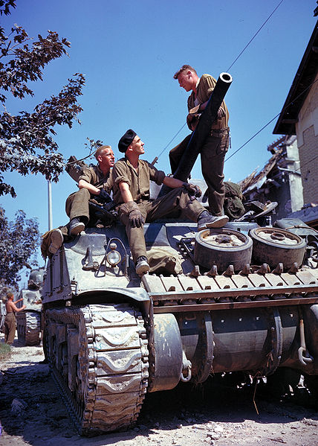
After 1492…
Beginning in the late 15th century, French and British expeditions explored, and later settled, along the Atlantic coast. France ceded nearly all of its colonies in North America to Britain in 1763 after the Seven Years' War. In 1867, with the union of three British North American colonies through Confederation, Canada was formed as a federal dominion of four provinces. This began an accretion of provinces and territories and a process of increasing autonomy from the British Empire, which became official with the Statute of Westminster of 1931 and completed in the Canada Act of 1982, which severed the vestiges of legal dependence on the British parliament.
Canadian soldiers during second world war

Slide 10
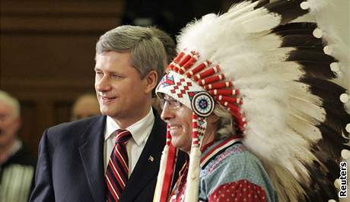
Today
Over centuries, elements of Aboriginal, French, British and more recent immigrant customs have combined to form a Canadian culture. Canadian culture has also been strongly influenced by that of its linguistic, geographic and economic neighbour, the United States. Since the conclusion of the Second World War, Canadians have supported multilateralism abroad and socioeconomic development domestically. Canada currently consists of ten provinces and three territories and is governed as a parliamentary democracy and a constitutional monarchy with Queen Elizabeth II as its head of state.

Slide 11
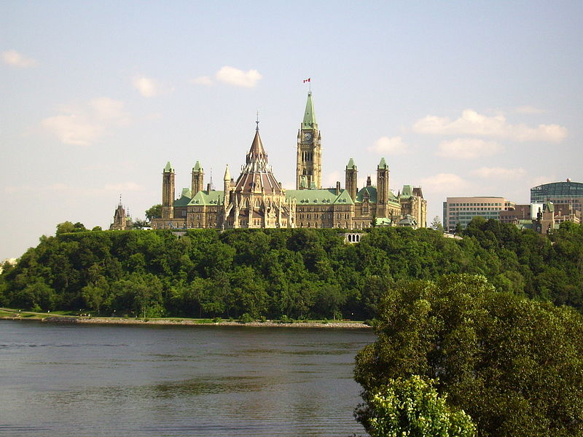
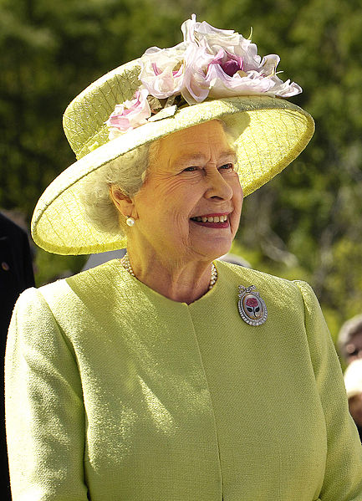
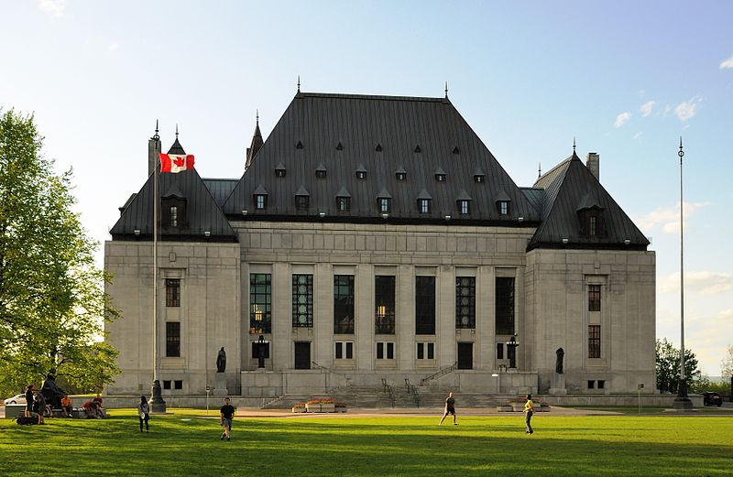
Government
Federal parliamentary democracy under constitutional monarchy
Monarch
Elizabeth II
Governor General
David Johnston
Minister
Stephen Harper

Slide 12
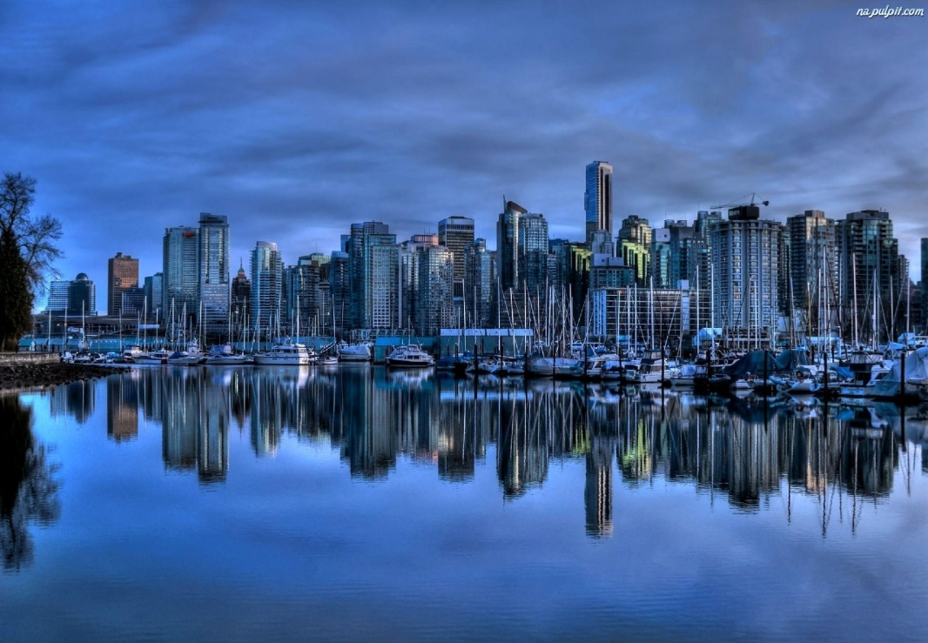
Province and Populations
Ontario
5,583,064
Quebec
3,824,221
British Columbia
2,313,328
Ontario–Quebec
1,236,324
Alberta
1,214,839
Alberta
1,159,869
Quebec
765,706
Manitoba
730,018
Ontario
721,053
Ontario
477,160

Slide 13
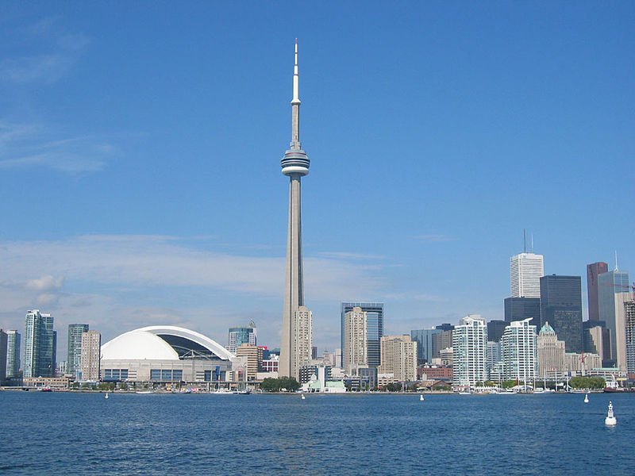
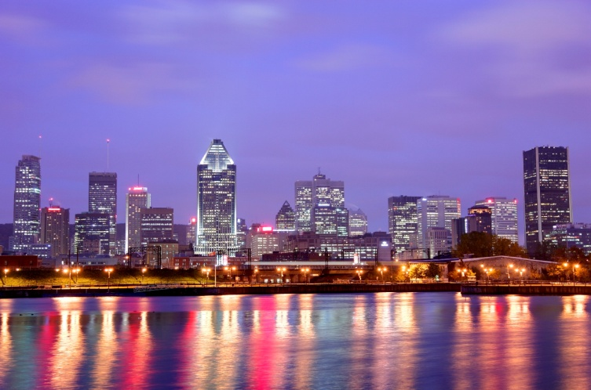
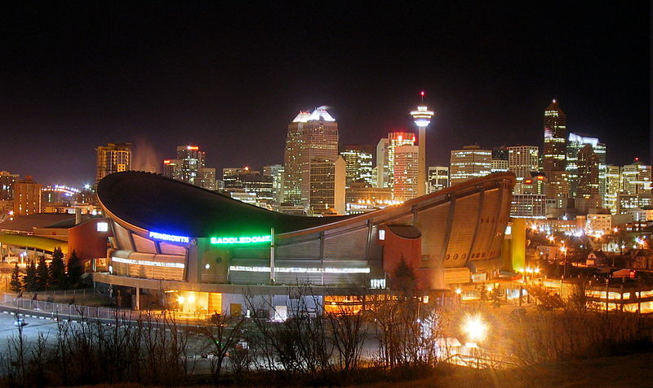
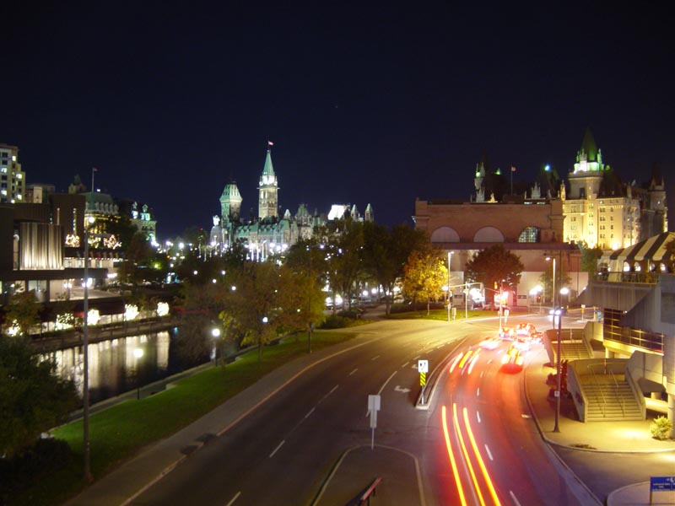
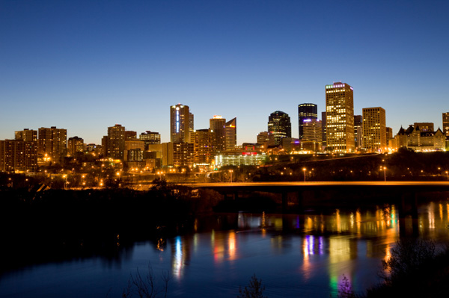
The largest cities
Toronto
Montreal
Ottawa
Edminton
Calgary

Slide 14
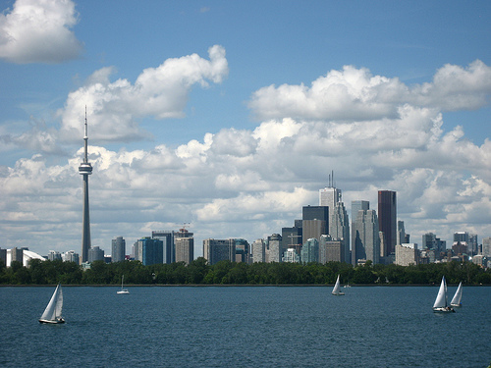
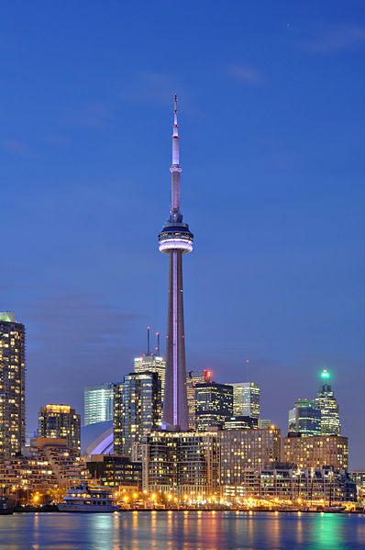
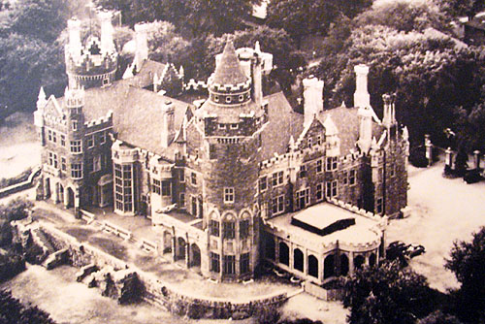
Toronto
Canada's largest city located in the southern part of the province of Ontario. The greatest attractions include the famous CN Tower, the Art Gallery of Ontario, Casa Loma.

Slide 15
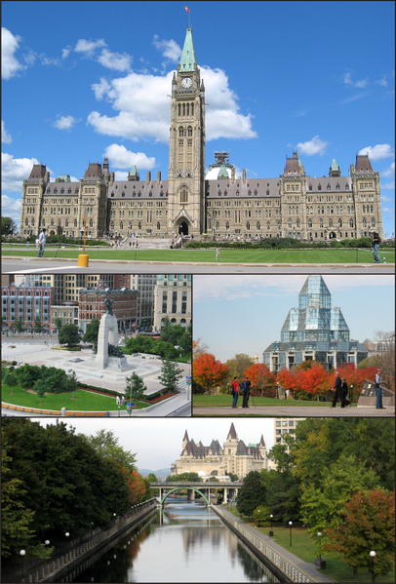
Ottawa
The capital of Canada, and the fourth largest city in the country. The city is located on the south bank of the Ottawa River in the eastern portion of Southern Ontario. Ottawa borders Gatineau, Quebec, and together they form the National Capital Region

Slide 16
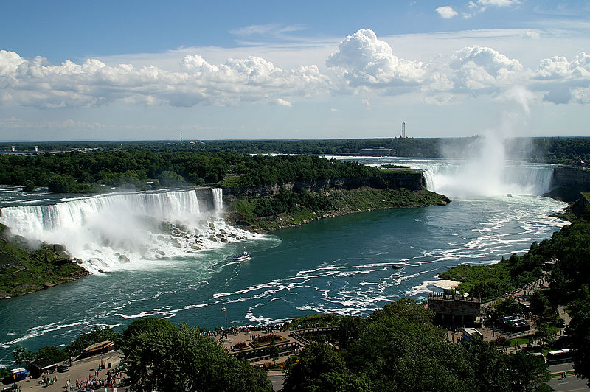
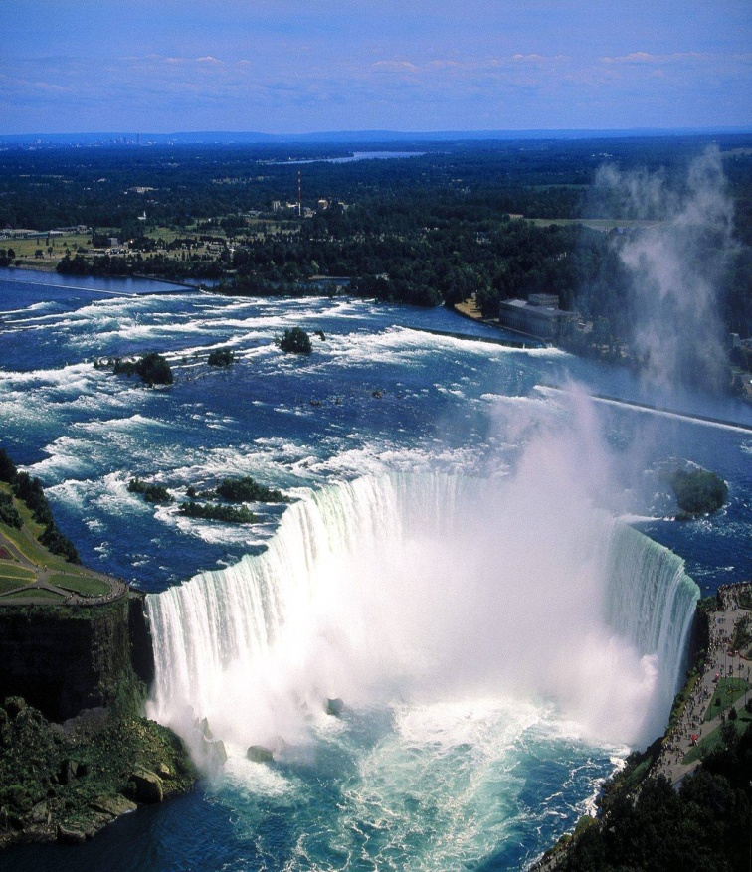
Niagara Falls
Waterfall on the Niagara River on the border between Canada and the United States. One part lies entirely within the United States. Its waterfalls, American and Bridal Veil (Veil Bride, 51 and 60 m in height, a total of approximately 300 m wide), separated by a narrow island Luna Island (40 m wide and 100 m long). The second part of the "Canadian" Horseshoe (Horseshoe, 49 m high and 900 wide).

Slide 17
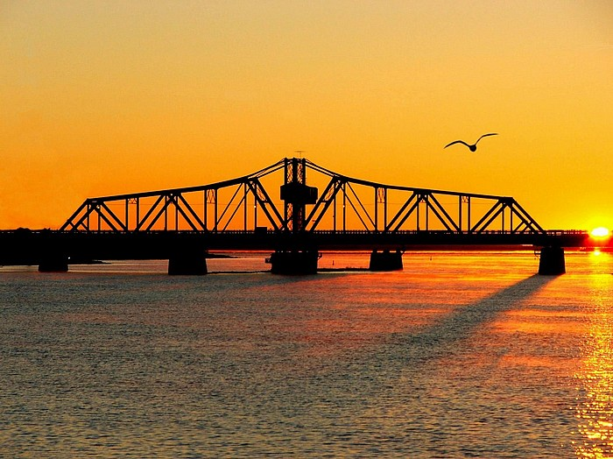
Manitoulin Island
The largest island in the world, which is located on the lake. It is located in Canada, in the northern part of the province of Ontario and Lake Huron

Slide 18
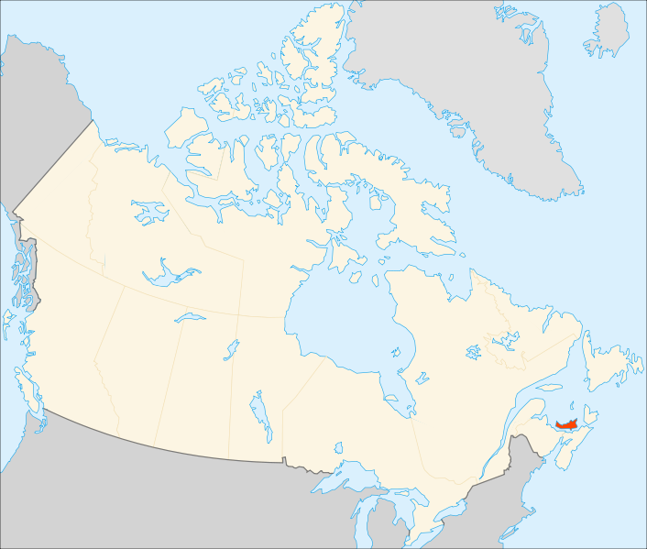
Prince Edward Island
The smallest and least populous, but also the most densely populated (25.3 pp. / 1 km ²) in the province of Canada.
Lucy Maud Montgomery , the author of „Anne of Green Gables” was born there. The action of her most popular novel, takes place there. Currently, you can visit the farm, Green Hill , where the writer wrote the book.

Slide 19
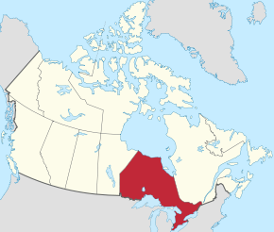
Ontario
Is one of the provinces of Canada, located in east-central Canada.It is Canada's most populous province or territory and second largest province in total area. Ontario is fourth largest in total area when the territories of The Northwest Territories and Nunavut are included.It is home to the nation's capital city, Ottawa, and the nation's most populous city, Toronto.

Slide 20
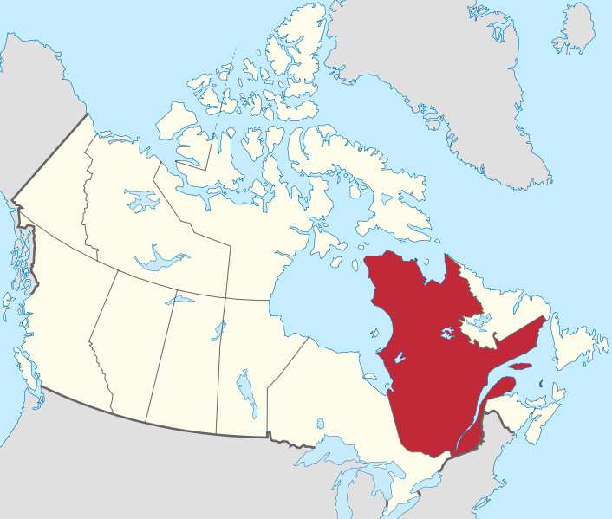
Quebeck
Is a province in east-central Canada. It is the only Canadian province that has a predominantly French speaking population and French as the sole official language at the provincial level.

Slide 21
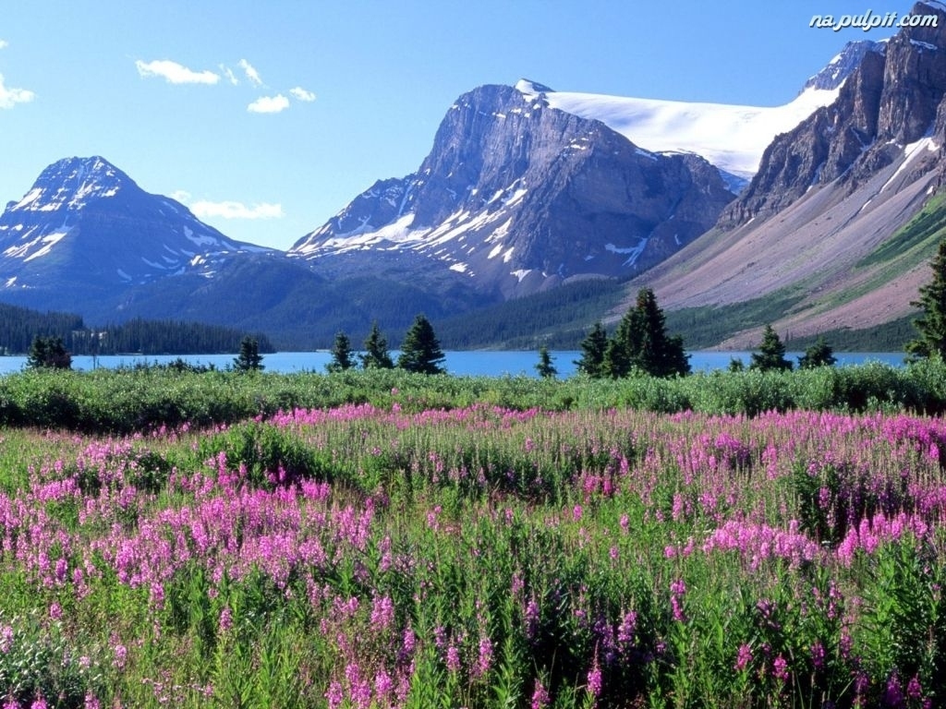
Climate
The climate in Canada is various and depends on the latitude. In the north of Canada the climate is subpolar and polar. In the center of the country it is cold continental climate, while in the south it is moderately warm. In the area of ​​the Cordillera Mountains it becomes
the mountain climate.

Slide 22
Natalia Józwiak Mateusz Jędrzejec Natalia Sołtysiak
The End
The presentation was created by:

