Slide 1
Language Workshops
Author: Filip Szewczyk Supervisor: mgr Małgorzata Stasińska

Slide 2
Introduction
Bilingual classes took part in the „Euroweek” project in February 2013 and April 2014. We spent 5 days in Długopole not far from Polanica Zdrój resort in south–western Poland. There were about 11 volonteers from such countries as: Turkey, Azerbaijan, Romania, Austria, Vietnam, China, Latvia, Columbia, Finland, Spain and more. And all of them presented us their countries, taught us their languages, traditional dances, showed us the most famous places and people, the nature and their cuisine. We could ask them all the questions we never had the opportunity to ask and some of the answers were really amazing (the story of a close encounters with the anaconda for example, brr!)

Slide 3
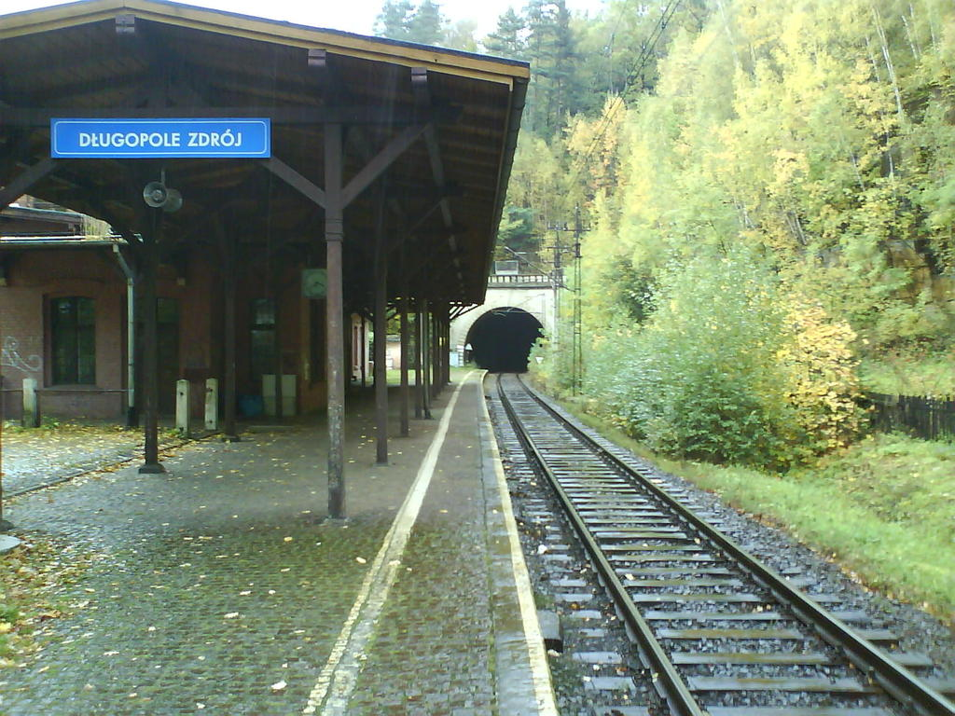
The Train station in Długopole zdrój

Slide 4
What is „Euroweek” ?
Euroweek’s aim is not only to get to know different nations from all over the world but also to gain a high level of competence in English.
The participants can learn about countries and their cultures as well as take part in many activities stimulating their brains and enhancing their creativity.
All the activities are done in English and the language of communication is English, so soon you start thinking in English, too. ☺

Slide 5
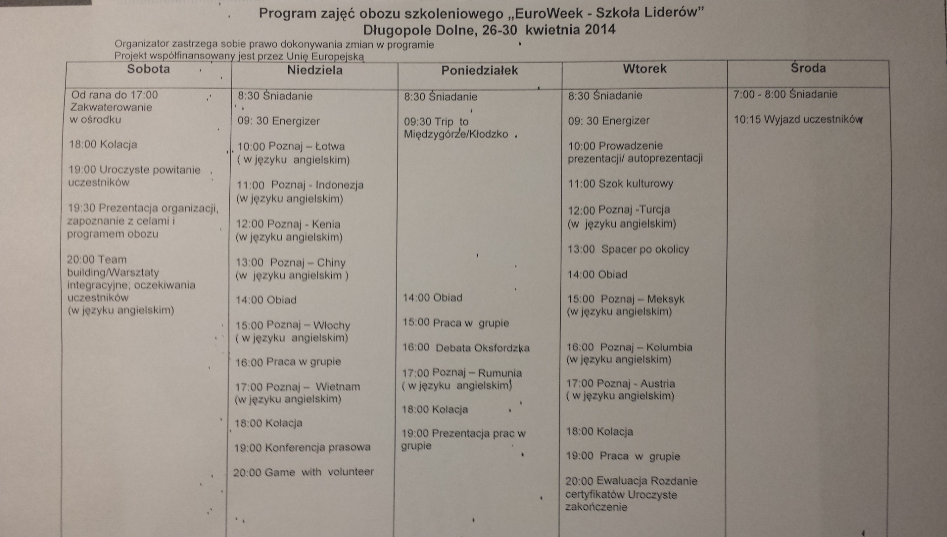
Euroweek’s schedule

Slide 6
The First Day
We arrived late in the afternoon and then after we unpacked, there was an activity to introduce us to the volunteers and other participants and vice versa. We had to draw our portraits and answer the questions as thruthfully and honestly as we could.
Later there was a task called the Secret Friend (when we had to draw lots and at the end of the workshop buy this person a present).
At the end of the day we told the volunteers our expectations concerning the workshops and we said goodnight.

Slide 7
The Second Day
We started the second day with so called Energizer activity which gave us enough energy for the whole day.
After that we had to work in groups and invent some product, think of its name, what was it for, its price, the way of producing it, etc. and present our invention to the others.
Then we went for a walk around Długopole.
After lunch we played many Games i.e. We had to choose a leader who by just using the vocal commands put as all in a square (and we were all blind, including the leader!!).

Slide 8
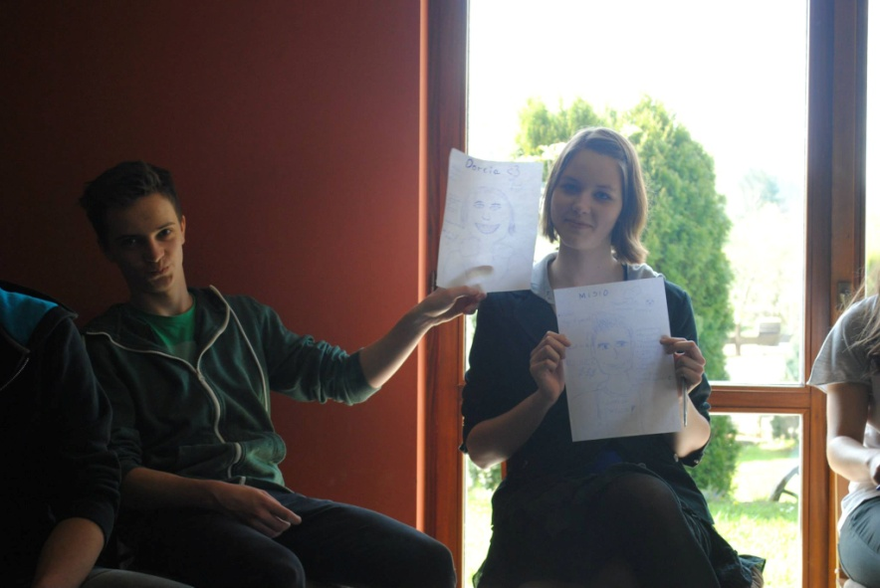
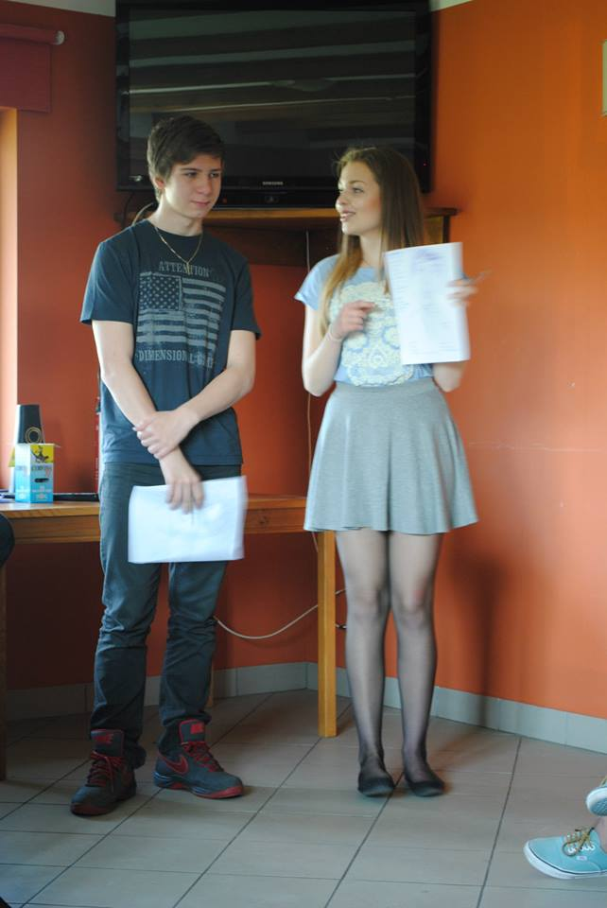
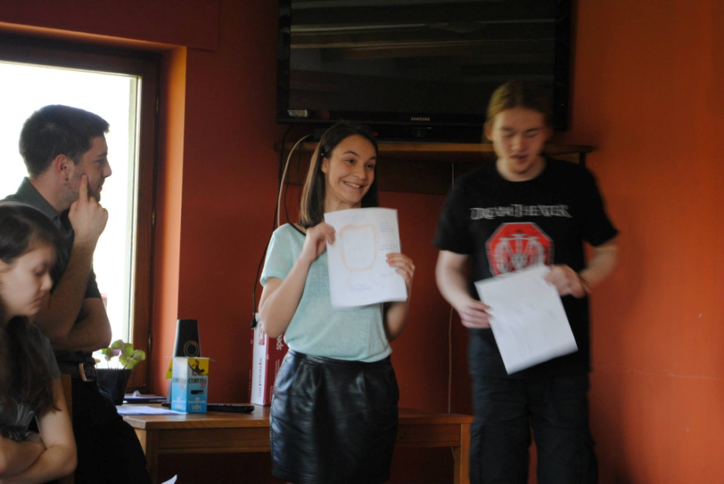
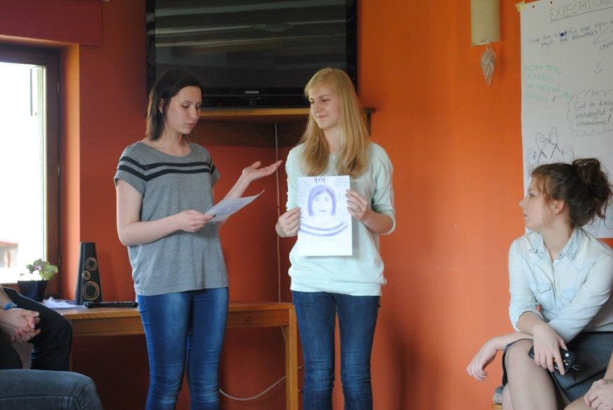
Our beautiful portraits

Slide 9
The Third Day
After breakfast, we went for a trip to Polanica Zdrój which is a small but picturesque town.
When we came back we worked in groups and took part in an Oxford Debate. The discussion was really heated and the arguments for both sides were really strong but the best won.
After that we played more games i.e. Hot chairs, where we had to listen to the music and sit immediately it finished, then the volunteers took one chair but nobody had to go away, so in the end there were 21 of us on just 2 chairs and we had made it … just ☺

Slide 10
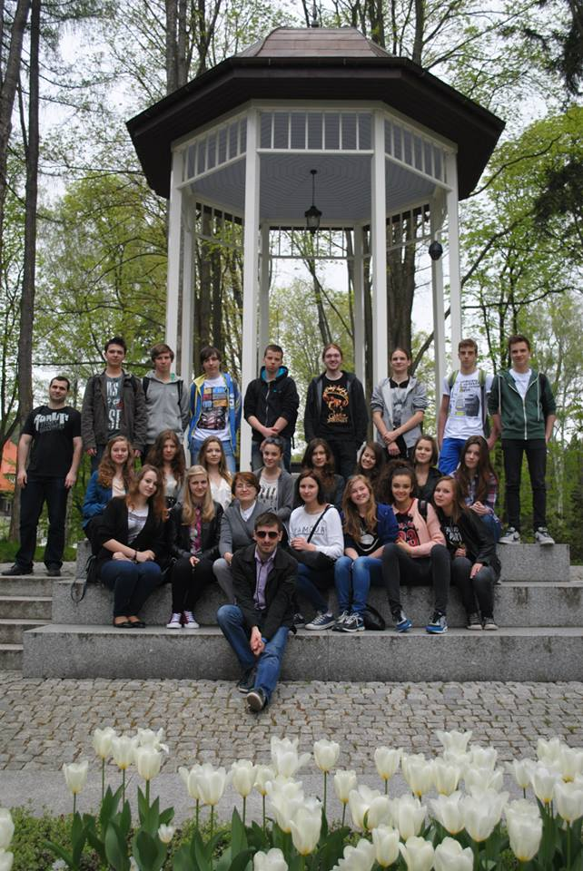
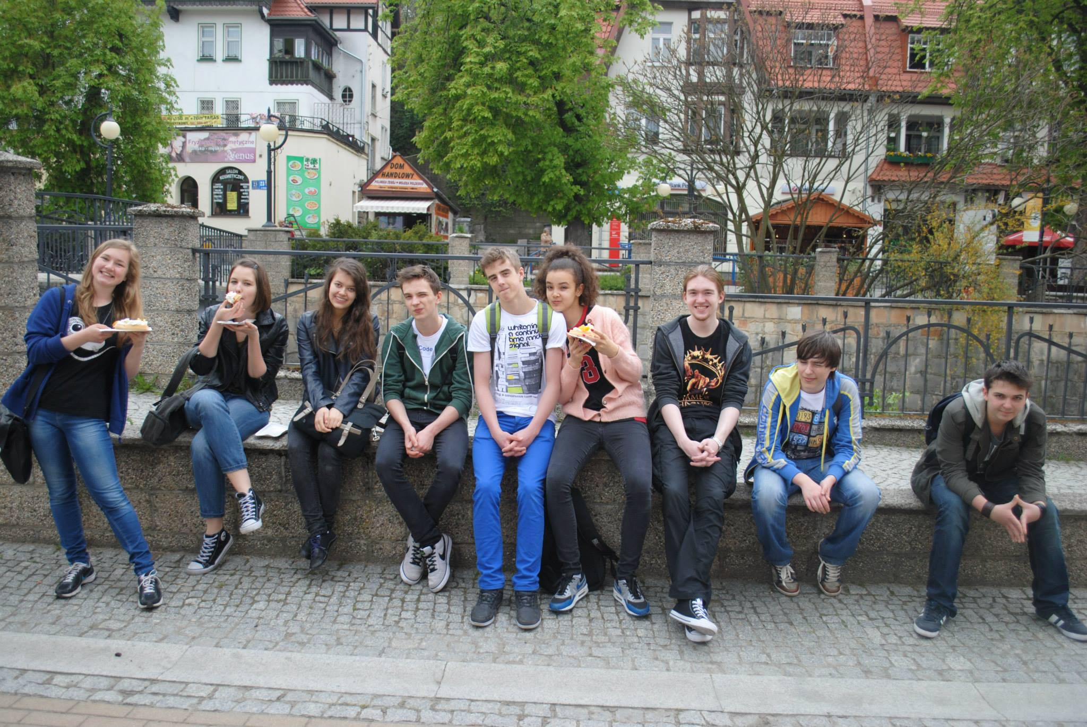
Memories of the trip to Polanica zdrój

Slide 11
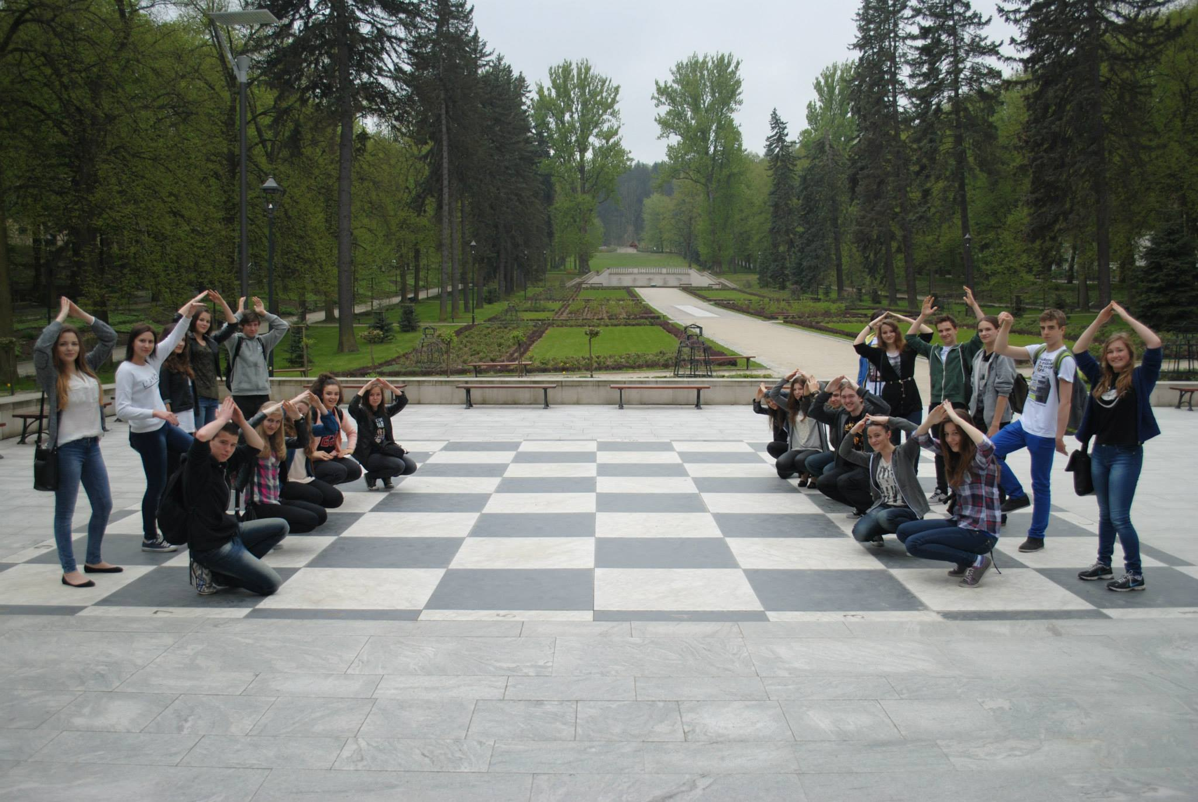
Unfortunately there was not enough time to play chess but we were ready ☺

Slide 12
The Fourth Day
The day started as always with the Energizer and then we discussed about the stereotypes and self-awarness.
After lunch we had to face Mission Impossible. There were 11tasks and only 30 minutes to complete them all, it really seemed impossible to accomplish it but we succeeded. Hurray!
Later we watched Steve Jobs’s speech and disscussed the meaning of what he had said and the volunteers presented us the different projects open for people like us such as Erasmus, Work & Travel or Youth Mobility
Then, unfortunately we had to say goodbye to our volunteers because it was the last day of EuroWeek.
We also gave presents to our Secret Friends. There was a lot of laughter at some people’s ideas.

Slide 13
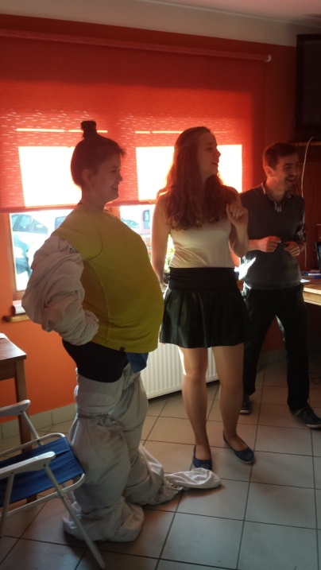
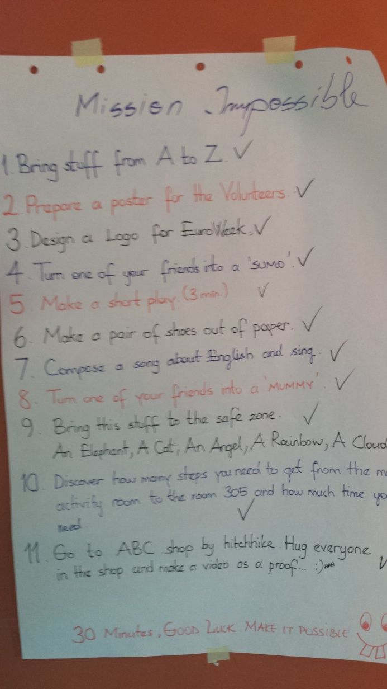
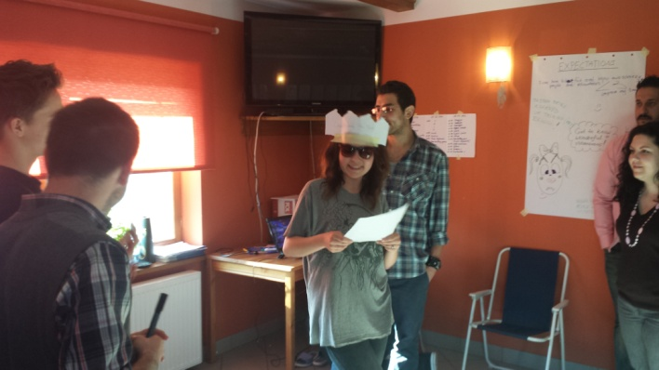
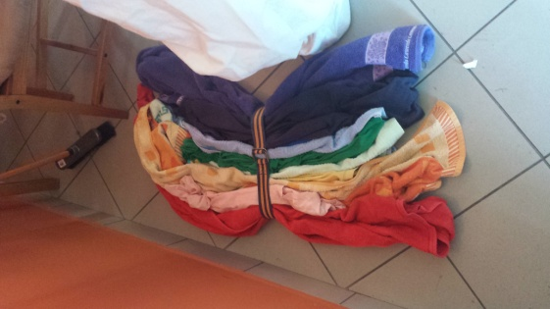
Mission Impossible
Lena - the sumo wrestler
God save queen susan
The rainbow

Slide 14
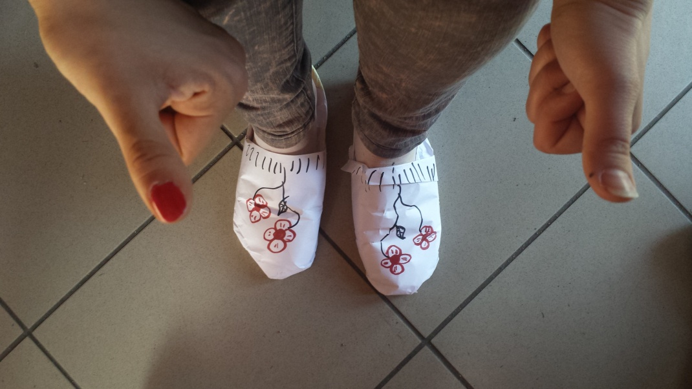
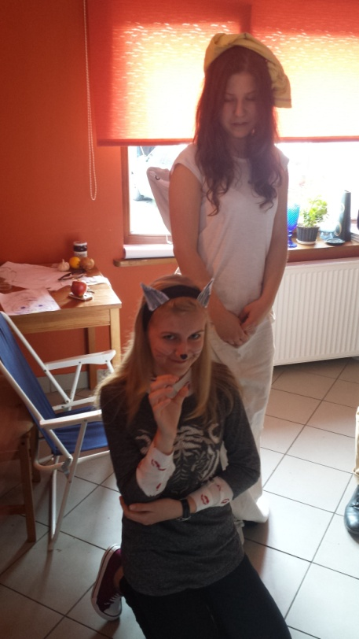
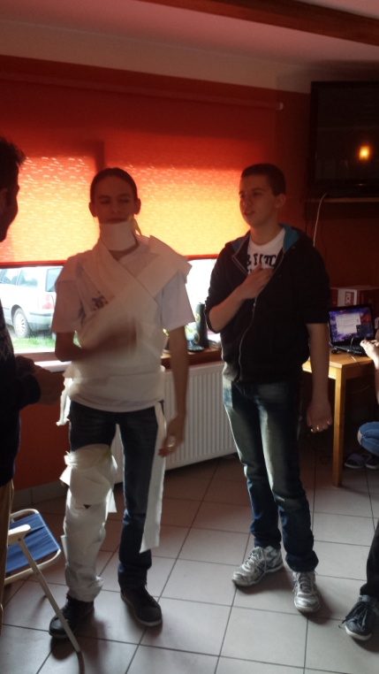
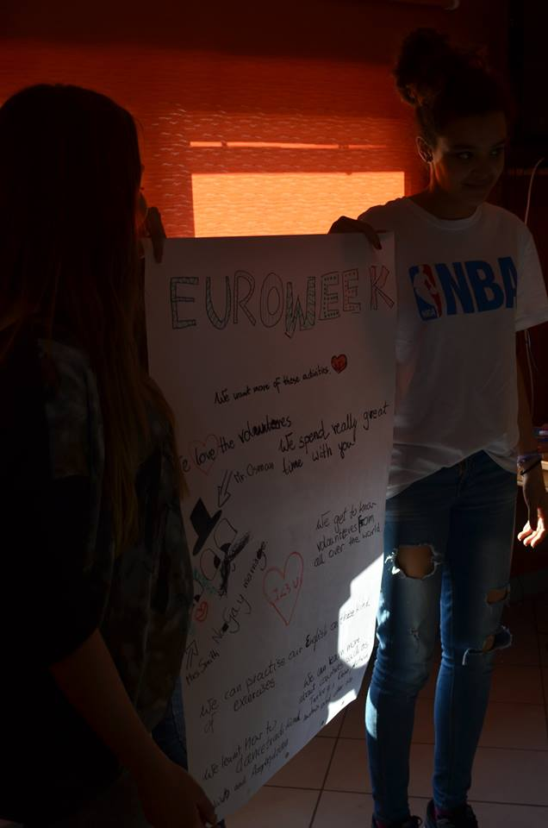
One of the tasks – paper shoes
The cat and the angel
Peter - the mummy
He seems more sleepy than scarry
The poster advertising euroweek

Slide 15
And that’s how Mission
IMpossible became Possible !!!
You just need a good leader to divide the tasks AND COORDINATE US☺

Slide 16
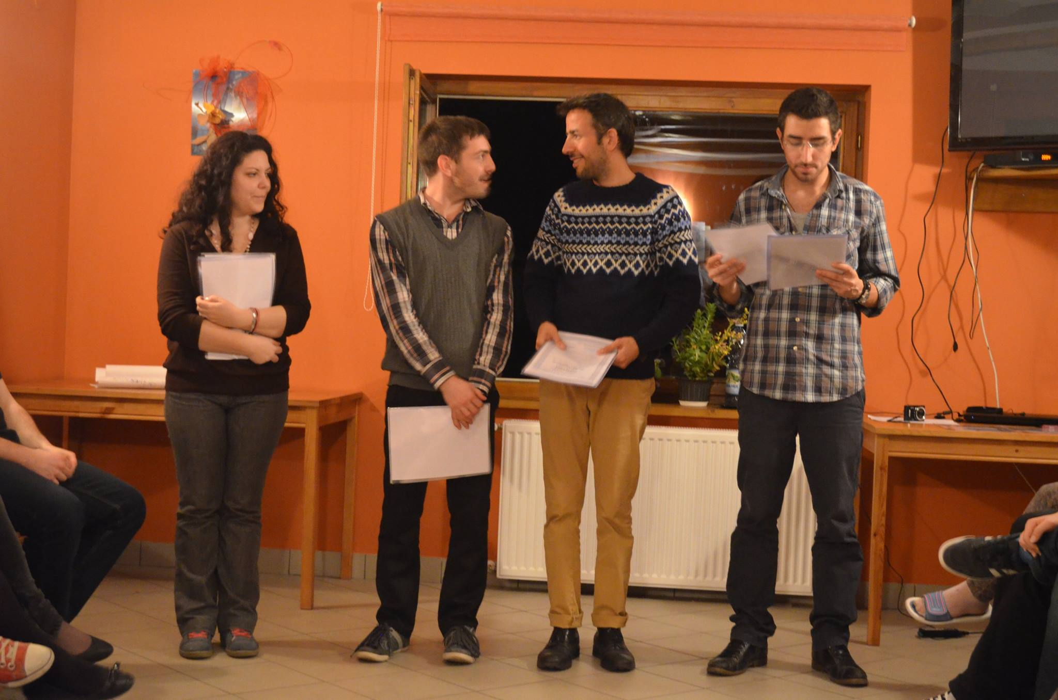
The volunteers are about to give us our certificates
Laura, Sorin, Emir, Beige

Slide 17
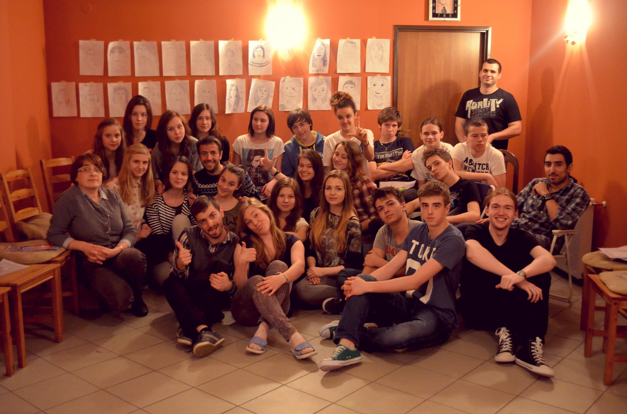

Slide 18
The Fifth Day
After a breakfast we left Długopole.
It was the worst day because we had to go back home and leave our wonderful volunteers.
But for some of us the thought of yummy food waiting for us in our homes was enough to make us look forward to seeing our parents again.
We arrived in Zgierz late in the afternoon, tired but happy.

Slide 19
A Few words at the end…
Everyday of the EuroWeek was extremely busy with a great variety of tasks, ideas and fun. During the course we could learn about lots of different countries, their cultures, traditions and customs and appreciate their value as part of the worldwide human heritage.
It was really great fun but also opportunity to see each other from different perspective and to think about our future plans and ambitions. All in all it was an unforgetable experience

Slide 20
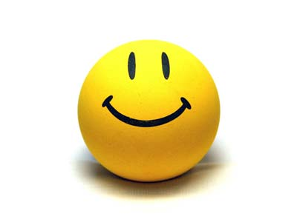
Thanks for watching!

